Slide 1
Broadband fest and famine in Asia
ESCAP Sub-Regional Workshop on
Internet Traffic Management for the
Asia-Pacific Information Superhighway (AP-IS)
Thimphu, Bhutan
December 7, 2016
Abu Saeed Khan, Senior Policy Fellow
LIRNEasia
abu@lirneasia.net

Slide 2
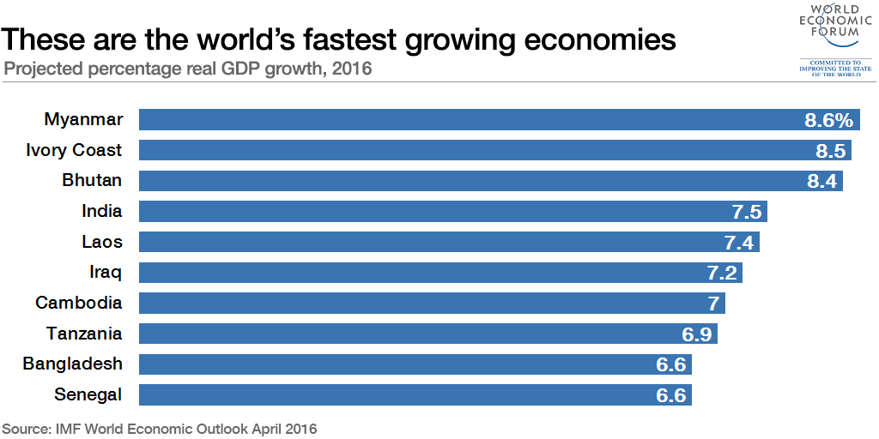
But poor ICT Development Index (IDI) is barrier to achieve SDG in Asia-Pacific

Slide 3
SDG #9: The clock is ticking!
Develop quality, reliable, sustainable and resilient infrastructure, including regional and transborder infrastructure, to support economic development and human well-being, with a focus on affordable and equitable access for all.
Significantly increase access to information and communications technology and strive to provide universal and affordable access to the Internet in least developed countries by 2020.

Slide 4
SDG #9: The clock is ticking!
Develop quality, reliable, sustainable and resilient infrastructure, including regional and transborder infrastructure, to support economic development and human well-being, with a focus on affordable and equitable access for all.
Significantly increase access to information and communications technology and strive to provide universal and affordable access to the Internet in least developed countries by 2020.

Slide 5
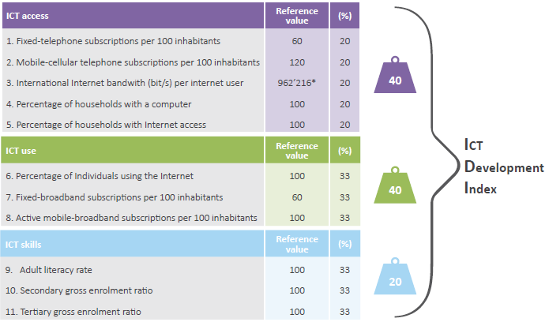
ICT Development Index: indicators, reference values and weights
Note: *This corresponds to a log value of 5.98, which was used in the normalization step.
Source: ITU.

Slide 6
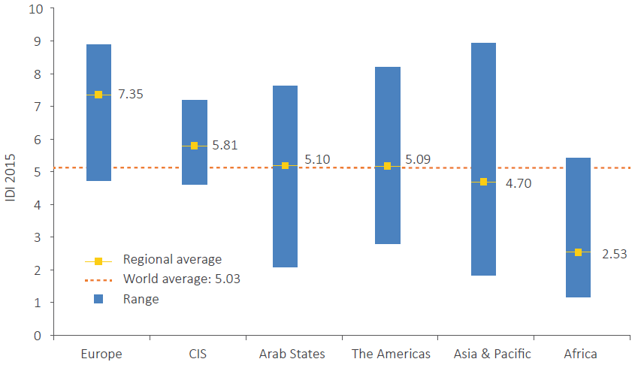
IDI by region compared with global average
Source: Measuring the Information Society Report, ITU, November 2016.

Slide 7

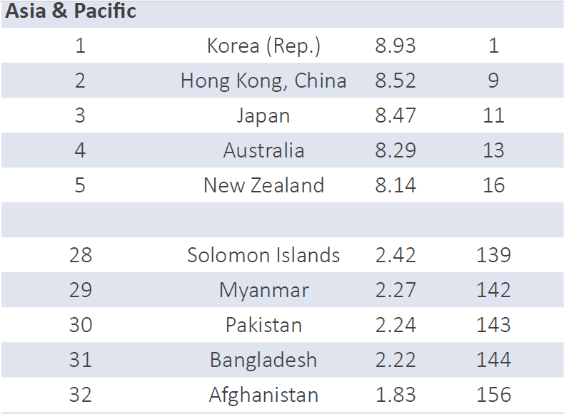
Highly polarized APAC
Top five
Bottom five

Slide 8
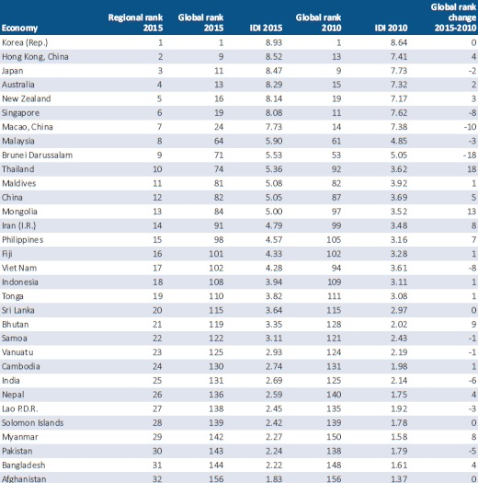
IDI rankings, APAC, 2015
Indonesia (108), India (131), Pakistan (143)
and Bangladesh (144) poor in Global ranking

Slide 9
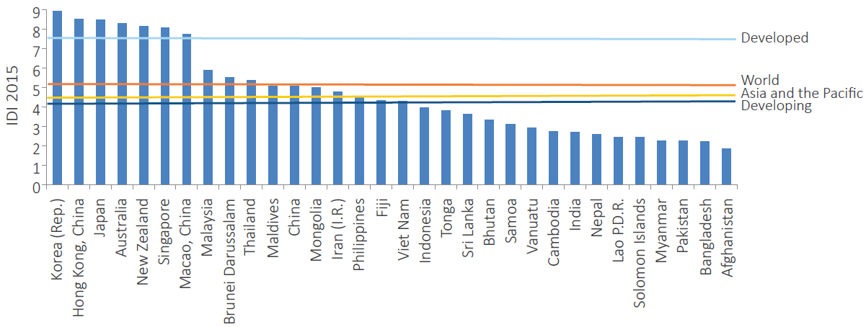
IDI values, Asia and the Pacific, 2015
Source: Measuring the Information Society Report, ITU, 2016

Slide 10
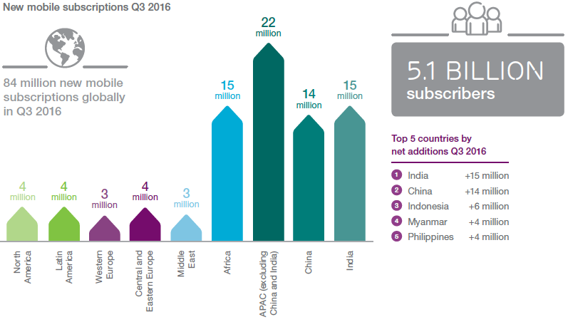
APAC still drives global mobile growth
Added
51%

Slide 11
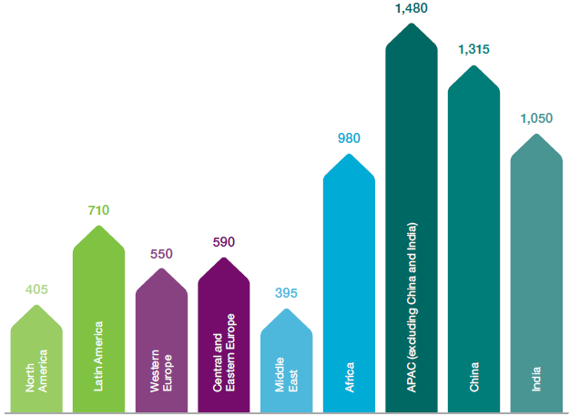
Mobile subscriptions 7.5 bn in Q3 2016
Source: Ericsson Mobility Report. November 2016

Slide 12
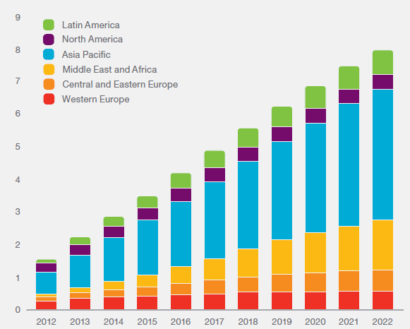
Mobile subscriptions outlook (billion)
Mobile broadband refers to HSPA, LTE, CDMA2000 EV-DO, TD-SCDMA and Mobile WiMAX
Source: Ericsson Mobility Report. November 2016
In 2022, there will be 8.9 billion mobile subscriptions, 8 billion mobile broadband subscriptions and 6.1 billion unique mobile subscribers.

Slide 13
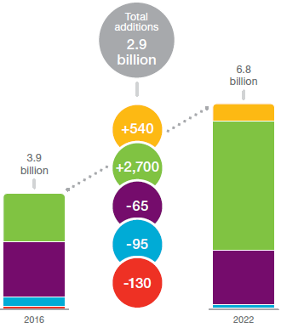

Smartphone subscription by technology
Almost 90% of smartphones are on 3G and 4G networks today (Q3 2016).
By the end of 2016, there will be 3.9 billion smartphone subscriptions.
Most of these subscriptions (90%) will be registered on WCDMA/HSPA and LTE networks.
It is despite the fact that GSM/EDGE-only subscriptions is still the largest subscription category.
By 2022, the number of smartphone subscriptions is forecast to reach 6.8 billion while >95% will be registered on WCDMA/HSPA, LTE and 5G networks
Source: Ericsson Mobility Report. November 2016

Slide 14
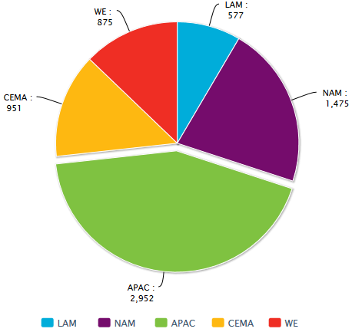
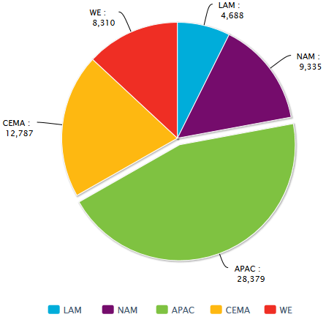
10X growth of Smartphone data in APAC
(APAC and NAM entered Exabyte era)
Data Traffic (PB/month)
of Smartphone 2016
Data Traffic (PB/month)
of Smartphone 2022
(43.2%)
(44.7%)
Source: Ericsson Mobility Report. November 2016
Note: 1 Petabyte is 1,000 Terabytes or 250,000 DVDs

Slide 15
“Akamai state of the Internet Q2 2016”
Broadband inequality across Asia Pacific

Slide 16
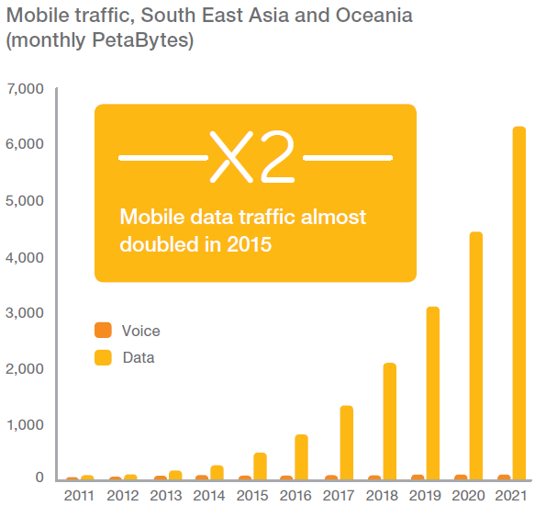
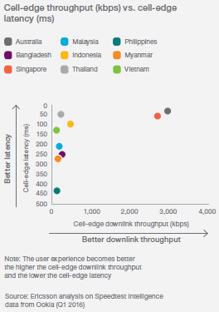
Latency is the honesty of broadband

Slide 17
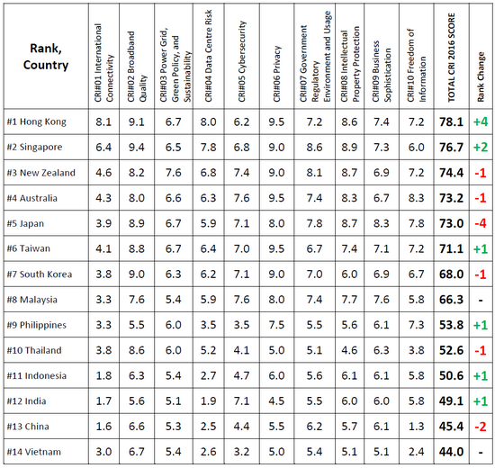
Cloud Readiness Index (and warning) 2016
The gap in cloud readiness between the top eight performers (Hong Kong to Malaysia) and the bottom six (Philippines to Vietnam) is widening, even as the cloud computing becomes a mainstream technology across the region.
The gap in cloud readiness may be becoming entrenched. The top performers are now reaping the benefits of multi-year national digitization plans, including plans for gCloud, broadband, and other connectivity rollouts.
Source: Asia Cloud Computing Association.

Slide 18
Ericsson also paints a gloomy picture
Despite ongoing deployment of LTE in China, which will result in more than 1.2 billion LTE subscriptions in the country by the end of 2022, LTE subscriptions will represent just 50 percent of all subscriptions in the region by the end of the same period. This will be around one quarter of the global total.
5G subscriptions will account for around 10 percent of all subscriptions in the region in 2022, with deployments starting in South Korea, Japan and China.
All three of these countries will host Olympic games in the coming six years, and have stated intentions to launch 5G services in conjunction with the games.

Slide 19
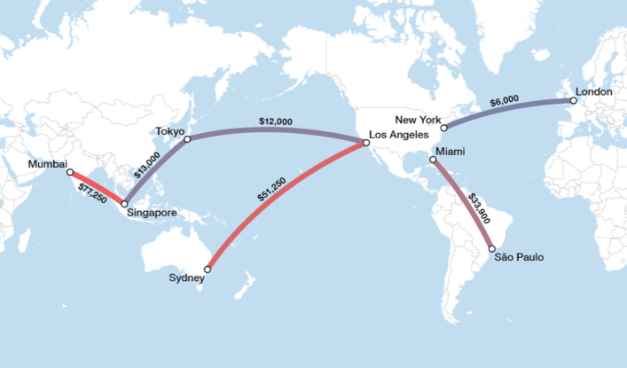
Competition is critical to transport costs
Median Lease Price, 10 Gbps wavelength, Q4 2015.
Courtesy: Cody Williams, TeleGeography @ APRICOT 2016
Notes:
And there is variation all over the world. Trans-Pac and Intra-Asia prices have come down quite a bit over the last handful of years. Compariatively, capacity to Australia and NZ and to India is expensive.

Slide 20
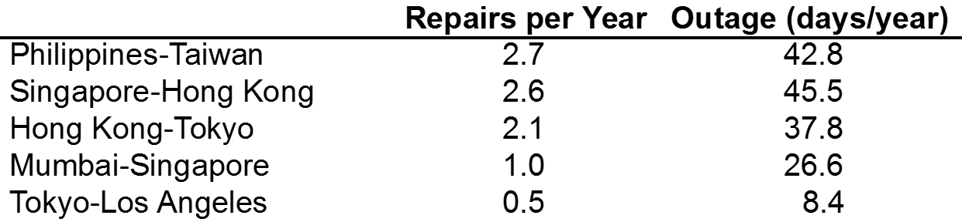

Is APAC resilient enough?
Source: Palmer-Felgate, A., and Booi, P., How Resilient is the Global Submarine Cable Network? SubOptic 2016 #OralWE2A-5

Slide 21
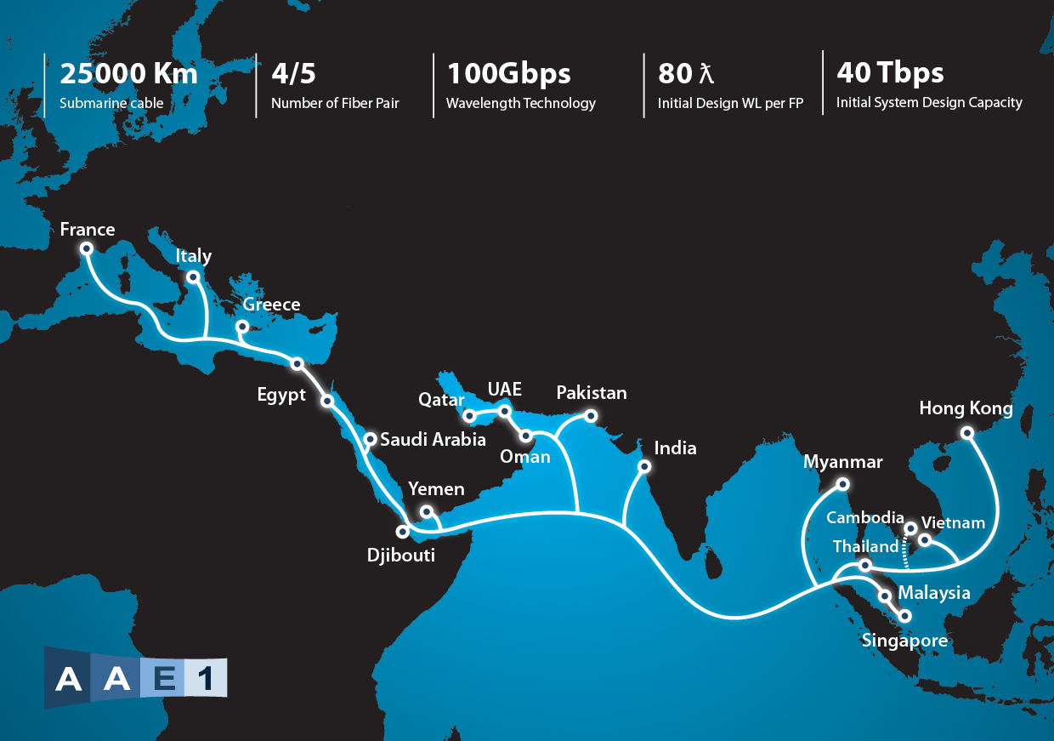


Best effort by Asia Africa Europe-1 (AAE-1) cable
Owners: China Unicom, Telecom Egypt, Etisalat, Omantel, Djibouti Telecom, OTEGLOBE, Pakistan Telecommunications Company Ltd., PCCW, Ooredoo, Mobily, Viettel Corporation, TeleYemen, Chuan Wei, Retelit, Reliance Jio Infocom.

Slide 22
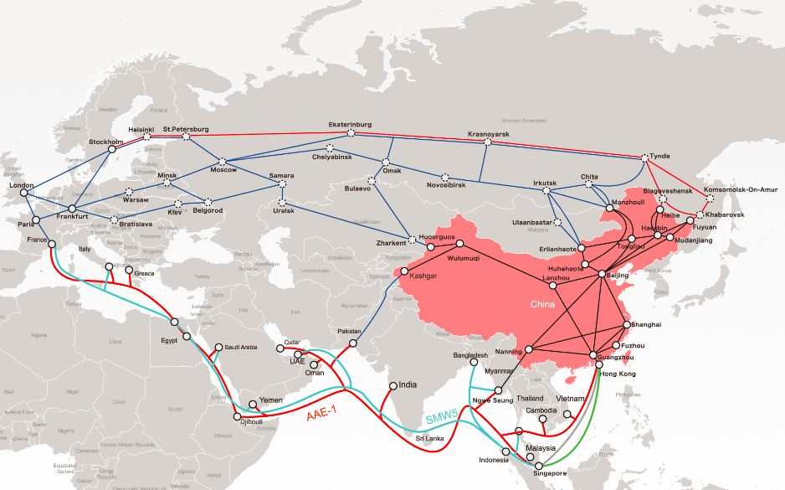
China Unicom takes a giant leap
AAE-1 via Pakistan and Myanmar
Source: People’s Daily online (March 2, 2016)
Terrestrial link to
the Arabian Sea
Terrestrial link to
the Bay of Bengal

Slide 23
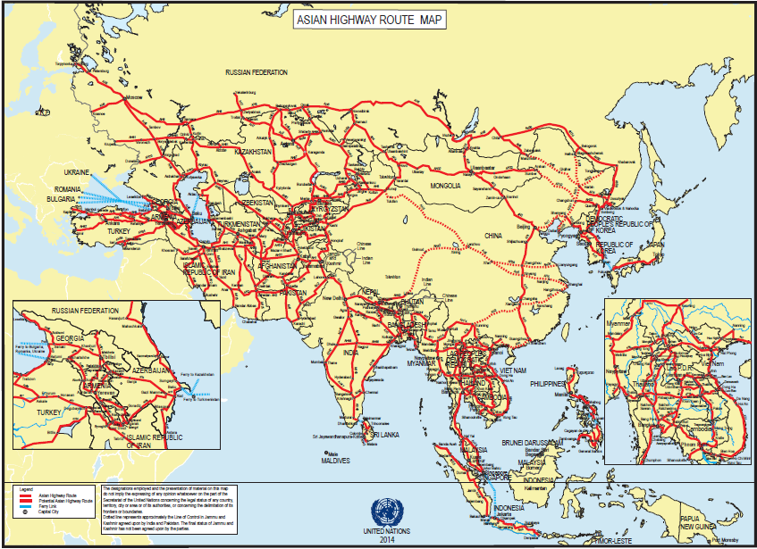
AP-IS offers every carrier equal resilience

Slide 24

Thank you!
Questions?

