Slide 1
Elements of Effective Broadband Policy based on regional experience
Rohan Samarajiva
Sri Lanka Broadband Forum
12 September 2017

Slide 2
How are we doing, compared to regional peers?
Country | Mobile Subscriptions/100 | Internet Users/100 | Facebook Users/100
 | 2016 | 2016 | 2017
Pakistan | 71.4 | 15.5 | 15.8
Bangladesh | 77.9 | 18.3 | 15.8
India | 87.0 | 29.6 | 15.9
Myanmar | 89.3 | 25.1 | 29.2
Philippines | 109.2 | 55.5 | 59.7
Sri Lanka | 118.5 | 32.1 | 25.0
Indonesia | 149.1 | 25.4 | 44.4
Thailand | 172.7 | 47.5 | 70.3
Sources: http://www.itu.int/net4/itu-d/icteye/AdvancedDataSearch.aspx; http://datatopics.worldbank.org/hnp/popestimates; facebook advertising portal;

Slide 3
On composite indicators . . .
 | Bangladesh | Cambodia | Myanmar | Sri Lanka | Thailand
Network Readiness Index (2016) - out of a possible 139 | 112 | 109 | 133 | 63 | 62
ICT Development Index (2016) - out of a possible 175 | 145 | 125 | 140 | 116 | 82
Inclusive Internet rankings (2017) - out of a possible 75 | 46 | 55 | 54 | 41 | 23
Human Development Index (2016)- out of a possible 188 | 139 | 143 | 145 | 73 | 87

Slide 4
What can we learn from government broadband initiatives in the region?
Gunaratne, R.L. et al. (2015). National broadband networks of Malaysia, India, Indonesia and Australia: A comparative study. Competition and regulation in network industries. Vol 16(1): 23-46.

Slide 5
Internet Ecosystem
Infrastructure
Palapa Ring – connecting all Islands through fiber
HSBB – FTTH in industrial areas
BBGP – connectivity via multiple tech in rural areas
NBN Australia – wholesale network FTTH, fixed wireless or Satellite
NOFN – fiber from block to gram panchayat level
Affordable User-friendly Devices
Attractive Content/ Applications
India
Australia
Indonesia
Malaysia
1Malaysia Netbook Distribution
Introduction of e-gov, e-education and e-health
App Development Centre
E-gov, e-health, e-education, e-commerce
My1Content portal
Skilled Users
Government User Network – Anchor client
Digital Literacy Program
Broadband Carnivals, ICT Training
Affordable packages
Tax breaks
Programs to improve ICT literacy

Slide 6
Malaysia – High Speed Broadband Network (HSBB) as at April 2014
25 Operators for HSBB Transmission
1.74Tbps total International Bandwidth Capacity (from 682Gbps)
5 Operators for HSBB Access
1.5 million Ports installed
International Connectivity
TM Fiber Network
Customers
723,014 Subscribers (48% take up)
International Backhaul
Domestic Backhaul
Access Network
Implemented by Telekom Malaysia, as a PPP with Gov. Total cost 3.5B USD, out of which Gov spent 0.75B. Conditions of access to network are commercially negotiated
Broadband for General Population – subsidizes BB in rural areas using Universal Service Provision Fund

Slide 7
Where does the money come from?
Country | Source of funds
India | 5% of adjusted gross revenue
Malaysia | 6% of weighted gross revenue, levied on operators with revenues from designated services above RN 2 million
Nepal | 2% of annual income
Pakistan | 1.5% of adjusted revenue
Sri Lanka | USD 0.03 per minute on international calls terminated in the country
Notes:
Industry levies- % of revenue or specific calls Malaysia- weights http://www.skmm.gov.my/skmmgovmy/media/General/pdf/USP-AR-2013.pdf, pg 39

Slide 8
Malaysia: Lots of money, but not spent
Source: Universal Service Provision Fund of Malaysia (2015) Annual report 2014. Calculations, graphics by authors

Slide 9
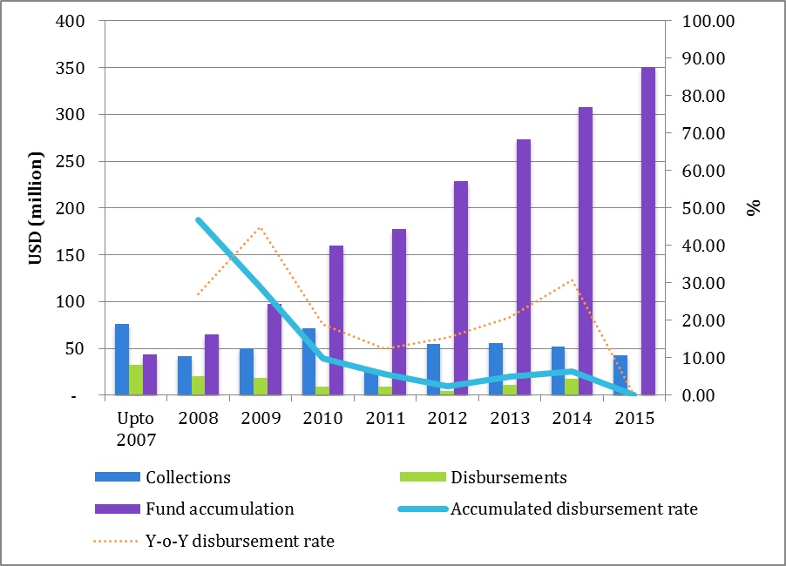
Sri Lanka’s universal service fund is smaller, but much remains unspent

Slide 10
What is to be done

Slide 11
Think in terms of entire eco system like Malaysia
Action required on all fronts, not just infrastructure
But this does not mean government should try to do everything
What are required are partnerships & creation of conditions for others to innovate & invest

Slide 12
Investment, not subsidies
Taxing incoming and outgoing calls in this day and age is silly
Sri Lanka has desisted from imposing universal-service levies; now is not the time to start
Spend down the accumulated funds and rely on PPPs for continuation
Is subsidies are needed
Use general tax revenues
Go for matching funds, not pure subsidies
Investment has to be priority

Slide 13
Investment comes when there is certainty and predictability
Understand that what amount to overlay networks will have to be built; major investments are required
Also understand that creating platforms for applications will require investment
For major investments, with relatively long gestation periods
Uncertainty in tax environment must be reduced
Regulatory risk must be reduced, especially re market entry-exit, scope of licenses & spectrum

Slide 14
Increasing taxes can decrease revenues . . .
Pakistan case
GST rates on telecom charges
In 2008, PTA conducted a tax-impact analysis, concluding that "with the given increase of tax rate from 15% to 21% the GST collections will decline"
Loss to governmental revenue in the first quarter of fiscal year 2008-9 was a predicted
As a result, GST rate was reduced from from 21% to 19.5% in next budget; revenues increased

Slide 15
. . . and also depress demand
It does not make sense to tax a service that is being encouraged
Recent reduction of excessive sector-specific tax on data is a good start

Slide 16
Reduce regulatory risk . . . Market exit
Who can best decide number of suppliers? Not Minister; not regulator; but the market
Transparently assign as many licenses as resources (spectrum) permit in blocks adequate for purpose (minimum of 5MHz for 3G, 10Mhz for 4G); no point in fragmenting ➔ increasing costs
Allow secondary trading so operators can find the optimum distribution of spectrum
Create orderly exit mechanisms (ideally, known at time of entry), so that market can settle at optimum level
Includes rules on spectrum, secondary trading is a solution
Also safeguards for consumers

Slide 17
Reduce regulatory risk . . . Spectrum
Spectrum is the most critical input in providing wireless broadband access
Spectrum refarming is central
All users of spectrum must understand that assignments are not for ever; that countries that are technology-takers must realign their spectrum assignments periodically
Difficult process; I did it in 2002-04 (900 and 1800 bands)
Requires extensive consultation with all affected stakeholders
Lots of listening and talk
Need to use proceeds of auctions to compensate “losers”
Digital transition for 700 MHz Band must be highest priority
Operators must be able to plan and to mobilize resources
Not just a question of auctions versus administrative allocation
Auctions are best, but unless embedded within a credible roadmap, they will distort bidder’s incentives

Slide 18
Reduce regulatory risk . . . Road map
Best way to improve spectrum regulation is to set out principles and a schedule for refarming actions (known as roadmap)
Make principles explicit and include time (when specific blocks will be refarmed/made available)
To the extent possible, reduce technology bias in spectrum assignments: e.g., why should 900 band be limited to specific technology?
Change and certainty
All should recognize that nothing is permanent in spectrum assignments
But change should be predictable and the path decided through extensive consultation based on principles

Slide 19
Government needs revenue. Policy choice: Now or over time?
Take as much as possible upfront OR create conditions for continuing revenue streams?
Sri Lanka has held a few auctions, but fees have been relatively low (e.g., 5th mobile license to Airtel went for USD 4 m); but TRC is the biggest contributor to Treasury: USD 98.2 million expected in 2017 (in addition to USD 5.2 million from SLT as dividends)
Auctions are the best way to allocate scarce resources
They can be designed to encourage rapid rollout OR optimize revenue

Slide 20
Sri Lanka needs new ICT legislation to create a modern regulatory environment
Working under a 26-year old law
Act governing the sector is from 1991; amended in 1996
Abuses of Fund which saw criminal misappropriation of USD 4 million is just one symptom
Time to develop a new statutory framework and restore legitimacy of regulator

