Slide 1
Knowledge to Innovation : the role of informal knowledge
Sujata Gamage, LIRNEasia
December 10, 2009

Slide 2
Formalization of knowledge, innovation and knowledge to innovation
Innovation is part of the human condition. At work or play we constantly try to make things easier for ourselves.
It used to be that we create knowledge as we tried to do things better, unknowingly, so to speak
Then came universities, research institutes, extension services and a host of other supporting organizations and activities

Slide 3
Did we go too far?
An innovation system is made up of institutions that create, store and transfer the knowledge, skills and artifacts which define new technologies.” (Metcalfe, 1995)

Slide 4
Innovation System – Actors (NSF, Sri Lanka)
Government/ Central & Provincial – Policy framework
Universities - Research
R&D institutes –Research & extension
S&T institutes – Supporting services
Other govt. departments - Supporting services
IPR – Technology transfer
NGOs – Participatory approach
Private sector - Marketing
Banks – Venture capital
Donor agencies - Funding
Legal firms/Lawyers – legal aspects
Society - Beneficiary

Slide 5
Corrections in progress
INNOVATION SURVEYS:
The most important links and collaborations for businesses are with other enterprises, including customers, suppliers and even competitors (HSRC, 2009).
KIBS LITERATURE
Soft’ sources such as suppliers and customers and skilled personnel or consultants recruited are critical for innovation in knowledge intensive business services (KIBS) (from Tether, 2004; Freel, 2006 in the KIBS literature)
WORLD BANK:
Research is an important source of knowledge for innovation, but it serves principally as a complement to other knowledge and other activities. Many countries have an urgent need to develop the other elements of the innovation system, particularly more extensive patterns of interaction and the attitudes and practices that support interaction. Once research is better integrated into this wider set of activities, it will become clearer where research capacity is limiting and where it needs strengthening [WB, 2006]

Slide 6
Mode -1 v. Mode -2
Knowledge produced outside of formal knowledge institutions in the context of work (or mode-2 knowledge) will be more important
Gibbons, et al. 1994
Novotny, Scott and Gibbons, 2006

Slide 7
ICT enabled connectivity makes mode-2 all the more real

Slide 8
Solid Waste Sector as Case Study

Slide 9
Survey of Solid Waste Managers in 325 LAs in Sri Lanka
SOURCES OF KNOWLEDGE
Who did you contact in the last 12 months to get the information/knowledge you needed
SUCCESS
What percent of your waste is separated and processed prior to dumping

Slide 10
Results
 | ALL
Connected/’Successful’ | 18%
Connected/Not ‘Successful’ | 40%
Not connected /Not ‘Successful’ | 42%
 | 106

Slide 11
Sources of Knowledge (19 ‘successful LAs
 | Number | %
Gov+ | 2 | 11%
Peer+ | 10 | 53%
Other | 7 | 37%
PEER: Anupa Pasqual, Balangoda UC, Bandaragama PS, Bulathsinhala PS, Kuruwita PS, Mawanella PS, Negombo MC, Rathnapura MC, Weligama UC
OTHER: Unnamed Expert-India; Pilapitiya-Expert Sri Lanka (4), Basnayake- Pofessor, U Perdeniya (on volunteer basis or as consultants)
Peers are an important source of knowledge

Slide 12
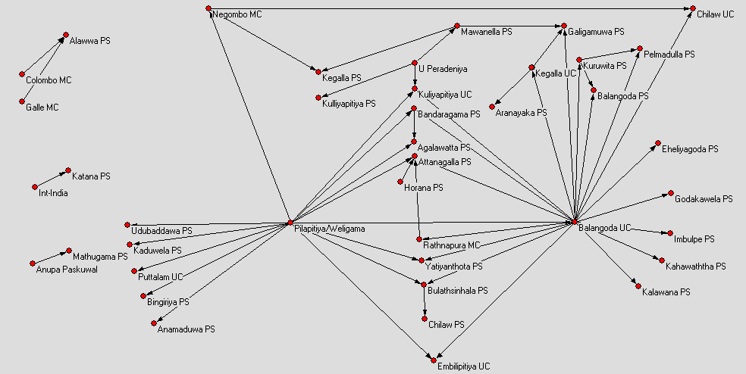
Connectedness of SW Managers in Sri Lanka (Sabaragamuwa (29/29; Wayamba; 30/32; Western, 9/9)

Slide 13
Challenges for Policymakers
 | SBRG | WYMB | WEST | ALL
Connected/’Successful’ | 17% | 21% | 17% | 19
Connected/Not ‘Successful’ | 41% | 30% | NA | 37
Not connected /Not ‘Successful’ | 41% | 41% | NA | 50
 | 29 | 29 | 48 | 106

Slide 14
Viewing the Solid waste as a System with attention to mode-2
KNOWLEDGE COMMUNIY
PEERS
LOCAL GOVERNMENT SERVICE PROVIDER
CIVIL SOCIETY
INDUSTRY PARTNERS
Dashed frame represents the enabling environment made up media and national regulatory framework

Slide 15
Testing Linkages (Jan 2008 – Dec 2009)
Between each Local Authority and
Peer community
Knowledge community
Civil society
Industry

Slide 16
Results

Slide 17
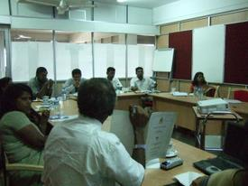
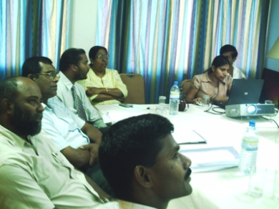
Standards and Certificates

Slide 18
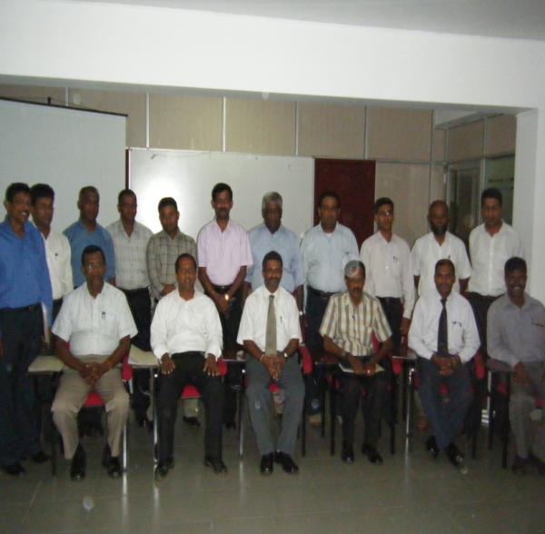
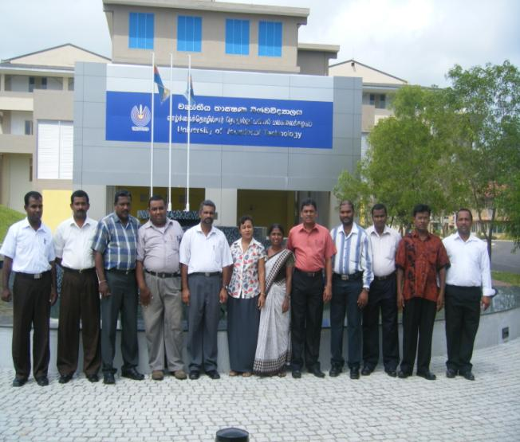
Training of trainers Curriculum writing

Slide 19
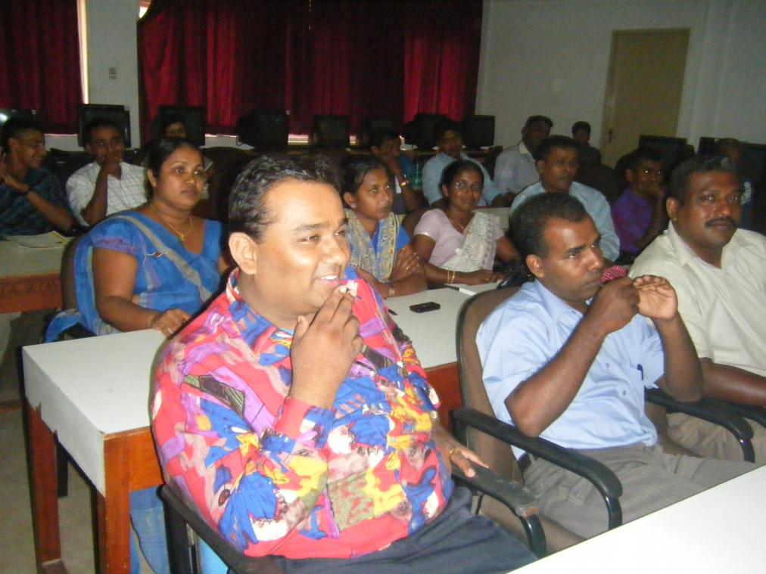
Training of trainers

Slide 20
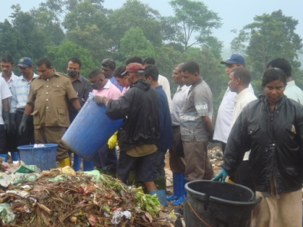
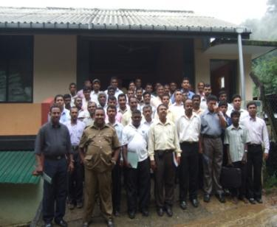
40 personnel from !0 LAs at Balangoda UC Training Center

Slide 21
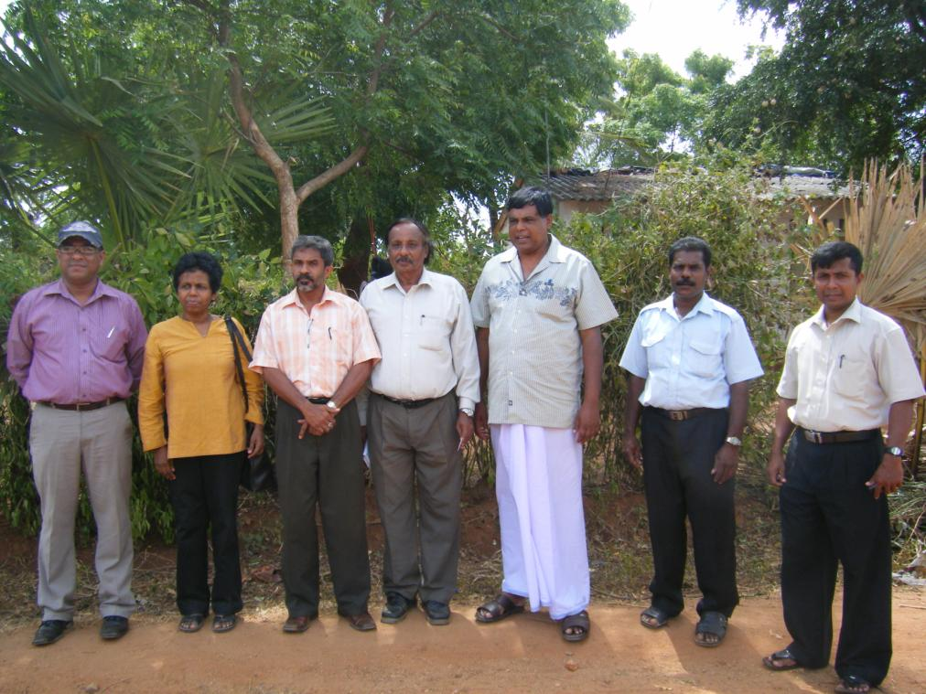
Visit by Balangoda UC to Vavuniya UC and IDP Camps

Slide 22
Conclusion
Peer-2-peer linkages are productive and sustainable K2I processes
Government agencies, universities and other formal knowledge actors should nurture these with creativity and humility

Slide 23
Future work
Cost of linkages in solid waste sector
Applications to other sectors

Slide 24
Cost?
Cost of linking v. Other imperatives
LINKING:USD 40,000 per province per year?
Peer-2-Peer training
Recognition of ‘most improved’ and ‘worst’ can be effective
Internships/Mphil
OTHER IMPERATIVES: Equipment, Sanitary landfill?

Slide 25
Thank you

