Slide 1
The workaround that gave Sri Lanka e-mail
Rohan Samarajiva
www.LIRNEasia.net; rohan [at] lirneasia.net
Colombo, 28 June 2010

Slide 2
Key points
Two attempts to connect Sri Lanka to the Internet (at least to e mail)
1985-86 failure, despite trying to do things the right way
1990-95 successful workaround
Workaround as common feature of Sri Lankan policy

Slide 3
1985-86 Bureaucracy 1/ Visionary 0

Slide 4
Mandate: Connect IFS
“Establish an uptodate science information system for the IFS.”
Post-it label, from Professor Cyril Ponnamperuma, Director of Institute of Fundamental Studies & Arthur Clarke Centre, August 1985
He meant “connect to ARPANET,” predecessor to the Internet
It is reported that by this time ARPANET traffic was 75% email
World wide web and browsers still in the future
CompuServe in existence; Lexis type databases coming on stream
NSFnet which went online in 1986 was in the planning and CP, being from within the beltway, may have been seeing an opportunity

Slide 5
Context
Challenges of connecting to a data network on the other side of the world from an organization where
The only accessible computer was a luggable Kaypro (perhaps there were two, this was 20+ years ago)
Telephone connections required “connections”
Dialtone required persistence and call queueing in programmed PBXes
Even Sir Arthur Clarke, who was generous with his lifetime subscription to CompuServe, urged caution with the dial-up IDD connection

Slide 6
State of telecom in Sri Lanka in the 1980s
Post and telecom bifurcated in 1981
Inspectors being dispatched to FTZ by Director Telecom to confiscate automatic diallers
Minister’s preferences, Director’s preferences, medical certificates needed to get phones
“Shadow Board” under Vernon Mendis established in 1986 to prepare for new Act and privatization
First AMPS mobile license granted in 1989

Slide 7
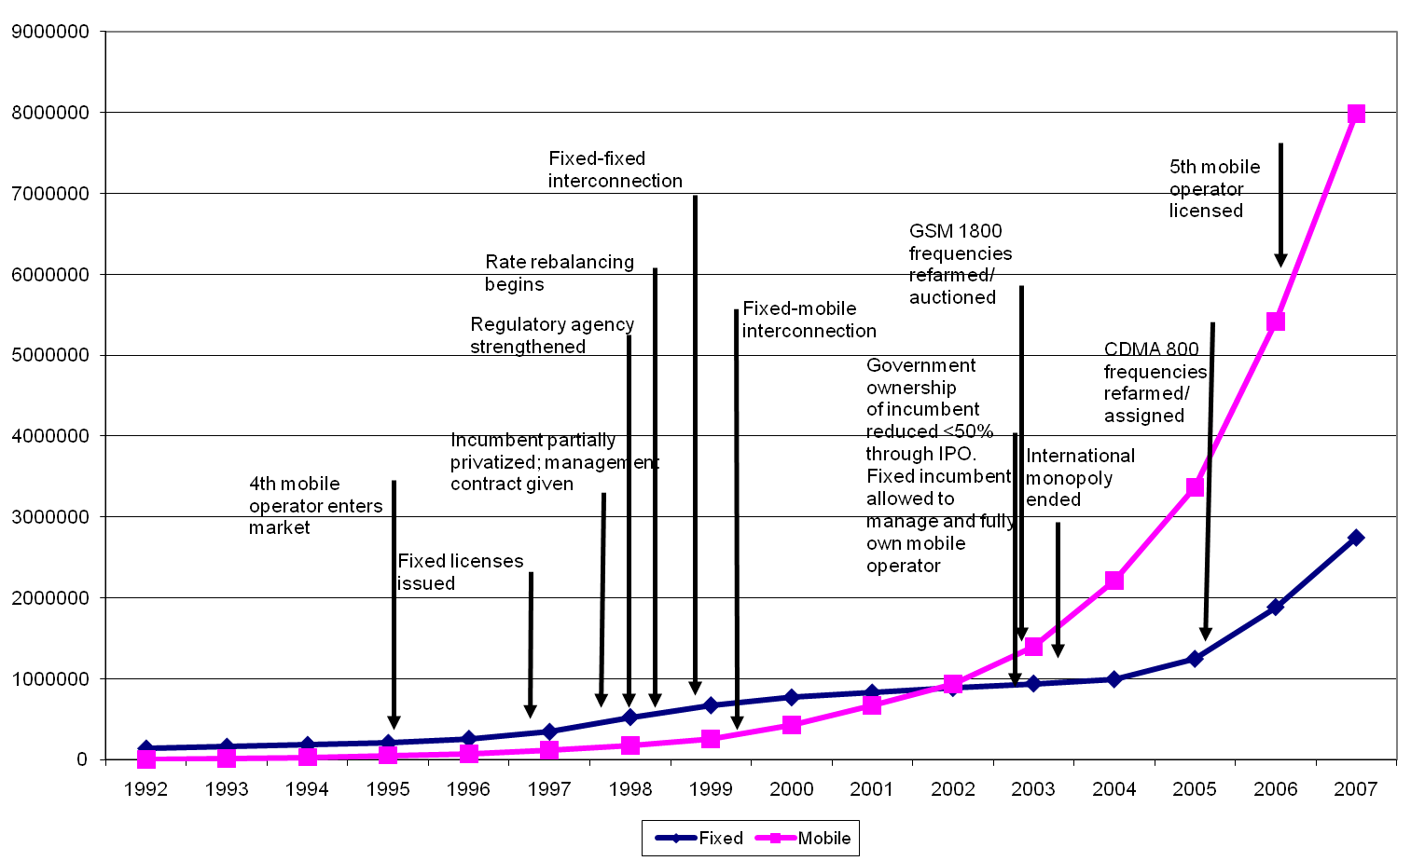

Slide 8
Failure, despite “I don’t need AR & FR; I have JR” Ponnamperuma onside
Potential to get free satellite time from INTELSAT for 2 years for experimental purposes
Had to get to satellite earth station from IFS located in Kandy
Response from unenthusiastic Director Telecom
Purchase a modem (very expensive) through the Department
Pay monthly fees (astounding) on top
No quality assurances
CP was willing to do it, but I considered it a white elephant unless combined with revenue generating business applications
For the latter, I had to be in Colombo; CP wanted me fulltime in Kandy handling media ➔ I left ACCMT/IFS in 1986 and Sri Lanka in 1987
Samarajiva, R. (1989). Appropriate high tech: Scientific communication options for small third world countries. Information Society, 6(1&2): 29-46

Slide 9
1990-95 Workaround
A workaround is a bypass of a recognized problem in a system.
A workaround is typically a temporary fix that implies that a
genuine solution to the problem is needed. Frequently
workarounds are as creative as true solutions, involving outside
the box thinking in their creation.

Slide 10
Rough history from an interested observer (corrections welcomed)
Running on the tenure track in Columbus OH; not much news of home
SLNet starts well; but descends into vicious spam wars, threats and recourse to courts (or was it soc.culture.sri-lanka?)
LAcNet emerges thankfully
Sometime in 1991 proposal comes by about sending/receiving email from LK through twice-a-day (?) dial-up connections

Slide 11
The workaround
.lk domain is actually hosted in a computer in the US
Purdue?
Stanford?
Or both?
Sri Lanka emails from within the connected universities intended for the world come to U Moratuwa (Dr Abhaya Induruwa’s lab)
US computer(s) collect the emails sent to .lk addresses and uses MCI Friends and Family calling to dial the Moratuwa number, once to dump the collected emails and then to collect the email from LK to the world
Cost of MCI F&F from donations
Vicum Perera used to send monthly accounts to all

Slide 12
Mainstreaming the workaround
Under leadership of then Minister of Industries, Ranil Wickremesinghe and Professor V.K. Samaranayake, then heading CINTEC, .lk comes home in 1992-93 (?) but LAcNet keeps paying for the link
1995 is when the workaround ends
LAcNet starts to use the donations for other good purposes

Slide 13
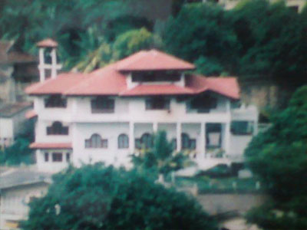
Anyone noticed how housetops have changed in Sri Lanka?

Slide 14
Workaround as general feature of policy in Sri Lanka
Because we could not/cannot compel SLT to share its backbone in an equitable manner, private operators use microwave excessively
➔ greater cost
Because the Ministry, the natural place to implement policy, proved to be seriously lacking in capacity, we created ICTA as a company (workaround)
But at cost in accountability

Slide 15
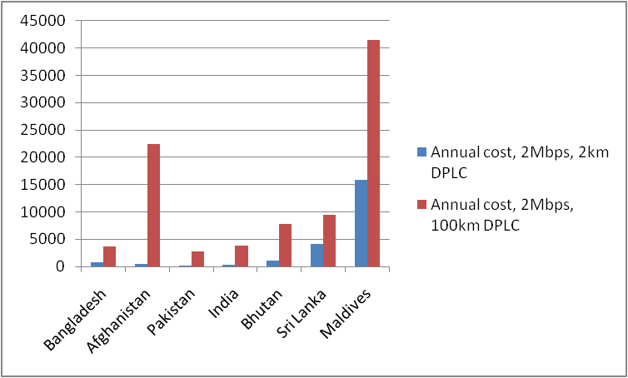
Today’s challenge: High leased-line prices

Slide 16
Leased-line prices are oxygen for Internet Service
From a good position five years ago, we have deteriorated
Domestic leased line prices are now more expensive than Bhutan!
When AF prices become effective, their tail cost will be less than ours
Data from February 2010, with detailed notes, at http://lirneasia.net/wp-content/uploads/2010/03/LIRNEasia-Broadband-prices-EmergingAsia-Feb-2010.pdf
No ready method for comparing international prices, but here too Sri Lanka is probably not very competitive
Do we need workarounds, or will the regulator act?

