Slide 1
LIRNEasia recommendations on proposed electricity tariffs 2013
Rohan Samarajiva

Slide 2
Our recommendations
 | Short Term – 1-2 months | Mid term – within 1 year | Long term – 2 + years
Reduction in cost of electricity supply | Create awareness to reduce consumption during peak hours | Rebates for consumers from cost reductions due to DSM & Norochcholai II, while maintaining the principle of bringing tariffs closer to costs Introduce smart and pre-paid meters New bill format | Implement time of day metering Reconsider rule allowing only 20% from one source Increase night time consumption Expedite cable connecting system to S Indian grid
Alternative tariff structure | Accept proposed tariff design | Reduce tariff bands and categories | Implement cost based (time of day pricing)
Subsidy | Provide LKR 150 for Samurdhi beneficiaries to meet the increase in expenditure | Subsidize religious institutions through Ministry of Buddha Sasana & Religious Affairs

Slide 3
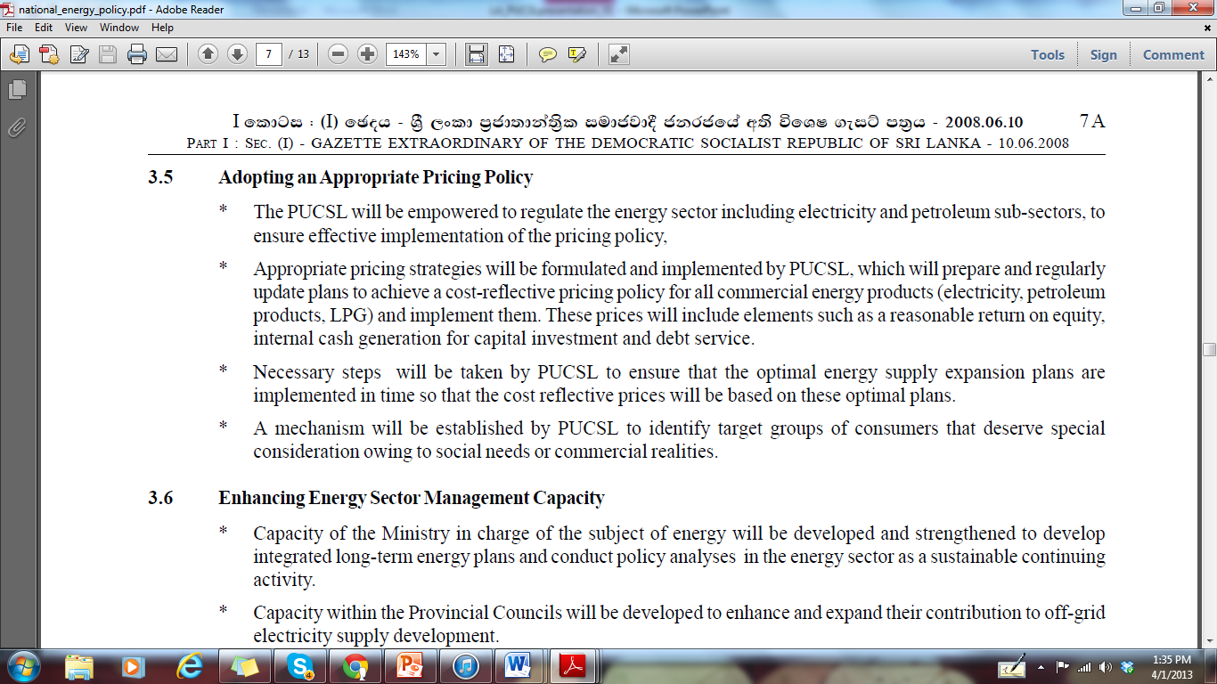
Government policy requires cost-reflective tariffs

Slide 4
We support the new tariff design
As the beginning of a multi-year process to establish cost-reflective tariffs
Because it creates strong incentives for managing demand which is of critical importance until Norochchalai II is operational
But we are not focusing on the specific numbers proposed by CEB

Slide 5
Last 5% of supply needed to meet peak demand is as expensive as first 50% of supply

Slide 6
Tariff increase will cause significant short-term pain for consumers as past policy mistakes are remedied
But fairness requires that pleasure is shared as well as pain
Assess actual consumption patterns and costs
If peak demand is lowered, give rebates to consumers
Costs will radically decline when Norochchalai II becomes operational
Use some savings to repay loans but give customers a rebate, while maintaining movement toward cost-reflective tariff design

Slide 7
Immediate remedy: Rs. 150 subsidy to Samurdhi recipients
Why Samurdhi?
Means-tested recipient group
Easy cash transfer possible
Consuming under 50 units = “energy poor”
Cost today for 50 units = 308.4
Cost under proposed tariff = 465
Difference ~ Rs. 150 = subsidy per family per month
~LKR 2.7 billion in total subsidy for ~1.5 million households on Samurdhi

Slide 8
Our recommendations
 | Short Term – 1-2 months | Mid term – within 1 year | Long term – 2 + years
Reduction in cost of electricity supply | Create awareness to reduce consumption during peak hours | Rebates for consumers from cost reductions due to DSM & Norochcholai II, while maintaining the principle of bringing tariffs closer to costs Introduce smart and pre-paid meters New bill format | Implement time of day metering Reconsider rule allowing only 20% from one source Increase night time consumption Expedite cable connecting system to S Indian grid
Alternative tariff structure | Accept proposed tariff design | Reduce tariff bands and categories | Implement cost based (time of day pricing)
Subsidy | Provide LKR 150 for Samurdhi beneficiaries to meet the increase in expenditure | Subsidize religious institutions through Ministry of Buddha Sasana & Religious Affairs

