Slide 1
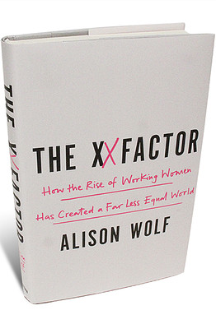
THE XX FACTOR HOW WORKING WOMEN ARE CREATING A NEW SOCIETY
Laleema Senanayake
LIRNEasia, 30.01.2014
This work was carried out with the aid of a grant from the International Development Research Centre, Canada.

Slide 2
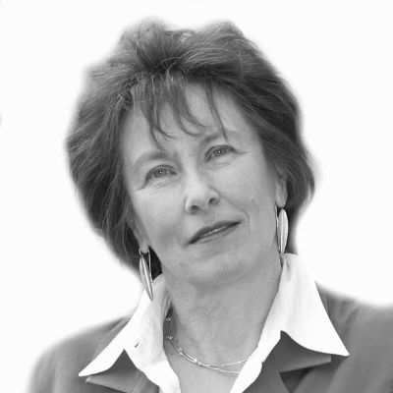
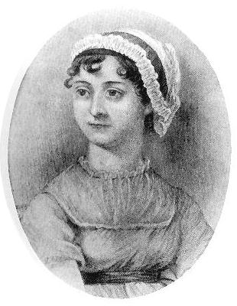
INTRODUCTION
Author: Alison Wolf
Sir Roy Griffiths Professor of public sector management at Kings College London
Published in 2013 by PROFILE BOOKS LIMITED
Jane Auston braking off her engagement with Harris Big Wither in 1802
Modern highly educated professional females, 70 million world wide who stand in a direct line from Jane Auston
1960s’ : Open up of elite education, change of job opportunities, shift of family structures and the arrival of the pill
Alison Wolff: Source: http://s.huffpost.com/contributors/alison-wolf/headshot.jpg
Jane Auston : Source: http://www.janeausten.co.uk/wp-content/uploads/2011/07/janepic.jpg

Slide 3
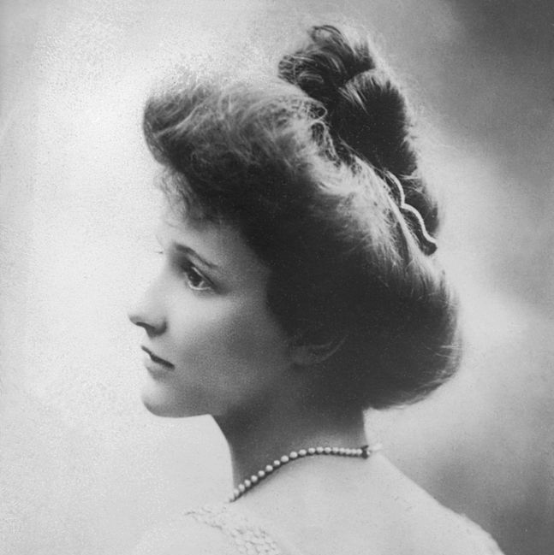
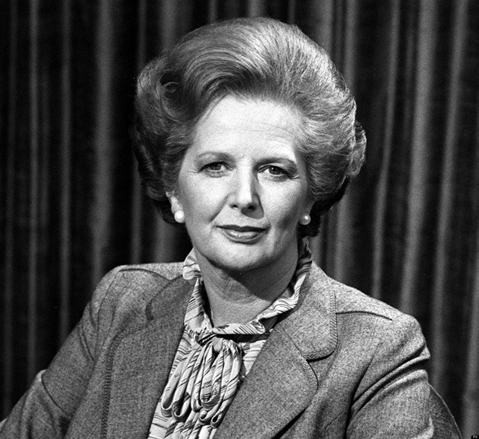
GOOD BYE TO ALL THAT: THE FRACTURING OF SISTERHOOD
FRAME OF THE CENTURY
Nancy Astor: Source: http://en.wikipedia.org/wiki/File:Nancy_Astor.jpg
Margaret Thatcher: Source: http://www.conservativehome.com/wp-content/uploads/2013/10/Margaret-Thatcher-BW.jpg
Hillary Clinton: Source: http://nyoobserver.files.wordpress.com/2013/04/hillary-clinton.gif%3Fw%3D660
‘Problem of the surplus women- Two Million who can never become wives ( Daily express headline, 1921)’

Slide 4
THE RICH GET RICH AND THE POOR GET CHILDREN
The proportion of American women who stay childless has doubled since 1970s’
The educated women have children later in their lives
Opportunities and professional success contributes to this trend
The uneducated doesn’t regret their choice either
God’s given me something and it’s for a reason’: Promises I can keep, Kathryn Edin and Maria Kefalas
Age at first birth for women aged 22–44 years, by education: United States, 2006–2010
Source: CDC/NCHS, National Survey of Family Growth, 2006–2010

Slide 5
THE RETURN OF THE SERVANT CLASS
“The hand that rock the cradle is the hand that rules the world”
: William Rose Wallace
First quarter of the 20th century: Marriage meant end of employment for females
Mid 20th century: Returning to work after marriage and child bearing became standard (Median age: 12, 13 years)
Past decade: The median age to return to work after birth is less than 6 years
Graduate mother today who postpones child bearing until thirty and then returns to work will probably suffer no earning loss at all for her first child, Heather Joshi
Yet the super rich, at the very tip ( 1- 0.1%) tend to stay back after birth
Source Hansen and Joshi, eds, 2007

Slide 6
PIZZA AND PARTNERS
Distribution of food expenditure, USA, 1960
Distribution of food expenditure, USA, 2009
MAKING IT
Source US Department of Agriculture Economic Research Service, adapted from Aguir and Hurst, 2007
1950- 51: Undergraduate enrolments, top private collages Northeast USA
2009- 2010: Undergraduate enrolments, top private collages Northeast USA
Source Collage admissions offices

Slide 7
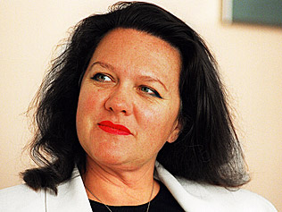
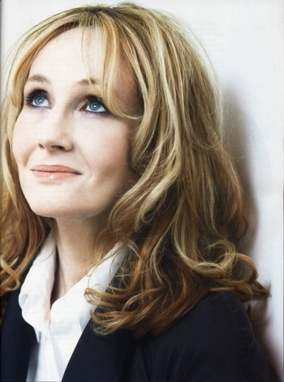
THE WAY WE LIVE NOW
Legislatures with the highest female representation, 2009
Rwanda | 56.3
Sweden | 47
South Africa | 43.5
Cuba | 43.2
Icelad | 42.9
Source Grant Thornton, 2009
Source Inter parliamentary union
Olga Forte
Georgina Rinehart
Oprah winfrey
J K Rowling

Slide 8
SOMETHING TO REGRET?
Percentage of women age 25- 44 reporting that they have volunteering on a given day: USA
Source American Time Use Survey

Slide 9
REVIEWS
“You may disagree with her interpretations of some of the data, but after reading The XX Factor we can no longer talk blithely about what ‘women’ want and do versus what ‘men’ want and do. Alison Wolf injects a raft of valuable and often surprising data into the ‘having it all’ debate and shows convincingly that the advances of professional elite women have wrought enormous social change but have also created deeply different life experiences between elite women and their less-privileged sisters.” –Anne-Marie Slaughter, president, New America Foundation
“A crucial bible for anyone wanting to check up on anything about contemporary woman.” –The Guardian
THANK YOU!

