Slide 1
Consumer protection and the regulator
Rohan Samarajiva
11 April 2014
This work was carried out with the aid of a grant from the International Development Research Centre, Canada.

Slide 2
Professor Stephen Littlechild on consumer protection
“Competition is indisputably the most effective - perhaps the only effective – means of protecting consumers against monopoly power. Regulation is essentially the means of preventing the worst excesses of monopoly; it is not a substitute for competition. It is a means of ‘holding the fort until competition comes.’”
1983 Report to UK Government, Para 4.11

Slide 3
Best economist not have received a Nobel: Albert Hirschman, 1915-2012
Economics privileges exit; Politics voice
But increasingly cross-overs occur
Very useful framework for thinking about quality of service in telecom

Slide 4
Consumer protection under monopoly
In a monopoly environment, government has major responsibilities for consumer protection
When there are no exit options (alternative suppliers), voice is only option (other than doing without)
Voice can be direct: consumer speaks/complains to supplier
Voice can be directed to 3rd party (consumer protection agency/utility regulator) who has authority over supplier

Slide 5
Consumer protection under competition
Caveat emptor (Let the buyer beware) is the starting position
Assumes homogenous products and costless exit options
Assumes perfect knowledge of competing products
Obviously unrealistic; For all markets, but especially for markets in infrastructure services
Government actions in absence of assumptions
Reduce information asymmetries
Regulate suppliers proportionate to deviation from competitive market (e.g., differential treatment of fixed v mobile telephony)

Slide 6
Purpose of LIRNEasia’s 2012-14 study
Extraordinary increase of customers served by mobile operators after competition introduced in South Asia
Without commensurate increase in service personnel
Not too bad a perception of service quality
Electricity services provided by monopoly suppliers, mostly government-owned
Could we offer suggestions on how consumers in both sectors could be better served, with emphasis on using the potential of the mobile platforms?
Could we catalyze the offering of services useful to the poor on mobile platforms, so that their development potential can be better realized?

Slide 7
Research methods
First, from supplier perspective
How are customers served? How are the relationships managed?
Interviews with service providers + desk research
Then, from user perspective
What services used? Problems? Satisfaction levels?
Quantitative: Sample survey of 3,180 Micro Enterprises (MEs) in strong and weak cities in each country
Qualitative: in-depth interviews of 76 participants and 12 ethnographies at sites of service provision

Slide 8
Mobiles most used by MEs for business

Slide 9
Mobiles used for business: Coordination with customers, suppliers & employees

Slide 10
Most mobile users experience network-related problems

Slide 11
Most MEs do not interact with telecom service provider

Slide 12
Of those with mobile-service problems, most thought it was not worth complaining

Slide 13
Much worse in electricity . . .
Why did you not complain to the service provider? (% low income MEs who use electricity for business)

Slide 14
Satisfaction with mobile service-provider interaction
Experience with service provider – YES (% low income MEs who have interacted with service provider)

Slide 15
Telecom: Most interactions with service providers through call centers
How do you normally contact your telecom service provider?
(% low income MEs who have interacted with service provider)

Slide 16
Examples of possible solutions in telecom

Slide 17
Supply- and demand-side studies show some overlap in problem perception
What the service providers said
What the customers said
In LK, network coverage related issues resulted in customers leaving for a competitor without complaining

Slide 18
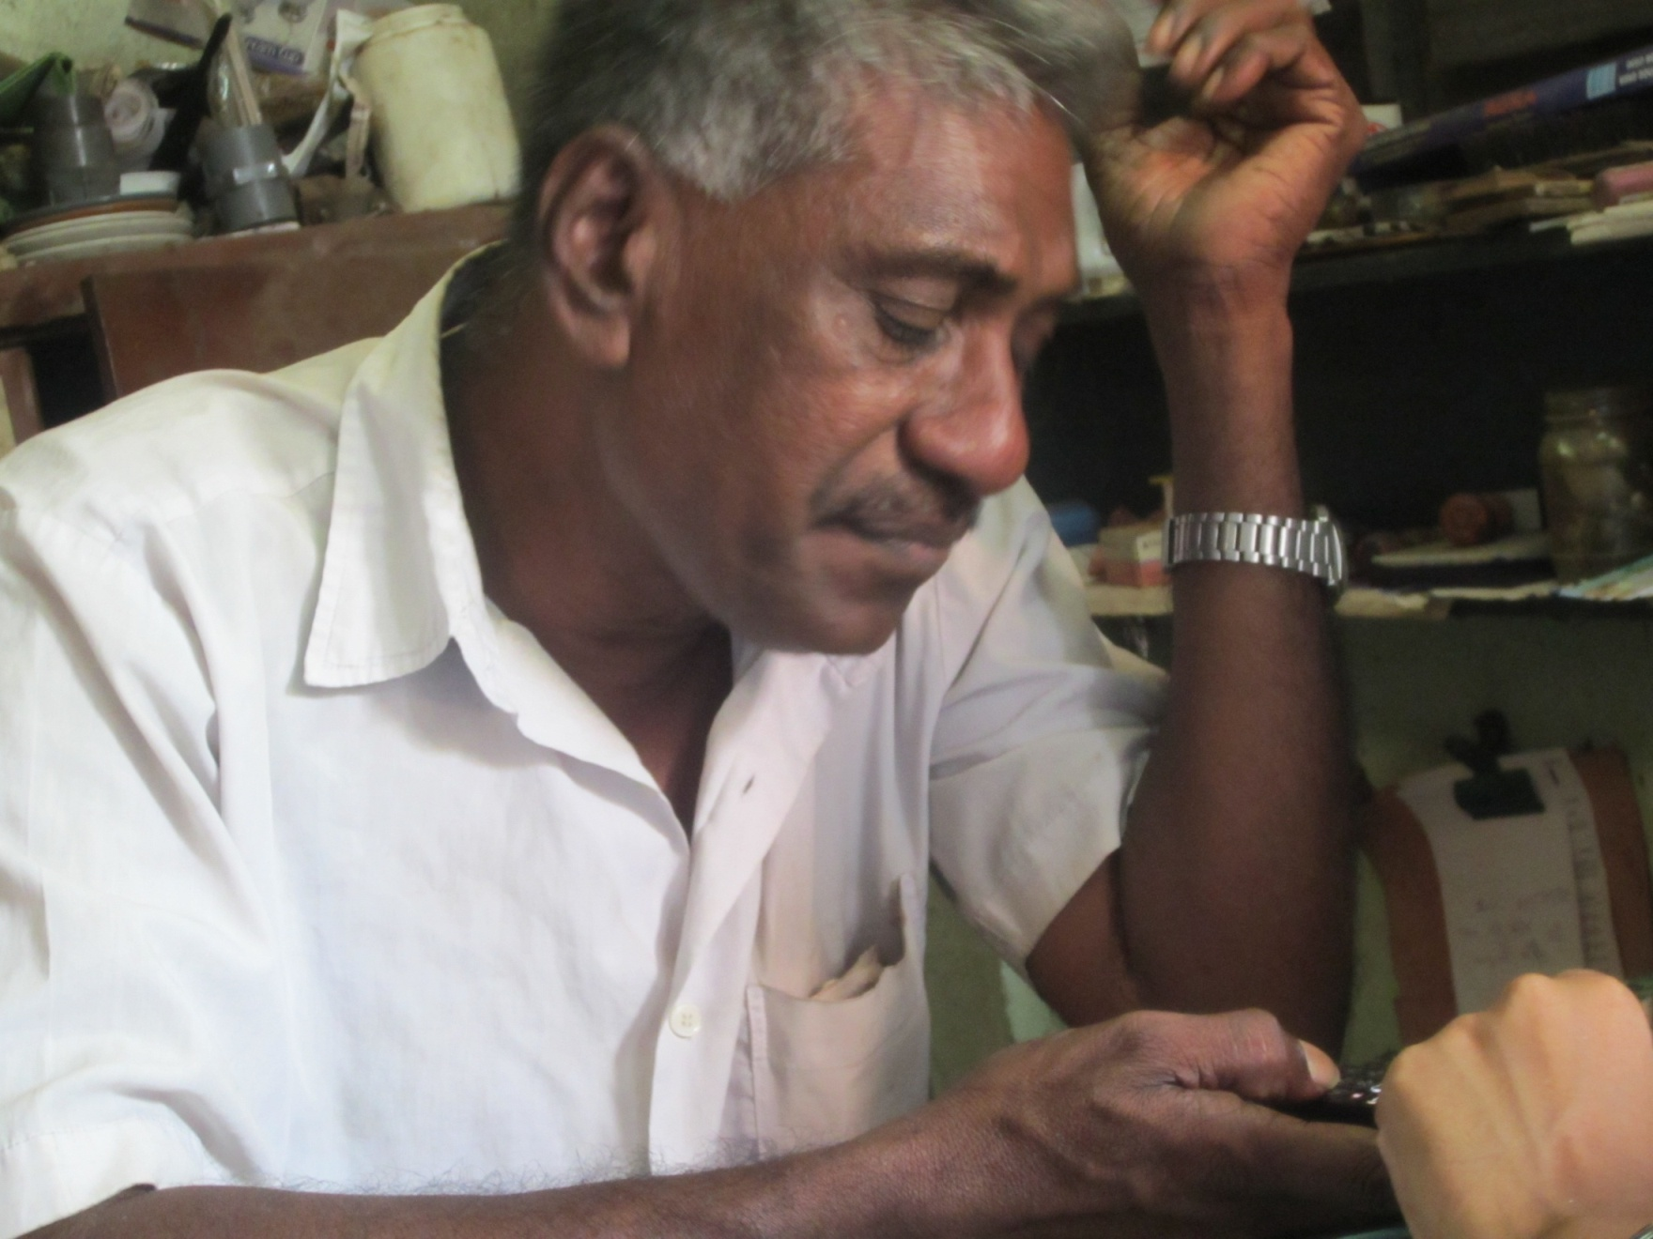
Problem: Network Coverage / Frequent Call Drops
“There are times when there is no network coverage because of which I lose out on my business. I wish there was a way to resolve this instantly.”
70% in LK use mobiles for business purposes
40% in LK say connectivity issues affects their livelihood
Name: Asif Ali
Age: 56 years
Education: Grade 9
Occupation: Rental company dealing with furniture, cutlery, glassware
Number of Employees: Four (Family members)
I have been running my business for the 15 years and I need good telecom service for my business. I need to be constant touch with my customers to follow up with them about their requirements and my payments.

Slide 19
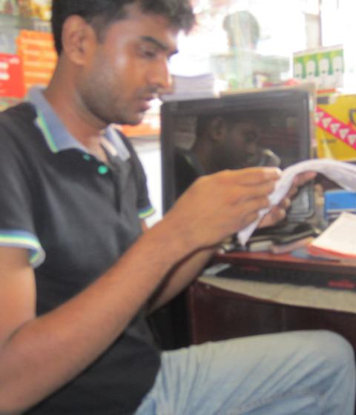
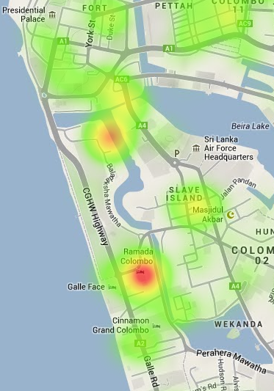
Solution: Crowd Sourced Map of Problem Areas
USSD / SMS
No Coverage <AREA>
USSD / SMS Thank you for your feedback.
Enable customers to log problems pertaining to coverage through USSD/ SMS. Operators can use this information to optimize the network and improve network connectivity.

Slide 20
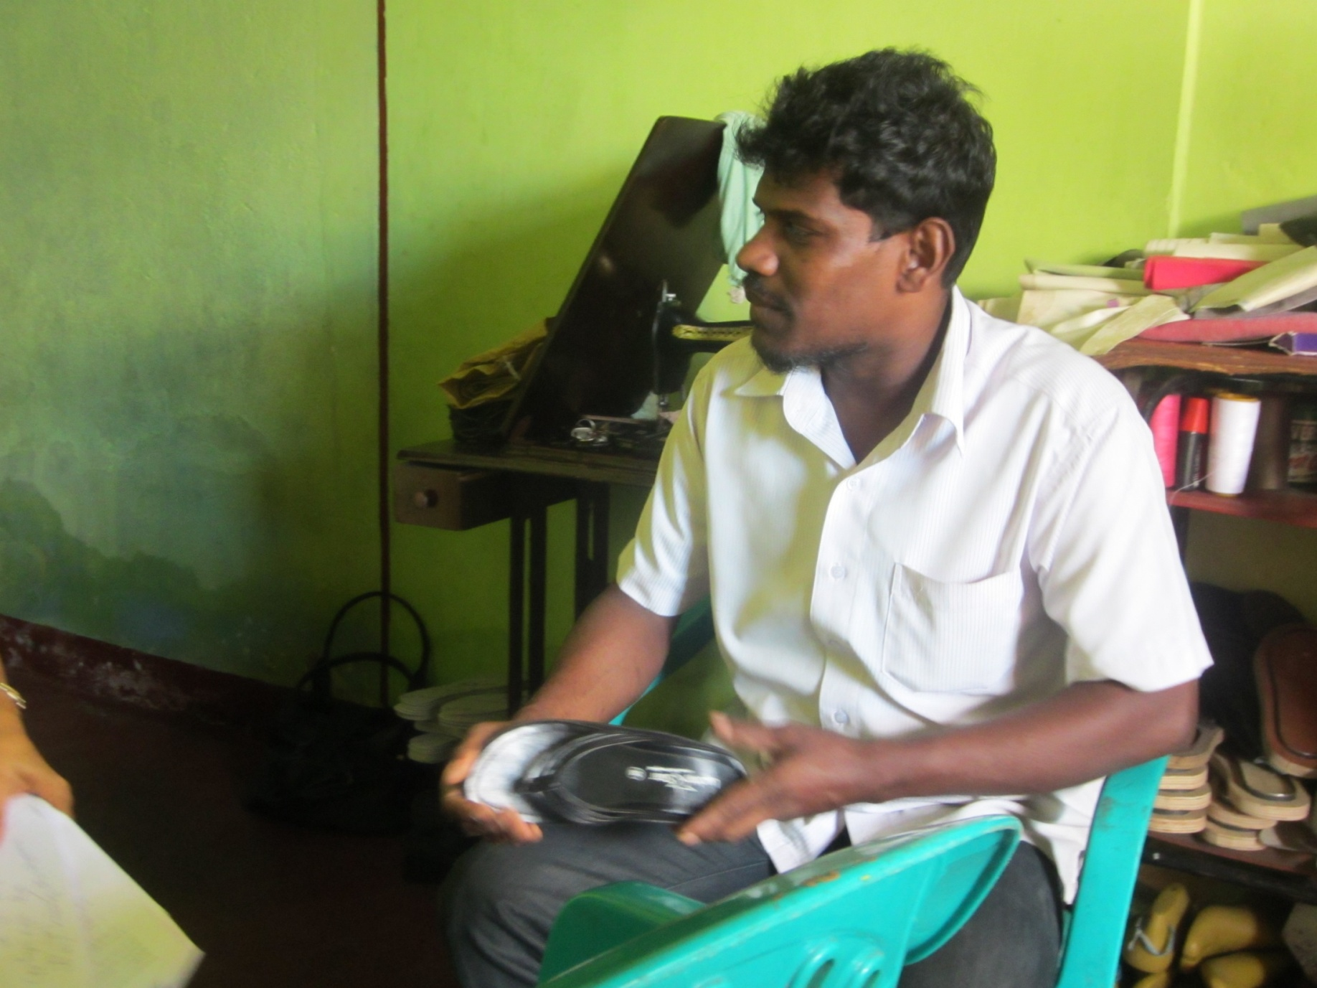
Unintended VAS activation: One of the top reasons to call contact centre
“I am not educated, so it is difficult for me to understand the messages I receive and the messages are not in Sinhala. I tend to press the wrong button which activates the VAS without my knowledge. I realized this only when my balance was cut”
Name: Supun Fernando
Age: 38 years
Education: Grade 9
Occupation: Shoe Seller
Number of Employees: Two
I have been running my business for the past seven years and I tend to get irritated with the messages I get from my telecom company.
In addition, MNOs send too many SMS; Most are ignored. In LK, SMS is not in local script; Cannot be understood.

Slide 21
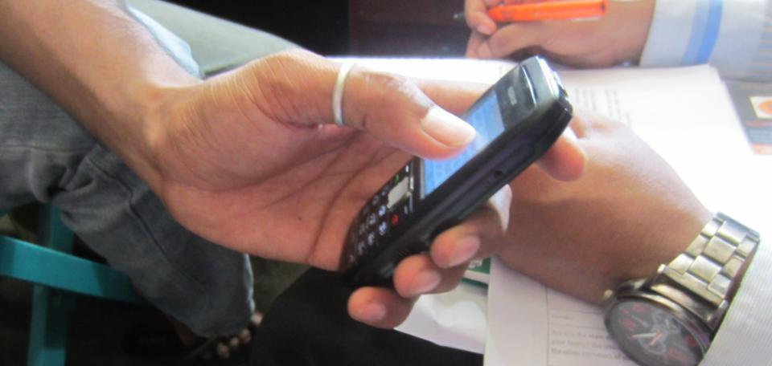
Solution: Active reconfirmation
Kindly press 8 if you wish to confirm activation of service, press 9 if you wish to deactivate the service.
8
9
Solution: On activation of VAS, the ME receives a confirmation (automated call or SMS) requesting them to confirm their activation.
OR
Reconfirmation request sent through SMS or IVR about VAS activated on phone at a given frequency (every 3-4 months). If VAS is not confirmed, it will get automatically deactivated.

Slide 22
More data and solutions at
http://lirneasia.net/projects/pro-poor-crm/

Slide 23
Is this something worth doing in the Pacific?
Given small populations, perhaps could be done for all consumers, not just urban, poor micro enterprises
LIRNEasia will be happy to share questionnaires, protocols, etc.

