Slide 1
Hope in the heart and money in the pocket
Rohan Samarajiva
Yangon, 27 July 2014
This work was carried out with the aid of a grant from the International Development Research Centre, Canada and the Department for International Development UK..

Slide 2
First some facts . . .
What my interns have found from the public “international” and national record
Please correct
If you need the sources, can provide
In all cases, Myanmar is placed in context of peer countries (again, you may wish to change the comparators for your own purposes)

Slide 3
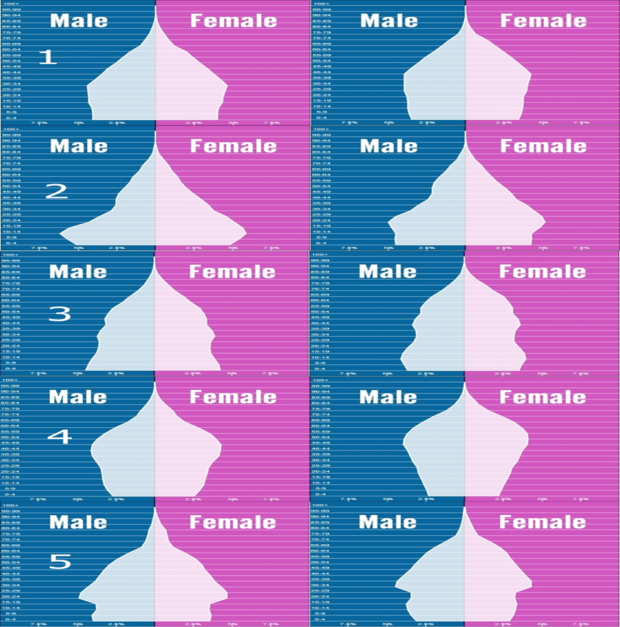
MM
NP
LK
TH
VN
2015
2025

Slide 4
 | Myanmar | Nepal | Sri Lanka | Thailand | Vietnam
GDP per capita / USD (2013) | 1700 | 1500 | 6500 | 9900 | 4000
Population/’000 (2013) | 53259 | 27797 | 20483 | 67010 | 89709
Literacy rate adult (15 and above)/% | 92.7(2011) | 57.4(2011) | 91.2(2010) | 93.5 (2005) | 93.4 (2011)
Secondary school enrolment/% | 50 (2010) | 67 (2013) | 99 (2012) | 87 (2012) | N/A
Tertiary school enrolment/% | 14 (2011) | 14 (2011) | 17 (2012) | 51 (2013) | 25 (2012)
Median age of population | 27.9 | 22.9 | 31.8 | 36.2 | 29.2
Expenditure on education (% of GDP) | 0.8 (2011) | 4.7 (2010) | 1.7 (2012) | 5.8 (2011) | 6.3 (2010)
Population below poverty line/% | 25.6(2010) | 25.2(2011) | 8.9 (2010) | 13.2 (2011) | 11.3 (2012)
Percentage urban population/% | 26 (2013) | 24 (2013) | 22 (2009) | 31 (2013) | 23 (2013)
Net number of migrants (2012) | -100000 | -400570 | -316785 | 100000 | -200002
Age dependency ratio (2013) | 43 | 66 | 51 | 39 | 41

Slide 5
 | Myanmar | Nepal | Sri Lanka | Thailand | Vietnam
Inward FDI Potential Index | 133 | 175 | 159 | 48 | 13
Ease of doing business index (2013)- ranking out of 189 | 182 | 105 | 85 | 18 | 99
Network Readiness Index (2013)- out of a possible 148 | 146 | 123 | 76 | 67 | 84
ICT Development Index (2012)- out of a possible 157 | 134 | N/A | 107 | 95 | 88
Knowledge Economy Index- 2012 (KEI)- out of a possible 145 | 145 | 135 | 101 | 66 | 104

Slide 6
Then discussion

Slide 7
Money . . . Hope . .
Make money/save money
Income (building new businesses, growing existing businesses, jobs)
Selected . . . .
OR
More efficient delivery of government services
Selected . . . .

Slide 8
White-collar, service-sector jobs
Software?
Possible niche: all things mobile
Challenges: finding export markets
Business process outsourcing/management?

Slide 9
Making other service industries more efficient?
Tourism?
Logistics?
Transit ports to bypass Malacca

Slide 10
Manufacturing
Of ICT hardware?
Other?
Apparel?

Slide 11
Agriculture
Connecting small holders to export supply chains
Using ICTs for extension
Reputation systems
Traceability

Slide 12
E government: Delivering services to the people
Voice is part of the answer:
Government call center

Slide 13
Not web OR voice, but web AND voice; supplemented by common access centers for specialized functions & special groups
Govt entity 1
Govt entity 2
Govt entity n
Web Interface 1
Web Interface 2
Web Interface n
Even in smartphone
rich New York City,
50,000 calls are made
every day.
CALL CENTER
Citizens | Industry | IGOs | Diaspora | CSOs

Slide 14
New York City 311 Call Center
USD 46 million a year to operate
(because of high NYC salaries)
306 full-time operators, handling
an average of 90 calls per shift
More than 50,000 calls a day on
average
3600 pieces of information
retrieved from database
Preparing the database is the
Most important activity; part of
reengineering government
“No door is wrong” except for 911
(but even here calls will be redirected)

Slide 15
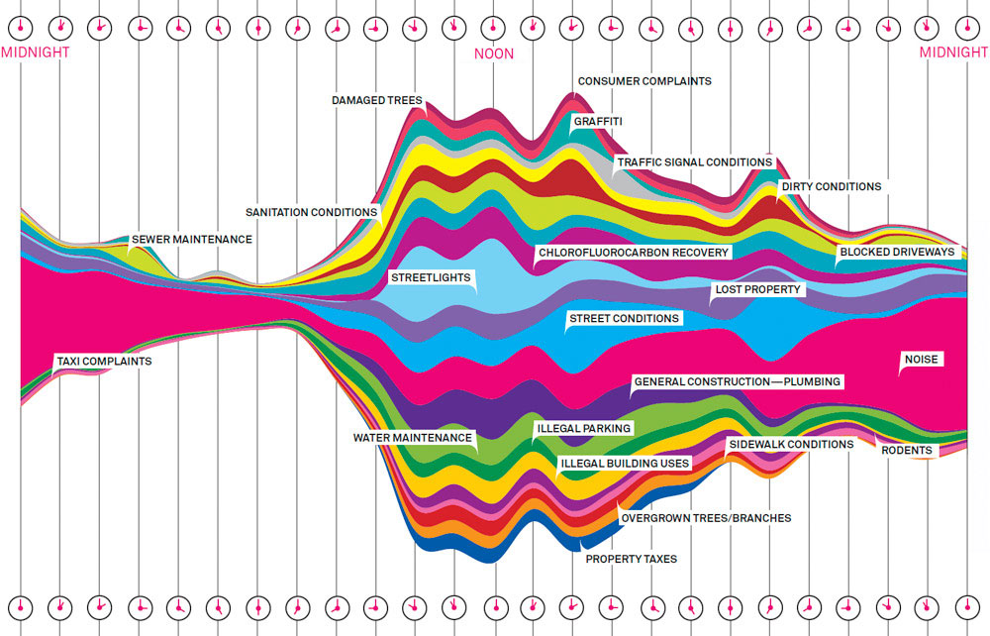
What calls to New York City 311 are about through the day

Slide 16
Big data from call centers (& web inquiries) can help improve services
Can serve as diagnostics to identify geographical areas with problems and also particular services
Can drive resource allocations
Can also provide geo-spatial clues to identify problems and solutions

