Slide 1
2015 World Development Report
Mind, Society and Behavior
Chiranthi Rajapakse Laleema Senanayake Radhika Gunawardena
http://www.worldbank.org/content/dam/Worldbank/Publications/WDR/WDR%202015/WDR-2015-Full-Report.pdf
13th January 2015
This work was carried out with the aid of a grant from the International Development Research Centre, Canada.

Slide 2
Overview
Part 1: Expanded understanding of human behavior for economic development: A conceptual framework
Part 2: Psychological and social perspectives on policy
Part 3: Improving the work of development professionals

Slide 3
Part 1 ; Understanding human behaviour for economic development
Thinking automatically
Thinking socially
Thinking with mental models

Slide 4
Two systems of thinking
Notes:
Automatic activities that are attributed to system 1; answer to 2+2 =? , Drive a car on an empty road, complete the phrase “bread and …”
System 2 operations; require attention are disrupted when attention is drawn away e.g. – Focus on the voice of a particular person in a crowded and noisy room, maintain a faster walking speed than is natural for you, compare two washing machines for overall value

Slide 5
A bat and ball cost $1.10. The bat costs $1.00 more than the ball.
How much does the ball cost?
Automatic system uses what comes quickly to mind to provide a plausible response

Slide 6
Which do we use more?
Routine situations?
“…(the deliberative system) would be a supporting character who believes himself to be the hero…the thoughts and actions that the deliberative system believes it has chosen are often guided by the figure at the centre of the story, the automatic system”
- Thinking, Fast and Slow, Daniel Kahneman

Slide 7
How do people make decisions?
Standard economic theory - people use information in an unbiased way and perform careful calculations.
But do people do this?

Slide 8
How do people make decisions?

Slide 9
Behavioral model of decision making
Several departures from the standard economic model
People may process only the information that is most salient to them
Mismatch between intentions and actions (the intention-action divide).
Even if people understand the full consequences of their actions
may make decisions that favor the present at the expense of the future

Slide 10
Why is this important for policy makers?
People may be powerfully influenced by the way that options are described
Simple changes in descriptions of options may change behavior
Limited power of merely providing information – confirmation bias

Slide 11
Policy mechanisms
Framing
Anchoring
Simplification
Reminders
Commitment devices

Slide 12
The automatic system relies on a framework of understanding

Slide 13
what our attention is drawn to
and what we focus on
are not always the things most needed for good decision making

Slide 14
Anchoring
Aspect of the environment that has no direct relevance to a decision BUT that nonetheless affects judgments. E.g. – the last thing that comes to mind
Implications for survey design
A. “How happy are you with life in general?”
B. “How often do you normally go out on a date?”
When question A asked first – no correlation between the answers
But if question B is asked first – answers highly correlated

Slide 15
Application: Consumer decisions in credit markets Field trial of payday borrowing in the United States
Notes:
A field trial of payday borrowing in the United States tried to remedy the factors that could potentially lead people to borrow more than they would actually want to if they assessed the full costs (Bertrand and Morse 2011).

Slide 16
The envelopes provided some anchoring to help borrowers evaluate the cost of payday loans
Notes:
The field trial randomly divided borrowers into groups. A control group received the standard payday loan company envelope with the cash and the paperwork
for their loan (figure 1.3, panel a). Another group received a cash envelope that showed, in addition, how the dollar fees accumulate when a loan is outstanding
for three months, compared to the equivalent fees for borrowing the same amount on a credit card (figure 1.3, panel b). The envelopes provided some anchoring to
help borrowers evaluate the cost of payday loans. The findings illustrate the “peanuts effect”: people do not consider the consequences of a small dollar
transaction because they view small amounts of money as “peanuts”; as a result, they incur high costs or forgo lucrative opportunities (Prelec and Loewenstein
1991).

Slide 17
Other factors that influence human behaviour
Thinking socially
Thinking with mental models

Slide 18
Thinking socially; social norms “I’ll have what she’s having”
Policies that take account of social norms better achieve development objectives.

Slide 19
“Marketing” existing social norms to shift behavior
Policies aimed at increasing tax revenues assumption that people are will evade taxes unless they face the right incentives
BUT expected penalties explain very little of the variation in compliance
Taxpaying = social norm involving conditional cooperation
cooperate to the degree that others are cooperating
When people feel that the tax system is fair and others are obeying the law
More likely to comply
In the United Kingdom, compliance increased when citizens received letters noting that most people in their postal code had already paid their taxes
Notes:
BIT (Behavioural Insights Team). 2012. Applying Behavioural Insights to Reduce Fraud, Error and Debt. London: Cabinet Office, BIT.

Slide 20
Example of social norms…corruption
“Presenting an interesting political theory, Disaster Management Minister Mahinda Amaraweera yesterday said voters must not topple this government as chances are minimum for corruption among UPFA members as they may have amassed ill lucre enough by now and if the UNP came to power, they would start afresh to make a killing.”
-Daily Mirror (2014-11-26)
Acceptance of corruption
Corruption in the social sense is a shared belief that using public office to benefit oneself and one’s family and friends is widespread, expected, and tolerated
Study in India; refusing to grant favors could subject a public official to complaints filed by constituents
Notes:
Wade, Robert. 1982. “The System of Administrative and Political Corruption: Canal Irrigation in South India.” Journal of Development
Studies 18 (3): 287–328.

Slide 21
Social meaning of an honest official = someone demanding no more than the going rate as a bribe Corruption may become automatic thinking for officials
Notes:
Where corruption is common, acting corruptly may become automatic thinking for officials.

Slide 22
Social expectations can become internalized
Diplomatic immunity
No legal obligation to pay for parking violations in New York City
Diplomats from countries where corruption is high had significantly more unpaid fines than those from countries where corruption is low
Notes:
Fisman, Raymond, and Edward Miguel. 2007. “Corruption, Norms, and Legal Enforcement: Evidence from Diplomatic Parking Tickets.” Journal of Political Economy 115 (6): 1020–48.

Slide 23
Mental Models
We generally use concepts that reflect the shared understandings of our community. We tend not to question views when they reflect an outlook on the world that is shared by everyone around us
Differ from social norms;
Mental models need not be enforced by direct social pressure
capture broad ideas about how the world works and one’s place in it
In contrast, social norms tend to focus on particular behaviors and to be socially enforced
E.g.; In some societies parents don’t think young children need extensive cognitive and linguistic stimulation- even norms against verbal engagement

Slide 24
The staying power of mental models
“… As I was boarding the plane I saw that the pilot was black. I had never seen a black pilot before, and the instant I did I had to quell my panic. How could a black man fly an airplane?”
- Nelson Mandela, Long Walk to Freedom
mental models can be passed down from generation to generation:
trust, gender, fertility, government

Slide 25
Changing mental models
Changing institutions
Changing mental models through the media
Through education and childhood interventions

Slide 26
Part II
Poverty
Early childhood development
Household Finance
Productivity
Health
Climate Change

Slide 27
Poverty
“Poverty is not simply a shortfall of money. The constant, day-to-day hard choices associated with poverty in effect “tax” an individual’s psychological and social resources. This type of “tax” can lead to economic decisions that perpetuate poverty”: WDR, 2015
Poverty is a fluid state, not a stable condition
Financial scarcity can
consume cognitive resources
Source: Jalan and Ravallion 2000; Pritchett, Suryahadi, and Sumarto 2000; Dercon and Krishnan 2000
Source: Mani and others 2013.

Slide 28
Implications of anti poverty policies and programs
Minimizing cognitive taxes for poor people
Avoiding poor frames
Incorporating social contexts into the design of programs
Targeting on the basis of bandwidth may help people make better decisions
Source: WDR 2015 team

Slide 29
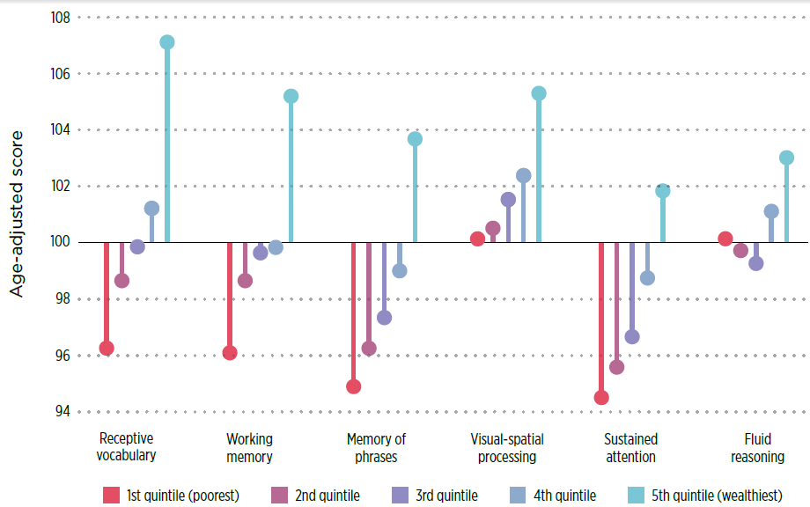
Early childhood development
“Children in poor families can differ dramatically from children in richer families in their cognitive and noncognitive abilities, resulting in enormous loss of human potential for themselves and society”: WDR, 2015
Variations by wealth in basic learning skills are evident by age three in Madagascar
Source: Fernald and others 2011

Slide 30
Designing interventions that focus on and improve parental competence
Complementing direct antipoverty programs
Changing mindsets, underlying belief systems, and mental models of parents’ role
Providing parents with the opportunity to learn and practice new skills and improve their mental health
Using complementary classroom-based interventions to support parental competence
A program in rural Senegal encourages parents to engage verbally with their children
Early childhood stimulation in Jamaica
resulted in long-term improvements in earnings
Source: WDR 2015 team, based on program material from the nongovernmental organization Tostan.
Source: Based on Gertler and others 2014

Slide 31
Household finance
“The consequences of biases in financial decision making can be profound for people
in poverty, or on the edge of poverty, because they lack a margin for error”: WDR, 2015
The human decision maker in finance
Losses loom larger than gains
Present bias: Overweighting the present
Cognitive overload and narrow framing
The social psychology of the advice relationship
Policies to improve the quality of household financial decisions
Framing choices effectively
Changing default choices can improve savings rates
Source: Bertrand and Morse 2011
Source: Thaler and Benartzi 2004

Slide 32
Productivity
“Understanding motivation and behavior at work requires us not only to zoom in
to examine cognitive and psychological barriers that individuals face and the
frames that work environments create but also to zoom out to examine the social contexts in which work takes place”: WDR, 2015
Unexpected wage increases can
trigger a productivity dividend
Altering the timing of purchases can be as effective as a subsidy for improving
investment
Source: Gilchrist, Luca, and Malhotra 2013
Source: Duflo, Kremer, and Robinson 2011

Slide 33
Health
“Telling people that there is a way to improve their health is rarely sufficient to
change behavior. Successful information campaigns are as much about social norms as they are about information”: WDR, 2015
Changing health behaviors in the face of psychological biases and social influences
Improving follow-through and
habit formation
Source: Ayers and others 2014
Source: Pop-Eleches and others 2011

Slide 34
Climate change
“An important role for psychological and social insights is to identify ways to convince populations to support, and governments to adopt, effective economic tools, such as carbon pricing, to curb greenhouse gas emissions”: WDR, 2015
Predicting the effect of rainfall forecasts on the success of growing familiar crops was difficult
for farmers in Zimbabwe
Source: Grothmann and Patt 2005

Slide 35
Part III
The biases of development professionals
Adaptive design, adaptive interventions

Slide 36
Do development professionals understand the circumstances in which the beneficiaries of their policies actually live, and the beliefs and attitudes that shape their lives?
A deeper understanding of the context that fit local conditions
Higher probability of succeeding

Slide 37
Development professionals can be susceptible to a host of cognitive biases, can be influenced by their social tendencies and social environments, and can use deeply ingrained mindsets when making choices.
Why is this important?
Because the decisions of development professionals often can have large effects on other people’s lives, it is especially important that mechanisms be in place to check and correct for those biases and influences.
Dedicated, well-meaning professionals in the field of development can fail to help, or even inadvertently harm, the very people they seek to assist if their choices are subtly and unconsciously influenced by their social environment, the mental models they have of the poor, and the limits of their cognitive bandwidth.

Slide 38
Challenges and the associated decision traps that affect them
The use of shortcuts in the face of complexity
Confirmation bias and motivated reasoning
Sunk cost bias
The effects of context and the social environment on group decision making
Each of these can be addressed through organizational measures itself.
The challenge that development organizations face is how to develop better decision making procedures and policy processes to mitigate these problems

Slide 39
The use of shortcuts in the face of complexity

Slide 40
Confirmation bias and motivated reasoning

Slide 41
Sunk costs bias

Slide 42
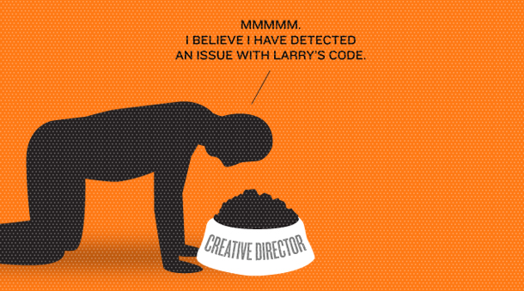
The effects of context and the social environment on group decision making

Slide 43
While the goal of development is to end poverty, development professionals are not always good at predicting how poverty shapes mindsets.
Determinants of behavior are often subtle and hard to detect. Better means of detection, starting with asking the right questions are needed.

Slide 44
Assumptions about why people behave the way they do
Policy

Slide 45
What can we do?
Concentrating more on the definition and diagnosis of problems, and expending more cognitive and financial investments at that stage, can lead to better-designed interventions
Testing during the implementation stage
…and tolerating failure can help identify cost effective interventions
Development organizations may need to change their incentive structures, budget processes, and institutional culture to promote better diagnosis and experimentation so that evidence can feed back into midcourse adaptations and future intervention designs.

Slide 46
What can we do? ….(cont)
The process of delivering products matter as much as the product itself
Effects and context on judgment and decision making
Focus groups
Being aware of the presence of biases and their consequences is the 1st step to addressing them
Asking the right questions
Treating failures as somewhat expected and as opportunities to learn helps let go of a failing project

Slide 48
This Report does not advocate specific interventions. Instead, it argues for the need to change the process of arriving at solutions, regardless of the nature of the problem
Conclusion: Learning and Adapting
Remember
R&D is not meant to yield immediate profits or improvements
R&D entails failure

Slide 49
Discussion/Brainstorming
2015 WDR Report – Why read it?
The theories discussed are not new
A great deal of real-life studies, which gives context to the topic
Demonstration of how Development Professionals think vs. the Reality on the Ground
How does this affect our work at LIRNEasia?

