Slide 1
Broadband Infrastructure in the ASEAN Region Markets, Infrastructure, Missing Links, and Policy Options for Enhancing Cross-Border Connectivity
Michael Ruddy
Director of International Research
Terabit Consulting

Slide 2
Part 1: Background and Methodology

Slide 3
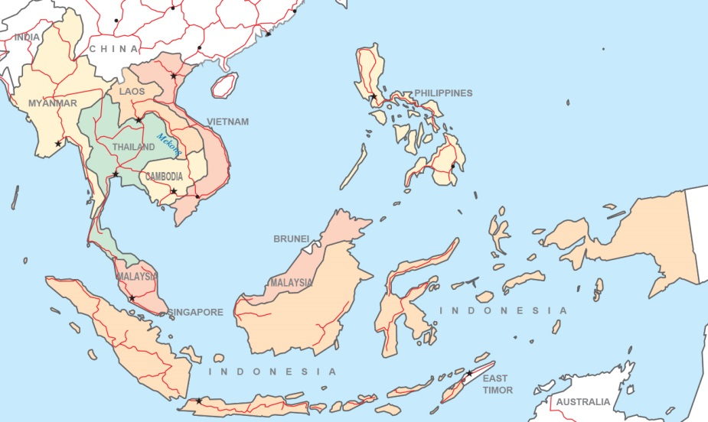
Project Scope
On behalf of UN ESCAP, Terabit Consulting performed a detailed analysis of broadband infrastructure and markets in the 9 largest member countries of ASEAN:
Cambodia
Indonesia
Lao PDR
Malaysia
Myanmar
Philippines
Singapore
Thailand
Vietnam

Slide 4
Scope (cont’d.)
The data and analysis for each country included:
Telecommunications market overview and analysis of competitiveness
Regulation and government intervention
Fixed-line telephony market
Mobile telephony market
Internet and broadband market
Consumer broadband pricing
Evaluation of domestic network connectivity
International Internet bandwidth
International capacity pricing
Historical and forecasted total international bandwidth
Evaluation of international network connectivity including terrestrial fiber, undersea fiber, and satellite
Evaluation of trans-border network development and identification of missing links

Slide 5
Sources of Data
Terabit Consulting has completed dozens of demand studies for submarine and terrestrial fiber networks worldwide
Constant contact with operators, ISPs, and other stakeholders
Terabit Consulting’s published reports include:
The Undersea Cable Report (1,500+ pages)
International Telecommunications Infrastructure Analysis (1,000+ pages)
Terabit Consulting’s data and intelligence regarding infrastructure, demand, traffic flows, pricing, and market share is unsurpassed

Slide 6
Part 2: State of the ASEAN-9 Bandwidth and Broadband Markets

Slide 7
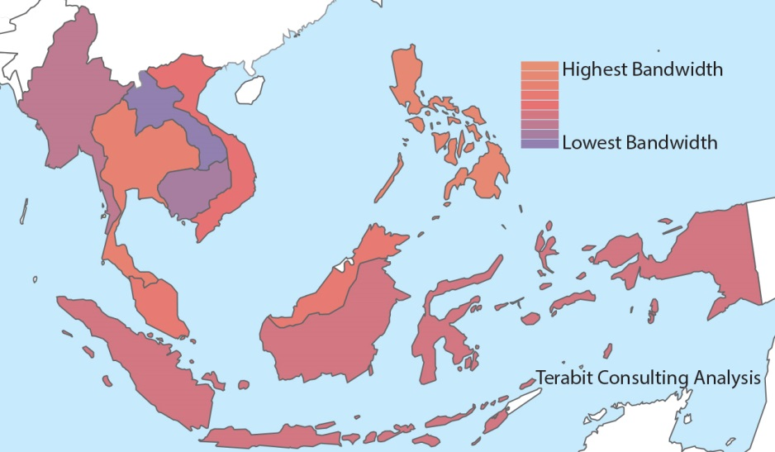
Int’l. Internet Bandwidth, Initial Research (2012)
Myanmar: 14 Gbps
Vietnam: 360 Gbps
Laos: 2.5 Gbps
Philippines: 560 Gbps
Thailand: 463 Gbps
Cambodia: 11 Gbps
Malaysia: 400 Gbps
Singapore: 1,389 Gbps
Indonesia: 250 Gbps

Slide 8
Int’l. Internet Bandwidth, Preliminary YE14 Est.
Myanmar: 32 Gbps
Vietnam: 875 Gbps
Laos: 13 Gbps
Philippines: 1,225 Gbps
Thailand: 1,215 Gbps
Cambodia: 22 Gbps
Malaysia: 920 Gbps
Singapore: 3,000 Gbps
Indonesia: 600 Gbps

Slide 9
Int’l. Internet Bandwidth per Capita (Kbps, YE14)
900 times difference between Myanmar and Singapore
Countries with 2.5 Kbps per Capita or Less: SERIOUS OBSTACLE TO DEVELOPMENT

Slide 10
Int’l. Internet Bandwidth per Capita in Central Asia
Difference between Turkmenistan and Azerbaijan: 180x
(Kbps)

Slide 11
Int’l. Internet Bandwidth per Capita in W. and So. Asia
Difference between Turkey and Bangladesh: 100x
(Kbps)

Slide 12
ASEAN: Int’l. Bandwidth Infrastructure
Singapore: By far, the strongest in the region
10 interregional submarine cables in service as of 2015, with 3 more under construction
7 additional regional systems (Malaysia/Indonesia)
Additional fiber via Causeway and Second Link
Philippines and Malaysia: Strong
PLDT has 3 cable stations, Globe has 2, Pacnet (Telstra) has 2
Malaysia served by FLAG, Sea-Me-We-3, SAFE, Sea-Me-We-4, APCN-2, Asia Submarine-Cable Express, AAG
Time dotCom shareholder in Unity transpacific cable
Thailand: Average
FLAG, Sea-Me-We-3, Sea-Me-We-4, AAG
Vietnam: Below average, but improving
Sea-Me-We-3 was supplemented by TGN-IA (2009) and AAG (2010)

Slide 13
ASEAN: Int’l. Bandwidth Infrastructure
Indonesia: Weak
Served by Sea-Me-We-3 but most other infrastructure routes through Singapore
Myanmar: Weak
Served by Sea-Me-We-3 and limited terrestrial connectivity
Planned Sea-Me-We-4 link via Bangladesh and planned Sea-Me-We-5 landing point; Mythic also under consideration by Campana Group (Singapore)
Cambodia and Lao PDR: Very Weak, with no direct interregional connectivity
Cambodian membership in AAG was too late, relies on Ezecom backhaul via Thailand and Vietnam
Lao PDR served exclusively by low-capacity terrestrial trans-border links

Slide 14
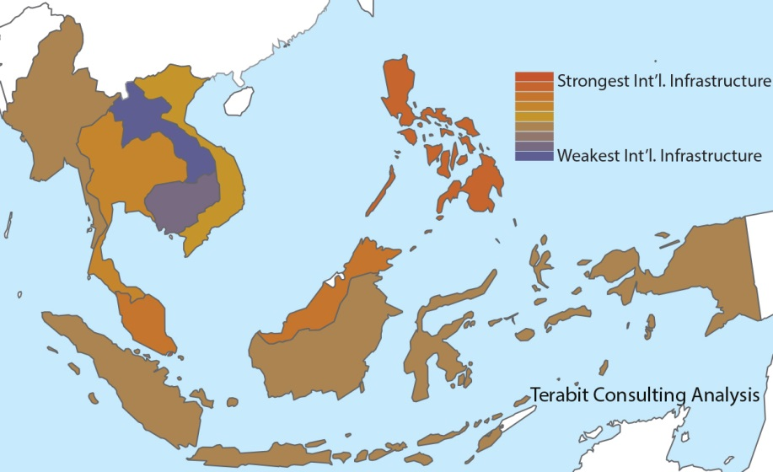
International Bandwidth Infrastructure
VN: BELOW AVERAGE
MM: WEAK
LA, KH: VERY WEAK
PH: STRONG
TH: AVERAGE
MY: STRONG
SG: VERY STRONG
ID: WEAK

Slide 15
The Impact of Low International Bandwidth & Weak International Infrastructure
At the macro level: a major obstacle to economic and human development
Detachment from digital economy
Continued economic inefficiencies and restrained growth
Lack of access to critical social tools including telemedicine, distance learning, scientific/research nets
More specifically within the telecom environment: higher wholesale and consumer prices, and lower broadband adoption rates
Cambodia, Lao PDR, Myanmar, and Vietnam: $50+ per Mbps wholesale
Compared to Singapore: $5 to $10 per Mbps

Slide 16
Weak Int’l. Bandwidth Impacts Consumer Pricing
1 Mbps Broadband Connection: Annual Subscription + Installation as a % of Per-Capita GDP (2013)
Higher Int’l. Bandwidth and/or Better Int’l. Infrastructure Yields Lower Consumer Broadband Prices

Slide 17
Overview of Broadband Status
 | GDP per Capita, YE 2014 (PPP, USD) | Int’l. Band-width per Capita (Kbps) | Int’l. Connect-ivity | Domestic Connect-ivity | IP Transit Price | Competitive-ness of Telecom Market | Fixed and Mobile Broad-band Infra-structure | Annual 1 Mbps Broadband Subscription + Installation as % of Nominal GDP per Capita (2013)
Cambodia | $3,200 | 1.5 | Weak | Adequate | Very Expensive | Reasonably Competitive | Very Limited | 48.7%
Indonesia | $10,500 | 2.4 | Weak | Adequate | Expensive | Competitive | Growing | 5.5%
Lao PDR | $5,000 | 1.9 | Weak | Limited | Very Expensive | Less Competitive | Very Limited | 27.4%
Malaysia | $24,000 | 31.0 | Excellent | Adequate | Reasonably Priced | Reasonably Competitive | Relatively Strong | 4.4%
Myanmar | $4,700 | 0.6 | Weak | Limited | Very Expensive | Newly Competitive | Limited | 132.8%
Philippines | $7,000 | 12.4 | Excellent | Relatively Strong | Very Expensive | Less Competitive | Growing | 11.2%
Singapore | $83,000 | 555.6 | Excellent | Very Strong | Inexpensive | Reasonably Competitive | Very Strong | 0.1%
Thailand | $14,300 | 18.1 | Average | Relatively Strong | Very Expensive | Reasonably Competitive | Average | 0.5%
Vietnam | $5,600 | 9.8 | Somewhat Weak | Limited | Expensive | Less Competitive | Limited | 7.9%

Slide 18
Part 3: Identification of Priority Cross-Border Terrestrial Links

Slide 19
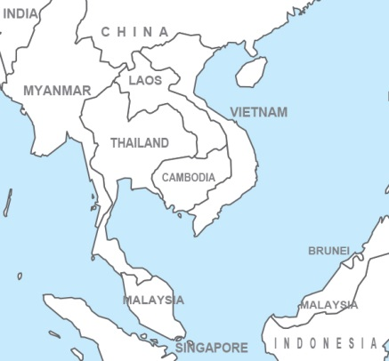
Priority Terrestrial Fiber Links
High Priority
Lao PDR to Yunnan
Indonesia to/from Malaysia
Medium Priority
Cambodia to Thailand
Lao PDR to Cambodia
Lao PDR to Myanmar
Myanmar to Thailand
Myanmar to Yunnan
Vietnam to Yunnan

Slide 20
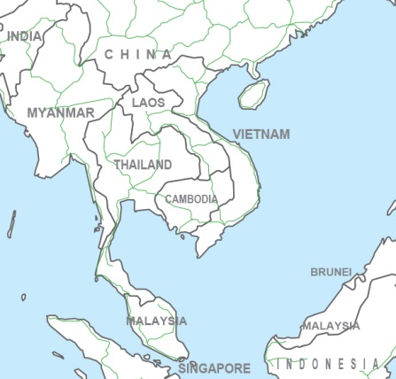
Envisioned Regional Fiber Network Based on Priority Trans-Border Links

Slide 21
Part 4: The Case for a Holistic, Pan-Asian Approach to Network Development

Slide 22
Understanding Int’l. Infrastructure in the Region
The vast majority of traffic is Internet Protocol
The majority of IP traffic is still destined for North America and Europe (i.e., location of most content)
Intra-Asian demand mostly destined for hubs (e.g. HK)
Bilateral, trans-border IP demand is minimal
Therefore: trans-border terrestrial links should be viewed holistically, as a means of
Accessing and supplementing interregional fiber networks
Increasing efficiency and equality and reducing prices
Providing redundancy and restoration paths to avoid submarine cable ‘choke points’
Terrestrial networks should not be evaluated on the merit of trans-border (bilateral) demand alone

Slide 23
Metcalfe’s Law: The Value of a Network is Proportional to the Square of the Number of Nodes
TERRESTRIAL EXPANSION TO EUROPE
INTEGRATION WITH REGIONAL AND TRANSOCEANIC SUBMARINE CABLES

Slide 24
Terrestrial as a Solution for Submarine
Source: The Undersea Cable Report 2015
by Terabit Consulting
The global telecommunications industry is desperate for a cost-effective solution that would avoid undersea choke points.

Slide 25
Overall Weakness of Existing Trans-Border Connectivity
Limited Geographic Scope
Most terrestrial links are trans-border, point-to-point
The region’s few multi-national networks fail to function coherently
Little or No Network Redundancy
Point-to-point links can only be used by operators who own alternative pathways; mesh network configuration is needed
Low Transmission Capacity
Typically 10 Gbps or less, preventing economies of scale and placing existing terrestrial links at a significant disadvantage to submarine
Lack of Open Access and Prohibitive Pricing
Most terrestrial is operated for the benefit of incumbent operators, and third parties are unable to access the networks cost-effectively
No Viable Intercontinental Terrestrial Bandwidth
Intercontinental traffic is aggregated over vulnerable subsea links

Slide 26
Part 5: The Case for Intervention to Ensure Network Development

Slide 27
Market Failure: Broadband Divide
Terabit Consulting’s analysis clearly reveals that low-cost, high-speed, and high-quality broadband services are concentrated in markets that are wealthy, urban, and/or coastal, while poor, rural, and/or inland markets are often neglected.
The analysis showed that the divide between the broadband “have” and “have-not” markets results in vast differences in:
international fiber connectivity, domestic connectivity, the pricing of IP transit capacity, the competitiveness of telecommunications and Internet markets, fixed and mobile broadband infrastructure, and the affordability of consumer broadband services.

Slide 28
The Need for Intervention
Intervention (by government or int’l. organizations) is required to ensure the implementation of a pan-Asian terrestrial fiber optic network for 5 reasons:
To overcome the region’s vast broadband inequality.
To ensure that the region receives broadband services on a par with more developed markets.
To finance or assist in financing a major capital project that is unlikely to be fully financed by the private sector.
To pool and leverage private-sector resources which are disparately insufficient.
To stimulate and facilitate future private investment through market development and maturation.

Slide 29
Options for Government/UN/DFI Participation
Asian Terrestrial Fiber Optic Connectivity
Construction of Coherent, Pan-Asian Terrestrial Fiber Network
Intervention by Government / Int'l. Organization to Ensure Implementation
Marketplace Left to Implement Its Own Coherent Solution
Continued Use of Fractured, Bilateral Terresrial Fiber Infrastructure
Full Government / Int'l. Organization Ownership and Project Management
Public-Private Partnership (PPP) / Private Sector Project Management
Choice of Project Design and Engineering, Supplier, Maintenance Authority, Operational Plan
Special Purpose Vehicle (SPV) with Government Shareholding (Investment)
Special Purpose Vehicle (SPV) with Government Contribution (Subsidy)
Build-Operate-Transfer (BOT)
Project Management Contract

Slide 30
Available Public-Private Partnership Options
Special Purpose Vehicle (SPV) Model with Government/Organizational Shareholding
Network operators form a special purpose vehicle to assume full responsibility for the development, operation, and maintenance of the pan-Asian terrestrial network.
Government, organizational, and/or developmental entities make capital contributions to the SPV and receive equity stakes and/or capacity on the network.
The contributor(s) receive a seat on the board of the SPV, thereby ensuring that policy goals are achieved.
A regulatory framework is adapted to ensure that the SPV’s outcome fulfills policy goals and improves the overall welfare of the region.
The contributor’s equity stake may be divested once certain milestones are achieved, or alternatively may be held until the winding-down of the SPV.
Special Purpose Vehicle (SPV) Model with Government/Organizational Contribution
Network operators form a special purpose vehicle with full responsibility for the pan-Asian terrestrial fiber optic network.
The government, organizational, and/or developmental entities make capital contributions to the SPV.
The contributor(s) do not receive equity or capacity on the network.
However, the contributor(s) do participate in the creation of the SPV’s governance framework, and receive a seat on the board of the SPV.
Mechanisms are instituted to ensure that policy goals are met.
Build-Operate-Transfer (BOT)
Following an open tender process, a concession is granted to one or more network operators for a fixed long-term duration (typically 20 years).
The network operators are assigned full responsibility for financing, operating, and maintaining the cable.
Certain market privileges may be accorded to the network operators.
The operators are allowed to retain all revenues during the period of its concession.
Once the concession agreement expires, ownership of the network is assigned to the government(s) at no cost.
Awarding of Project Management Contract
A tender is issued to select one or more network operators responsible for the construction, operation, maintenance, and commercialization of the pan-Asian terrestrial fiber optic network.
The contract recipient is paid to manage the cable and assume these responsibilities, including the sales of capacity to operators. The contract recipient’s management fees may be fixed or based on a percentage of revenue.
The network remains the property of the Government(s), which collect all profits (less management fees).

Slide 31
Part 6: Principles to Guide Network Development

Slide 32
Principles to Guide Future Network Development
Fully integrated and coherent
Mesh configuration to allow for in-network healing in the event of physical cable outages or political instability affecting connectivity in specific countries.
Functioning and monitored as single, uniform network
Existing multi-national terrestrial networks cannot offer uniform quality-of-service guarantees between endpoints (as good as “weakest link” or “weakest operator”).
Leveraging existing infrastructure
Right-of-way procurement and uniform construction techniques would be enabled through the use of the Asian Highway network, Pan-Asian Railway project, or power transmission networks.

Slide 33
Principles to Guide Future Network Development (Continued)
Cost-effective
With suitable transmission capacity and fiber count, a pan-regional terrestrial fiber network could compete effectively with submarine cable on both a regional and intercontinental basis.
Open access and non-discriminatory pricing
In order to achieve development and policy goals, as well as to serve the region’s consumers, all purchasers of capacity must be able to access the network on an equal, non-discriminatory basis.
Developed and managed by a Special Purpose Vehicle (SPV)
SPV shareholding would ensure the neutrality and efficiency of the network
Allows participation by all stakeholders while still maintaining arm’s-length terms over all capacity sales and leases.

Slide 34
Part 7: Gaining Support for the Project

Slide 35
Stakeholder Participation is Key
The study by Terabit Consulting identified 95 potential stakeholders in ASEAN-9 that should be involved in the project, including:
National Regulatory Authorities
Incumbent Operators and Major International Gateway Operators
Competitive Telecommunications Operators and ISPs
Road and Railway Authorities/Operators
Suppliers and contractors should also be consulted in the development stage.

Slide 36
Convincing Governments of the Project’s Advantages
Benefits to consumers
Myanmar, Cambodia, and Lao PDR: 1 Mbps of consumer broadband costs 132.8%, 48.7%, and 27.4% of per-capita GDP
Only Singapore and Thailand offered broadband access that is considered to be truly affordable.
Better, more cost-effective connectivity in the region will greatly reduce consumer prices in less developed markets and improve broadband reliability throughout the region.
Economic growth
Improvement in ICT infrastructure yields:
Increased demand for the output of other industries (demand multiplier)
New opportunities for production in other industries (supply multiplier)
New goods and services for consumers (final demand)
It also increases firms’ innovation capabilities and increases the probability of new products, innovations, and organizations

Slide 37
Convincing Governments of the Project’s Advantages (Continued)
Increased government revenue
Growth in economic output from ICT investment results in greater tax revenue
Increased employment in the telecommunications sector
Greater collections from telecom licenses and excise
Regional stability through better international and intercultural relations
More efficient routing of trans-border traffic would encourage trans-border initiatives in the education, healthcare, and research sectors that would not otherwise be possible.

Slide 38
Convincing the Private Sector of the Project’s Advantages
The network would offer the private sector reliable, high-capacity international fiber paths across all borders
Compared to low-capacity, less-reliable links currently in service
The network would finally provide a cost-effective alternative to undersea cable “choke points”
Of interest not only to operators, but communications-critical industries (e.g. finance)
Commercial arguments can be made on a case-by-case basis to win support of incumbent operators wary of competition.

Slide 39
Terabit Consulting’s Overall Thoughts
Terabit Consulting has worked on dozens of key fiber infrastructure projects in every region of the globe
The Pan-Asian network opportunity is among the strongest it has seen
Commercially viable; initial evaluation of business case inputs are very positive
The network would be critical to ensure greater broadband equality, promote regional economic/social development
Urgently needed by global telecommunications operators who must compensate for submarine cable choke-points
Urgently needed by governments and communications-critical industries who are compromised by submarine cable choke-points
However, the project can only be achieved with persuasive intervention by UNESCAP and governments

Slide 40
Thank you!

