Slide 1
Enabling Healthy Internet Access
Doug Madory, Director of Internet Analysis
June 2015
CommunicAsia 2015, Singapore

Slide 2
What contributes to a Healthy Internet?
Resiliency and performance of links to the global Internet
Policies that promote competition improve affordability and growth
Locally hosted content can be delivered faster and support the local Internet economy

Slide 3
RESILIENCY AND
PERFORMANCE

Slide 4
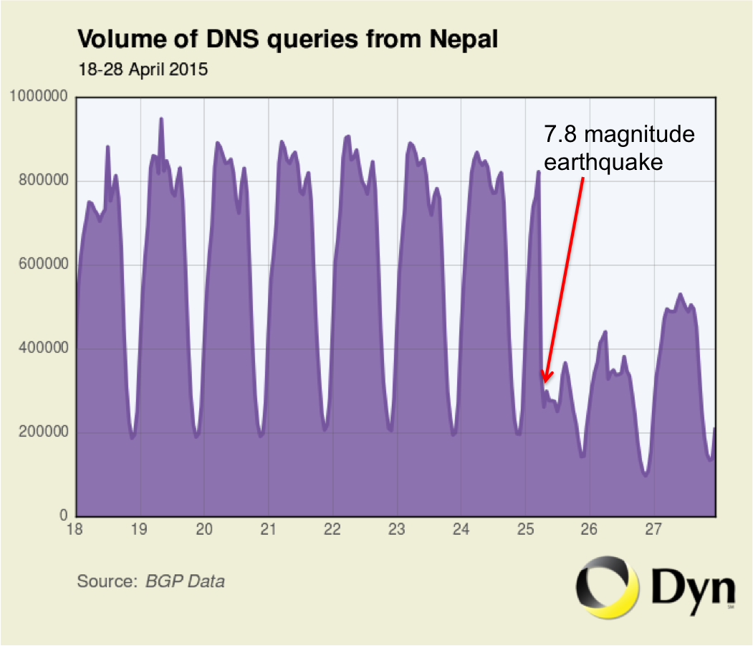
Resilient Links
Devastating earthquake in Nepal damaged “last-mile” connectivity, but international links stayed up
Like Bhutan, Nepal connects exclusively through India, but is pursuing Chinese terrestrial transit.
http://research.dyn.com/2015/04/earthquake-rocks-internet-in-nepal/

Slide 5
Resilient Links
Had the links to India gone down, then establishing redundant links to China would be at the forefront of present discussions about the resiliency of the Nepali Internet
http://research.dyn.com/2015/04/earthquake-rocks-internet-in-nepal/

Slide 6
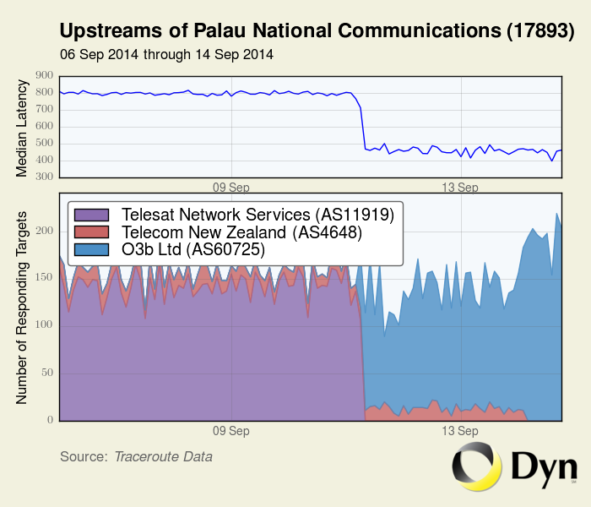
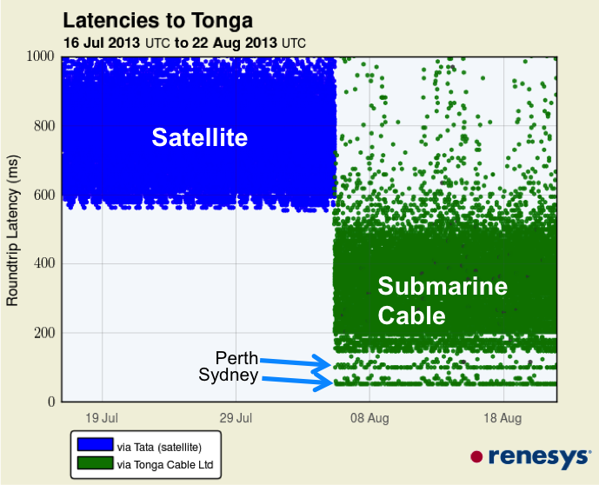
Performance / Infrastructure Improvements
New submarine cable connections in the region and advancements in medium-earth-orbit satellite service greatly improving connectivity
Low-latency satellite
http://research.dyn.com/2013/10/subsea-cables-add-resilience/
http://research.dyn.com/2015/01/faster-satellite-service-next-billion/

Slide 7
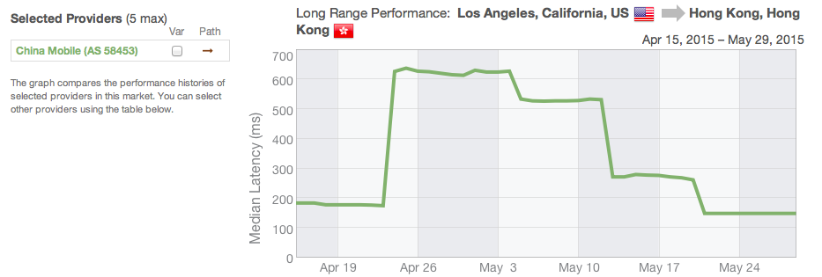
Performance Require Vigilance
China Mobile gains transit from TeliaSonera in April
But initially, traffic routing the wrong way around the world
Carriers need visibility to detect and understand suboptimal routing

Slide 8
POLICIES FOR GROWTH

Slide 9
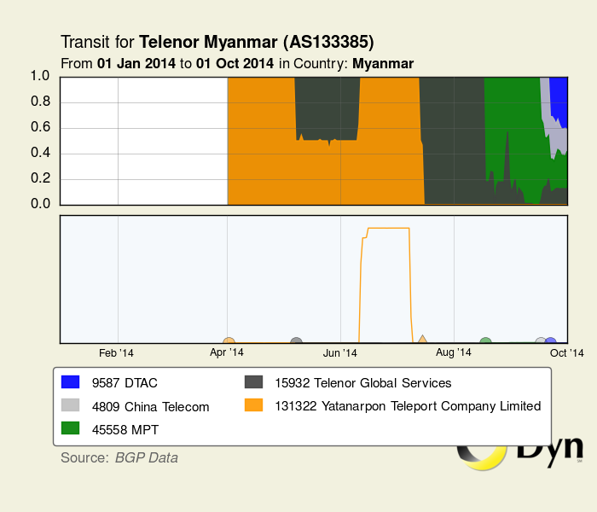
Policies to foster open markets - Myanmar
Opening up of Myanmar politically
• Beginning with government reforms Aug 2011
The last big green field in telecom
• Country of 60 million with almost no telecom
June 2013: 1st private telecom concessions awarded
• Telenor and Ooredoo win bids to become first independent mobile operators in Myanmar
• Telenor activates in spring 2014*
• Ooredoo appears in summer 2014
• Incumbent MPT cuts tariffs to compete
http://research.dyn.com/2014/03/telenor-activates-historic-link-myanmar/

Slide 10
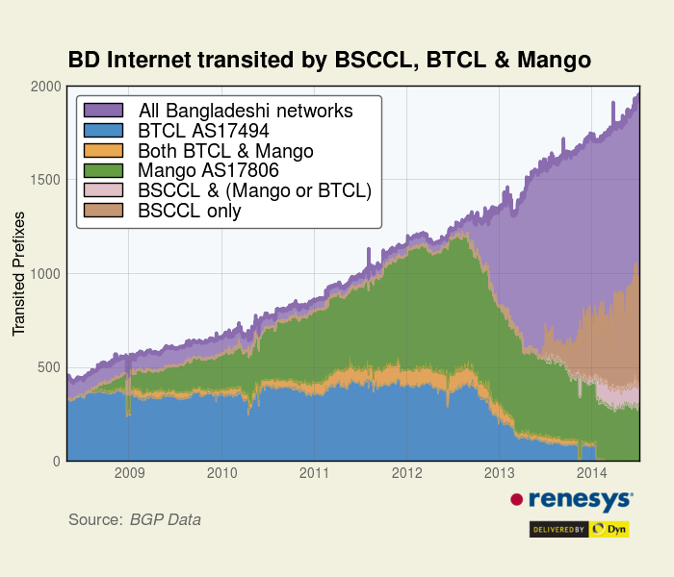
Policies to foster open markets - Bangladesh
Bangladesh market prior to 2013
• Dominated by BTCL, Mango
• Subject to national outages during
submarine cable maintenance
Terrestrial link to India established*
• Has completely eliminated national outages due to submarine cable downtime
• Licenses first given to smaller competitors like Fiber@Home
Telecom regulatory policies have remade the Internet in Bangladesh
http://research.dyn.com/2013/01/bangladesh-connects-via-india/

Slide 11
CONTENT ON THE EDGE

Slide 12
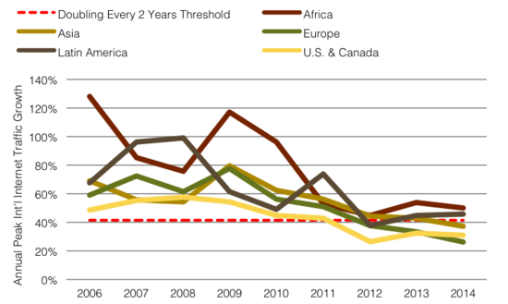
Content on the Edge
Telegeography reports slowing of growth of demand on core links of the Internet
Cisco predicts annual Internet Protocol (IP) traffic will triple between 2014 and 2019**
How to reconcile these trends?
* https://www.telegeography.com/press/press-releases/2012/09/06/global-internet-capacity-reaches-77-tbps-despite-slowdown/index.html
** http://newsroom.cisco.com/press-release-content?type=webcontent&articleId=1644203

Slide 13
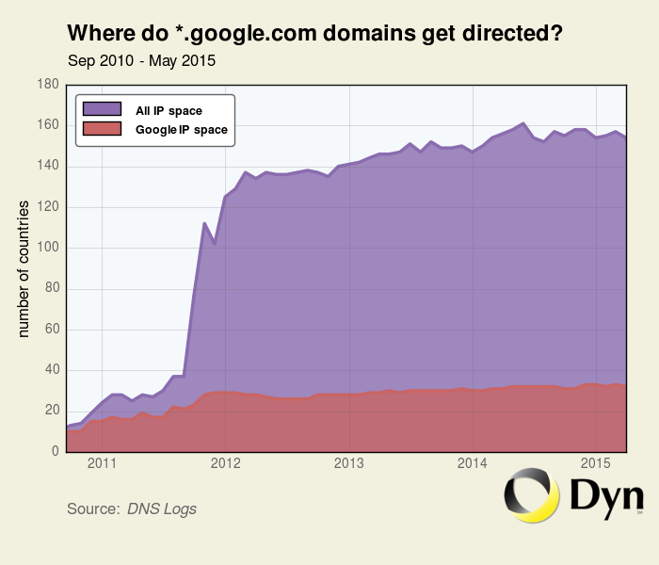
Content on the Edge
Growth of CDN caching nodes bringing content closer to users, alleviating demand on links
At the forefront: Google Global Cache servers operating in 1,000’s of networks in over 150 countries
Count of countries with GGC nodes not hosted by Google

Slide 14
WHERE IS CONTENT
HOSTED IN 2015…
…AND WHY?

Slide 15
Content Can Be Hosted Locally .. Or Far Away
Price and availability of local hosting
Servers
Power
Expertise
Regulation
“Critical Mass”
Overhead of remote hosting
Latency (speed of light)
International transit costs
Photo © Emilian Vicol

Slide 16
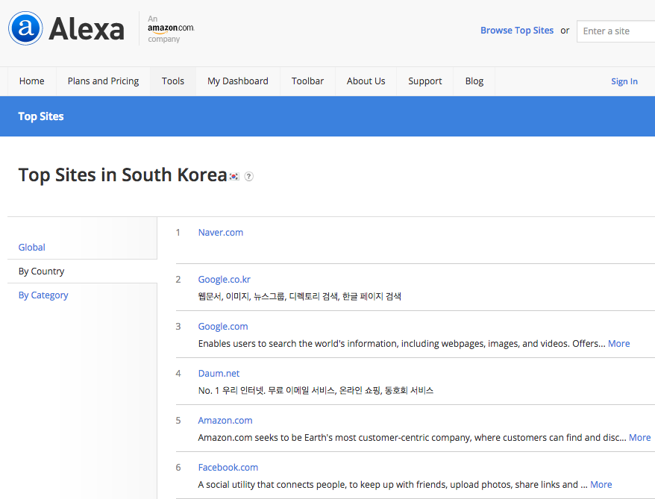
Let’s Take A Snapshot of Global Content
Identify the top 100 domains accessed in each country on earth, per Alexa
Resolve them to IP addresses using resolvers in that country
Geolocate the country of origin for that content
Use BGP Routing to identify the originating provider for the address space

Slide 17
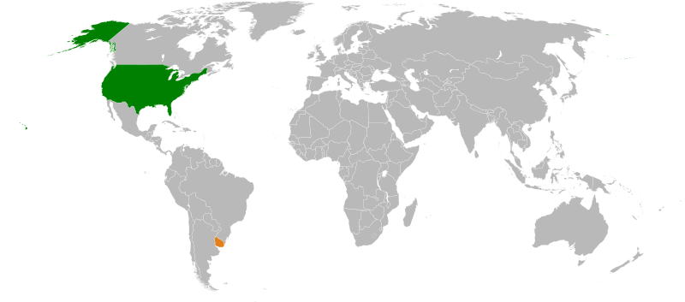
Example: Uruguay
Facebook.com
Google.com.uy
Google.com
Youtube.com
Mercadolibre.com.uy
ElPais.com.uy
Amazon.com
Live.com
Twitter.com
Yahoo.com

Slide 18
Example: Uruguay
Facebook.com
Google.com.uy
Google.com
Youtube.com
Mercadolibre.com.uy
ElPais.com.uy
Amazon.com
Live.com
Twitter.com
Yahoo.com
..+ local CDN

Slide 19
Example: Uruguay
Facebook.com
Google.com.uy
Google.com
Youtube.com
Mercadolibre.com.uy
ElPais.com.uy
Amazon.com
Live.com
Twitter.com
Yahoo.com
..+ local CDN
Localization of common domains via DNS, with servers in-country

Slide 20
Example: Uruguay
Facebook.com
Google.com.uy
Google.com
Youtube.com
Mercadolibre.com.uy
ElPais.com.uy
Amazon.com
Live.com
Twitter.com
Yahoo.com
..+ local CDN
Localization of common domains via DNS, with servers in-country
Note that the .UY top level domain is no guarantee of Uruguayan hosting

Slide 21
Example: Uruguay
Facebook.com
Google.com.uy
Google.com
Youtube.com
Mercadolibre.com.uy
ElPais.com.uy
Amazon.com
Live.com
Twitter.com
Yahoo.com
..+ local CDN
Localization of common domains via DNS, with servers in-country
Note that the .UY top level domain is no guarantee of Uruguayan hosting
Foreign content

Slide 22
Example: Uruguay
Facebook.com
Google.com.uy
Google.com
Youtube.com
Mercadolibre.com.uy
ElPais.com.uy
Amazon.com
Live.com
Twitter.com
Yahoo.com
11-50: US (50%), Uruguay (32%), Argentina (8%), other (10%)
51-100: US (62%), Uruguay (12%),
Argentina (8%), Spain (6%),
other (12%)

Slide 23
Example: Uruguay
Overall: 22% self-hosted content
Virtually all the rest comes from North America

Slide 24
Regional Self-Hosting Percentages
North America .. 84%
Western Europe .. 59%
East Asia (incl China) .. 57%
Eastern Europe .. 48%
Oceania .. 32%
Middle East .. 27%
South America .. 25%
South Asia .. 15%
Africa .. 11%
Worldwide national median is 33%

Slide 25
WHY MIGHT THIS
CAUSE A PROBLEM
FOR ENDUSERS?

Slide 26
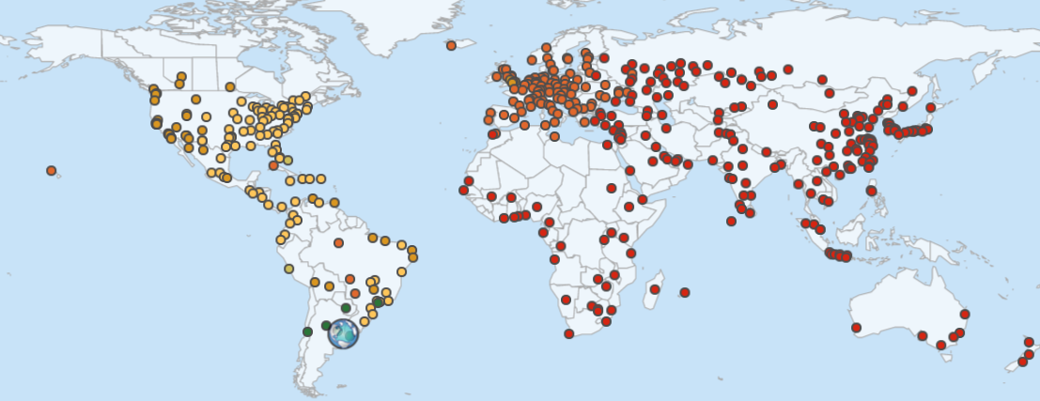
Nonlocal hosting impacts customer experience!
Typical latencies from Montevideo:
150-190ms (US East)
200-230ms (US West)
150-190ms
200-230ms
South America’s dominant connectivity is North-South
Regional connectivity is inconsistent at best

Slide 27
More Than 2/3 of Hot Global Content “lives” in North America/Western Europe (% of Alexa 100 across all countries)
‘Other:’
Middle East …2%
South America …2%
South Asia/Oceania …2%
Central America/Caribbean …1%
Africa …0.5%
Central Asia …0.5%
Private/unknown …2%

Slide 28
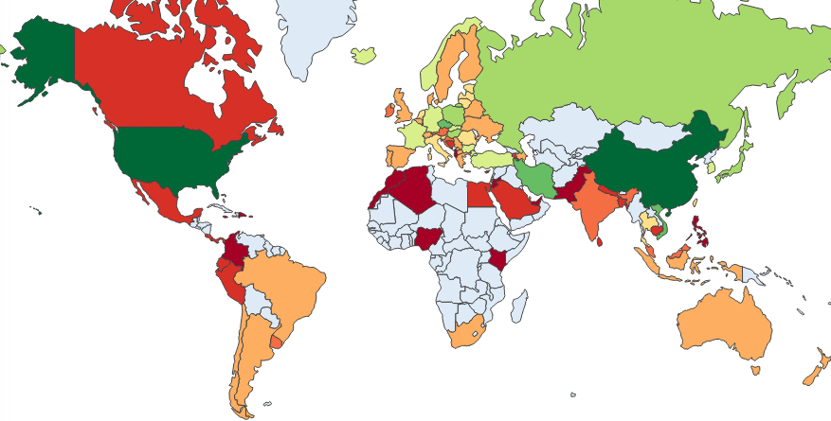
Self-Hosting % of Alexa Top 100
Russia: 55%
USA (90%) suppresses local hosting for the Western Hemisphere:
Canada (16%) Mexico (17%)
Panama (15%)
Costa Rica (15%)
Colombia (8%)
Median: 33%
China: 85%
Iran: 65%
Vietnam: 71%
Uruguay: 22%

Slide 29
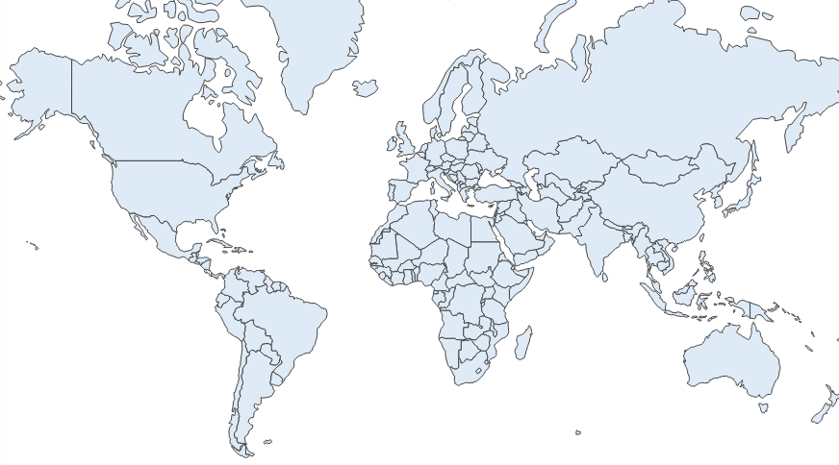
Self-Hosting % of Alexa Top 100
Russia: 55%
USA (90%) suppresses local hosting for the Western Hemisphere:
Canada (16%) Mexico (17%)
Panama (15%)
Costa Rica (15%)
Colombia (8%)
84%
10%
Median: 33%
China: 85%
Iran: 65%
Vietnam: 71%
North America

Slide 30
Self-Hosting % of Alexa Top 100
Russia: 55%
USA (90%) suppresses local hosting for the Western Hemisphere:
Canada (16%) Mexico (17%)
Panama (15%)
Costa Rica (15%)
Colombia (8%)
59%
Median: 33%
China: 85%
35%
Iran: 65%
Vietnam: 71%
Western Europe

Slide 31
Self-Hosting % of Alexa Top 100
Russia: 55%
USA (90%) suppresses local hosting for the Western Hemisphere:
Canada (16%) Mexico (17%)
Panama (15%)
Costa Rica (15%)
Colombia (8%)
21%
48%
Median: 33%
30%
China: 85%
Iran: 65%
Vietnam: 71%
Eastern Europe

Slide 32
Self-Hosting % of Alexa Top 100
Russia: 55%
USA (90%) suppresses local hosting for the Western Hemisphere:
Canada (16%) Mexico (17%)
Panama (15%)
Costa Rica (15%)
Colombia (8%)
17%
Median: 33%
China: 85%
47%
Iran: 65%
27%
Vietnam: 71%
The Middle East

Slide 33
Self-Hosting % of Alexa Top 100
Russia: 55%
USA (90%) suppresses local hosting for the Western Hemisphere:
Canada (16%) Mexico (17%)
Panama (15%)
Costa Rica (15%)
Colombia (8%)
Median: 33%
52%
China: 85%
30%
Iran: 65%
11%
Vietnam: 71%
Africa

Slide 34
Self-Hosting % of Alexa Top 100
Russia: 55%
USA (90%) suppresses local hosting for the Western Hemisphere:
Canada (16%) Mexico (17%)
Panama (15%)
Costa Rica (15%)
Colombia (8%)
Median: 33%
10%
China: 85%
85%
Iran: 65%
Vietnam: 71%
China

Slide 35
Self-Hosting % of Alexa Top 100
Russia: 55%
USA (90%) suppresses local hosting for the Western Hemisphere:
Canada (16%) Mexico (17%)
Panama (15%)
Costa Rica (15%)
Colombia (8%)
15%
Median: 33%
60%
China: 85%
5%
Iran: 65%
Vietnam: 71%
15%
South Asia

Slide 36
Self-Hosting % of Alexa Top 100
Russia: 55%
USA (90%) suppresses local hosting for the Western Hemisphere:
Canada (16%) Mexico (17%)
Panama (15%)
Costa Rica (15%)
Colombia (8%)
6%
Median: 33%
46%
China: 85%
8%
Iran: 65%
36%
Vietnam: 71%
East Asia

Slide 37
HOW IS THE HOSTING
INDUSTRY RESPONDING?

Slide 38
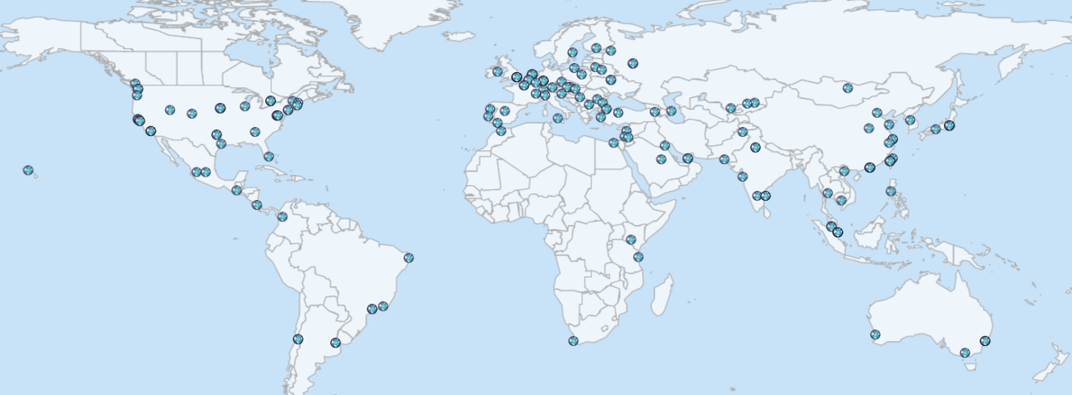
Overlapping 100ms coverage zones Measured from Amazon AWS locations

Slide 39
Consumer Markets with High Growth, Limited Coverage: South America Subsaharan Africa Middle East India Central Asia

Slide 40
PUTTING IT ALL
TOGETHER

Slide 41
What contributes to a Healthy Internet?
Resiliency and performance of links to the global Internet
Policies that promote competition improve affordability and growth
Locally hosted content can be delivered faster and support the local Internet economy

Slide 42
A Few Modest Predictions for 2020
Projects such as OpenStack will create a deep bench of emerging markets with hosting expertise.
The desire to host applications locally will resonate with national regulators, and will be good business for both incumbents and challengers.
Instead of 5 or 10 hosting zones to choose from, there will be hundreds worldwide .. close to any audience.

