Slide 1
Origin-Destination matrix estimation in Sri Lanka using mobile network big data
Danaja Maldeniya, Sriganesh Lokanathan and Amal Kumarage (Phd)
13th International Conference of IFIP working group 9.4
22nd May 2015
This work was carried out with the aid of a grant from the International Development Research Centre, Canada and the Department for International Development UK..

Slide 2
Big data
An all-encompassing term for any collection of data sets so large or complex that it becomes difficult to process using traditional data processing applications. The challenges include analysis, capture, curation, search, sharing, storage, transfer, visualization, and privacy violations. Examples:
100 million Call Detail Records a day generated by Sri Lanka companies
45 Terabytes of data from Hubble Telescope

Slide 3
Why big data? Why now?
Proximate causes
Increased “datafication”: Very large sets of schema-less (unstructured, but processable) data now available
Advances in memory technology: No longer is it necessary to archive most data and work with small subset
Advances in software: MapReduce, Hadoop

Slide 4
If we want comprehensive coverage of the population, what are the sources of big data in developing economies?
Administrative data
E.g., digitized medical records, insurance records, tax records
Commercial transactions (transaction-generated data)
E.g., Stock exchange data, bank transactions, credit card records, supermarket transactions connected by loyalty card number
Sensors and tracking devices
E.g., road and traffic sensors, climate sensors, equipment & infrastructure sensors, mobile phones communicating with base stations, satellite/ GPS devices
Online activities/ social media
E.g., online search activity, online page views, blogs/ FB/ twitter posts

Slide 5
Currently only mobile network big data has broad population coverage
 | Mobile SIMs/100 | Internet users/100 | Facebook users/100
Myanmar | 13 | 1 | 4
Bangladesh | 67 | 7 | 6
Pakistan | 70 | 11 | 8
India | 71 | 15 | 9
Sri Lanka | 96 | 22 | 12
Philippines | 105 | 39 | 41
Indonesia | 122 | 16 | 29
Thailand | 138 | 29 | 46
Source: ITU Measuring Information Society 2014; Facebook advantage portal

Slide 6
What is Mobile Network big data ?
Visitor Location Registry (VLR)
A recorded is generated every time a mobile phone comes within range and makes contact with a base station. No user intervention is required. Due to extremely large volumes Sri Lankan operators flush these records periodically.
Call Detail Records (CDR)
A record is generated every time an individual uses a mobile phone to receive or make a call, use the internet or send a text. Used by operators for billing purposes

Slide 7
Data used in the research
Multiple mobile operators in Sri Lanka have provided four different types of meta-data
Call Detail Records (CDRs)
Records of calls
SMS
Internet access
Airtime recharge records
No Visitor Location Register (VLR) data
Data sets do not include any Personally Identifiable Information
All phone numbers are pseudonymized
LIRNEasia does not maintain any mappings of identifiers to original phone numbers
Cover 50-60% of users; very high coverage in Western (where Colombo the capital city in located) & Northern (most affected by civil conflict) Provinces, based on correlation with census data

Slide 8
What does a CDR look like ?
Call Direction | Calling Party Number | Called Party Number | Cell ID | Call Time | Call Duration
1 | A24BC1571X | B321SG141X | 3134 | 13-04-2013 17:42:14 | 00:03:35

Slide 9
Mobile network big data + other data ➔ rich, timely insights
Mobile network big data
(CDRs, Internet access usage, airtime recharge records)
Other data sources
Insights
Census data
HIES data
Survey maps
Transportation schedules
++++
Urban & transportation planning
Socio-economic monitoring
Crisis management & DRR
Health monitoring & planning
Financial inclusion
Construct behavioral variables
Mobility variables
Social variables
Consumption variables
Analytics

Slide 10
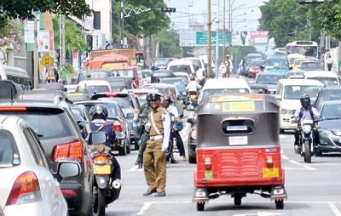
Congestion : an emerging issue in Sri Lanka
Congestion is expensive
Results in
Wasted fuel
Wasted time for commuters
Loss of productivity for businesses (delivery/ production)
In 2011, the cost of congestion in the Western Province was approximately LKR 32 billion (USD 285 million), an average of LKR 10,000 per person per year
Source: Kumarage (2011)
9

Slide 11
Traditional Transport Forecasting
Focus on data from travel and land use surveys and census
A set of steps that converts this data into predictive transport models for forecasting using analytical methods (Four Step Approach)
Four Step Approach
Trip Generation
Predict volume of trip generations and attractions at a traffic analysis zone.
Trip Distribution
Predict volume of trips between pairs of traffic analysis zones
Mode Choice
Predict the likelihoods of trips between locations being undertaken by different modes of travel such as private/public transport
Route Assignment
Assign estimated trips to the road network for traffic estimation.

Slide 12
MNBD has numerous advantages over traditional data collection
Inexpensive
Supports frequent updates to forecasts
Greater spatial/temporal detail
Capable of providing insights at multiple stages of traditonal forecasting
Forecasts for areas currently not covered under traditional approaches at no additional cost

Slide 13
Estimating Origin-Destination Matrices with MNBD
O-D matrices are the output for the “Trip Distribution” step (2nd step) of the traditional forecasting approach.
Matrix of person flows between traffic analysis zones.
In this research we used two approaches for capturing human mobility with MNBD
Stay based approach
Transient approach

Slide 14
Stay based O-D estimation
The daily trajectory of an individual can be imagined as composed of trips between locations where he/she is stationary for some meaningful amount of time.
We use CDR records for each individual to identify stays consisting of a geographical location associated with a specific time period during which the individual was stationary

Slide 15
Stay based O-D estimation Cont.…
In terms of the CDRs for an individual, a stay is identified by a continuous series of records such that,
Two contiguous records in the series are less than a distance D apart, where D = 1km.
Two contiguous records are separated by a time interval T_{Interval} such that,
10 minutes ≤ T_{Interval} ≤ 1 hour
Each pair of consecutive stays for an individual for a day is considered the origin and destination of a trip.

Slide 16
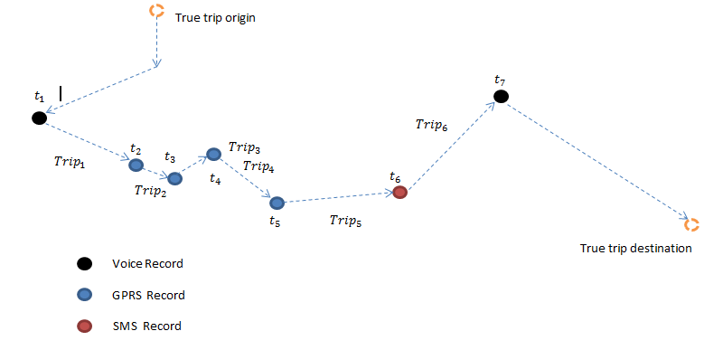
Transient O-D estimation
We identify individual “trips” by considering consecutive call/ GPRS/ SMS events with spatio-temporal constraints
Trips are transient, i.e they don’t necessarily represent actual trips of a person, but at the very least capture segments
11

Slide 17
Transient O-D estimation
A trip is, a pair of consecutive events where a displacement occurs for a user which is more than 10mins and less than 1hr apart
This approximates actual trips
This also minimizes false positives where consecutive events are served by different neighbouring towers when the user is stationary
Trips are aggregated considering base stations as origins and destinations
Trips are aggregated daily and hourly as Origin-Destination (OD) matrices
12
Notes:
why r u repeating what is on slide 6?

Slide 18
Stay based approach vs. Transient O-D approach
Stay based approach | Transient O-D
Trips more aligned with actual travel | Trips are transient, results more appropriate for flow analysis
Tighter spatio-temporal constraints result in relatively small number of trips captured | More mobility information extracted from MNBD
Spatial constraints partially mitigates localization errors | Results are subject localization errors, effective estimates for short trips

Slide 19
Validation
Flows estimated based on 1 month of data for nearly 10 million SIMs were compared with then best available validation data (Trip generations for the Western Province)
Adjusted R²
Stay based approach = 0.82
Transient O-D approach = 0.85

Slide 20
Circadian Rhythm of transport demand
Weekly
Transient O-D approach

Slide 21
Circadian Rhythm of transport demand
Daily
Transient O-D approach

Slide 22
Mobility in the Western Province on a regular weekday

Slide 23
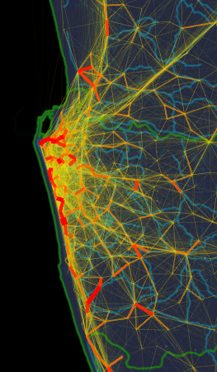
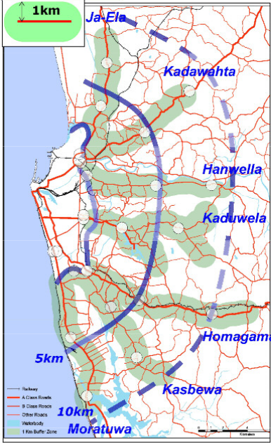
Mobility visualization for Colombo District
identifies transport corridors
Source: COMTRANS report,2013, Ministry of Transport
Low
High
20
Notes:
Followed by key locations at given times

Slide 24
Transport forecasting with MNBD: challenges and possible solutions
Localization errors due to same area being served by multiple base stations at different times
Decrease spatial resolution
Identify and filter unrealistic movement
Data sparsity (90% of subscribers have less than 25 records daily)
Interpolation techniques
Probabilistic models of mobility (Ex : HMM)
Variation of base station densities by region
Adjust resolution of analysis, limits type of analyses by region

Slide 25
Transport forecasting with MNBD: challenges and possible solutions
Sampling bias : bias towards activity, mobile penetration
Adjusting for mobile penetration by using resident mobile users and census population
Survey relating mobility to calling behavior (Shibasaki lab. U of Tokyo)

Slide 26
Reproducibility
MNBD is private data owned by operators who have concerns about sharing
competitive value
privacy of subscribers
Data used in research
provided with strict non-disclosure conditions
No demographic information
Bare bones CDR
In developed countries,
sharing/selling normalized aggregate mobility and other information (based on analysis) generated in house or an intermediary (Ex : Airsage)

Slide 27
Current and Future work
Estimating O-D based on regular mobility
Predicting travel motives using land usage data
Understanding impact of shocks and crises on mobility
Predicting infectious disease propagation

