Slide 1
Group-02
Government e-services and Applications that are of value to Sri Lankan users
“Feasibility of making government services available to citizens electronically and recommend services and applications that are of value to Sri Lankan users”
Team Members
Ariaratnam Wilfred Arjun
Chameera Madushan Wijerathna
Piyumi Nisansala Gamage
Kasun Sameera Hettiarachchi

Slide 2
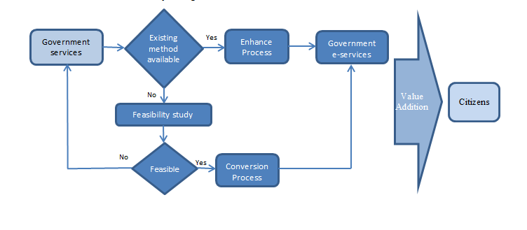
Methodology of converting Government services to e-services

Slide 3
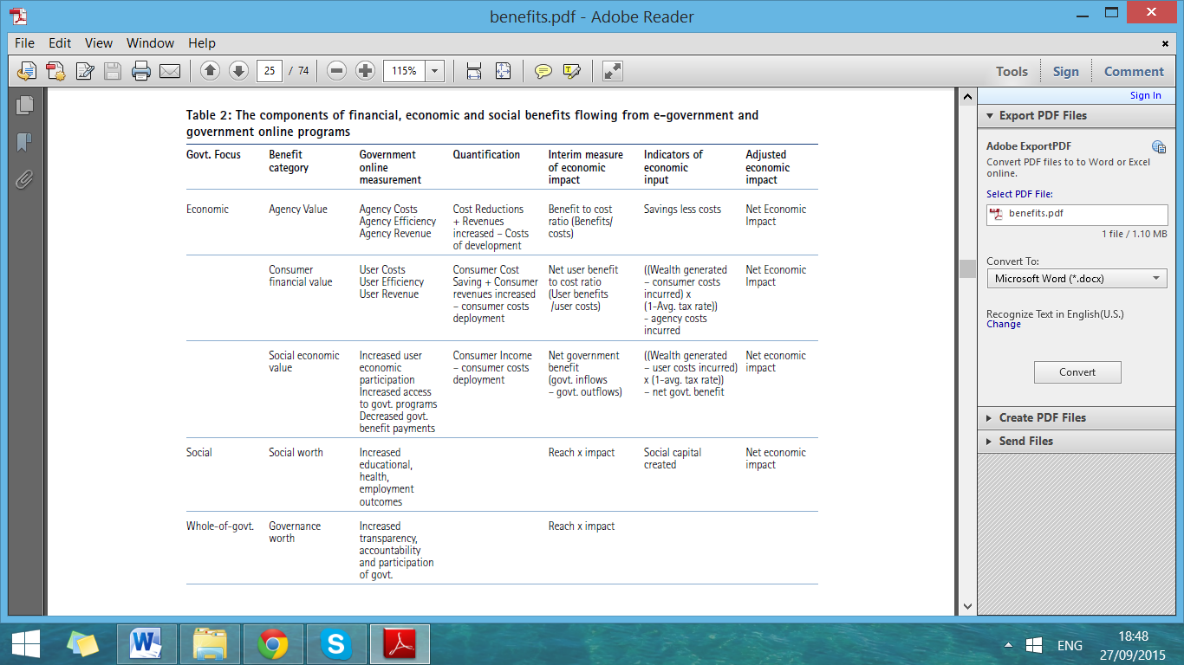
Feasibility of introducing e-government services
Source: Australian Government report on E-benefits

Slide 4
The Sectors which Need e-services
01.Health- http://www.health.gov.lk/
02.Judiciary- http://www.justiceministry.gov.lk/
03.Power and Energy- http://powermin.gov.lk/english/
04.Agiriculture- http://www.agrimin.gov.lk/
05.Education- www.moe.gov.lk
06.Labour- http://www.labourmin.gov.lk/web/
07.Immigration and Emigration- http://www.immigration.gov.lk/
08.Transport- http://www.transport.gov.lk/

Slide 5
Ministry of Power and Energy
Update on unplanned power cuts
SMS notification with recovery time and reason of power cutoff .
Assists to plan on alternative source of power based upon the time it takes to recover.
2551.3 activity hours for the last 13 days in September. #CEB official outage details
Planned power cuts notification
58% in LK do not get an advance notice about power cuts.#LIRNEasia
34% of industrial electricity users in terms of power usage as at 2011.#PUCSL
Non prior notification directly hits with business.
Red Notice reminder via a SMS
Personal login for each consumer
Average usage
Equipment wise bill calculation
Power saving promotions
E-payments

Slide 6
Electricity Sector
 | 2010 |  | 2011
 | Users | Percentage | Users | Percentage
Domestic Users | 4,363,324 | 88.06% | 4,572,084 | 88.06%
Religious Users | 29050 | 0.59% | 30611 | 0.59%
Hotel/Industry | 48969 | 0.99% | 50901 | 0.98%
General Purpose | 513,784 | 10.37% | 538,669 | 10.37%
Total users | 4,955,127 | 100.00% | 5,192,265 | 100.00%

Slide 7
Judicial Sector
E-Governance in Court System of Sri Lanka :Determining Stakeholder Potential to Implement Full-fledged ICT Based Court System and its Legal, Technological and Socio-Economic Implications By-D.R.Perera Source- http://www.kdu.ac.lk/department-of-management-and-finance/images/reserach/Dhinesha_Perera/Revised_Abstract_DR_Perera.pdf (Accessed on 27-09-2015)
Participants | Litigants- 100 | Response-126- 89%- | ICT users-96
 | Professionals-50 |  | Non Users-29
Following o the best practices | ICTA- e laws project-2012
 | World Bank Proposals
Benefits of e-courts | Accountability, Transparency, Impartiality, Responsibility on Judicial proceedings.

Slide 8
Judicial Sector cnt..
Issue | Sri Lankan Status | Steps will be taken | Benefit | Responsible Authority
Filing a case | Only for FR Cases (http://efiling.supremecourt.lk/). | Enable a web portal to facilitate the cases and motions. Example the U.S is following the same (Source -http://www.uscourts.gov/courtrecords/electronic-filing-cmecf Accessed on 27-09-2015) India- ecourts.gov.in (Accessed on 27-09-2015) | Time serving, lack of labour involvement. Over all productivity. | Ministry of Justice
Motions/ case records | None | Enable a web portal which working on the base of identity of attorneys. | Reduced the hardships of professionals as well as the litigants. | Ministry of Justice.
Dates of the cases | None | Enable a public web portal to access the next dates and dead lines for answering in all national languages. SMS alert is desirable. | To ensure the litigants get to know the details in up to date and it may help in the process of administration of Justice.

Slide 9
Health Sector
Issues | Sri Lankan Status | Steps will be taken | Benefits | Responsible Agency
Online OPD Appointments | None | The appointments for OPD should be make available by online | Time Saving, Less labour force is enough, More productivity In India this system implemented since July-2015, around 567860 patients get benefit from this scheme - Source: http://ors.gov.in/copp/welcome.jsp (Accessed on 25-SEP-2015) | Ministry of |Health and Nutrition (http://www.health.gov.lk/en/)
Online Lab Reports and Prescriptions | None | To establish national health database to ensure the needy reports are kept in online. | Instant Access of the reports and prescription may help to take instant inform decisions by doctors in emergency. | Ministry of |Health and Nutrition

Slide 10
Health Sector cnt..
Issues | Sri Lankan Status | Steps will be taken | Benefits | Responsible Agency
Waiting Surgery list | None | To create an online data base of waiting list patients for surgery. | The transparency in heath sector will be established. The patient may taken informed decisions regarding the surgery and give the option to select the other available hospital. | Ministry of health and Nutrition.
Knowledge in medicines | None | Create a comprehensive web portal to facilitate the brands of medicine. | The patients as the consumers of the medicines should be vigilant regarding the cost as well as quality. | Ministry of health and Active Civil Societies.

Slide 11
Agriculture Sector
E-service | Government organization involved | Current status
Wikigoviya An online community platform for people involved in farming | Department of Agriculture | Web page under construction
Daily food prices Two Options: visit http://www.harti.gov.lk/index.php?option=com_hartidaily or call 6666 from a Mobitel sim | Hector Kobbekaduwa Agrarian Research and Training Institute (HARTI) | Web link does not work. Calling option is up to date
1920 Advisory service | Department of Agriculture | Up to date (32308 calls in 2014) Source: Dept of Agri
Agriculture Information Management System (AgMIS) http://agmis.lk/ | Department of Agriculture | Search option does not give any result

Slide 12
Suggestions
E services are recommended for
Fertilizer availability and access points
Government storage availability with time ( For paddy)
Value chain quality improvement and assurance
Advisory service on demand fluctuations in the local and international markets
Online weekly and monthly weather forecasts

Slide 13
Education Sector
Online registration for O/L and A/L examination. It is possible thorough School code number and Student ID number.
Online tutorials for all subjects at least from O/L students upwards. It may help the student to improve the understanding capacity. The materials including audio and video recordings and other automated interactive methods
Candidates | O/L -2014 | A/L-2015
School Candidates | 370,739.00 | 172,063.00
Private Candidates | 206,481.00 | 62,134.00
Total No | 577,220.00 | 234,197.00
Source: http://newsfirst.lk/english/2015/03/gce-ordinary-level-exam-results-to-be-released-soon/84681 (Accessed on 26-09-2015)

Slide 14
Suggestions for E-Services under education sector
Introduce the online registration system for O/L and A/L(IT literacy is 55%) exams through the ministry web portal it may make the possibility to save three month period delay as well as from human errors.
Prepare the comprehensive online study packs for each grade in all national languages.
It may in the form of Audio video format and automated interactive sessions/ exercise (Multiple Questions)
Online storage system

Slide 15
Q&A

