Slide 1
Affordable Terminal Devices for all
Group 4
Ishara Madushanka
Thushara Silva
Dushan Udugama
Radhika Wijesekera

Slide 2
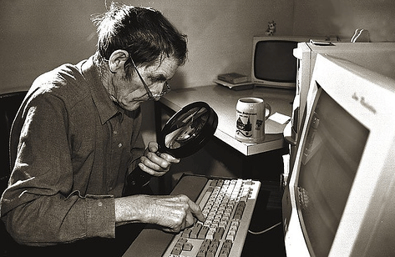
Affordable terminal Devices that all can use, with special attention being paid to Elderly and the Differently able

Slide 3
10% of Sri Lankans live with physical or mental difficulties which limit their use of information technology

Slide 4
The problem
Access to Government information and services for the elderly and those with disabilities is very limited.
The Government should take steps to ensure their inclusion in the information society.

Slide 5
Brief overview of findings

Slide 6
Distribution of disabilities in Sri Lanka (Department of census and statistics 2012 Report)
Per 1000 people

Slide 7
Source : Census of Population and Housing 2012, Department of Census and Statistics, Sri Lanka

Slide 8
Elderly Population in Sri Lanka
At the moment, there is no United Nations standard numerical criterion, but the UN agreed cutoff is 60+ years to refer to the older population.
12.4% of the Sri Lankan population are 60 and above 60 according to the report of the Census and Statistics Department. 2012.

Slide 9
What options are available for people with disabilities in Sri Lanka?
Regular voice calls to the Govt. information hotline 1919
Some existing mobile handsets carry features such as sticky-keys, bolder displays, navigation by voice commands and through the movement of the face or hand.

Slide 10
What options are available for similar people in other countries?

Slide 11
Singapore
Silver Infocomm Hotspots
IDA has set up about 90 Silver Infocomm Hotspots (SIHs) to provide access to computers and internet services for seniors free-of-charge. The SIHs are set up at accessible locations for seniors island-wide such as Community Centres, self-help group centres, Residents' Committees and public libraries.
Silver Infocomm Junctions
Nine senior-friendly and conveniently located IT learning hubs, called Silver Infocomm Junctions (SIJs), are set up island-wide. The SIJs offer affordable infocomm training and customised curriculum for seniors. Seniors are also able to enjoy follow up tutorials for more in-depth learning.

Slide 12
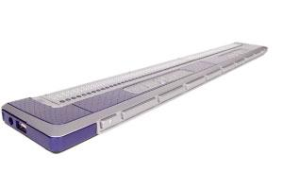
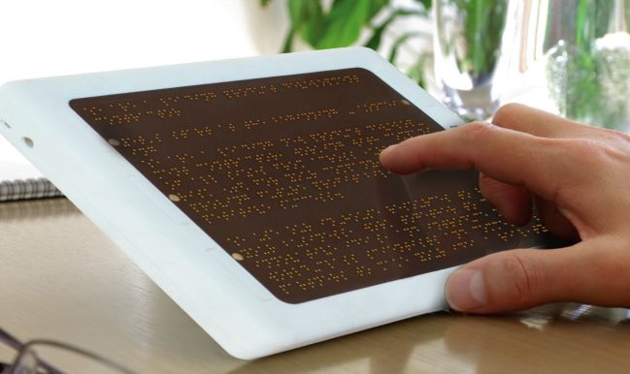
ALVA BC680
Rs. 1,125,360/=

Slide 13
Limitations
The GoSL cannot impose policy decisions on mobile phone manufacturers to include disabled friendly features in their products.
Sri Lanka lacks proven hardware manufacturing expertise. However, suitable hardware devises can be assembled in Sri Lanka using micro computer units such as Raspberry Pi
One software or app is unable to cater to each and every type and magnitude of physical and mental disability.

Slide 14
Recommendations
Along with the options of viewing websites in Sinhala, Tamil and English, all GoSL websites should include a 4th viewing option that is friendly to the visually impaired, and those whose fine motor skills are no longer fine.
Larger lettering and buttons
Bold and contrasting colours
Less clutter

Slide 15
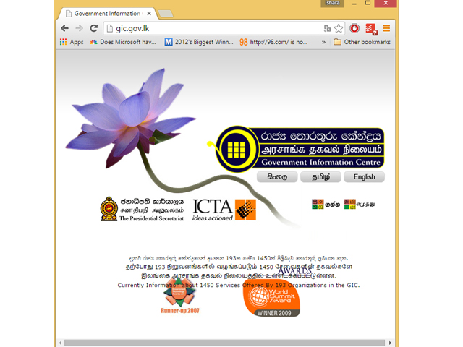

Slide 16
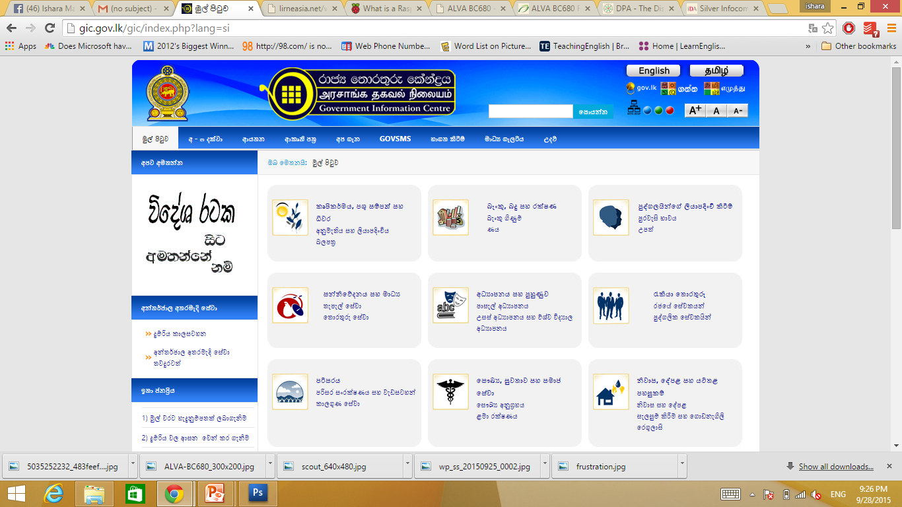

Slide 17
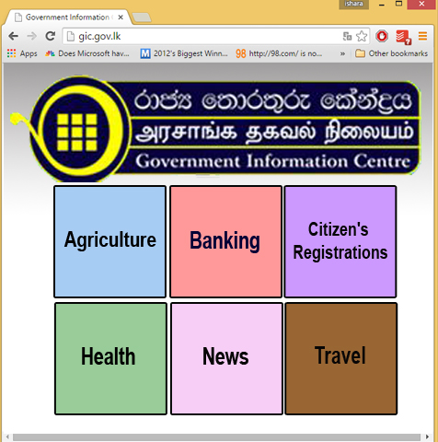

Slide 18
Recommendations …cont.
A relatively inexpensive hardware device such as The Raspberry Pi Foundation’s Raspberry Pi micro computer unit allows for an app to be installed, which will allow a disabled user to manipulate a computer, a tab or a smartphone.
Provision of one disabled-friendly terminal each at Nenaselas for the use of the aged and those with visual impairments
Recommend that pilot projects be carried out in the Ratnapura, Kandy and Nuwara Eliya districts (why? Direct attention to the map on slide 5)
Provide training and assistance to the aged and visually impaired to use these terminals
Encourage the app development community in Sri Lanka to develop an app which would connect the user to a human being at the Government information hotline, who will search for information on behalf of the user

Slide 19
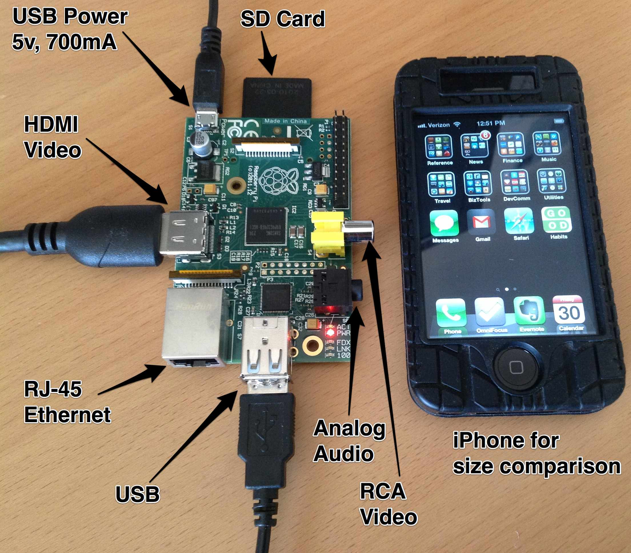
$35

Slide 20
Q and A

Slide 21
References
Health Statistics and Information Systems (2015). Web.
http://www.who.int/healthinfo/survey/ageingdefnolder/en/ (accessed September 2015)
Population and Housing Census, 2012
http://www.statistics.gov.lk/PopHouSat/CPH2011/Pages/Activities/Reports/FinalReport/FinalReport.pdf

Slide 22
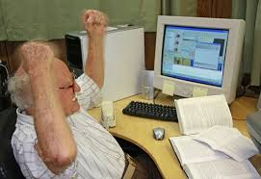
Thank you!

