Slide 1
Big and Open Data: Challenges and Issues
Sriganesh Lokanathan
Team Leader – Big Data Research, LIRNEasia
This work was carried out with the aid of a grant from the International Development Research Centre, Canada and the Department for International Development UK..

Slide 2
Big data
An all-encompassing term for any collection of data sets so large or complex that it becomes difficult to process using traditional data processing applications.
Challenges include: analysis, capture, curation, search, sharing, storage, transfer, visualization, and privacy violations.
Examples:
100 million Call Detail Records per day generated by Sri Lanka companies
45 Terabytes of data from Hubble Telescope

Slide 3
Why big data? Why now?
Proximate causes
Increased “datafication”: Very large sets of schema-less (unstructured, but processable) data now available
Advances in memory technology: No longer is it necessary to archive most data and work with small subset
Advances in software: MapReduce, Hadoop

Slide 4
There are many potential sources of big data in an economy…..
Administrative data
E.g., digitized medical records, insurance records, tax records
Commercial transactions (transaction-generated data)
E.g., Stock exchange data, bank transactions, credit card records, supermarket transactions connected by loyalty card number
Sensors and tracking devices
E.g., road and traffic sensors, climate sensors, equipment & infrastructure sensors, mobile phones communicating with base stations, satellite/ GPS devices
Online activities/ social media
E.g., online search activity, online page views, blogs/ FB/ twitter posts

Slide 5
….but currently only mobile network big data has broad population coverage
 | Mobile SIMs/100 | Internet users/100 | Facebook users/100
Myanmar | 13 | 1 | 4
Bangladesh | 67 | 7 | 6
Pakistan | 70 | 11 | 8
India | 71 | 15 | 9
Sri Lanka | 96 | 22 | 12
Philippines | 105 | 39 | 41
Indonesia | 122 | 16 | 29
Thailand | 138 | 29 | 46
Source: ITU Measuring Information Society 2014; Facebook advantage portal

Slide 6
Mobile network big data + other data ➔ rich, timely insights that serve private as well as public purposes
Mobile network big data
(CDRs, Internet access usage, airtime recharge records)
Other Data Sources
1. Data from Dept. of Census & Statistics
2. Transportation data
3. Health data
4. Financial data
5. Etc.
Dual purpose insights
Private purposes
1. Mobility & location based services
2. Financial services
3. Richer customer profiles
4. Targeted marketing
5. New VAS
Public purposes
1. Transportation & Urban planning
2. Crises response + DRR
3. Health services
4. Poverty mapping
5. Financial inclusion
Construct Behavioral Variables
1. Mobility variables
2. Social variables
3. Consumption variables

Slide 7
What can we do with such data?
Since 2012, LIRNEasia has been working with mobile network big data, having obtained historical and pseudonymized data from multiple operators in Sri Lanka
Covering nearly 50% of population

Slide 8
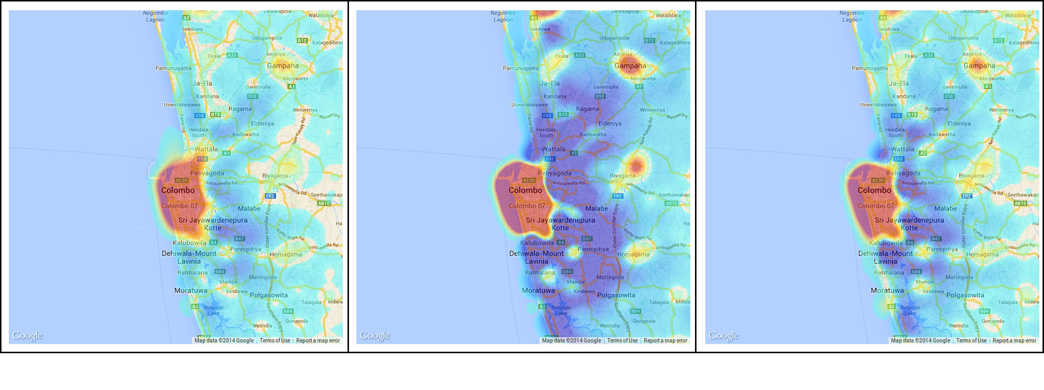
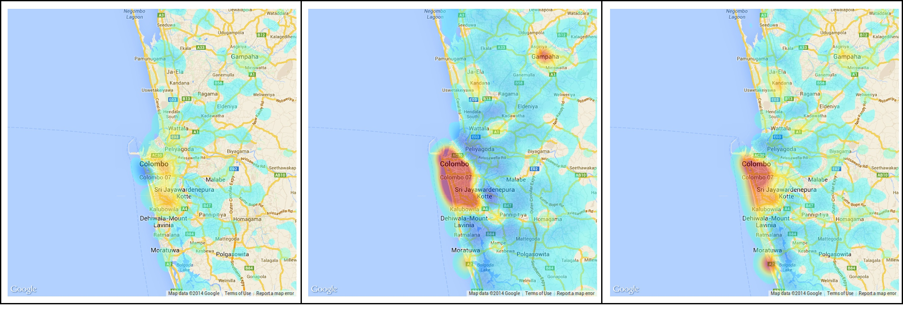
Population density changes in Colombo region: weekday/ weekend Pictures depict the change in population density at a particular time relative to midnight
Weekday
Time 06:30
Time 12:30
Time 18:30
Sunday
Decrease in Density
Increase in Density

Slide 9
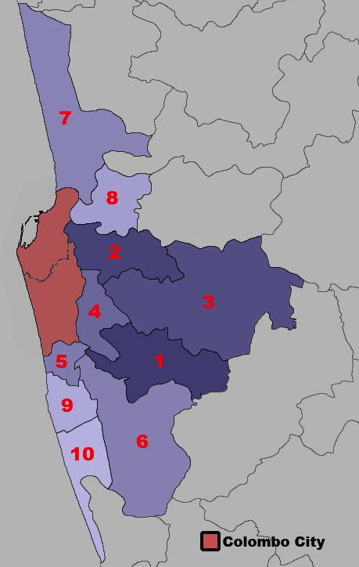
46.9% of Colombo City’s daytime population comes from the surrounding regions
Colombo city is made up of Colombo and Thimbirigasyaya DSDs
Home DSD | %age of Colombo’s daytime population
Colombo city | 53.1
Maharagama | 3.7
Kolonnawa | 3.5
Kaduwela | 3.3
Sri Jayawardanapura Kotte | 2.9
Dehiwala | 2.6
Kesbewa | 2.5
Wattala | 2.5
Kelaniya | 2.1
Ratmalana | 2.0
Moratuwa | 1.8

Slide 10
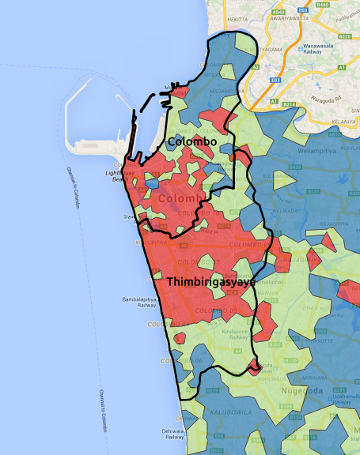
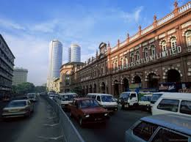
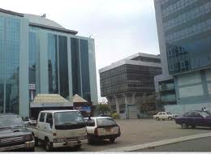
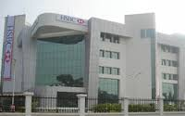
We can exploit the diurnal base station signatures to understand land use patterns
Highly commercial
Highly residential
Mixed-use

Slide 11
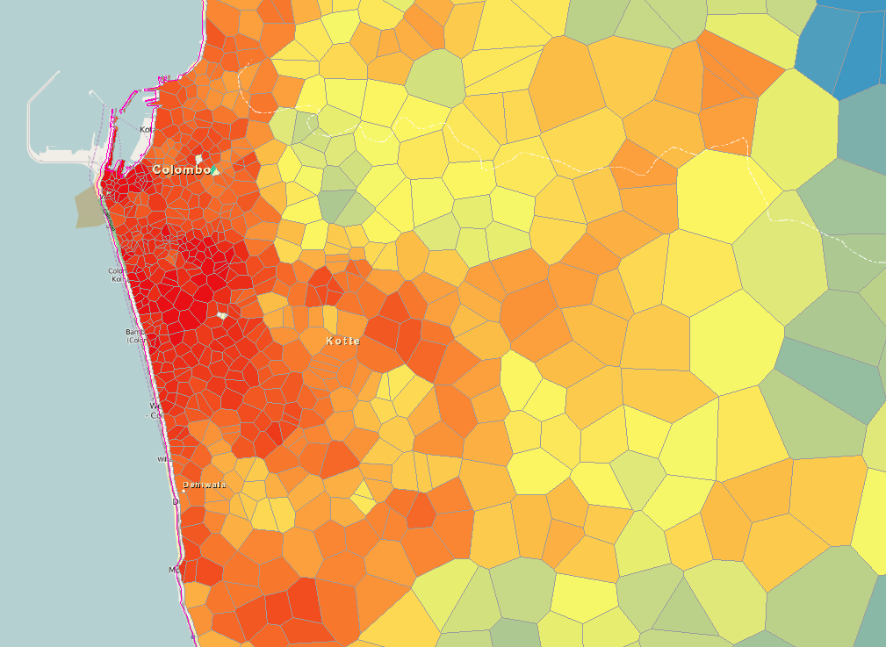
We can develop new proxy measures of economic activity
Estimated log(wage)
High Estimated Wage
Low Estimated Wage

Slide 12
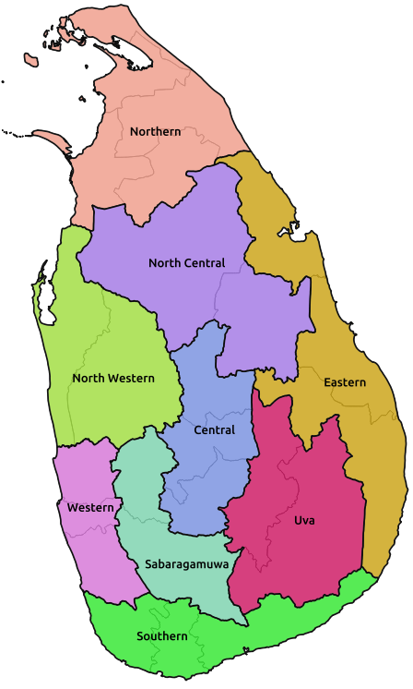
Understanding the geo-spatial extent of communities
The 11 detected communities
The 9 provinces

Slide 13
So what are the challenges and issues?

Slide 14
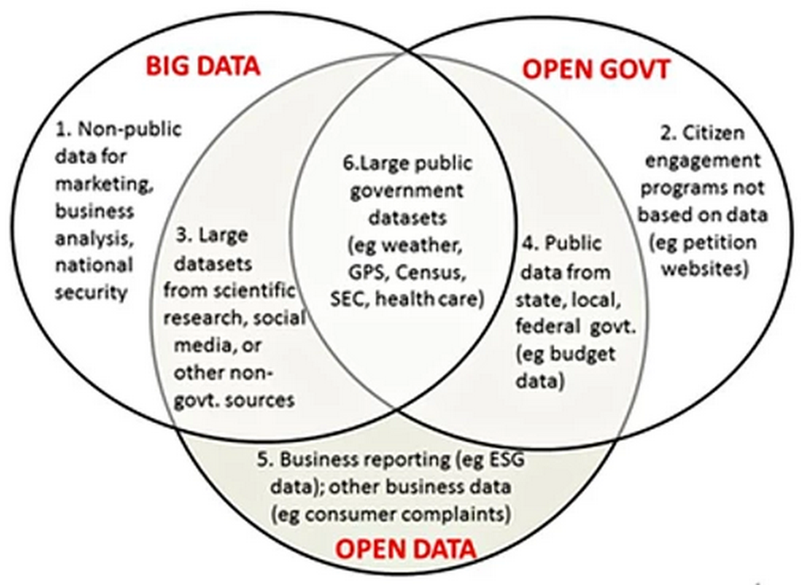
Low levels of ‘datafication’
Big AND OPEN data doesn’t really exist in Sri Lanka
But even if there were large open data sets easily available there are several issues
Diagram source: Joel Gurin in http://www.theguardian.com/public-leaders-network/2014/apr/15/big-data-open-data-transform-government

Slide 15
Issues
Standardization
Accountability & liability
Data and analytical literacy
Private sector versus public sector data
Competitive industries versus monopolies
Privacy

