Slide 1




  Big Data for Development: New opportunities for emerging markets
Presentation to Access to Information Unit, Bangladesh Prime Minister’s Office, Dhaka
October 2015
This work was carried out with the aid of a grant from the International Development Research Centre, Canada and the Department for International Development UK..

Slide 2
What kinds of comprehensive big data are available in emerging economies?
Administrative data
  E.g., digitized medical records, insurance records, tax records
Commercial transactions (transaction-generated data)
  E.g., Stock exchange data, bank transactions, credit card records, supermarket transactions connected by loyalty card number
Sensors and tracking devices
  E.g., road and traffic sensors, climate sensors, equipment & infrastructure sensors, mobile phones communicating with base stations, satellite/ GPS devices
Online activities/ social media
  E.g., online search activity, online page views, blogs/ FB/ twitter posts

Slide 3
Currently only mobile network big data satisfies criterion of broad population coverage
 | Mobile SIMs/100 | Internet users/100 | Facebook users/100
Myanmar | 13 | 1 | 4
Bangladesh | 67 | 7 | 6
Pakistan | 70 | 11 | 8
India | 71 | 15 | 9
Sri Lanka | 96 | 22 | 12
Philippines | 105 | 39 | 41
Indonesia | 122 | 16 | 29
Thailand | 138 | 29 | 46
Source: ITU Measuring Information Society 2014; Facebook advantage portal

Slide 4

Mobile network big data + other data ➔ rich, timely insights that serve private as well as public purposes
Mobile network big data
(CDRs, Internet access usage, airtime recharge records)
Other Data Sources
1. Data from Dept. of Census & Statistics
2. Transportation data
3. Health data
4. Financial data
5. Etc.
Dual purpose insights
Private purposes
1. Mobility & location based services
2. Financial services
3. Richer customer profiles
4. Targeted marketing
5. New VAS
Public purposes
1. Transportation & Urban planning
2. Crises response + DRR
3. Health services
4. Poverty mapping
5. Financial inclusion
Construct Behavioral Variables
1. Mobility variables
2. Social variables
3. Consumption variables

Slide 5
Data used in the research
Multiple mobile operators in Sri Lanka have provided four different types of meta-data
  Call Detail Records (CDRs)
    Records of calls
    SMS
    Internet access
  Airtime recharge records
Data sets do not include any Personally Identifiable Information
  All phone numbers are pseudonymized
  LIRNEasia does not maintain any mappings of identifiers to original phone numbers
Cover 50-60% of users; very high coverage in Western (where Colombo the capital city in located) & Northern (most affected by civil conflict) Provinces, based on correlation with census data

Slide 6
Actions to improve data sharing
Reduce transaction costs
  Guidelines on managing privacy and competitive implications developed; being consulted with experts and stakeholders
    Language can be used in non-disclosure agreements
  Work ongoing to reduce pseudonymization burdens to companies

Slide 7
Work performed by collaborative inter-disciplinary teams
LIRNEasia
  Sriganesh Lokanathan
  Kaushalya Madhawa
  Danaja Maldeniya
  Prof. Rohan Samarajiva
  Dedunu Dhananjaya
  Madhushi Bandara
  Nisansa de Silva (moved on to U of Oregon)
University of Moratuwa
  Prof. Amal Kumarage
    Transport
  Dr. Amal Shehan Perera
    Data Mining
  Undergraduates working on projects
LIRNEasia/ MIT
  Gabriel Kreindler (Economics)
  Yuhei Miyauchi (Economics)
Other US Universities
  Prof. Joshua Blumenstock (U Washington, School of Information)
    Data Science
  Saad Gulzar (NYU Poli Sci)
    Political Science
Advisors:
  Dr. Srinath Perera (WSO2)
  Prof. Louiqa Rashid (U of Maryland)

Slide 8
Illustrative findings
Understanding population density & mobility
  Population density
  Commuting patterns: where do people live and work
  Mobility changes during important events: Case study of “Avurudu”
Understanding land use characteristics
Understanding communities
Preliminary work on gaining insights on economic activity
Exploratory work on gaining insights from reload data

Slide 9
Understanding population density & mobility
  Population density
  Commuting patterns: where do people live and work
  Mobility changes during important events: Case study of “Avurudu”
Understanding land use characteristics
Understanding communities
Preliminary work on gaining insights on economic activity
Exploratory work on gaining insights from reload data

Slide 10
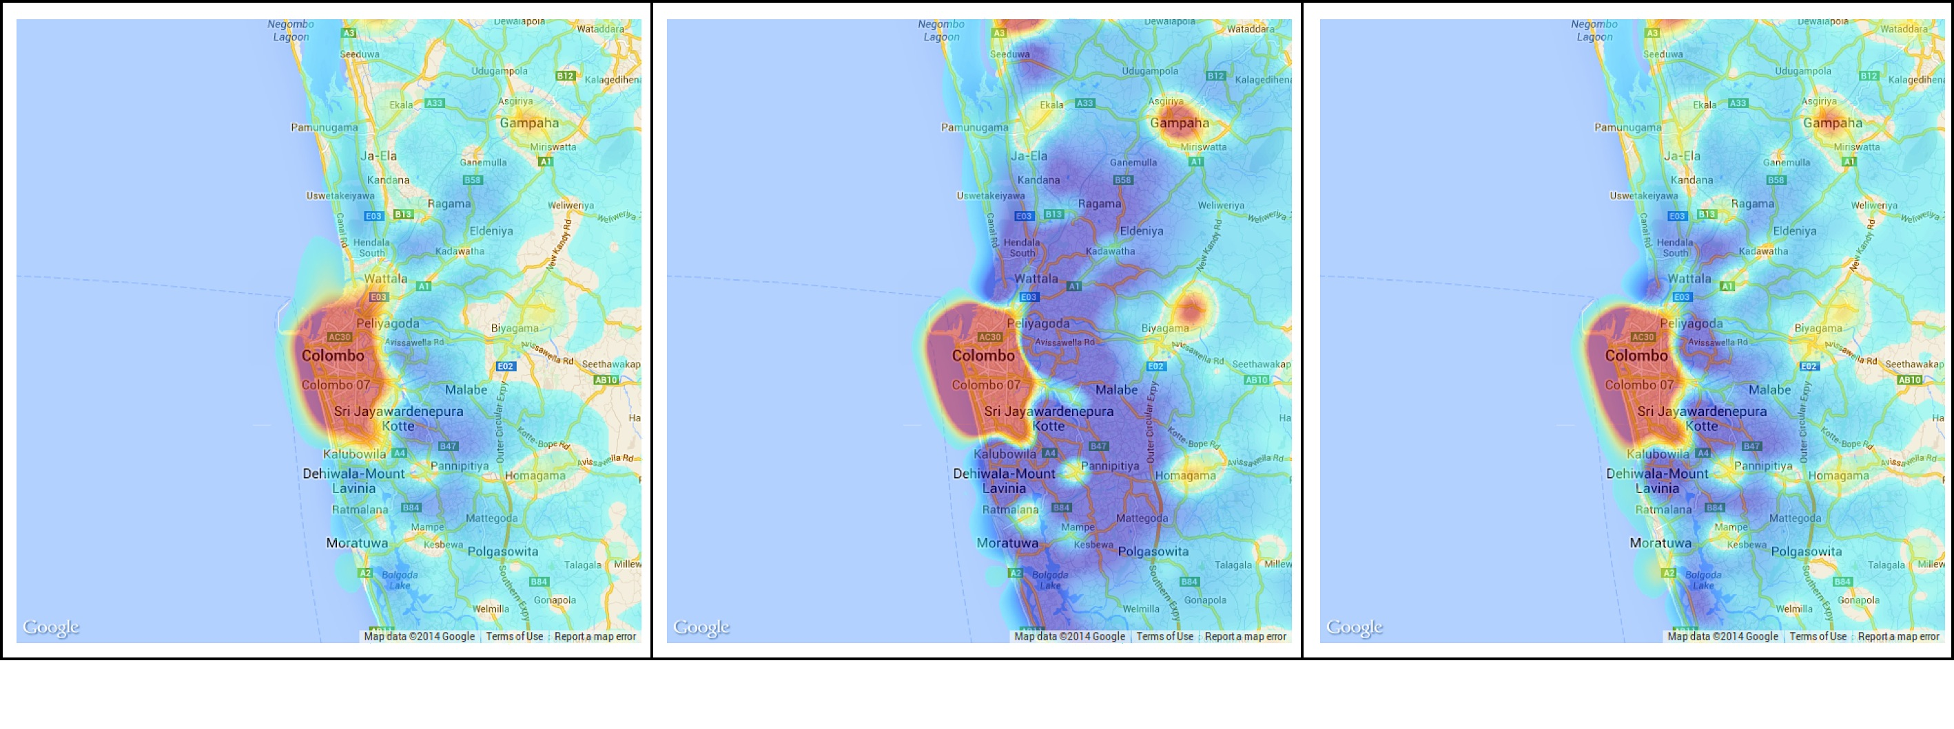
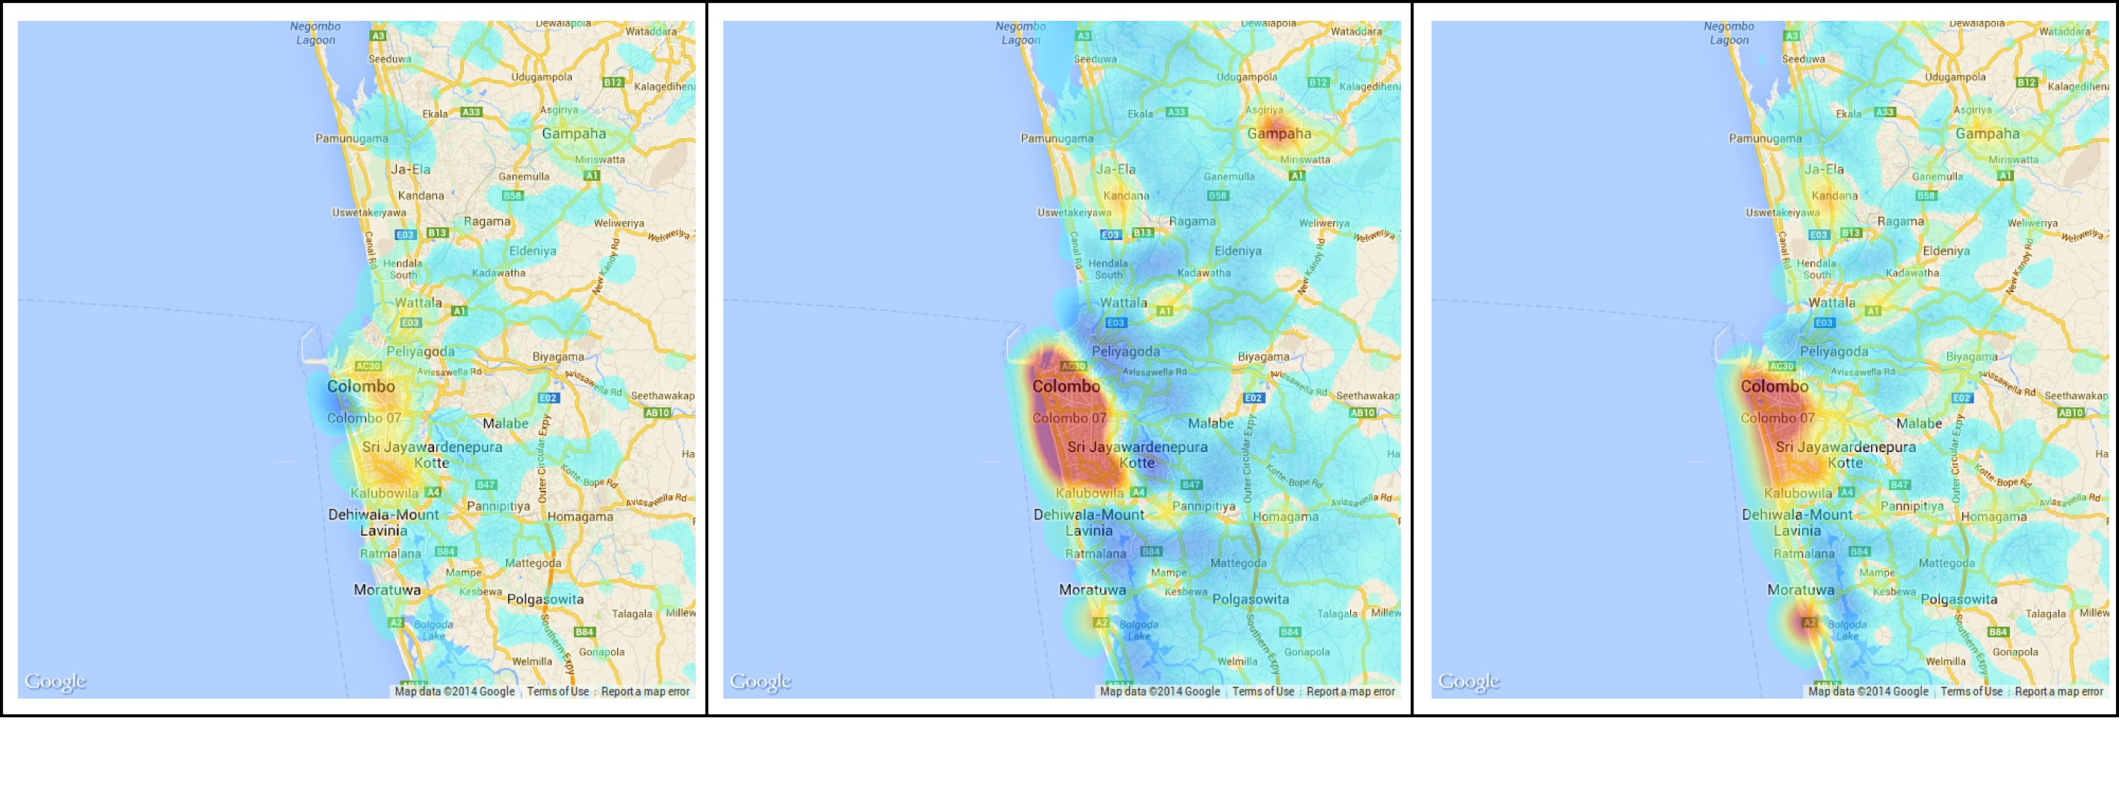
Population density changes in Colombo region: weekday/ weekend
Pictures depict the change in population density at a particular time relative to midnight
Weekday
Time 06:30
Time 12:30
Time 18:30
Sunday
Decrease in Density
Increase in Density

Slide 11
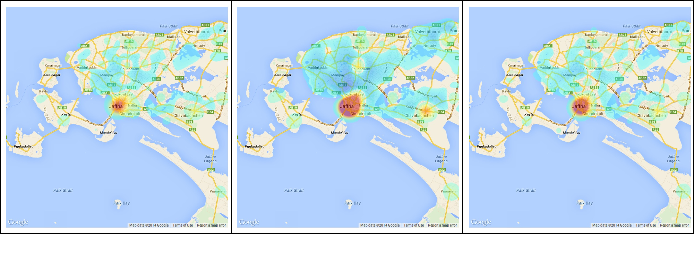
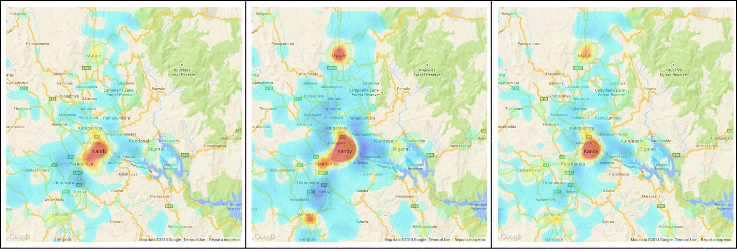
Population density changes in Jaffna & Kandy regions on a normal weekday
Pictures depict the change in population density at a particular time relative to midnight
Jaffna
Time 06:30
Time 12:30
Time 18:30
Kandy
Decrease in Density
Increase in Density

Slide 12
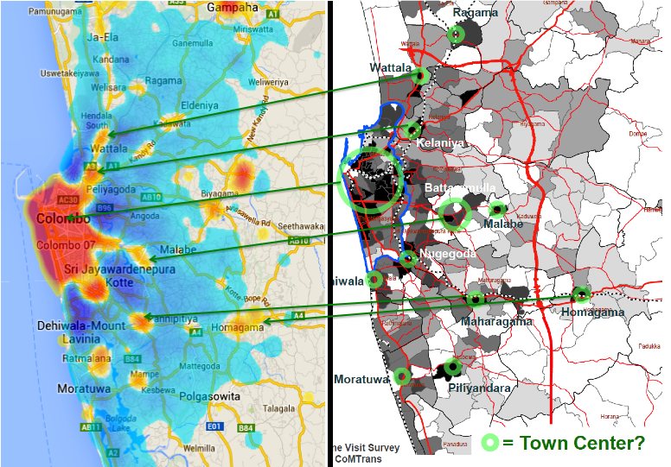
Our findings closely match results from expensive & infrequent transportation surveys

Slide 13
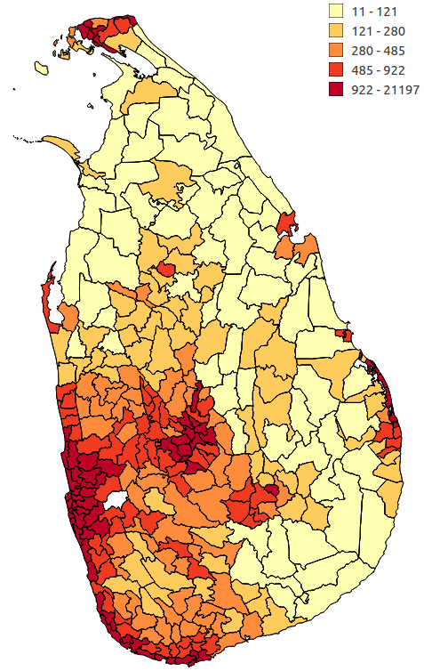
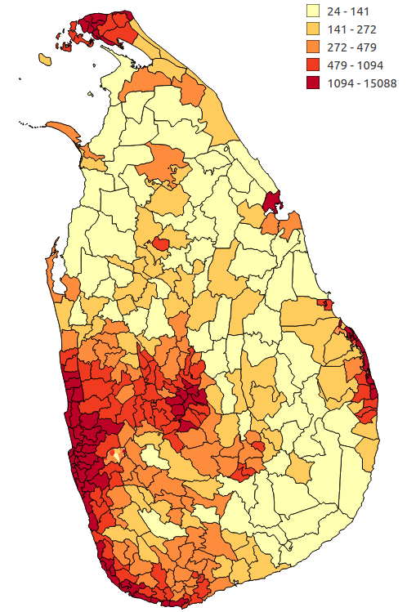
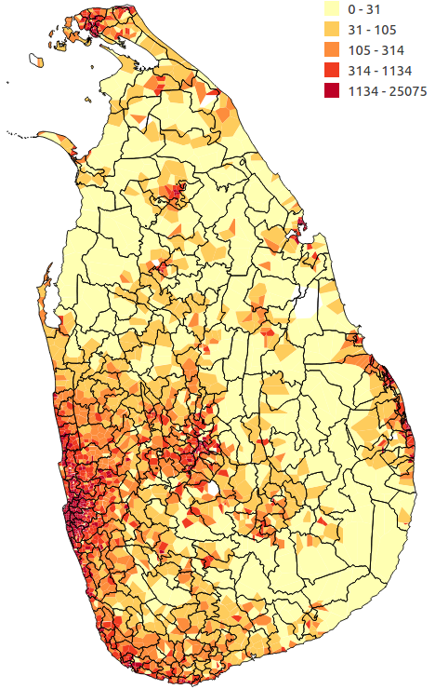
MNBD data can give us granular & high-frequency estimates of population density
DSD population density from 2012 census
DSD population density estimate from MNBD
Voronoi cell population density estimate from MNBD
Notes:
Work in progress

Slide 14
Understanding population density & mobility
  Population density
  Commuting patterns: where do people live and work
  Mobility changes during important events: Case study of “Avurudu”
Understanding land use characteristics
Understanding communities
Preliminary work on gaining insights on economic activity
Exploratory work on gaining insights from reload data

Slide 15
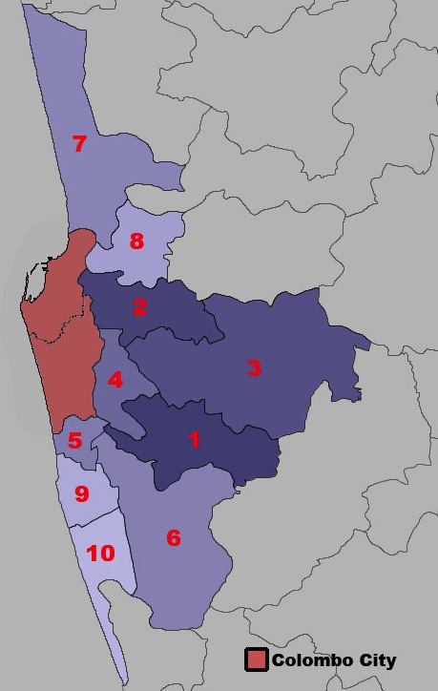
46.9% of Colombo City’s daytime population comes from the surrounding regions
Colombo city is made up of Colombo and Thimbirigasyaya DSDs
Home DSD | %age of Colombo’s daytime population
Colombo city | 53.1
Maharagama | 3.7
Kolonnawa | 3.5
Kaduwela | 3.3
Sri Jayawardanapura Kotte | 2.9
Dehiwala | 2.6
Kesbewa | 2.5
Wattala | 2.5
Kelaniya | 2.1
Ratmalana | 2.0
Moratuwa | 1.8

Slide 16
Understanding population density & mobility
  Population density
  Commuting patterns: where do people live and work
  Mobility changes during important events: Case study of “Avurudu”
Understanding land use characteristics
Understanding communities
Preliminary work on gaining insights on economic activity
Exploratory work on gaining insights from reload data

Slide 17
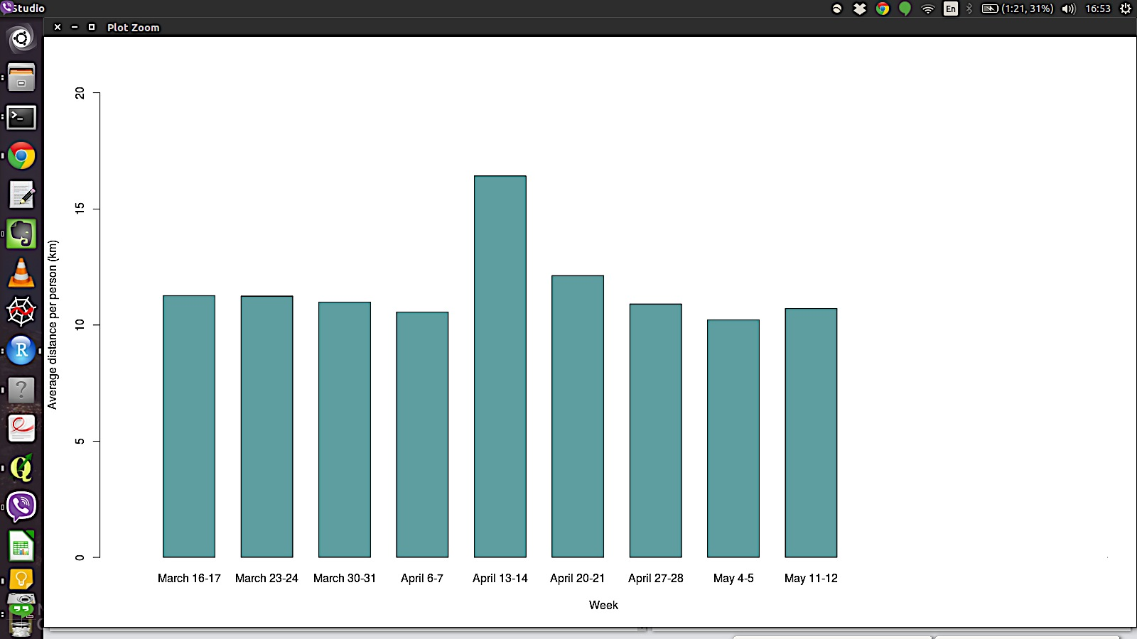
People travel greater distances during major holiday
Average: 11.6km
A-4
A-3
A-2
A-1
A
A+1
A+2
A+3
A+4

Slide 18
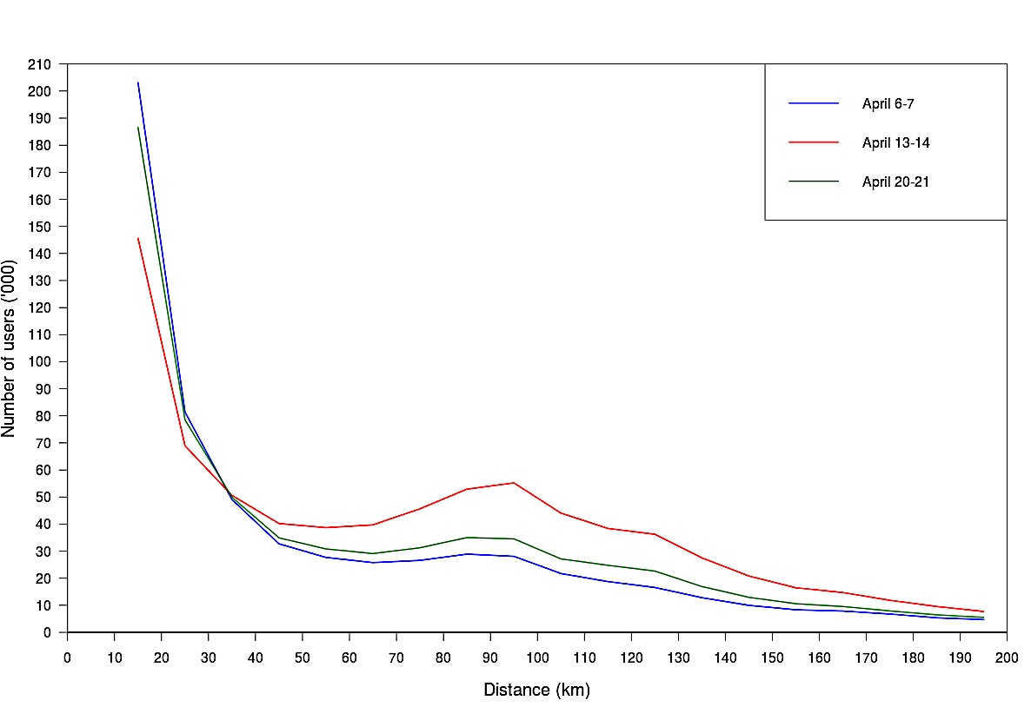
More people travel greater distances during “Avurudu”
A -1
A
A +1

Slide 19
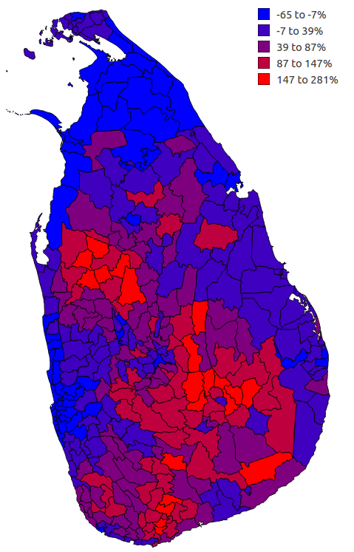
Net inflow during Avurudu weekend
With the exception of Ampara, more Colombo city residents travelled to other DSDs during Avurudu, as compared to other weekends (some examples below):
Nuwara Eliya: 315%
Kotmale: 233%
Town & Gravets (Trincomalee): 100%
Udunuwara: 93%
Kalutara: 90%
Jaffna: 80%
Galle Four Gravets: 77%
Gangawata Korale: 71%
Attanagalla: 71%
Mirigama: 66%

Slide 20
Implications for public policy
Population maps and mobility/migration patterns are essential policy tools
  Included in most census and household surveys
MNBD allows us to improve & extend measurement
  Large sample sizes
  Very frequent measurement
More precise measures
  Commuting/ seasonal/ long-term migration

Slide 21
Implications for public policy
Improve planning for “spiky” events that create pressure on government and privately supplied services
  Humanitarian response to disasters
  Special events/holidays
Urban & transportation planning
  Can identify high volume transport corridors to prioritize for provision of mass transit
  Map de facto municipal boundaries
Health policy
  Mobility patterns that can help respond to spread of infectious diseases (e.g., dengue)

Slide 22
Understanding population density & mobility
  Population density
  Commuting patterns: where do people live and work
  Mobility changes during important events: Case study of “Avurudu”
Understanding land use characteristics
Understanding communities
Preliminary work on gaining insights on economic activity
Exploratory work on gaining insights from reload data

Slide 23
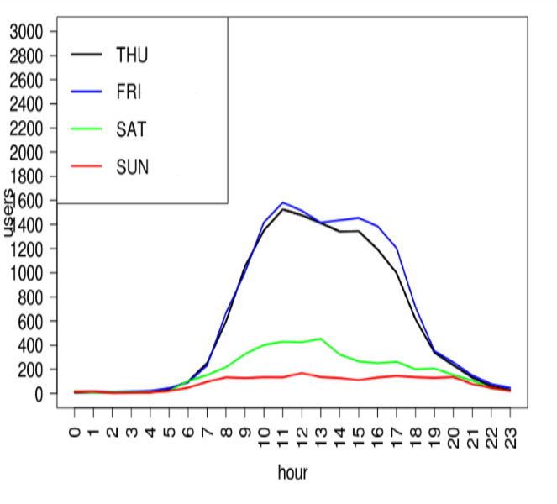
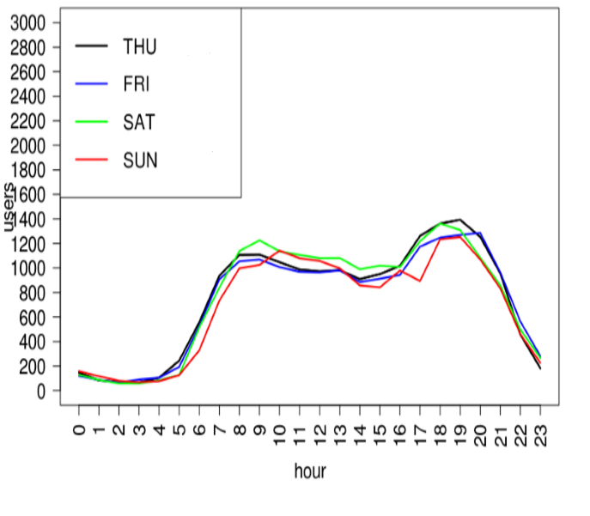
Hourly loading of base stations reveals distinct patterns
Type X: ?
Type Y: ?
We can use this insight to group base stations into different groups, using unsupervised machine learning techniques

Slide 24
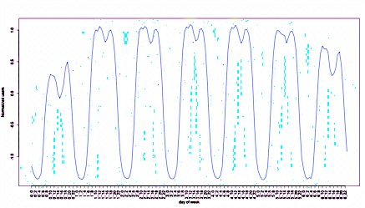
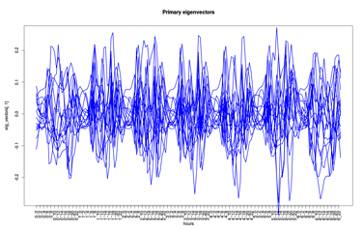
Methodology
The time series of users connected at a base station contains variations, that can be grouped by similar characteristics
A month of data is collapsed into an indicative week (Sunday to Saturday), with the time series normalized by the z-score
Principal Component Analysis(PCA) is used to identify the discriminant patterns from noisy time series data
  Each base station’s pattern is filtered into 15 principal components (covering 95% of the data for that base station)
Using the 15 principal components, we cluster all the base stations into 3 clusters in an unsupervised manner using k-means algorithm

Slide 25
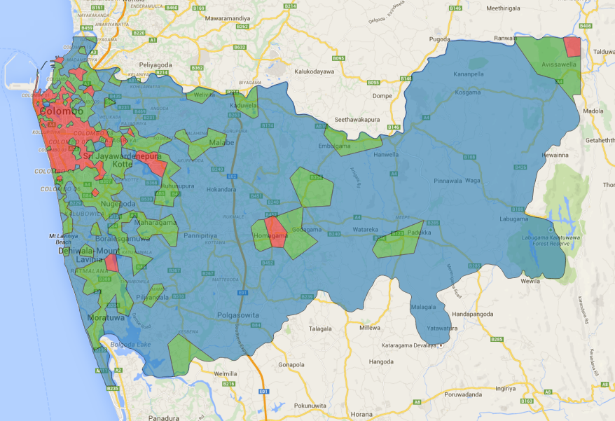
Three spatial clusters in Colombo District
Cluster-1 exhibits patterns consistent with commercial area
Cluster-3 exhibits patterns consistent with residential area
Cluster-2 exhibits patterns more consistent with mixed-use

Slide 26
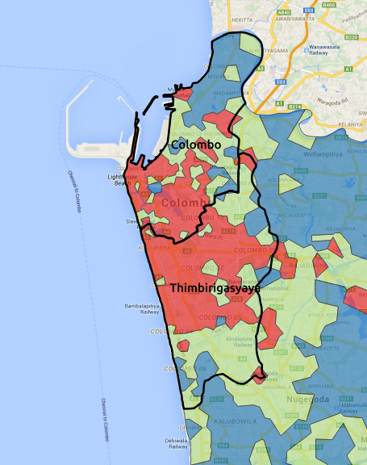
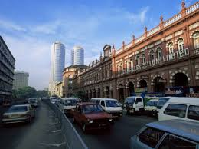
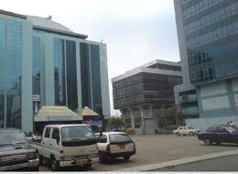
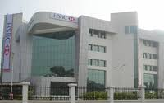
Our results show Central Business District (CBD) in Colombo city has expanded

Slide 27
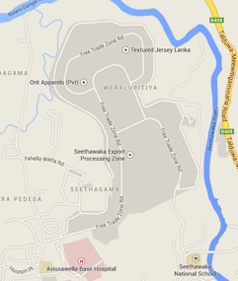
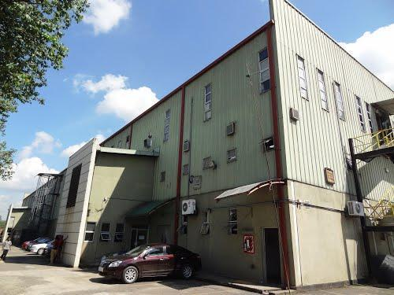
Small area in NE corner of Colombo District classified as belonging to Cluster 1?
Photo ©Senanayaka Bandara - Panoramio
Seethawaka Export
Processing Zone

Slide 28
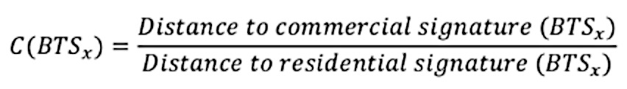
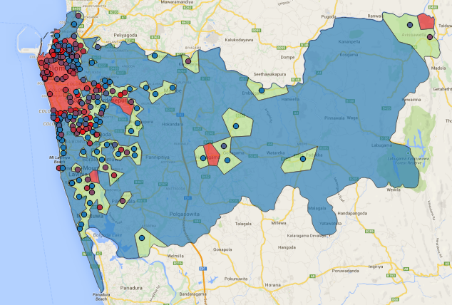
Internal variations in mixed use regions:
More commercial or more residential?
To evaluate the relative closeness to the other two clusters, we define extent of commercialization as:
Blue dots: more residential than commercial Red dots: more commercial than residential

Slide 29
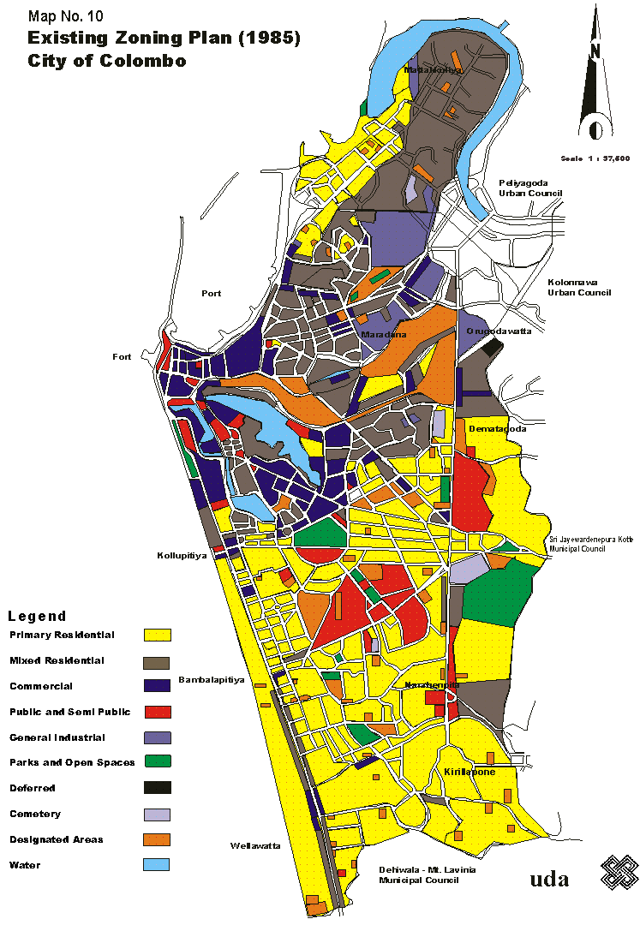
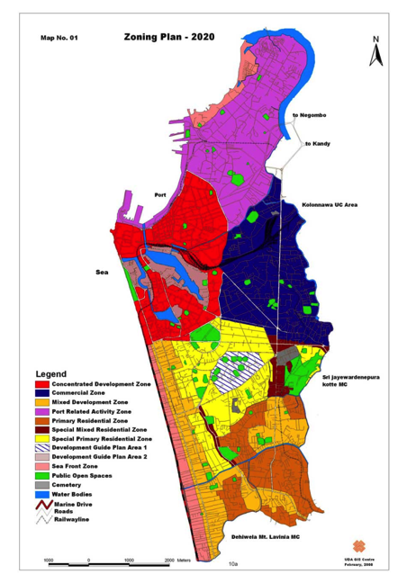
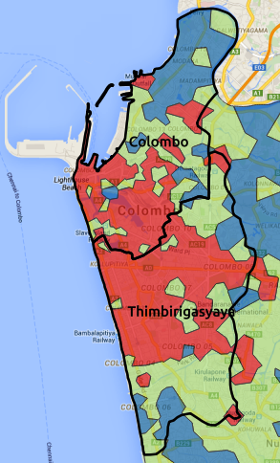
Plans & reality
1985 Plan
2020 UDA Plan
2013 reality
Notes:
Purple: commercial areas
Red in 2020: concentrated development zones
Brown: residential
Yellow: special primary residential zones
Dark brown: special mixed residential zones

Slide 30
Implications for urban policy
Almost real-time monitoring of urban land use
  We are currently working on understanding finer temporal variations in zone characteristics (especially the mixed-use areas)
Can complement infrequent surveys & align master plan to reality
LIRNEasia is working to unpack the identified categories further, e.g.,
  Entertainment zones that show evening activity

Slide 31
Understanding population density & mobility
  Population density
  Commuting patterns: where do people live and work
  Mobility changes during important events: Case study of “Avurudu”
Understanding land use characteristics
Understanding communities
Preliminary work on gaining insights on economic activity
Exploratory work on gaining insights from reload data

Slide 32
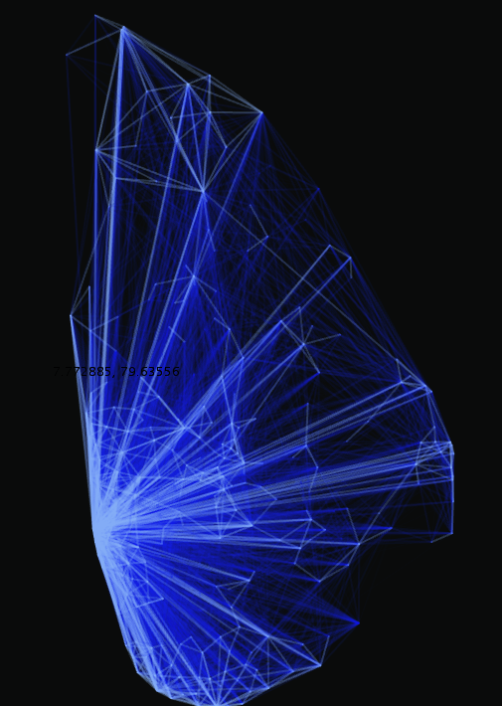
Prima facie, Colombo city (Colombo & Thimbirigasyaya DSDs) seems to be the center of
Sri Lanka’s social network
Each link represents the raw number of outgoing and incoming calls between two DSDs
  Divisional Secretariat Division (DSD) is a third level administrative division; 331 in total in LK
Low
High
No. of calls

Slide 33
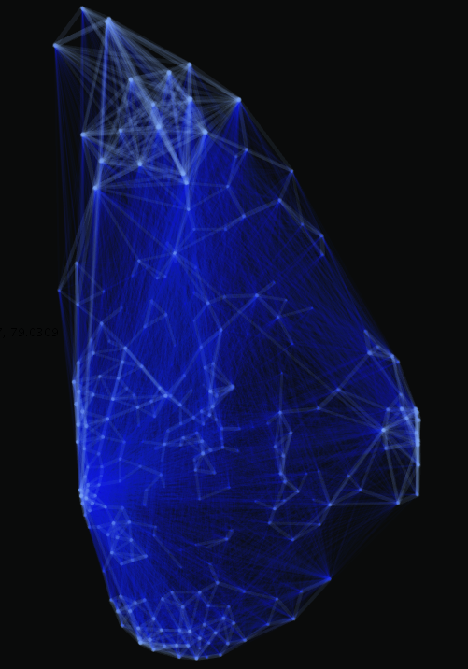
A different picture emerges when call volume is normalized by population
Strongly connected regional networks become visible
Low
High
No. of calls

Slide 34
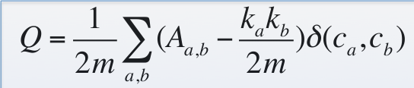
Identifying communities: methodology
The social network is segregated such that overlapping connections between communities are minimized
Strength of a community is determined by modularity
  Modularity Q = (edges inside the community) –
  (expected number of edges inside the community)
M. E. J.-Newman, Michele-Girvan, “Finding and evaluating community structure in networks”, Physical Review E, APS, Vol. 69, No. 2, p. 1-16, 204.

Slide 35
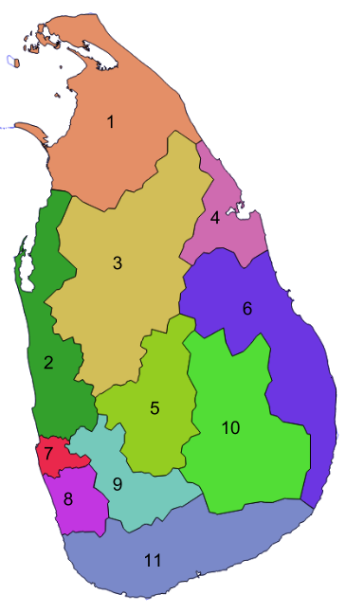
We find Sri Lanka is made up of 11 communities

Slide 36
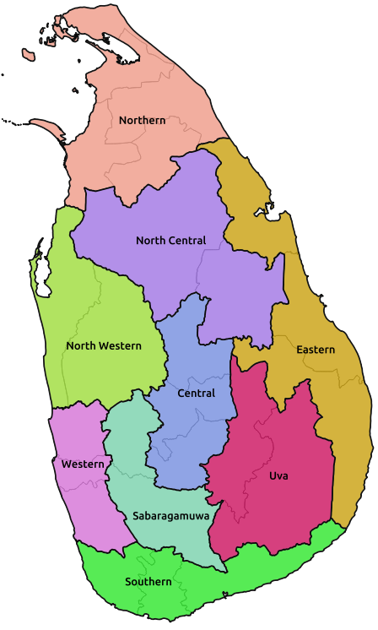
How do communities match existing administrative divisions?
The 11 detected communities
The 9 provinces

Slide 37
With some exceptions, boundaries of communities differ from existing administrative divisions
Northern (1), Uva (10) and Southern (11) communities most similar to existing provincial boundaries; but 11 takes Embilipitiya and Kataragama
Colombo district is clustered as a single community (7)
Gampaha merges with coastal belt of North Western Province (2) and Kalutara (8) is its own community
  What does this mean for Western Province Megapolis?
Batticaloa & Ampara districts of the Eastern Province merge with the Polonnaruwa district of North Central Province to form its own distinct community (6)
  Possibly reflective of economic linkages since this is the rice belt of Sri Lanka
  Does economics override ethnicity?

Slide 38
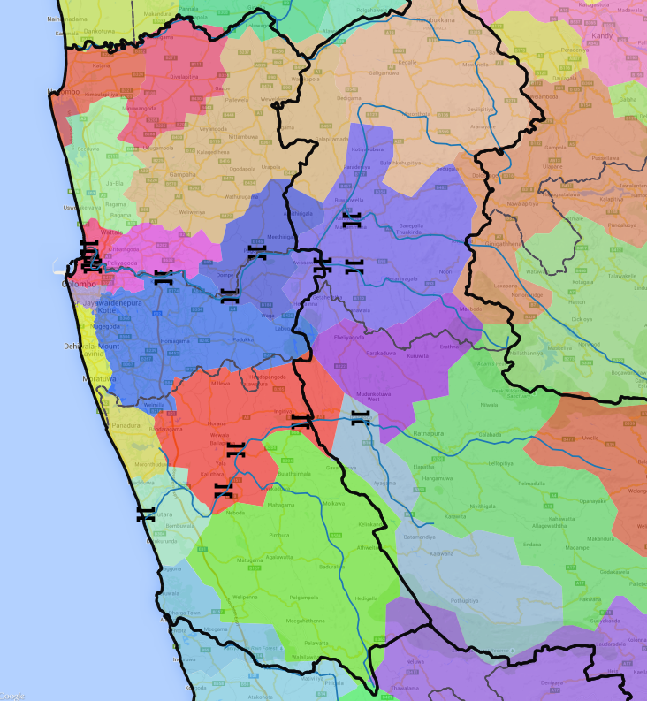

More differences appear when we zoom in further
The littoral regions form their own distinct sub-communities
The northern part of Colombo city forms a community with Wattala, across the Kelani river
In general, rivers no longer form natural boundaries of communities
Bridge

Slide 39
Understanding population density & mobility
  Population density
  Commuting patterns: where do people live and work
  Mobility changes during important events: Case study of “Avurudu”
Understanding land use characteristics
Understanding communities
Preliminary work on gaining insights on economic activity
Exploratory work on gaining insights from reload data

Slide 40
How is mobility informative about economic activity?
Economic activity =
(number of workers) x (productivity per worker)
Observed Must be inferred
We assume more productive regions are more attractive destinations
Commuting patterns emerge from the trade-off between attractiveness of a workplace and the cost of getting there

Slide 41
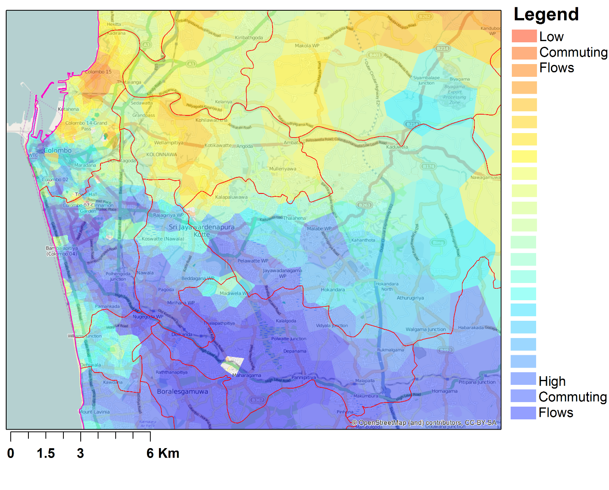
Example of commuting flows from one origin location
Biyagama
Export
Processing
Zone
Notes:
This image shows all commuting flows stemming from one origin (the green polygon) to all other possible destinations. It’s clear that distance is inversely related to commuting flows. It is also worth pointing out some other features: Byiagama attracts a higher share of commuters than would be predicted by its distance to the origin. In the opposite direction, north Colombo attracts FEWER commuters compared to destinations at a similar distance.

Slide 42
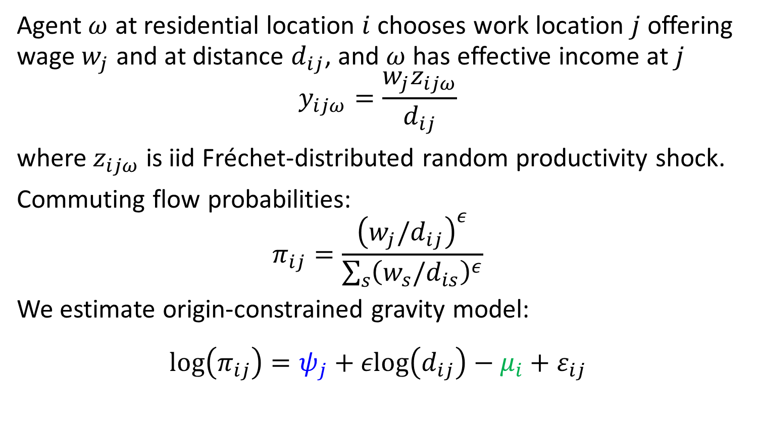
Theoretical model outline

Slide 43
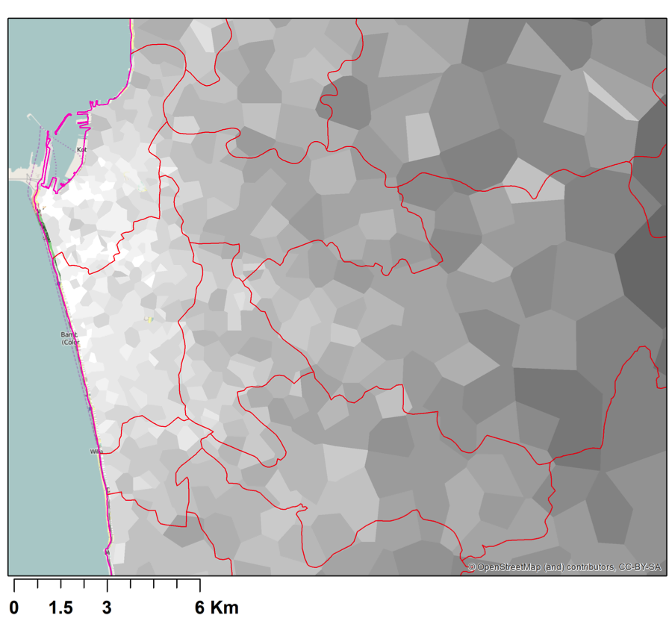
Economic activity/km²
Low
High

Slide 44
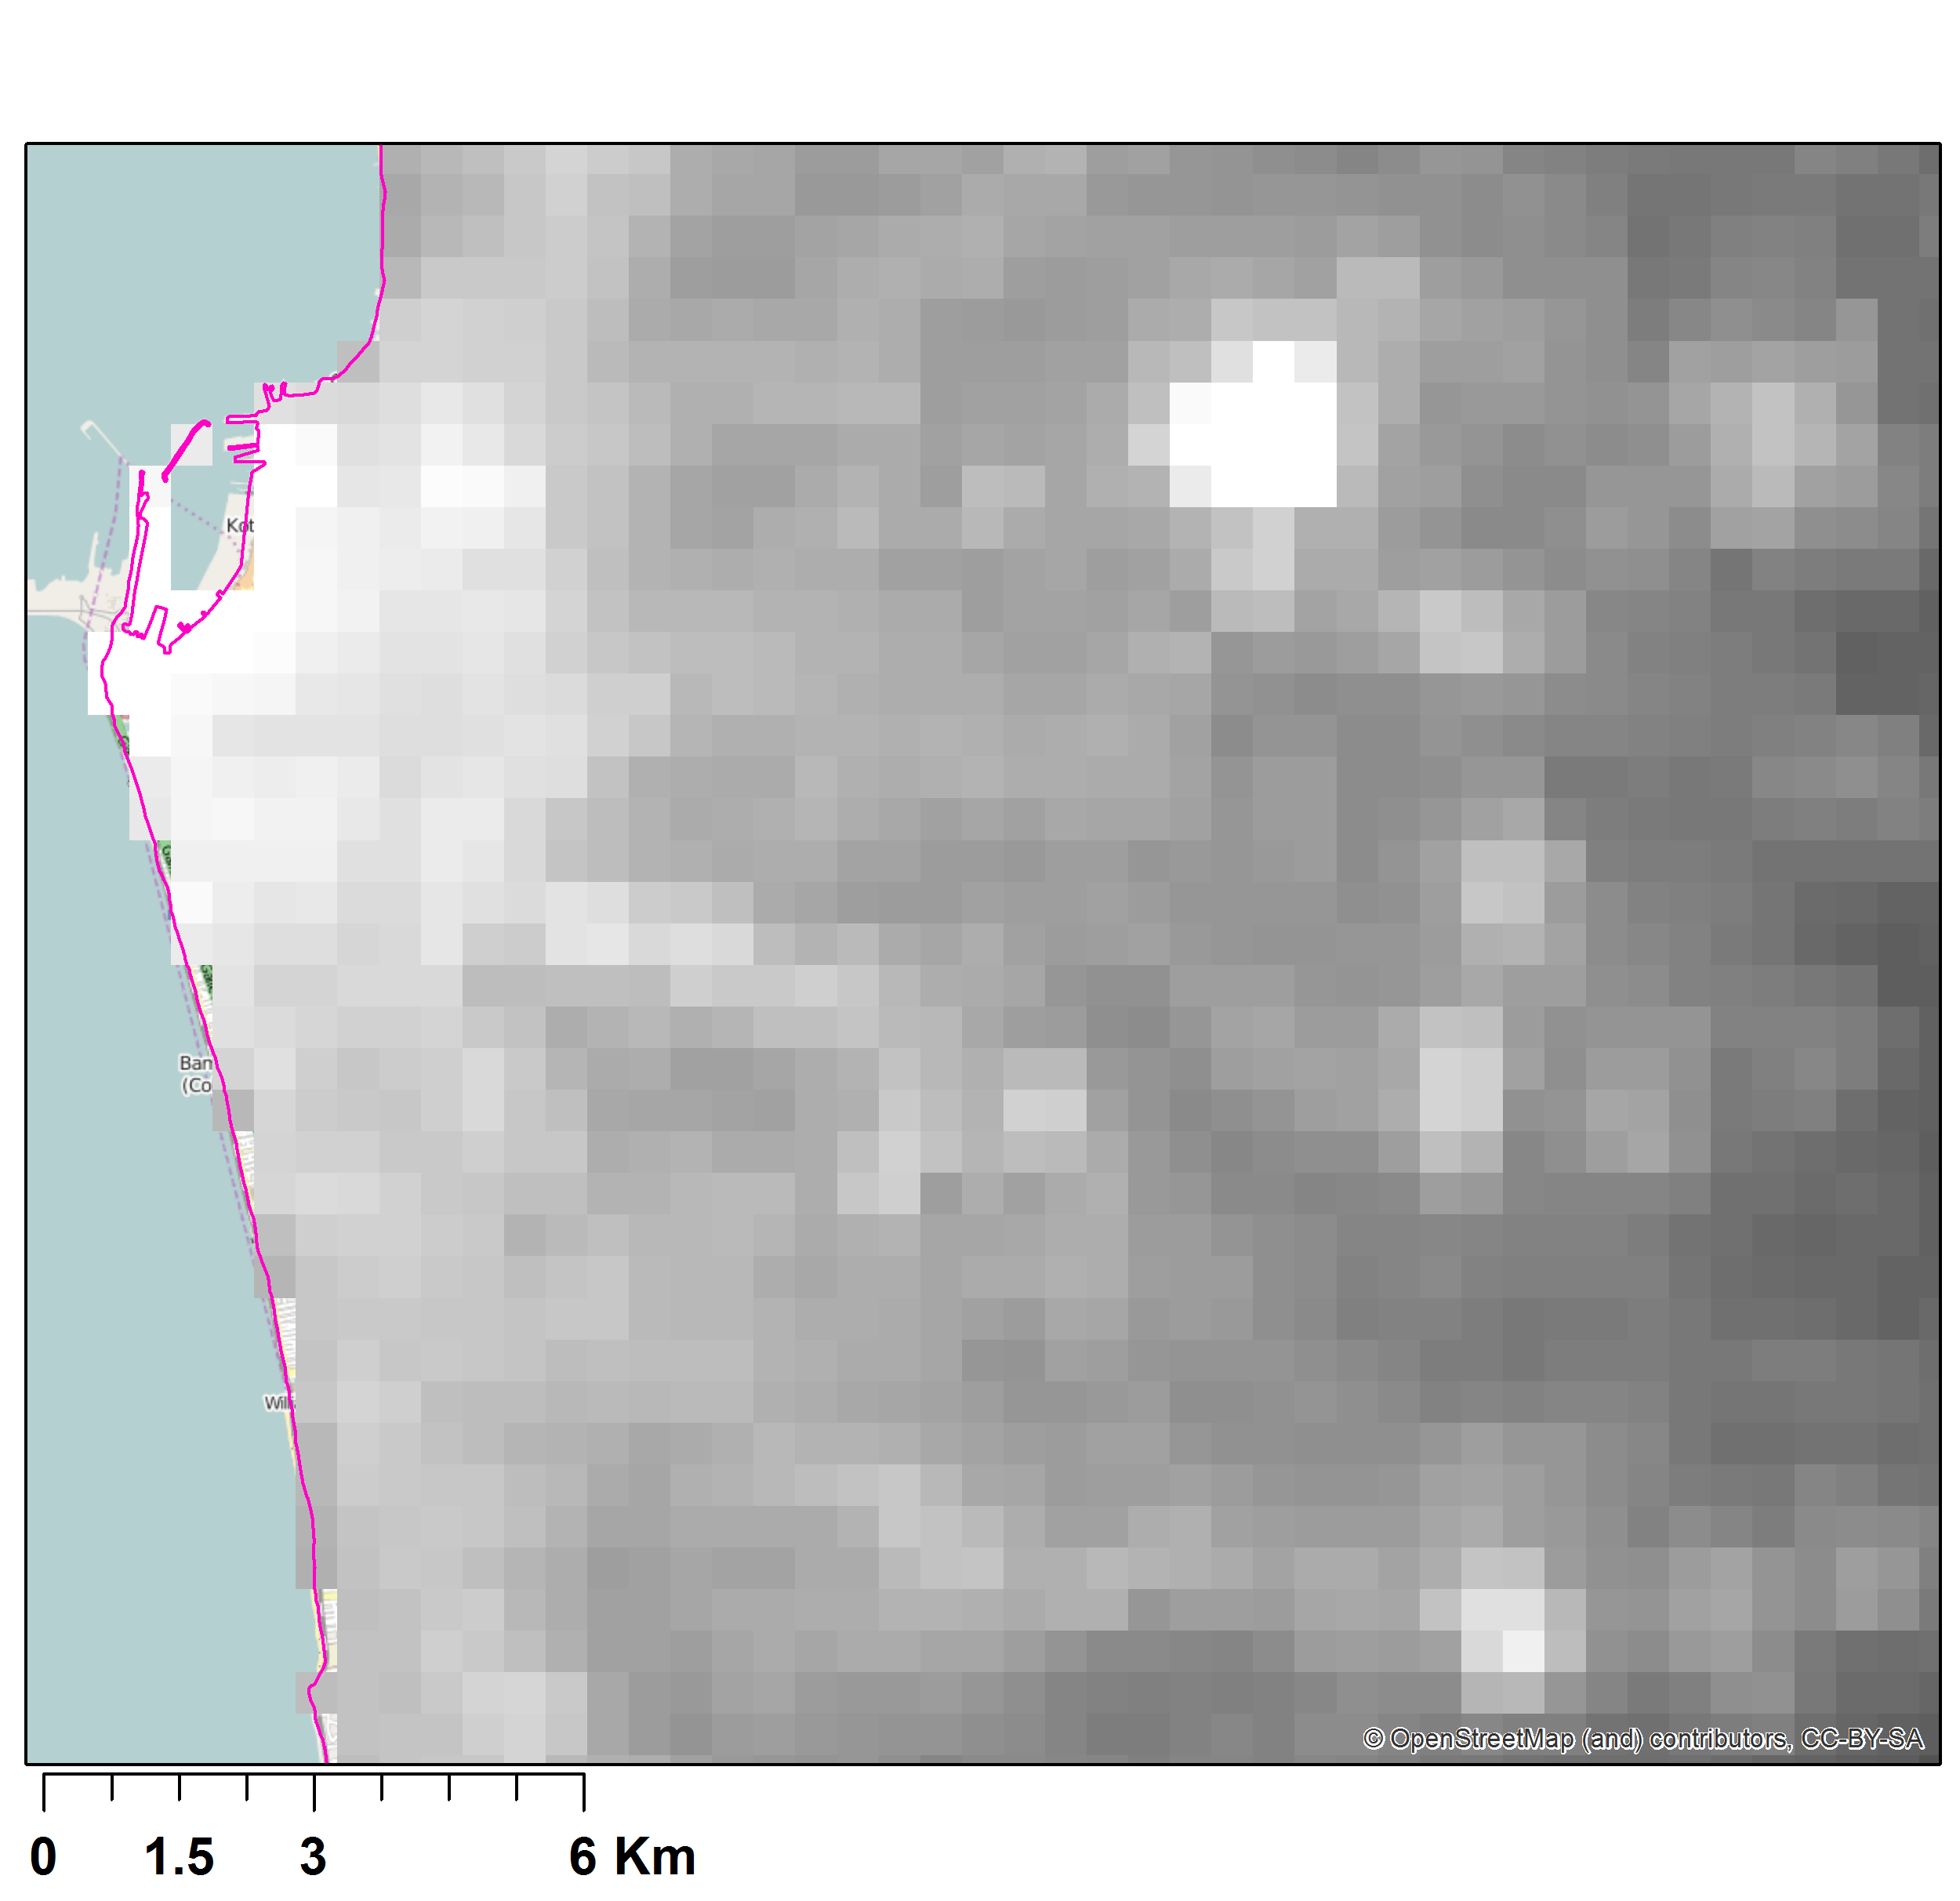
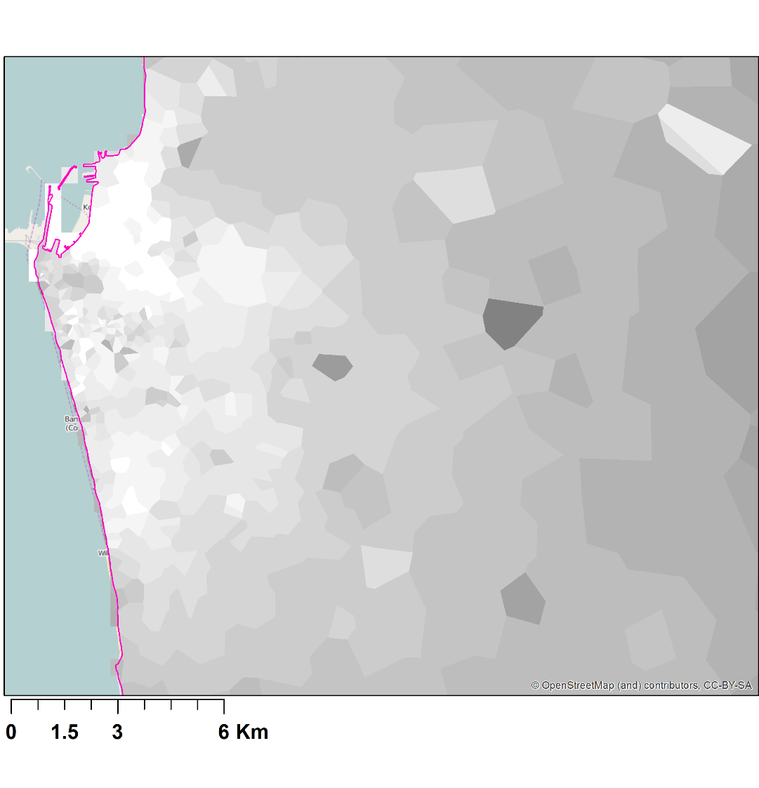
Model validation using
nightlight data from satellites
Nightlights Mean income
Low
High
Notes:
I would point out that the large flare in nightlights is a gas refinery, and the three smaller bright spots lower and to the right are highway entry ramps. My take on this graph is that the model does a good job, yet there can be clear improvements.

Slide 45
Incorporating other data can give further insights
Household data: Census/HIES/LFS
Industrial data: ASI, Industrial Census
 | Nightlights | Household data | Industrial Data
Geographic variation
Time variation | yearly | quarterly/ 2-3yrs/decade | yearly/decade
Relevant variables |  | Education, (un)employment, skill levels | Employment, capital intensity
Ideal for: |  | Improving Measure | Improving & Validation
Notes:
HIES household income and expenditure survey
LFS: labor force survey
ASI: Annual Survey of Industries

Slide 46
Benefit of an improved framework for modeling economic activity
Increase the coverage of existing surveys (both temporal and geographic)
  By calibrating with household, industry census and survey data, when available
  Then, mobile data can be used to predict/extrapolate for time periods and regions without survey data
Can capture informal economic activity
  Other research suggests informal economy is almost 30% of GDP in Sri Lanka

Slide 47
Implications
A new measure of economic activity from commuting flows (from mobile phone data)
  Significant potential use for policy and research.
  Fine temporal and spatial resolution.
Preliminary validation with the best available data looks promising
Additional data (Industrial, Household) will allow measure to be taken to next level

Slide 48
Understanding population density & mobility
  Population density
  Commuting patterns: where do people live and work
  Mobility changes during important events: Case study of “Avurudu”
Understanding land use characteristics
Understanding communities
Preliminary work on gaining insights on economic activity
Exploratory work on gaining insights from reload data

Slide 49
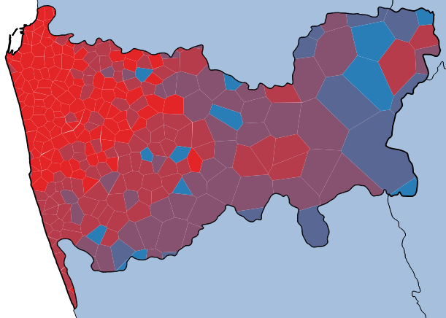
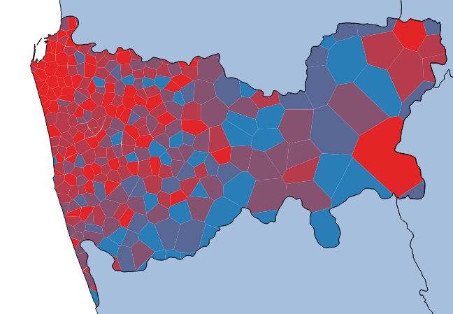
Average monthly reload by residents of Colombo & adjacent region is high, as is variability
Average monthly reload amount
Co-efficient of Variation (COV)
Low
High

Slide 50
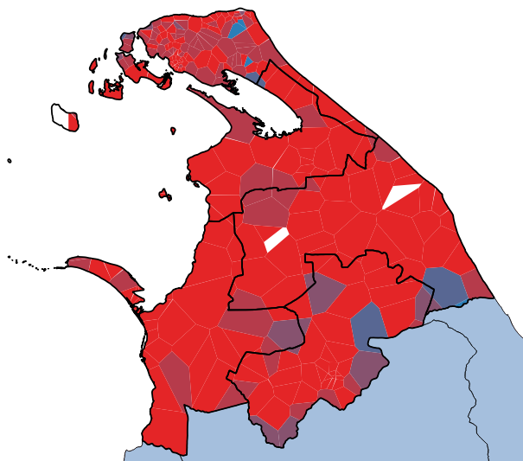
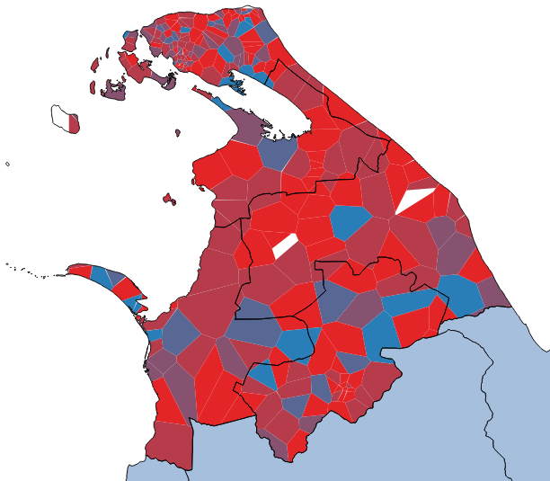
Similar story for Northern Province residents, but average monthly reload is higher than Colombo district
Average monthly reload amount
Co-efficient of Variation (COV)
Low
High

Slide 51
Research in other countries suggest differential reload behavior may be correlated to household income
Higher
household income
Average
top-up size
10
Lower
household income
1
1
1
1
1
1
1
1
1
1
Top-up frequency
Source: Gutierrez, T., Krings, G., & Blondel, V. D. (2013). Evaluating socio-economic state of a country analyzing airtime credit and mobile phone datasets, 1–6. Retrieved from http://arxiv.org/abs/1309.4496

Slide 52
But preliminary LK results are inconclusive
Large majority of LK mobile users reload using recharge cards and higher denomination cards are not easy to come by
High reload spending in Northern Province meshes with
  Findings from Department of Census and Statistics
  LIRNEasia research on high communication expenditures
Addition work required:
  Ideally we would have user-level socio-economic data through phone surveys, but difficult to implement
  Co-relate fine grained MNBD behavioral data (not just reload but also mobility and social) with census-block level data from HIES and Census
    V. Soto, V. Frias-Martinez, J. Virseda, and E. Frias-Martinez. 2011. Prediction of socioeconomic levels using cell phone records. In Proceedings of the 19th International Conference on User Modeling, Adaption, and Personalization (UMAP’11). Springer-Verlag, Berlin, 377–388

Slide 53
Selected Publications & Reports
Lokanathan, S., Kreindler, G., de Silva, N. D., Miyauchi, Y., Dhananjaya, D., & Samarajiva, R. (forthcoming). Using Mobile Network Big Data for Informing Transportation and Urban Planning in Colombo. Information Technologies & International Development
Samarajiva, R., Lokanathan, S., Madhawa, K., Kriendler, G., & Maldeniya, D. (2015). Big data to improve urban planning. Economic and Political Weekly, Vol L. No. 22, May 30
Maldeniya, D., Lokanathan, S., & Kumarage, A. (2015). Origin-Destination matrix estimation for Sri Lanka using mobile network big data. 13th International Conference on Social Implications of Computers in Developing Countries. Colombo
Kreindler, G. & Miyauchi, Y. (2015). Commuting and Productivity: Quantifying Urban Economic Activity using Cell Phone Data. LIRNEasia
Lokanathan, S & Gunaratne, R. L. (2015). Mobile Network Big Data for Development: Demystifying the Uses and Challenges. Communications & Strategies.
Lokanathan, S. (2014). The role of big data for ICT monitoring and for development. In Measuring the Information Society 2014. International Telecommunication Union.
More information:
http://lirneasia.net/projects/bd4d/

