Slide 1
What is the significance of ICTs to Union legislators?
Rohan Samarajiva
Yangon, 21 June 2016
This work was carried out with the aid of a grant from the International Development Research Centre, Canada and the Department for International Development UK..

Slide 2
About LIRNEasia
Our mission:
“Catalyzing policy change through research to improve people’s lives in the emerging Asia Pacific by facilitating their use of hard and soft infrastructures through the use of knowledge, information and technology.“

Slide 3
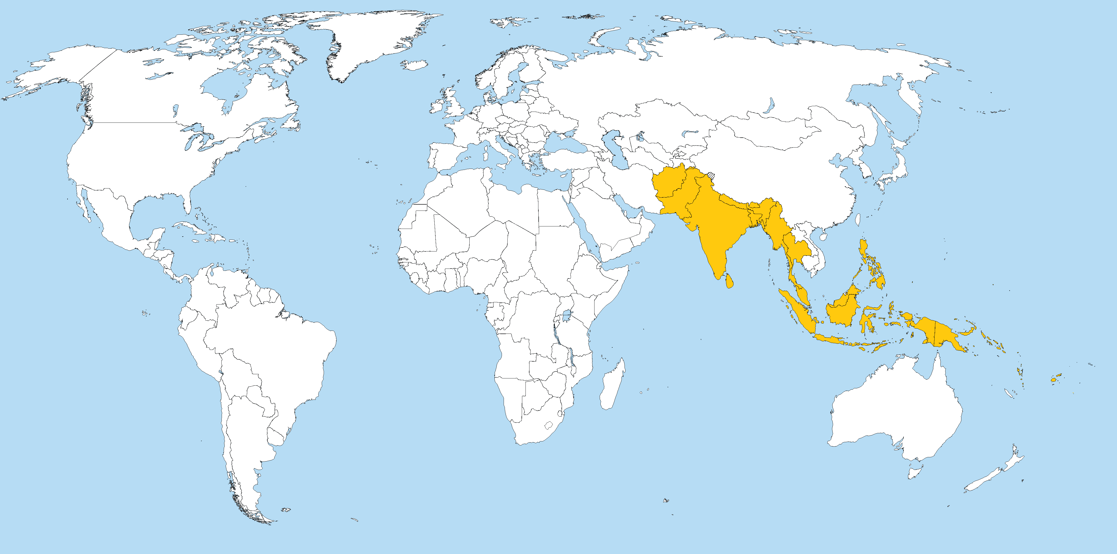
Countries that we engage with

Slide 4
Something seemingly simple

Slide 5
Gates Foundation 2011 Innovation Awardee: Bangladesh’s Dr Asm Amjad Hossain
Raised immunization rates in 2 districts from 67% and 60% in 2009 to 85% and 79% in 2010
How did he do it?
Registered pregnant women (date of delivery, location, and phone number) so vaccinators knew when children were born, where they were, and could contact their mothers
Established annual schedules for vaccinations
Had vaccinators put phone numbers on immunization cards, so parents with young children could get in touch with a health worker

Slide 6
Necessary condition is close to being achieved
80 SIMs per 100 people
20 m (MPT); 15.5 m (Telenor); 6.9 m (Ooredoo) by end April 2016
Possibly more than 50% data users
Coverage in all regions and states though areas without coverage exist
It is now possible to assume electronic connectivity like Dr Amjad Hossein does

Slide 7
Sufficient condition needs to be worked on
Decentralized innovation like that of Dr Amjad Hossein

Slide 8
Reforms need more work

Slide 9
Establishing regulatory agency
S. 86: “In order to be able to implement this law on telecommunications services, the Union Government shall establish an independent Myanmar Telecommunications Commission, led by an appropriate individual at the Union level, within two years of the effective date of this law.”
Two years was up 2015 October
Close analysis of Law and Rules shows substantive amendments are required

Slide 10
Capacity for regulatory functions (MTC) and policy functions (Ministry)
Does the capacity exist within the country?
Can expatriate Myanmarese be attracted?
Can adequate compensation packages and career paths be provided?
Can Ministry obtain required expertise other than from MPT?
Will telecom be neglected in new Ministry of Transport and Communication?

Slide 11
Functions within Union jurisdiction; You know this best
SCHEDULE 1
Posts, telegraphs, telephones, fax, e-mail, Internet, Intranet and similar means of communication
Television, satellite communication, transmission and reception, and similar means of communication (and housing and buildings?)

