Slide 1
Legislation, policies, plans, strategies, regulation
Rohan Samarajiva
Yangon, 21 June 2016
This work was carried out with the aid of a grant from the International Development Research Centre, Canada and the Department for International Development UK..

Slide 2
Objective
Clarify different government functions and demarcation of responsibilities in ICT infrastructure and services/applications

Slide 3
ICT infrastructure (telecom)
Clarity re different functions and demarcation of responsibilities is important because
Multiple private players are active
Market and technology conditions change rapidly and
Large investments are at stake

Slide 4
ICT services and applications
Clarity re different functions and demarcation of responsibilities is important because
Even more private players are active, and
Market and technology conditions change rapidly
Optimal sequence of actions may be different

Slide 5
definitions

Slide 6
The framework
Is the supreme law, the Constitution

Slide 7
Law is . . .
Made and amended by Parliament
Subordinate to the Constitution, the Telecommunications Law (2013 Union Parliament Law No. 31) sets out the broad principles and powers
Not expected to be changed frequently, though ICT sector laws become obsolete quickly
Rules made under a Law spell out details and allow greater flexibility

Slide 8
Policy, plan and strategy are . . .
Adopted by the Executive; subordinate to Law
Policy sets out what must be done and justifies why it must be done
Plans, which are more concrete and short-term, provide the strategy by which the policy is to be implemented
Plans define how the necessary actions will be taken by whom and when so that the policy objectives may be realized

Slide 9
Regulation is . . .
“Sustained and focused control by a public agency over activities in a sector”
Restraining
Enabling
More on why regulatory agencies should be independent later

Slide 10
Ict infrastructure sector

Slide 11
Why policy?
Some countries manage without formal policy
Sri Lanka’s telecom policy is from 1994
Bangladesh is from 1998
Both are almost completely obsolete
India adopted a formal National Telecom Policy in 2012, after 13 years
But, a formal policy, adopted after due consultation, serves as a guide to private investors and stakeholders and reduces uncertainty, especially in infrastructure ➔ encourages investment

Slide 12
Pakistan

Slide 13
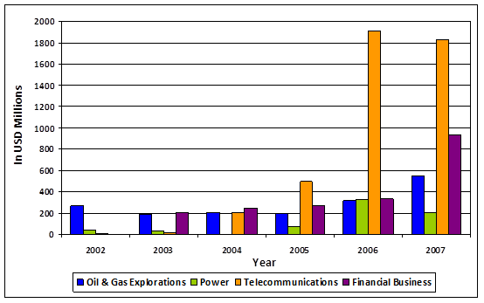
Foreign Direct Investment in Pakistan by sector, 2002-07
Mobile cellular
policy
Source: State Bank of Pakistan (2008; http://www.sbp.org.pk/ecodata/NIFP_Arch/index.asp)

Slide 14
Ict services & application sector: an example

Slide 15
E Sri Lanka program
2001 economic and political crisis ➔ new reform government; President & Prime Minister from opposing parties
Prime Minister keen to emulate Hyderabad and create white-collar jobs in IT enabled services
Young, dynamic Minister with strong international credentials given charge of Information Technology, not Telecom

Slide 16
Starting with a program
World Bank aid sought to formulate an integrated ICT development program for Sri Lanka, mid 2002
Cross-sectoral effort; first time for World Bank
Local team actively participated in design
Infrastructure reforms to end contested exclusivity for international telecom services were being implemented in parallel

Slide 17
Program architecture
E leadership
E society
E government
E business
Infrastructure

Slide 18
Diagnosing road blocks
Existing organization, CINTEC, was unable to perform apex function
New agency?
What to do with old one?
Coordinating with multiple government agencies to advance e government was seen as the greatest challenge
Authority higher than individual Ministers?

Slide 19
Different sequence
Program design, inclusive of policy, plan and strategy
Informal linkage to related telecom policy
Law followed

