Slide 1
Group 5 Wi-Fi Access to the Bottom of Pyramid (BoP) A. Prabaharan Anirban Das Dushyant Mahadik
How to Engage in Broadband policy and regulatory processes?
IIT-DELHI, 19-22 AUGUST 2016

Slide 2
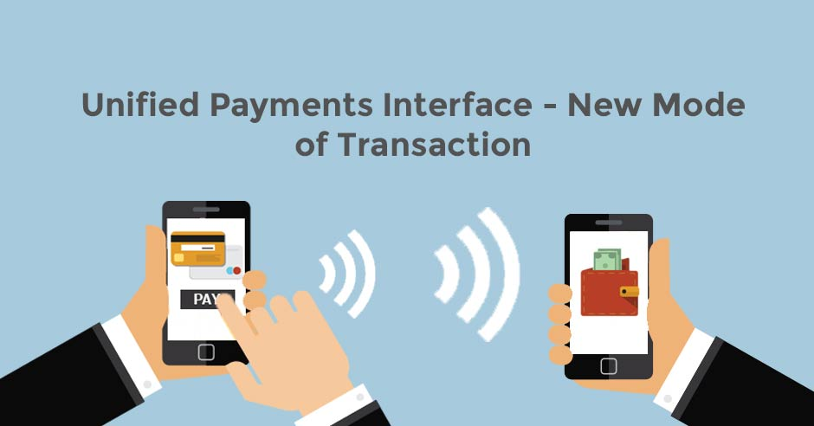
Introduction
This policy brief is to examine whether the Unified Payment Interface (UPI) is to be adopted by the Internet Service Provider (ISP) for easy subscription of Wi-Fi access in India and the types of content to be hosted by the local community.
We are giving this policy brief based on our study of TRAI policy paper 14/2016, various books, academic journals, newspapers, and websites.

Slide 3
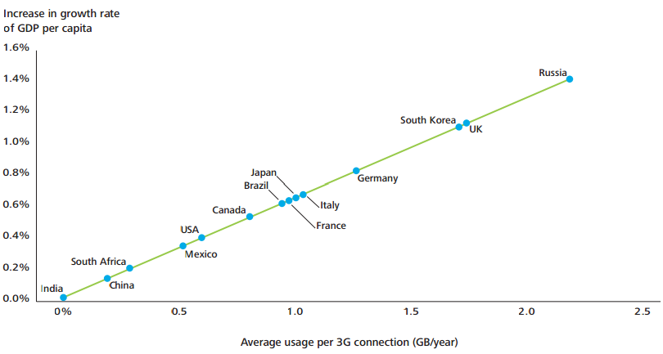
Vitality of ICT
Research across the world shows that access to technology especially internet and Smartphones can increase the GDP of a nation in a substantial way as shown in Figure 1 [1].
Fig 1: Average data usage per 3G on growth of GDP per capita

Slide 4
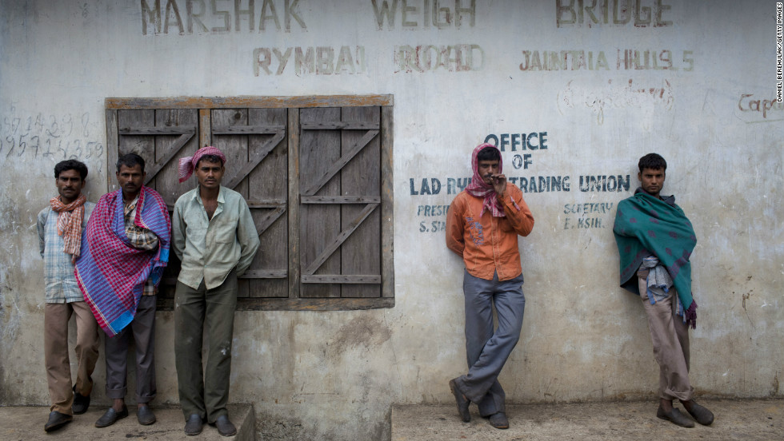
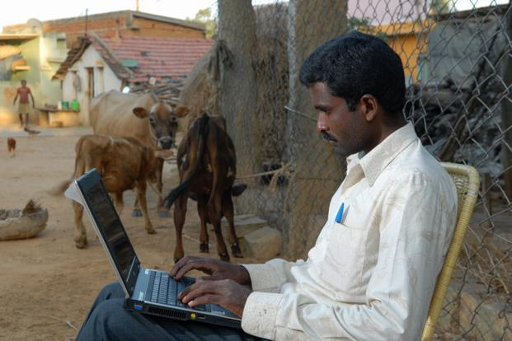
Triple Jump India
India can triple jump the industrial age backwardness in the digital age by providing Wi-Fi to its bottom of the national pyramid free of cost.
India’s performance in provision of internet connection to its people is very dismal
D
I
G
I
T
A
L
D
I
V
D
E

Slide 5
Chak De Young India
India has the largest youth population in the world
This demographic advantage can be used to make it as an economic power-house if the large number of youth can be skilled through ITES.

Slide 6
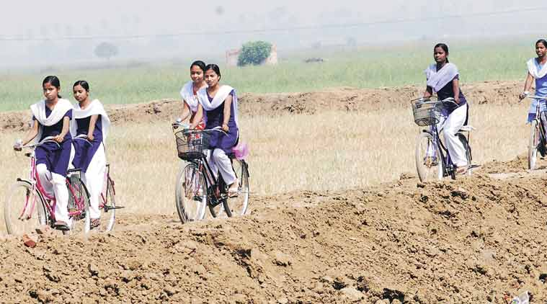
Connect the Unconnected
A vast majority of the unconnected are either residing in rural parts or urban poor.
In this context, it is pertinent to connect the unconnected across the country.

Slide 7
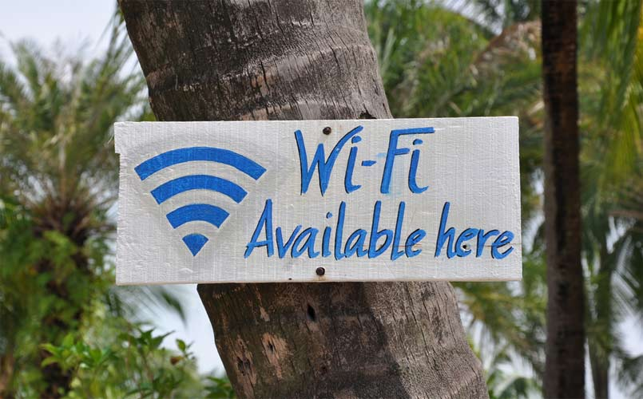
Go for Wi-Fi
WiFi is seen as a potent alternative that will be cheap to implement due to its use of unlicensed spectrum.
Moreover, it minimizes the capital intensive cabling work.

Slide 8
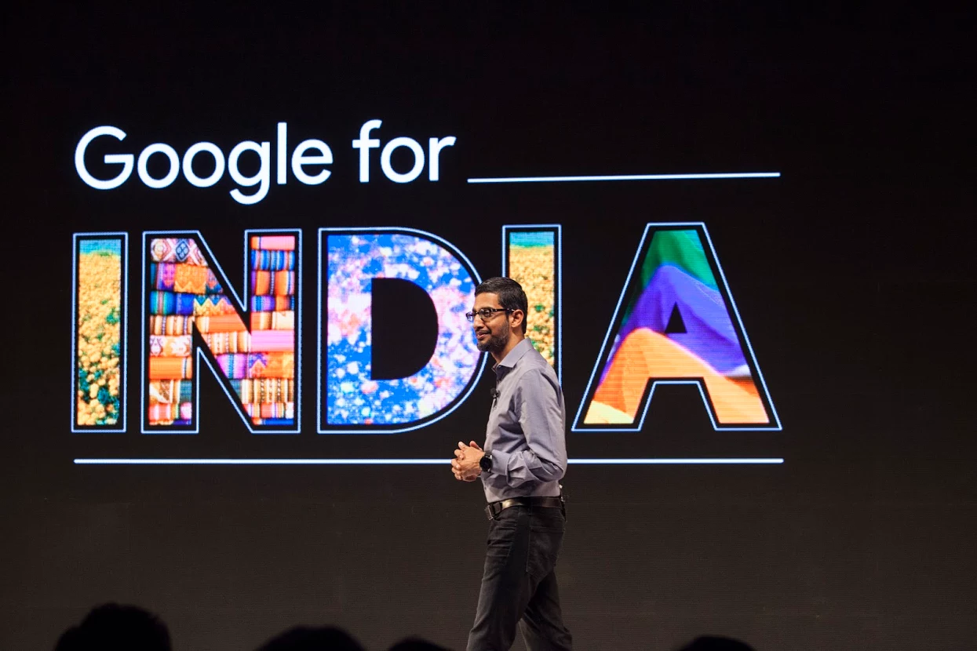
Hi-Fi Wi-Fi India
We live in the ‘Free Age’ where there is an increasing free offers day in and day out.
WhatsApp, Wikipedia, email, search, blogs, e publishing etc are free.
In this ‘Free Age’ it is good to offer limited Wi-Fi access to the poor people in both rural and urban areas.
Especially youth below 35 years can be targeted in the scheme which can be coined as “Hi-Fi Wi-Fi India”.
Those who can afford the costs can be offered unlimited Wi-Fi access for payment.

Slide 9
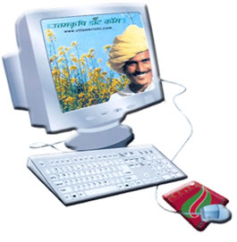
Partner to Move India
We suggest that the partnership among Public, Private and Philanthropists to give free gadgets cum Wi-Fi access to those who cannot afford it. (Abramson et al)
Tamil Nadu Government has been giving free laptops for the past 5 years. It has proposed to provide hi-fi broadband access to every household (Illum Thorum Inaiyum – Internet for every household).

Slide 10
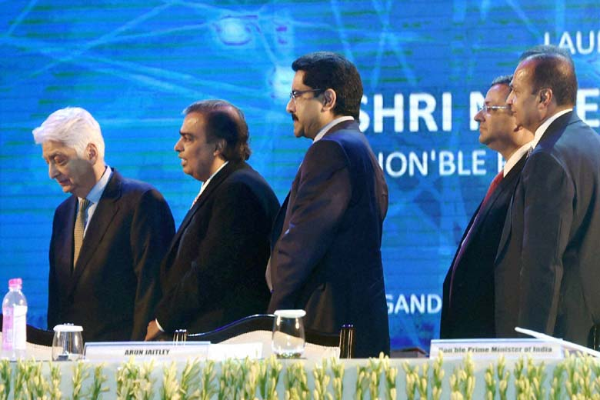
Freemium Wi-Fi
We suggest that 36 willing corporate companies may be invited to provide free Wi-Fi access to the poor in 29 states and 7 union territories of India
This can be their Corporate Social Responsibility.
We support the Freemium model for Wi-Fi access for the poor people

Slide 11
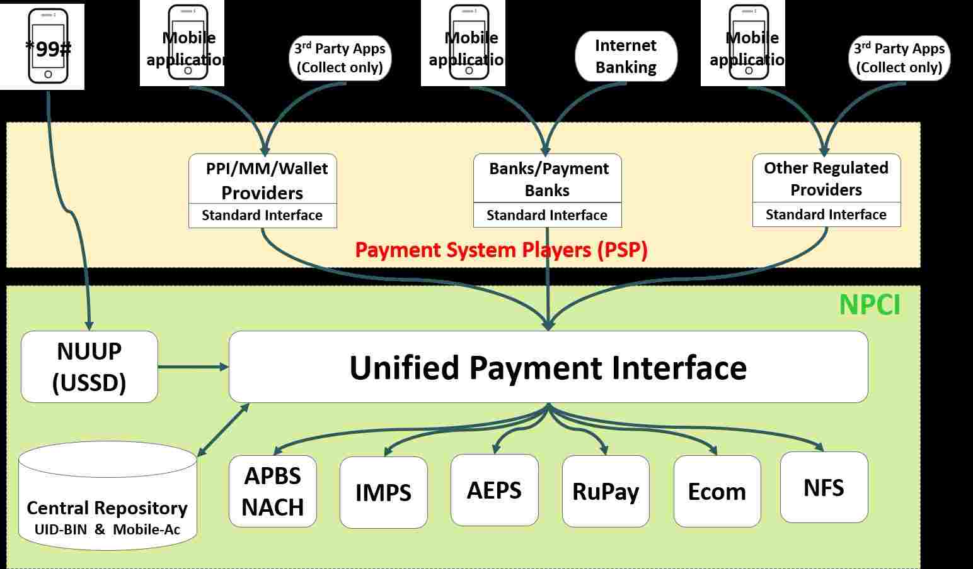
Complexity of UPI
Unified Payment Interface of the National Payment Corporation of India provides a significantly smoother payment experience for payments initiated by either payee or payer.
The interface is flexible to make possible payments over apps, websites, near field; with the help of QR code and other mechanisms.
However, a simplistic UPI based interface will require 802.11u standard devices, for the devices to move between networks seamlessly.
These devices are rare even in urban affluent settings.
It may take many years before it reaches the target segment of bottom of pyramid.

Slide 12
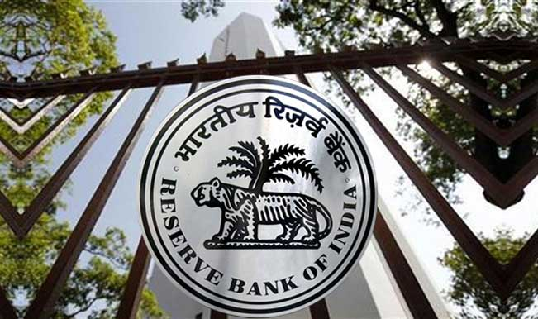
RBI’s lens is beyond telecom connectivity
Ownership and regulation of payment platform is under the purview of financial regulator - Reserve Bank of India.
RBI looks at broader issues than mobile connectivity.
Therefore, the question of ownership and control of platforms cannot be answered through only the limited lens of telecom connectivity.

Slide 13
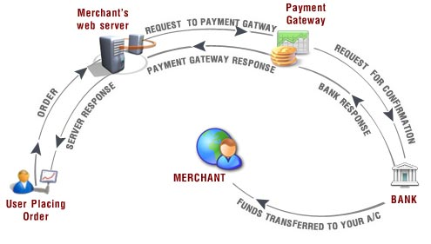
Different models for different people!
Thus, the decision not to force a payment interface is a conscious one.
The entities that would charge over and above the free data pack should also be given the freedom to choose their mode of collection of payments, so as to suit their respective market realities.

Slide 14
Local hosting of data
The rationale for local hosting is to reduce the price of data and connectivity is low to the end users.
However, as first 20 MB data is to be give free per day, the local hosting is not required.
The local hosting may be undertaken to deal with eventualities of loss of connectivity from NOFN.

Slide 15
CSC – The Future Hope
Community Service Centres (CSCs) in every Panchayat can host data of community interest.
This can come free of cost supported by the CSR activities of local companies or the government.
In case of the absence of the above two, then it can be borne by the population collectively.
Further, the local hosting of contents is also open to private entrepreneurs, if there is a business model around it.

