Slide 1
WI-FI HOT SPOTS Facilitating Creation and Access
Group 3
Purva Grover, Arijit Das, Suhas Ranjan, Nalini Srinivasan

Slide 2
Login and Authentication
Are there any challenges being faced in the login/authentication procedure for access to Wi-Fi hotspots? In what ways can the process be simplified to provide frictionless access to public Wi-Fi hotspots, for domestic users as well as foreign tourists?

Slide 3
Summary Recommendations
This group would like to recommend:
The establishment of a Unique Telecom Identification Number (UTIN) as a means to register for and avail of services across multiple telecom service providers. Such UTIN could facilitate the digital authentication of user credentials as also payment for services across service providers
The consideration of device based access to Wi-Fi services across providers as available in other countries
The implementation of Wi-Fi roaming agreements between service providers across India (WRIX) in the near term

Slide 4
Challenges
KYC is required for the national security but this causes inconvenience for the general public
OTP based authentication
Network Congestion
Foreign telephone connections not recognized
Photo id based authentication
Fake ids
Id not always available particularly in the case of dependent women (Male dominant society)
Relevant Id in case of foreigners is still undecided
No central agency designated for authentication
Single use per login restriction
Interoperability across providers unavailable
Repeated authentication at each instance of access
No standards set vis-a-vis charge collection
Lack of standardization in hot spot login/authentication process
Wi-Fi still perceived as a free service

Slide 5
Recommendation – Unified ID Based
Creation of a Unified Telecom Identification Number (UTIN)
MHA/UIDAI/TRAI to maintain a centralized-cloud based digital portal for storage and authentication
Obtained upon first registration with any service provider (ISP/TSP/VNO etc)
Digital storage of credentials in such portal by service provider upon registration and authentication
Subscriber provided UTIN based portal login once registered
UTIN based access to all telecom services
To be associated/connected with payment wallet
Foreign users can obtain UTIN with Visa application (e.g. Taiwan)
Implementation of Wi-Fi roaming agreements between service providers across India (WRIX) a prerequisite

Slide 6
Other solutions
Domestic Users
Portable device based wireless internet access operable across all the networks and service providers (e.g. Teppy in Lithuania)
International Users
Such a device (Teppy) could be made available at Indian Embassy while applying for Visa or at point of entry
Bilateral or Multilateral Wi-Fi agreements with other nations for Wi-Fi roaming (e.g. Singapore and US)
Some facilitates should be made so that foreigners can use Boingo and iPass as in other countries.

Slide 7
Frequency Band De-licensing
Apart from frequency bands already recommended by TRAI to DoT, are there additional bands which need to be de-licensed in order to expedite the penetration of broadband using Wi-Fi technology? Please provide international examples, if any, in support of your answer.

Slide 8
Summary Recommendations
This group would like to recommend that
Like in other countries more frequencies particularly in the 5-6 GHz band could be un-licensed for WLAN use. Specifically the 5.15-5.35 GHz, and 5.725-5.825 GHz be considered for de-licensing
TV White Space (470- 582 Mhz) available with Doordarshan under Ministry of I&B be un-licensed and be used as a mesh technology with the existing connectivity medium till NOFN/BharatNet is completed

Slide 9
Indian Scenario
In India the 27MHz band (Citizen Band) and the Wi-Fi range from 2.4 GHz and the 5.8 GHz ranges are unlicensed today
Community Wireless Networks operating using unlicensed frequencies can facilitate initiatives like telemedicine, e-governance, e-commerce, e-learning, and telephony service through Voice over Internet Protocol (VoIP) thus serving the unreached at a much lower cost
Both bands (2.4 GHz and 5.8 GHz) are highly congested thanks to ISPs shifting to these unlicensed bands
Equipment available for use in this band require large spectrum range and compromise solutions from the limited options lower quality of service and restrict expansion in band
NTP 2012 recognized the need for more un-licensed spectrum release

Slide 10
Other countries
Following recommendations of the World Telecommunications Conference (WRC) in 2003, US, UK and Canada unlicensed spectrum in the 5-6 GHz range
The FCC unlicensed the 5.15-5.35 GHz and 5.725-5.825 GHz frequencies. The FCC also added 5.47-5.725 GHz to the unlicensed NII band.
In March 2003, EU advised its member states to de-license the 2.4 GHz and 5 GHz bands to administer public communication networks and services
The 433-434 MHz band has been unlicensed in Australia, Singapore, Malaysia, the European Union, and New Zealand
In Brazil, the TPC use in 5.150–5.725 GHz band is optional. DFS is required only in 5.470–5.725 GHz band
China MIIT expanded and allowed channels as of Dec 31 2012 to add UNII-1, 5150 ~ 5250 GHz, UNII-2, 5250 ~ 5350 GHz (DFS/TPC)

Slide 11
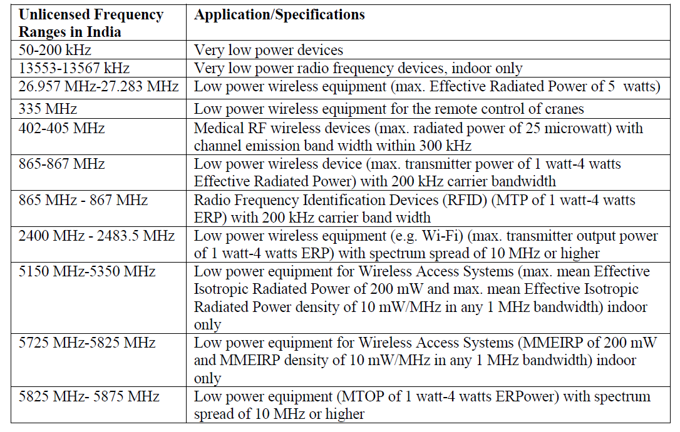

Slide 12
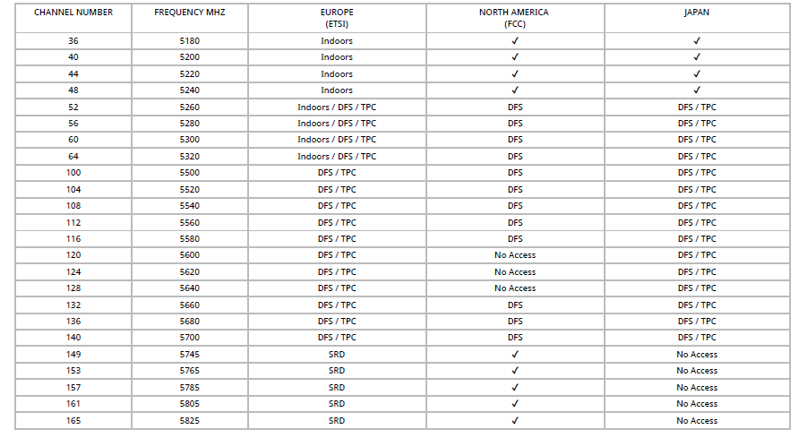
5 GHz WiFi Channels and Frequencies

Slide 13
Our Recommendations
Many industry bodies and advocacy groups in India have specific requests for unlicensed spectrum
The requests cover candidate bands including, 433-434 MHz, more bands in sub-1 GHz, more slots under 2.4 GHz, 1880-1900 MHz, 5.15-5.35 GHz, and 5.725-5.825 GHz
Like in other countries more frequencies in the 5-6 GHz band could be un-licensed for WLAN use
It is also recommended that TV White Space available with Doordarshan be un-licensed as well

Slide 14
Thank You

