Slide 1
Wi-Fi available here, Everywhere Interoperability for Public Wi-Fi
Dheep Joy Mampilly, Jaspreet Singh, Ranjeet Rane & Mayank Singhal

Slide 2
Recommendations
Public Wi-Fi to be included as an integral component of the Smart Cities Mission
City administration to be the nodal implementing authority
City administration to formulate a PPP model
Implement existing standardized technology solution for interoperability between Wi-Fi Networks
Single window payment solution that tracks data usage and does centralized billing
Extension to Rural India after successful urban Implementation

Slide 3
Integration with Smart Cities Mission
Internet connectivity and interoperability among IoT devices would be a fundamental requirement of Smart Cities
The Mission as well as Digital India initiative clearly states the need for integrating communication infrastructure in new urban development plans
The political will to push the Smart Cities program is very strong and enjoys support and guidance of the PMO as well
The progress of this mission is being tracked directly by the MoUD on high priority
Most of the Smart City finalists have incorporated nodal agencies for the mission and these are under the ULG institutions in the respective cities with fair representation from the state administrative machinery

Slide 4
Municipal Public Wi-Fi
Nodal agency under Municipal Corporation incorporates setting up of backhaul infrastructure in PPP model
The city is divided into smaller areas for the purpose of setting up of Wi-Fi hotspots
Compared to a nationwide implementation this can be more focused and will also enable extension of the city circles to adjoining rurban areas as the city limits are increased annually
India had 29,205 Wi-Fi hotspots in 2014 (31,518 in 2016). In comparison, top ranking countries like France, United States, and United Kingdom had significantly higher numbers at 13 million, 9.8 million and 5.6 million hotspots, respectively
The demand to set up Public Wi-Fi in India originates from the need to reach a goal of one hotspot for every 150 people, 8 lakh additional hotspots will have to be installed

Slide 5
Technological Solution
Nodal Body
Will provide interoperability among different Wi-Fi networks (as well as between cellular and Wi-Fi networks) of ISPs, by connecting all ISPs to a central server in each telecom circle
Will consist of a single window payment solution that tracks data usage and does centralized billing
Will provide a mechanism to attract entrepreneurs to set up and manage public Wi-Fi hotspots to cover the whole area, according to pre-specified Service Level Agreements, on a remunerative basis

Slide 6
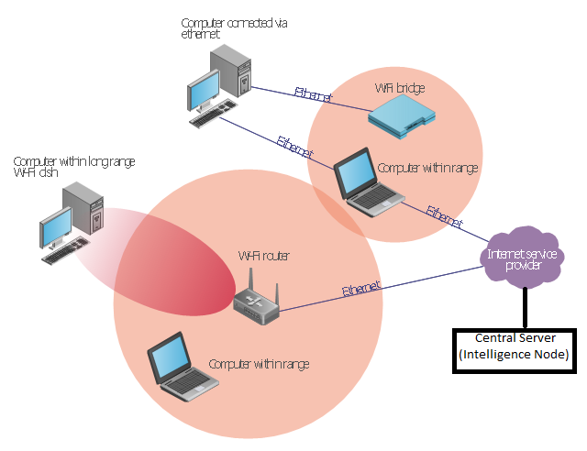
Architecture
Functioning of the IN node:
Will be connected to every ISPs through lease line.
Will be connected to each and every Public Wi-Fi Hotspot deployed in a city or any small area
Will be responsible for user authentication and a single window for payment portal
Will take care of the data usage of all ISPs.
Network Operating Centre (NOC) for managing the complete Wi-Fi operations by the one who is deploying the network.
SSID should be kept same for every city
The entity who will deploy the Wi-Fi Hotspot can take the internet bandwidth from the Point of Presence from any ISP and can start offering his services to users.

Slide 7
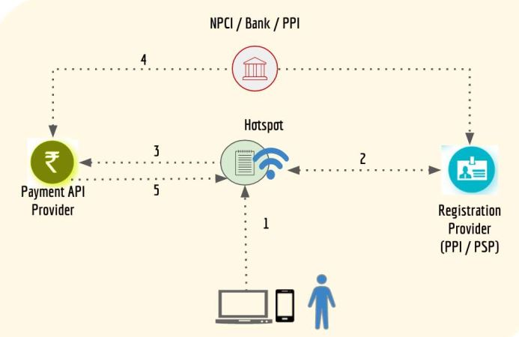
Single Click Payment
The entity who will first deploy the Wi-Fi Hotspots will first get revenue back and the data usage charges can be distributed among the different ISPs.

Slide 8
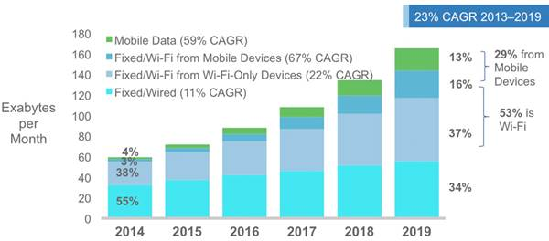
Future Demand
Source: http://www.cisco.com/c/en/us/solutions/collateral/service-provider/visual-networking-index-vni/mobile-white-paper-c11-520862.html

Slide 9
Getting Bharat Online
By the time the first phase of roll-out of public Wi-Fi in urban areas is completed, all Gram Panchayats of the country would have been connected via optical fiber cable (or other appropriate technology)
This would allow us to replicate a version of the city Wi-Fi model in the rural areas too
District administration to be tasked with establishing a PPP model
Good complement to Bharat Net infrastructure
Room for local customization, using Virtual Network Operators and TV White Space Radios

Slide 10
Socio-Economic aspects
Equity & Digital Inclusion
Service delivery & Infrastructure efficiencies
Civic engagement & Community building
Economic development & Local innovation
Safety & Security

Slide 11
THANK YOU
Q&A?

