Slide 1
Communicating research to policy
Rohan Samarajiva
New Delhi, 16-19 December 2016
This work was carried out with the aid of a grant from the International Development Research Centre, Canada and UKaid from the Department for International Development, UK.

Slide 2
Stripping out regressive & discriminatory elements from a mobile-only tax in September 2007

Slide 3
Anatomy of a regressive tax
 | +General tax | pre-2007 | Proposed |  | Revised
Value | +17.5% VAT & SRL | +2.5% MSL | +7.5% MSL & 50 | Tax as % of value | +10% MSL | Savings
200 | 235 | 241 | 303 | 51.3 | 259 | -44
400 | 470 | 482 | 555 | 38.8 | 517 | -38
600 | 705 | 723 | 808 | 34.6 | 776 | -32
800 | 940 | 964 | 1061 | 32.6 | 1034 | -27
1000 | 1175 | 1204 | 1313 | 31.3 | 1293 | -21
1200 | 1410 | 1445 | 1566 | 30.5 | 1551 | -15
1400 | 1645 | 1686 | 1818 | 29.9 | 1810 | -9
1600 | 1880 | 1927 | 2071 | 29.4 | 2068 | -3
1800 | 2115 | 2168 | 2324 | 29.1 | 2327 | 3
2000 | 2350 | 2409 | 2576 | 28.8 | 2585 | 9
Range of
Prepaid
ARPUs
Relative
winners
Losers

Slide 4
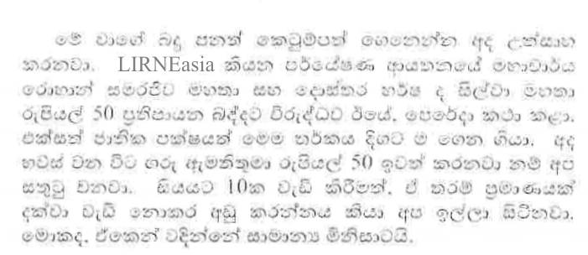
From the Hansard, September 6, 2007
Translation: We will be pleased if Hon. Minister removes the regressive tax of LKR 50 as pointed out by Prof. Rohan Samarajiva, Dr. Harsha de Silva of LIRNEasia and UNP Members. We also request not to increase the mobile subscriber levy to 10%. This tax will have an adverse effect on the common man.

Slide 5
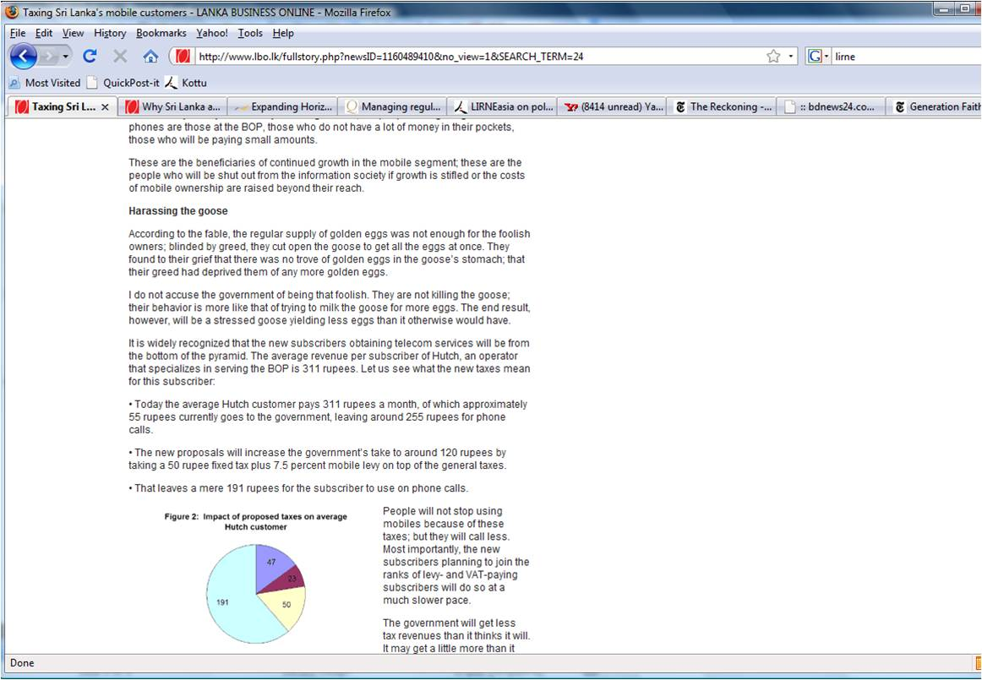
September 3, 2008
“I do not accuse the government of being that foolish. They are not killing the goose; their behavior is more like that of trying to milk the goose for more eggs. The end result, however, will be a stressed goose yielding less eggs than it otherwise would have”

Slide 6
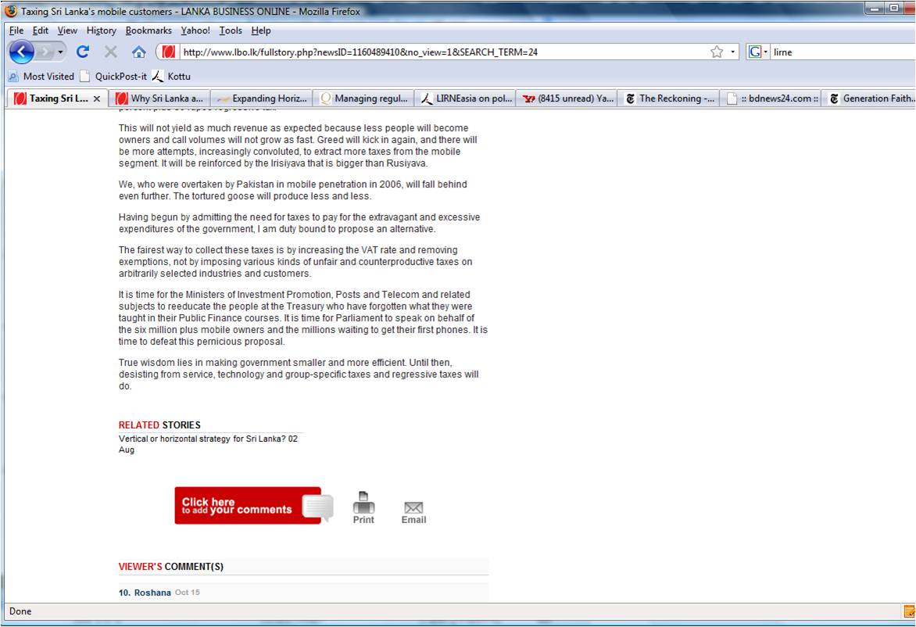
It is time for the Ministers of Investment Promotion, Posts and Telecom and related subjects to reeducate the people at Treasury who have forgotten what they were taught in their Public Finance courses.
True wisdom lies in making government smaller and more efficient. Until then, desisting from service, technology and group-specific taxes and regressive taxes will do.

Slide 7
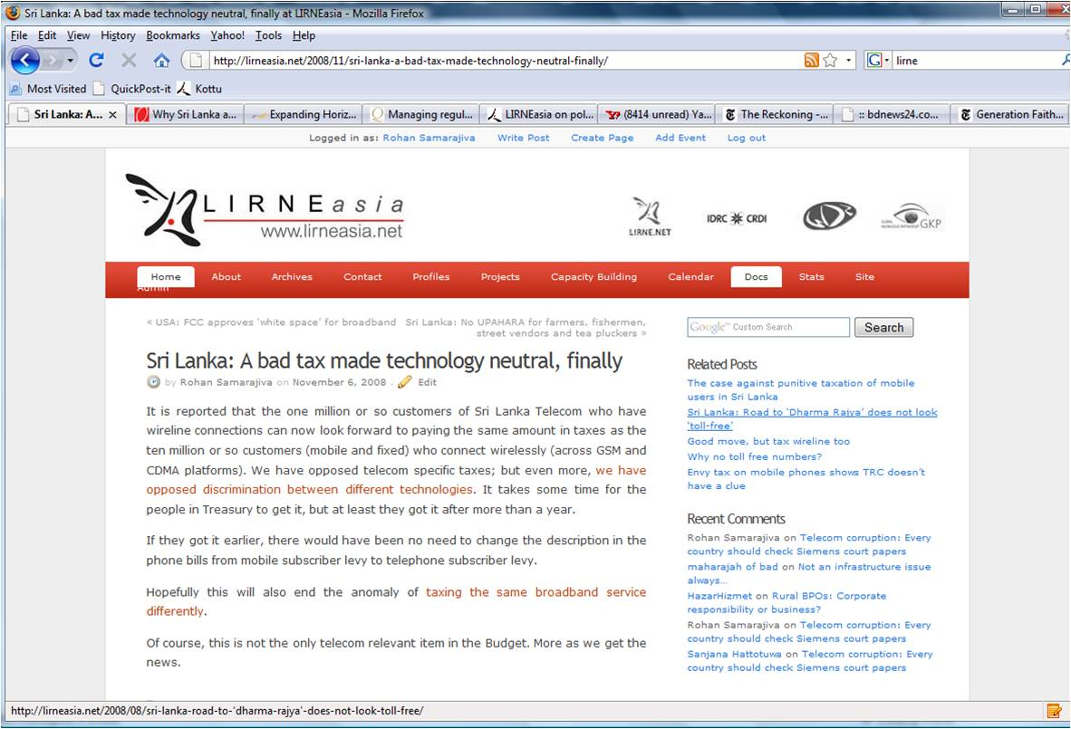
November 6, 2008

Slide 8
Tax increases in 2015-16 with the former opposition in power

Slide 9
Key actors
2007
2015-16
Minister of Finance/ President
Minister of Telecom
Leading opp spokesperson from on tax
Not an MP
Consultant Lead Economist at LIRNEasia
Chair & CEO, LIRNEasia
Now opp. MP
Now Minister of Urban Dev
Minister of Strategic Enterprises
Minister of Telecom
Deputy Minister of Foreign Affairs
Chair, LIRNEasia

Slide 10
New government in financial trouble
Deficit rose after giving approximately INR 5,000 salary increase (to 1.4 million govt employees) and many other goodies as election payoffs
Imposed value-added tax on as many things as they could
Tax-on-tax
Voice, SMS, VAS: 25% telecom levy + 2% NBT+ 15% VAT
Data: 12% + 2% NBT + 15% VAT

Slide 12
Tax misadventure
Inappropriate processing of legislation ➔ tax that was announced for May only implemented in November
By that time, debate around tax had already driven down demand, depressing revenues
2017 Budget Speech (Nov-Dec 2016) proposes equalization of data and voice taxes
Also proposes large number of IT projects and 500% increase in allocation for Telecom & Digitial Infrastructure Ministry

Slide 13
Mild media effort
Article also published in Sinhala weekly read by opinion leaders
But was noticed because of concluding paras
In this light, I propose some additional cost-saving measures. No country should have an agency devoted to the promotion of a demerit good. Now that voice and data services are being treated as demerit goods akin to tobacco and alcohol, it does not make sense to continue the ICT Agency that was established under a previous UNP government. We could begin by shutting it down. All that noise about public Wi Fi and Internet from the sky must have been just for the election. There is no reason to shut down the Telecom Regulatory Commission, though there may be merit in considering its merger with the Department of Excise, since its primary function is that of raising revenue for the government by strictly regulating providers of undesirable services.

Slide 14
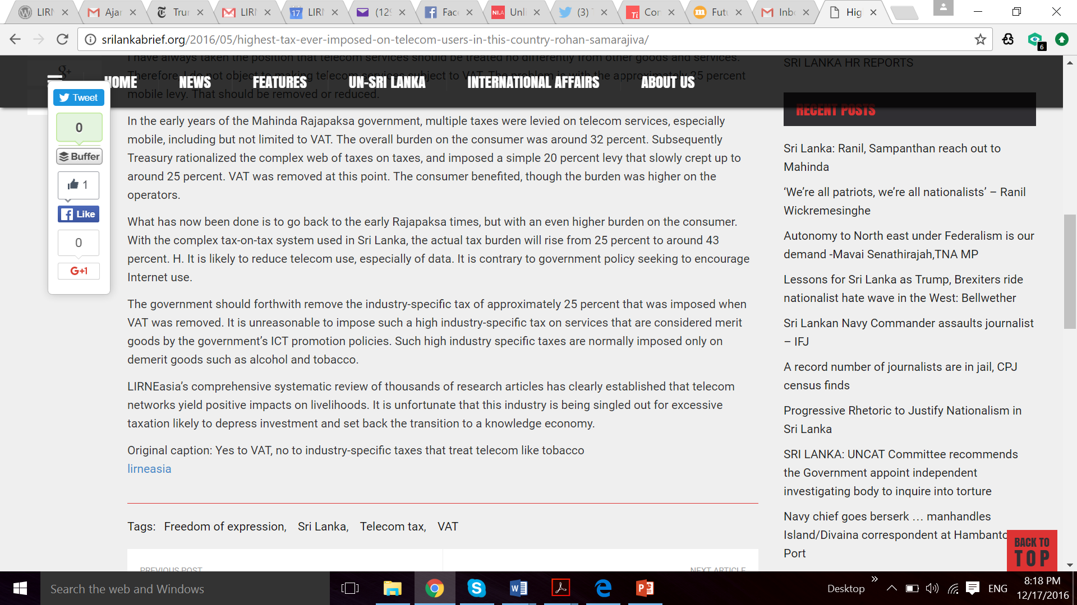

Slide 15
Effects
Independent opposition to telecom taxes emerged in social media
“Telecom should not be treated like alcohol and tobacco” meme started to cropping up in Sinhala social media

Slide 16
Govt managed to reinstate VAT on telecom services by November 1
Again, in Sinhala and English
As I stated back in May, the government should decide whether voice and data are demerit goods like alcohol and tobacco, in which case sector-specific taxes are justified, or whether they are merit goods, deserving of a five-fold increase in budgetary allocations. Otherwise some may conclude that the Finance Minister and his officials suffer from dissociative personality disorder and require clinical treatment. I myself think the explanation is simpler: they think they know how to spend our money better than we do. So they will take LKR 50 and LKR 32 for every LKR 100 we spend on voice and data respectively and use it on boondoggle projects that they think are best for us. For this, and for the clarifications on how to calculate the percentage tax burden, we should be thankful.

Slide 18
Response to the Budget (Nov 2016)
“The 2017 Budget answers a question I raised whether the government considered telecom to be a demerit good. It does.
Until this budget we paid LKR 50 in taxes for every LKR 100 spent on voice and value-added services (33 percent); and LKR 32 in taxes for every LKR 100 spent on data (24 percent). By raising the tax on data, the government has removed any ambiguity. They want to discourage the use of Internet.
I invite readers to reconcile the budget proposals with the Prime Minister’s economic statement of 27 October 2017: “The digital economy will empower our nation – through providing affordable and secure Internet connectivity to every citizen in any part of Sri Lanka, removing barriers for cross-border international trade.”

Slide 19
Two tariff fights
2007, successful
2016, so far unsuccessful
Regressive element stripped out; govt still got revenue
Telecom Minister vs Minister of Finance
Short, intense fight assisted by media, mostly electronic
General tax; any change would reduce govt revenues
Telecom Minister did not intervene publicly; even defended MoF
Dragged out process
Media interested, but no invitations to come on evening news
Social media playing important role

Slide 20
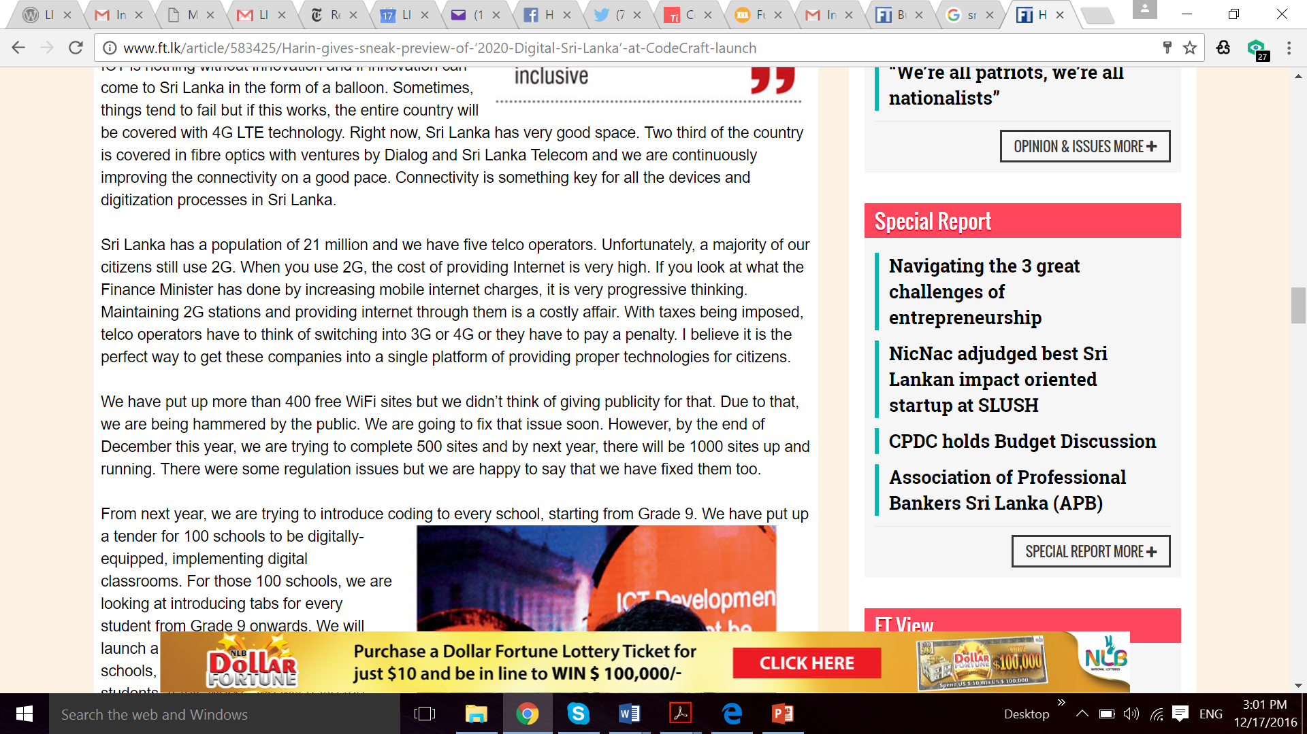

Slide 21
Long game
Finance Act Amendments have to be moved for Levy to be made effective
Usually, April; this time, may be February
Year will begin with publicity being given to comparative tax burdens

