Slide 1
Detecting Geographically Dispersed Overlay Communities Using Community Networks
Madhushi Bandara¹, Dharshana Kasthurirathna², ,Danaja Maldeniya¹ , Mahendra Piraveenan³
1. LIRNEasia, Colombo, Sri Lanka
2. Sri Lanka Institute of Information Technology, Sri Lanka
3. Complex Systems Research Group, Faculty of Engineering & IT, University of Sydney, NSW,Australia

Slide 2
Community structure in networks
Community is a group of nodes that have a higher likelihood of connecting to each other than to nodes from other communities
Has numerous applications in social networks and biological networks
In social networks, understanding the underlying community structure may help to understand the social dynamics in a social group and make predictions (e.g. Zachary’s Karate Club [1])
In biological networks, community structure may help to understand diseases at the cellular level and how groups of molecules carry out cellular functions

Slide 3
Community detection techniques
Minimum-cut method – The network is divided to predetermined number of groups of approximately same size, chosen such that the number of edges between groups are minimized
Hierarchical Clustering – A similarity measure (e.g. cosine similarity) is used to quantify similarity between node pairs
Girman-Newman algorithm – Identifies the edges that connect communities and removes them, based on the betweenness centrality of each edge

Slide 4
Modularity maximization
Ideal for large, unstructured and self-organizing networks
Modularity is a scale value between -1 and + 1, which measures the density of edges inside communities to edges outside communities
Smaller communities are grouped into single nodes and iteratively grown into larger communities until the modularity measure is maximized
Louvain method [2] produces better modularity values with higher performance

Slide 5
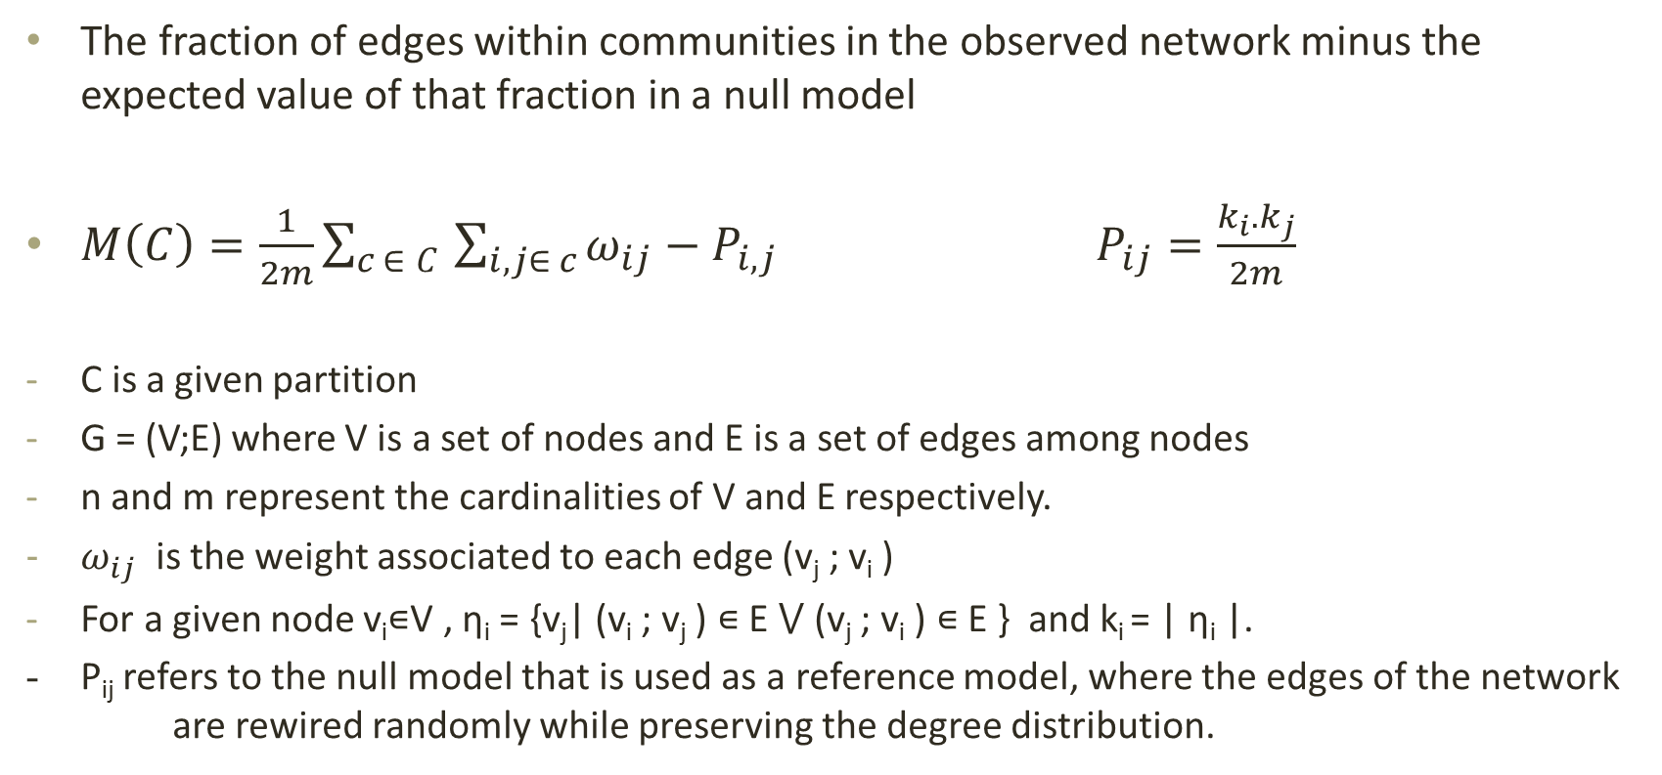
Newman-Girvan Modularity Measure
The fraction of edges within communities in the observed network minus the expected value of that fraction in a null model
$M\left(C\right)=\frac{1}{2m}\sum_{c ∈ C}{\sum_{i,j∈ c}{ω_{ij}−P_{i,j} }}P_{ij}=\frac{k_{i}.k_{j}}{2m}$
C is a given partition
G = (V;E) where V is a set of nodes and E is a set of edges among nodes
n and m represent the cardinalities of V and E respectively.
$ω_{ij}$ is the weight associated to each edge (v_{j} ; v_{i} )
For a given node v_{i}∊V , ƞ_{i} = {v_{j}| (v_{i} ; v_{j} ) ∊ E ⋁ (v_{j} ; v_{i} ) ∊ E } and k_{i} = | ƞ_{i} |.
- P_{ij} refers to the null model that is used as a reference model, where the edges of the network are rewired randomly while preserving the degree distribution.

Slide 6


Spatial bias in community structure
I call to my friends all the time, for partying, when I want a lift or to discuss homework.
Does that mean my brother, whom I call twice a week, is not a part of my community?
Alice’s College Friends
Alice’s Brother -
Lives in New York
Alice –
Studies in London

Slide 7

Dist-Modularity [3]
In many real world social/biological networks the nodes that are in close geographical proximity have a higher tendency of forming communities.
Dist-modularity tries to normalize the effect of spatial bias
f: distance decaying function
d: distance between the two nodes connected by an edge
$$M_{dist}\left(C\right)=\frac{1}{2m}\sum_{c ∈ C}{\sum_{i,j\text{∊}c}{ω_{ij}−P_{i,j}}}$$
$$P_{ij}=\frac{{\hat{P}}_{ij}.+\hat{P_{ji}}}{2}$$
$$\hat{P_{ij}} =\frac{k_{i}k_{j}f(d\left(v_{i},v_{i}\right))}{\sum_{v_{q∈V}}{k_{q}f(d\left(v_{q},v_{i}\right))}};f:R^{+} →(0,1]$$

Slide 8
Detecting geographically dispersed communities
There can be important links between communities that are geographically far apart.
E.g: Migrant worker community networks and Terrorist networks
Dist-modularity tries to normalize the effect of geographical proximity to extract geographically dispersed communities
However, this is done at the expense of losing the information about the geographically proximate communities. (assumes the community is dispersed at the node level)
Communities may be geographically dispersed at the community level and not the individual node level

Slide 9
Can we extract geographically dispersed communities while preserving the information about the geographically proximate communities???

Slide 10
Extracting geographically distributed overlay communities
Extract the community set C using the Louvain method of N-G modularity optimization;
for each community c in the set of communities C do
  Identify the centroid of each community based on geographical location of each node in the community ;
  Assign the centroid as the node representing that particular community in the community network ;
for each community pair p in the set of communities C do
  Compute the strength of the link connecting the community pair p by aggregating the connections among the nodes in community pair p ;
  Normalize the link strengths by the community sizes by dividing the link strengths by the multiplication of community sizes of the community pair p ;
Identify the communities that are relatively further apart geographically yet have relatively higher link strengths as the `overlay communities' ;

Slide 11
Applying to a real-world network
Gowala Social Network [4] with check-in details of users
196,591 connected users with location records of 107,092 users
Louvain algorithm was applied to total network data set
  820 communities were detected at the highest modularity value
The centroid of each resulting community was decided by home locations of members with known locations (through Check-in details)
Notes:
Home location calculation: To derive approximate home location of each user, most frequent location for check-in was calculated. Based on that, all the check-in locations greater than 95% of the distance from the most frequent location were ltered out, assuming they represent anomaly trips of the user. Then, for each user, the weighted center of gravity of his check-in locations was calculated. That was considered the home location for
them.

Slide 12
Distribution of Community Size and Degree
Evidence for scale-free characteristics of the network
Scale-free correlation: 0.74
Scale-free exponent : 0.67
Notes:
According to the 2nd figure, the degree distributions well into a power-law degree distribution. The scale- free correlation and the scale-free exponent of the network were measured to be 0.74 and 0.67, respectively, further indicating that the community network fits into the scale-free
model.

Slide 13
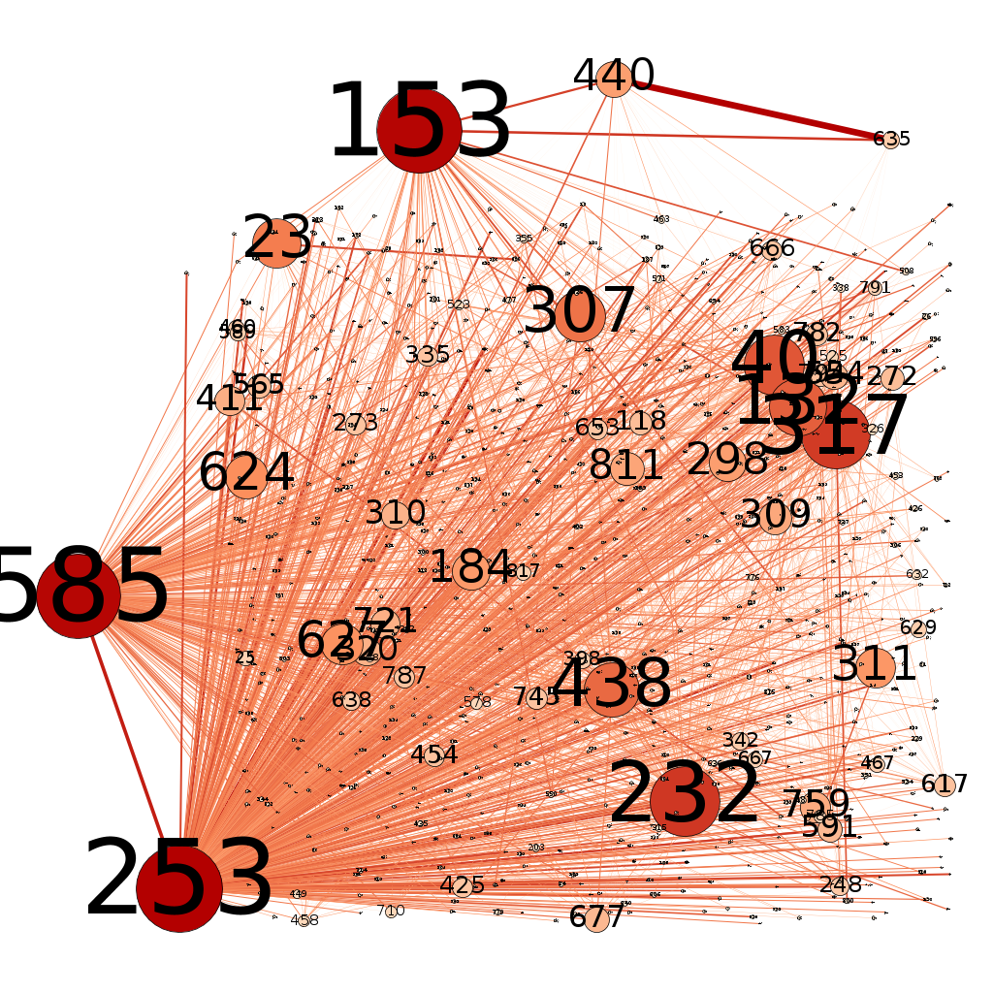
Community network with heterogeneous node sizes and normalized link strengths.
The community sizes and link strengths are non-correlated

Slide 14
Evidence of communities that are tightly connected despite being geographically apart.

Slide 15
Community Pair with a relatively high normalized link strength
253 - 585
When we normalize the tie strength by population, the link strength of these communities is higher than 82% of community pairs observed.
It is important to note that these two communities are not overlapping and geographically apart
Thus, we could identify this particular community pair as a geographically dispersed single overlay community.

Slide 16
Extracting geographically distributed overlay communities
Better performance than dist-modularity optimization – Time Complexity O(n log n)
May be used to identify geographically dispersed communities while preserving geographically proximate communities (both may be relevant)
E.g. Migrant communities, Terrorist cell networks
The extracted overlay communities may be used for effective marketing campaigns, defense related applications, understanding how economies work, studying migration patterns, etc.

Slide 17
Future work
Could be applicable in biological networks as well (e.g. Neural networks in the brain)
More insights from overlay community networks? (centrality, robustness, assortativity)
Other dimensions for community bias that may be considered other than spatial proximity? (e.g. income/educational level forming a bias in community structure)

Slide 18
Acknowledgements
LIRNEasia.net
International Development Research Centre (IDRC) of Canada
Sri Lanka Institute of Information Technology (www.sliit.lk)

Slide 19
References
[1] Girvan, Michelle, and Mark EJ Newman. "Community structure in social and biological networks." Proceedings of the national academy of sciences 99.12 (2002): 7821-7826.
[2] De Meo, Pasquale, et al. "Generalized louvain method for community detection in large networks." Intelligent Systems Design and Applications (ISDA), 2011 11th International Conference on. IEEE, 2011.
[3] Shakarian, Paulo, et al. "Mining for geographically disperse communities in social networks by leveraging distance modularity." Proceedings of the 19th ACM SIGKDD international conference on Knowledge discovery and data mining. ACM, 2013.
[4] Leskovec, Jure, and Andrej Krevl. "{SNAP Datasets}:{Stanford} Large Network Dataset Collection." (2015).

Slide 20


Slide 21


