Slide 1
Net Neutrality, Zero Rating and applicability in low internet conditions
Rohan Samarajiva & Helani Galpaya
Dhulikhel, July 2017
This work was carried out with the aid of a grant from the International Development Research Centre, Ottawa, Canada.

Slide 2
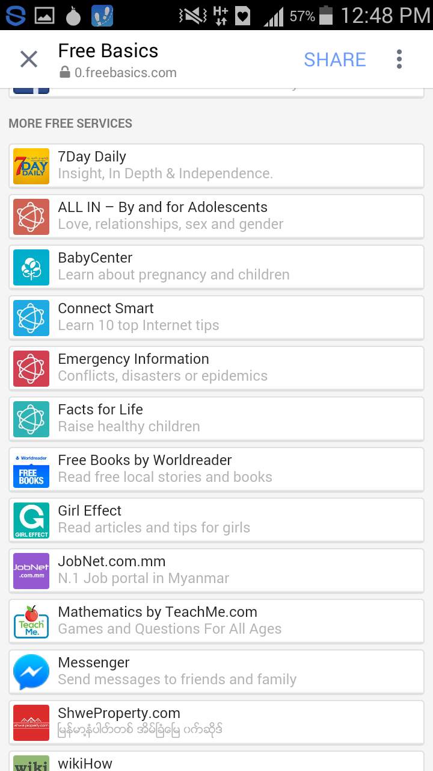
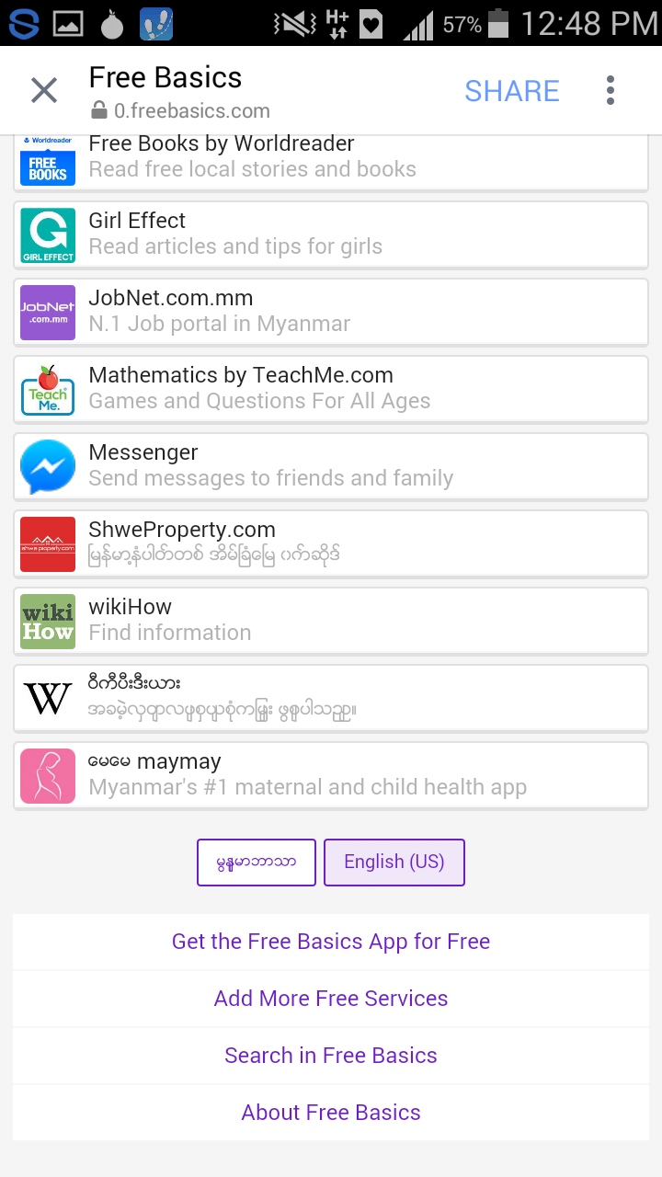
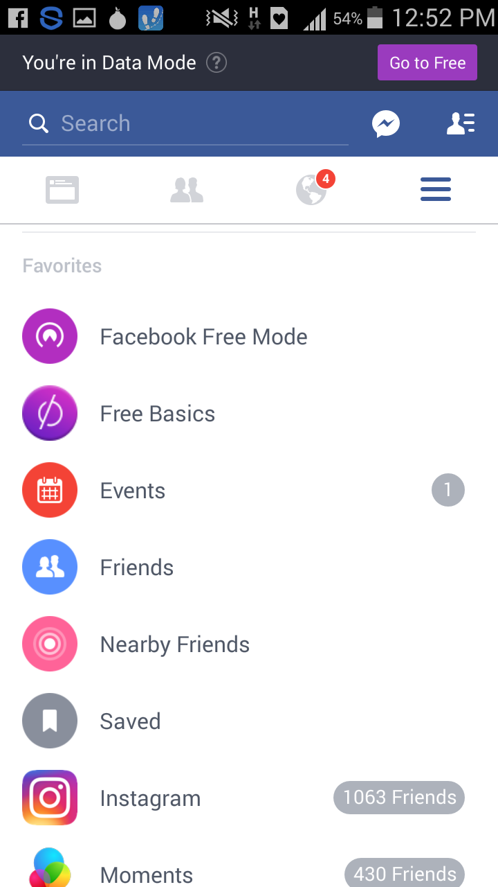
Have you seen this?

Slide 3
Used to be called Internet.org. Was available in India. Now it’s not. Nepal?
Facebook decided it wanted to “connect the world”
It offered a limited set of “free” apps/content on a platform called Internet.org (at the time; now it’s called FreeBasics).
Signed an agreement with the 3rd largest telecom operator in India to offer Internet.org
The telco bears the cost of the data that’s free to the user
Internet.org has a picture/video free version of Facebook, Facebook Messenger, and some other apps (jobs, weather, maternal health, news, provided by 3rd parties).
All this content does not count toward data cap (can use as much as you want)
All other content (i.e., the content outside this WALLED GARDEN), the user pays for, at normal rates

Slide 4
And then…..
In March 2015, the Indian telecom regulator (TRAI) called for public consultation.
“Regulation of Over the Top (OTT) services”. (OTT = Over the Top Services; like messaging apps; Facebook; other apps that run on top of the internet service provider networks)
Asked users to respond on: Should OTTs register? Should telcos be allowed to charge money from OTTs? Etc.
A hugely successful campaign “SaveTheInternet.org” started rallying users.
Focused against Facebook, Internet.org and Mark Zuckerberg
Claimed “Internet.org” is a violation of Net Neutrality
By 24 April 2015, 1.2 million people had written to TRAI, asking for regulation of OTT service. Many focused on “Internet.org”, and asked for it and other such Zero Rated services to be banned
TRAI and DoT became paralyzed and spent the next 8+ months issuing draft reports

Slide 5
The SaveTheInternet.org campaign continued
Demanded Net Neutrality laws
Demanded Facebook stop offering Internet.org
Facebook changed “Internet.org” name into FreeBasics.
Facebook agrees that it will not just offer selected content on the FreeBasics platform.
ANYONE who can create an app, and meet basic technical criteria can get on the platform.
Finally, February 2016, TRAI rules that bans “discriminatory tariffs” for data services.
But then in May 2016, issues another document for public consultation on “Subsidized Data Plans” which address the same issue.
What is Net Neutrality?
Let’s get a little technical

Slide 6
The internet as a ‘generative’ network
Net Neutrality
The idea that all content on the Internet is treated the same, irrespective of what type of content, who created it, where its going.
Allowed anyone to connect at the edges
With any equipment
Anny application
Anyone (from any machine) can connect to any other machine
Meant to be content agnostic
Video, voice, books, music, etc. all can be transmitted
As long as basic governing rules are followed:
Routing tables, protocols (TCP/IP), IP #s (in a registry), etc.
“Open”
“Generative”
“Neutral”

Slide 7
Best-effort networks connect A to B via peering or transit
Peering: two autonomous networks connect directly and exchange traffic with each other
A <--> B
Not all networks can connect to all other networks
Transit: when one autonomous network agrees to carry the traffic of another autonomous network, and all other networks
A <--> C <--> D<--> ….. B
Most ISPs do both peering and transit
Routing done on a best-effort network

Slide 8
Peering and transit on a best-effort network depends on many things
$
$
$
$
$
$
$
$
$
$
$
$
http://cyber.law.harvard.edu/digitaldemocracy/week1/transit%20diagram.png

Slide 9
Peering & transit: Bilateral business and technical agreements
Peering: Two providers agree to accept traffic from one another and from one another’s customers (and their customers’ customers)
No cash payments, no cash settlements (depends on agreement; but can be up to 150% of agreed upon amount)
No SLA [service-level agreement]
Transit: one ISP (sells) connectivity to all destinations in the global Internet
In most cases, transit provider will carry traffic to/from its customers to other customers AND to every destination on the Internet
Traffic from 3rd parties to 3rd parties
Defined price: usually on volume basis
From customer point of view: simple relationship; paid; governed by a SLA

Slide 10
What is Net Neutrality (NN)?
NN = “all content is treated equally, irrespective of type of content, sender or user”
“No blocking, no throttling, no paid prioritization”
A violation of NN = a deviation of the open nature of the Internet
Do we know it when we see it being violated?
Minimal case definition includes
NN = no blocking of content
More nuanced case includes
Paid prioritization
Free/subsidized data

Slide 11
Blocking as violation of net neutrality

Slide 12
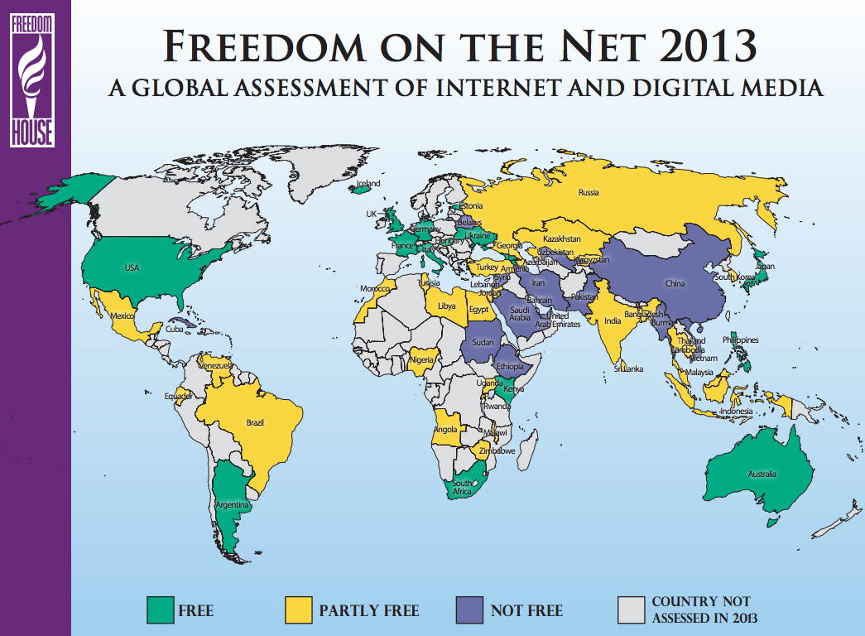
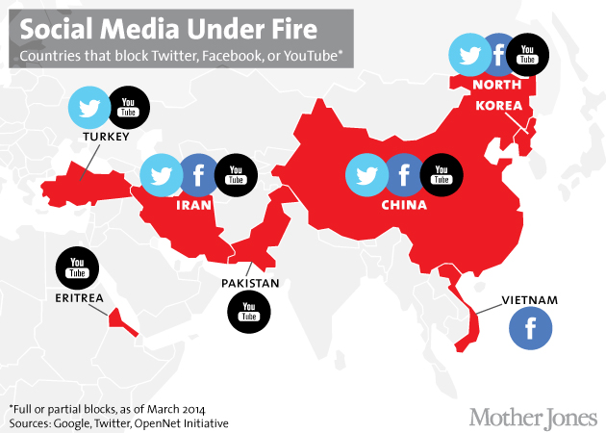
Blocking as a source of power. For governments

Slide 13
But are we unhappy with all forms of traffic blocking?
Most people happy when some content is blocked by their ISP
Child pornography
SPAM
Government seek ISP assistance to block such content

Slide 14
PAID PRIORITIZATION

Slide 15
Governments are not only entities who want to control content
Not necessarily block
But to determine the speed of certain content
ISPs along the Internet value chain have technical ability to do this, if they want to
A source of economic power
By throttling, offering to prioritize

Slide 16
In the US, video (Netflix, YouTube) issues
At peak, > 80-90% of traffic Netflix, YouTube, Google
Should ISPs (e.g., Comcast) increase the size of the pipe?
Rational, yes
Who should pay?
2012 WCIT debate: “suppliers” (e.g. Google/Netflix/YouTube) should pay the BB service providers
Why is this a bad idea?

Slide 17
Company Y’s mail server
NETFLIX
D
E
F
Transit Network T1
Delay/throttle everything from Network E
ISP A
B
C
COMCAST
User Y

Slide 18
What did Comcast (allegedly) do?
How is traffic routed?
Eye-ball networks (users who demand content)
Content networks (providers of content)
Throttling ALL traffic of content provider network
Through which Video was being routed until Peering Agreement was re-negotiated
What happens to others on the network?

Slide 19
Railroads, people, movement
Sleepy town, rail road runs through
New waterpark opens in sleepy town
Visitors increase x 100 fold
What should the rail network do?
Increase capacity: run more trains per hour?
Increase capacity: build an extra train line?
Who should pay for increased capacity?
The rail company?
The waterpark?

Slide 20
Comcast’s defense
Comcast says
Peering arrangements are commercially negotiated
Roughly equal traffic
If this changes, re-negotiate
Because upgrading interconnection is costly
Counter argument (of sorts)
Upgrading interconnection point is cheap (new network card is less than USD 400)
Rest of the network should be upgraded anyway as sound business practice

Slide 21
Was that an example of a violation of network neutrality?
Go back to trying to define NN
“Open”, all content treated as equal
Minimal definition: No blocking
Not this example.
Next nuance: No throttling (downgraded speed)?
This is what happened
Is it a violation of NN?
The US courts have ruled that paid prioritization is illegal (so Comcast CANNOT charge Netflix, YouTube, Google or other high-bandwidth content delivery networks)

Slide 22
But are we unhappy with all prioritization?
‘Reasonable’ network traffic management
Prioritizing delay-sensitive traffic (voice before e-mail)
Reserving bandwidth for delay-sensitive traffic (voice over LTE)
Prohibiting high-bandwidth traffic (video on airplanes)
Rendering resolution dynamically (video over wireless)
Adopted from Christopher Yoo (PhD) 2015 GSMA Mobile World Congress presentation

Slide 23
What could be unintended consequences?
The 80 – 20 rule: 80% of the Internet bandwidth is used by 20% of users; or 20% of content
In order to give them quality, ISPs now increase network capacity
Where does money for this investment come from?
If the market is not competitive (i.e. has few ISPs), the ISP can raise prices. So the user pays
Then what about the poor, who find the Internet even more unaffordable now?
Even for basic use, like filling out a job application?
But in highly competitive markets, less ability of ISP to to raise prices

Slide 24
Are these violations of NN?
A country’s government blocking certain types of content
E.g. Certain social media (China, routinely)
Block YouTube during riots in PK
Differentiating speed/price bundles?
100 Mbps for USD 20 per month
200 Mbps for USD 30 per month
Etc.
All you can eat (uncapped) packages vs. limited (capped) packages?
All you can eat was the norm in the US
changing now, e.g. US iPhone packages by AT&T
Not uncommon for fixed BB
Rarely found in emerging Asia

Slide 25
PAID PRIORITIZATION

Slide 26
What is Zero-Rating?
Some type(s) of content does NOT count towards data cap
Buy a basic (entry level) data plan, and get
An unlimited (or very large) quantity of some specified content (i.e. ‘Zero Rated’) for free (or for a nominal price)
Need to pay “normal rates” for all other content
Buy nothing, but get a free data bundle with unlimited or limited access to specific content
Need to pay for all other content
Facebook, WhatsApp or other apps/content popular as zero-rated offering
Social media and certain applications/content drives usage
Operators use it as a ‘honey pot’: to attract users
Category of PAID PRIORITIZATION as violation of NN

Slide 27
Why is this attractive?
To users
Free content
Free content that is EXTREMELY attractive (social media is most popular content)
To telecom operator
People are not coming online (even when prices are low)
Suddenly, attractive content is offered to users
Users are attracted/hooked → Eventually convert to paying users
To Facebook, Google and other content providers
More eyeballs → increased ad revenue
Is there money changing hands?

Slide 28
FreeBasics is most popular example. But many others.
TurkCell in 2010
Unlimited use of Facebook Zero (0.facebook.co and zero.facebook.co)
Only text; pop up warning when user wants to view photos/videos or any link outside of Facebook
Bharti Airtel in India, 2010
m.facebook.com zero-rated; no other data connection/subs required
Beyond FB Zero, allowed photos (not just text). But no games or chats
AirCell, Idea, other operators, since end 2014
FB Zero free, OR
FB App for INR 40 when you buy basic data (for about INR 100)
Etc.
Many Asian telcos offers free music (songs) to users

Slide 29
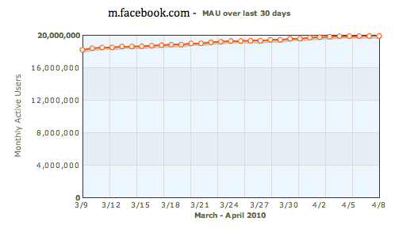
“Free” is popular.
MAU over last 30 days for m.facebook.com on AirCell IN
TurkCell
6.5 million people went online via FB
Revenue/sub up 9%
34% increase in mobile Twitter use (in 2012 promotion)
Aircell India 2010 promotion
+2Million mobile app users (MAUs) in 30 days
Source: AdWeek
Early indications: ZR content increases people’s willingness to consume (i.e. pay for) data

Slide 30
In Myanmar, popular if telco offers AND if users are aware of it (LIRNEasia research)
Do you use any of these applications/services?
(% of those offered free applications/services)
 | %
Wiki-zero | 8%
Facebook-zero | 49%
Certain music/songs/ring tones I can listen to/ | 20%
Certain pictures/video I can download/view for free | 5%
Other types of content | 14%
None | 7%
Base: Those whose service provider offered free content and aware of the fact
Compared to national use levels of …
20% overall adoption of any social media (Facebook included)
5% for Wiki-Zero

Slide 31
How might ZR violate network neutrality?
“FB- packets are given priority/favored because they are free”
Are users of B at a disadvantage?
What could happen?:
Say avg. user consumes 0.5MB/day
5MB used up in 10 days
On package A: If user is price sensitive, those on A can’t go online after day 10. No internet Day 11 – 30 each month
On package B: If user is price sensitive, he doesn’t go online after day 10. But continues to use FB0 till the end of the month
A period (20 days) where ‘internet’ = FB0 for Package B users
Is this a problem? How can it be ‘corrected’?
Banning package B?
Avg. consumption (0.5 per day x 30 days) = 15 MB per month; insist all ZR plans have to offer 15MB as base package?
Should we even TRY to correct this?
Package A | Package B
5MB per month, for Rs. 100; each additional MB Rs 50 each | Same as A + unlimited 0.facebook.com (FB0)

Slide 32
How might ZR violate network neutrality?
Free is attractive to users
Specially financially constrained
It’s therefore de-facto PRIORITIZING the free (Zero Rated content) against other (paid-for or non Zero Rated content)
Gives advantage to ZRd content

Slide 33
How might ZR violate network neutrality? ….contd.
“People will stay in FB. And think FB = internet. That is a disadvantage to developing country users. Their rights are violated”
“In developed economies people came online with the full internet” (everyone could access everything; every packet/byte cost the same as another)
AOL/CompuServe short-lived exceptions?
But FB = internet is not new
Indian operators: 65-85% of avg users data use is for Facebook, YouTube and WhatsApp. Before ZR phenomenon
LIRNEasia and RIA research from 2011/12, heavily quoted by advocates on both sides.
But all this BEFORE ZR plans were popular

Slide 34
Reported in
Quartz (qz.com)
Telegraph (UK),
DailyMail (UK),
Smithsonian.com
AdWeek
Investmentwatch
etc.

Slide 35
And other research shows people DON’T always just inside the walled garden
Facebook data: Within 30 days of coming online for the first time on Internet.org/FreeBasics, 50% of users purchase a full-paying data plan
i.e. become consumers of the “full” internet
Alliance for Affordable Internet research form 2016 shows that
28% of all ZR users no longer use a ZR plan, and are now paying customers (of the full Internet)
35% of ZR users use it AND a full cost (paid) plan (i.e. for the full Internet)
37% continue to use ZR plans IN COMBINATION with free WiFi (to access full Internet)
So in FACT, people do not consume ONLY Zero Rated Content. They use a mix.
It appears that in practical terms, ZR is not a form of prioritization that gives undue advantage to the ZR’d content provider
But we need to see how it works for Nepali users

Slide 36
Concern1 = Competitive dynamics related to platform lock-in
“Facebook will become the dominant/only platform. Gives too much power to FB”
Network effects: FB popular → more content on FB by app developers/governments/pvt sector/individual users → FB even more popular
Worry of Telcos (becoming the dumb pipe)
FB as preferred platform
Who can get on it? Apps FB approves? FB’s competitors’ apps?

Slide 37
Concern 2 = Innovation dynamics. Who can get in the walled garden?
Can young app developers ever have “win”?
Negotiating skills with the telco (and ability to pay?) drives in/out of walled-garden
Not necessarily what the users think is ‘best app’
Is this ok?
AT&T’s 2014 ‘Sponsored Data’ program
Anyone can participate (pay AT&T, then their content is ZR)
Does commercial vs. non-commercial content make a difference?
WikiZero thinks so

Slide 38
Concern 3 = Competitive dynamics inside the platform (exclusive contracts)
Telco (or FreeBasics) signs with a big music streaming service, ZRs
Contract between telco and music company prohibits ANY OTHER MUSIC STREAMING SERVICE from being ZRd.
Is this problematic?
Depends on…market power
Can new music service go to another telco and still do well?
How to mitigate?
Competition law (and regulators, and processors and institutions)
Enforce time-limited ZR?

Slide 39
Concern 4 = Internet “Fast Lanes” for some content [slow for other content]
Operator or platform (like Facebook) optimizes speeds of ZR content
Fast access for that content
Non ZR content is throttled, not prioritized
Takes longer to access
Is this a problem?
Possible solution part 1: force ISPs to publicize traffic management rules
If there’s competition, users can go elsewhere.
Solution part 2: QoSE “rules” that allow for +ve discrimination
ALL content is guaranteed minimal and advertised speed.
Some content can be treated BETTER than this by telco.
QoSE testing of all content types; publication of results
Enforce minimum standards for ALL content
ZR content may be optimized but at least minimum speed (that’s promised) is available for non ZR content
Users pay for higher speed packages if they want faster base speed for all content

Slide 40
At times, implementing ZR has been good for competition; At times, banning ZR has been bad
Australia
4 large ISPs ‘Gang of Four’ refusing to peer with smaller ISPs.
Smaller ISPs having to buy transit→ high costs → low roll-out
ZeroRated entertainment content from top/popular channel
Traffic, subscriptions increase. Network rolls out. Dominance of big guys becomes less
USA
MetroPCS (5th largest operator) struggling financially
New package: USD40/month for unlimited voice + small amount (capped) data + ZeroRated (uncapped0 YouTube)
Worked with Google to optimize Streaming
NN advocates protest → ZR-based plan abandoned
By 2012 no option but to sell to T-Mobile (reducing competition)

Slide 41
Proposals for making ZR less problematic
Time-limited ZR (can’t give any content for ever)
Only as promotion to attract user
“one-click-away” ZR
The first click outside of the walled garden is also free
Equal rating: e.g., ZR in return for ad viewing
Access X amount of ANY content after watching an add
ZR 2G; but not on 3G
Any content over very slow speeds is free
Necessary conditions:
Advertised minimum speeds apply to ALL content; face penalties.
Publish network traffic management techniques used by operator.
Capable competition regulator

Slide 42
Should regulators/policy makers act?
Is it increasing welfare?
Are users better of by paying less of data service?
Are people who would otherwise not consume, consuming due to ZR?
Appears so. But strong causality not established.
Is new economic activity being enabled by this?
Possibly. E.g. Syntonics, US startup that manages sponsored data for others
Anecdotal evidence of ‘innovative’ impacts
Is it having negative competitive impacts?
Are people(users)/app developers/governments/firms getting pushed towards one platform/walled garden?
Is it reducing the possibility of alternate platforms/walled gardens?
Evidence not conclusive; but indications are it could.

Slide 43
What might a regulatory response to ZR be?
What should regulators do when evidence is unclear?
Watch, research, be ready for action
In the mean time: do all the other stuff that they were supposed be doing all this while
increase competition at all points in the value chain, give enough spectrum → decrease prices
Release government data → locally relevant content/apps
Best defense for harms is high levels of competition THROUGHOUT Internet/BB value chain
Retail (operators, content), content production, backhaul/wholesale networks, etc.

Slide 44
Some questions to ask when the Free Basics debate starts in Nepal
QUESTION | If Answer is “YES” | If Answer is “NO”
Is the agreement between Facebook and telecom company exclusive | Bad. If FreeBasics becomes popular, the telco stands to gain users and content apps, increasing market concentration | Good. Other telcos can also start offering FreeBasics, reducing operator market power. BUT, bad if telcos are prevented from offering (future) competing platforms,
Can any app developer get their app on the FreeBasics Platform? | Good. Competing apps can co-exist on the platform itself (e.g. 2 apps that give political news, etc.) | Bad. Facebook could act as “gatekeeper” to Internet. It may not do so, but need to see what it does in practice.
Do app developers pay FreeBasics or the telco? | Could be problematic – speeds of those who pay can be prioritized, at the expense of others | No apparent reason to prioritize/discriminate against certain apps but not others
Is telco or FreeBasics allowed to treat their own content differently to other content? | Bad. Apps that compete will be slowed down or otherwise discriminated against | Good. Less concerns on competition and dual-lanes on the internet.
Are users never leaving the FreeBasics Platform? | Worrying. Need awareness campaigns, other content and cheaper prices to attract users. | Good. But patterns change over time. Need to monitor

