Slide 1
Introduction: Course on “How to engage in broadband policy and regulatory processes”
Rohan Samarajiva
Dhulikhel, 14-17 July 2017

Slide 2
What the course seeks to achieve
To enable Nepal citizens marshal available research and evidence for effective participation in broadband policy and regulatory processes including interactions with media, thereby facilitating and enriching policy discourse on means of increasing broadband access by the poor and persons with disabilities

Slide 3
Who is offering the course and why?
LIRNEasia, whose mission is that of
Catalyzing policy change through research to improve people’s lives in the emerging Asia Pacific by facilitating their use of hard and soft infrastructures through the use of knowledge, information and technology.

Slide 4
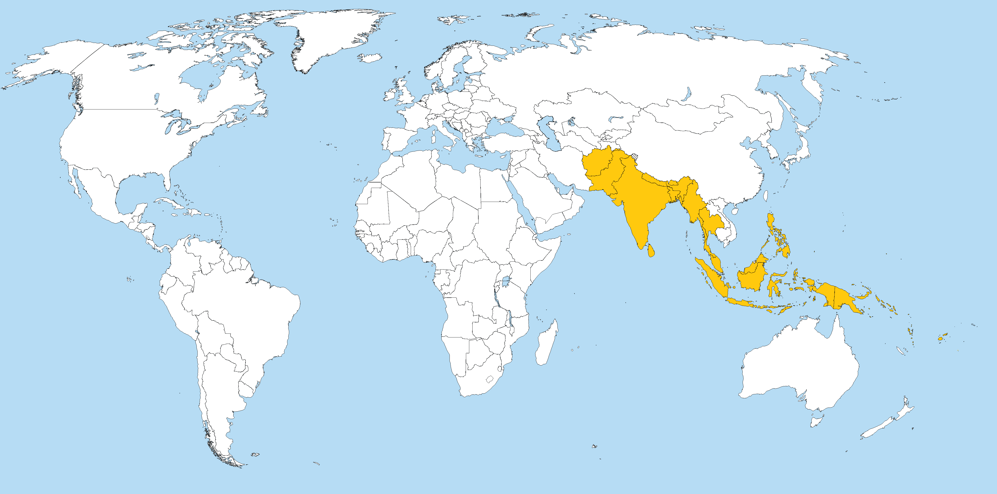
Countries that we engage with

Slide 5
Supported by
The Ford Foundation which “supports visionary leaders and organizations on the frontlines of social change worldwide.”
“We believe all people should have the opportunity to reach their full potential, contribute to society, and have voice in the decisions that affect them. We believe the best way to achieve these goals is to encourage initiatives by those living and working closest to where problems are located; to promote collaboration among the nonprofit, government and business sectors; and to ensure participation by men and women from diverse communities and all levels of society. In our experience, such activities help build common understanding, enhance excellence, enable people to improve their lives and reinforce their commitment to society.”

Slide 6
Co-hosted by ISOC Nepal and Center for Law & Technology
ISOC Nepal Mission: “To promote the use of Internet in every aspects of life”
Objectives:
Standardization of internet from every prospect of use, infrastructure, awareness and its operation
Facilitating the governing body with policy recommendations and amendments at national level according to the global needs
Providing a better platform of coordination between the public and private sector
To organize effective trainings and seminars in the field of internet development and new innovations
Effective policy recommendation and voicing the need of better internet governance

Slide 7
Objective of the course
Is to produce discerning and knowledgeable consumers of research who are able to engage in broadband policy and regulatory processes
Not, as in our CPRsouth activities, to produce policy-oriented researchers like us
But no harm if it improves your research/scholarship

Slide 8
At end of course, attendees will
Be able to find and assess relevant research and evidence
Be able to summarize the research in a coherent and comprehensive manner
Have an understanding of broadband policy and regulatory processes in Nepal

Slide 9
Who is teaching?
Rohan Samarajiva, PhD
Dileep Agrawal
Lochan Lal Amatya
Baburam Aryal
Manohar Kumar Bhattarai
Kuber Chalishe
P. Vigneswara Ilavarasan, PhD
Ananda Raj Khanal
Nirmita Narasimhan, PhD
Laleema Senanayake
Santosh Sigdel
Rajib Subba, PhD

Slide 10
How we will teach?
Tell me and I'll forget ➔ less theory
Show me and I may remember ➔ greater reliance on examples
Involve me and I'll understand ➔ active learning through assignments

Slide 11
Assignments
Participants ➔ teams on Day 1
Study the assigned case as a team
Write it up based on a template provided
Make presentations on Day 4

Slide 12
Your responsibility and ours
All presentations must be evidence based
Extensive feedback will be provided

Slide 13
What does this mean?
Research has to be done within bounds of the course & the Internet (no libraries)
Not optimal, but surprising how close to reality this is
When policy windows open, one has to jump through; wait too long and window will close
Perfect research & no policy impact OR good research & some policy impact
One must have
Stock of knowledge that can be repurposed
Need to know where to look for information
Networks that can be fired up quickly for new data, fact checking and frank assessments of quality of arguments

Slide 14
Policy windows
“Unpredictable openings in the policy process that create the possibility for influence over the direction and outcome of that process.”
“These windows sometimes open regularly (e.g., cabinet shuffles and budget speeches), but who makes successful use of them or not is a matter of chance and skill.”
Kingdon, John W. 1995. Agendas, Alternatives, and Public Policies, 2nd ed. Ann Arbor, MI: University of Michigan Press.

Slide 15
Example: Research on customer relations management in electricity
Timeline | Action
September 2012 | Research commenced
December 2012 | Rough idea of what the results would look like
March 2013 | Offered SAFIR Training Course for electricity regulators that used Sri Lanka as case study; Former investment analyst with deep infrastructure and finance skills as co-director
8 March 2013 | Co-director is invited for TV interview causing him to “cram” on electricity sector data
11 March 2013 | Public Utilities Commission calls for written comments by March 28 for Public Consultation on Tariff Proposal
Week of March 11th | LIRNEasia Chair on multiple TV programs and evening news
15 March 2013 | Column appears online at LBO.LK

Slide 16
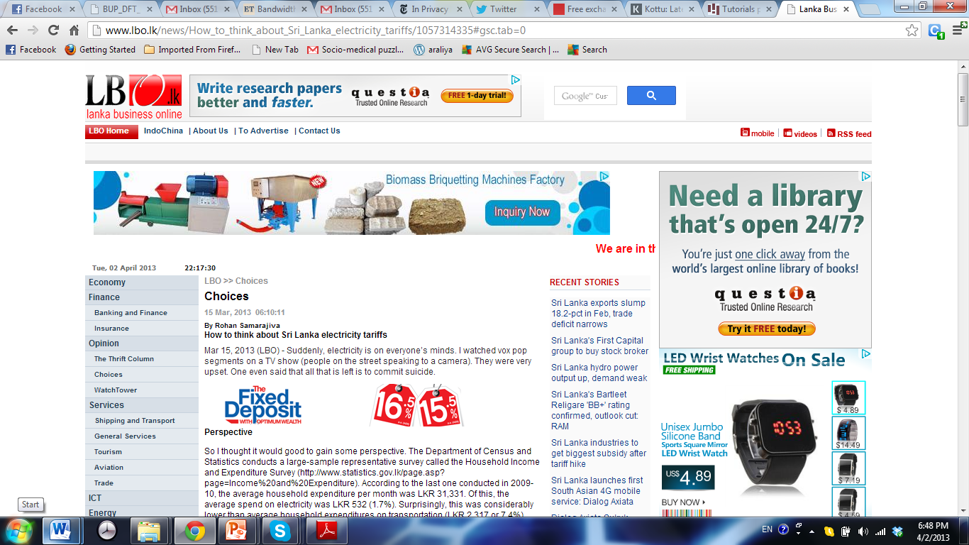

Slide 17
Exploiting a policy window . . .
Timeline | Action
23 March 2013 | First substantive article on electricity tariff in Sinhala weekly paper
28 March 2013 | Official submission that deviates materially from what was said on media submitted
2 April 2013 | PUCSL Chairman’s full page interview on Page 4 (high-value platform) in highest readership newspaper published; includes whole chunks from LIRNEasia media output, including an error
4 April 2013 | Oral submission at first session of Public Consultation with potential for framing the debate
17 April 2013 | Decision does not include any of our recommendations
1 October 2013 | LIRNEasia invited to present its views on demand-side management at a public hearing, apparently a direct result of April intervention

Slide 18
Issues for discussion
Our research on customer-relationship management not quite cooked
But we decided to use the policy window to at least lay a foundation
Research based (but different research)
Last 5% of electricity supply responsible for 17% of total costs (first 50% is also responsible for 17% of costs) ➔ lowering peak consumption will dramatically reduce costs
Therefore, we recommend Demand Side Management to lower the peak demand (now drawing from our half-cooked research)

Slide 19
Issues for discussion
Was our research in best shape?
No, top 5% and bottom 50% costing the same appeared in media as top 5% costs 50%
Did we fix our errors?
Yes, exchanges with a sharp journalist helped remove the error (a form of peer review)
Could we always stay on message?
No, got dragged into subsidy issues especially in 3 minute interviews for the news
Is this replicable?

Slide 20
How does one measure success?
Measuring outputs
Example: our memes appearing in the interview of PUCSL Chair

Slide 21
How does one measure success?
Measuring outcomes
DSM or time-sensitive tariffs implemented (along with use of our recommended methods of communication through texts, reformatted bills, etc.)
Rebate and/or subsidy, fully or partially implemented
What is the threshold of success?

Slide 22
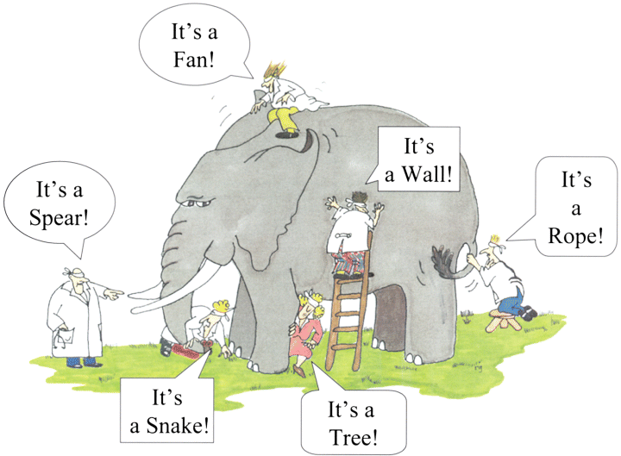
An image to keep in mind . . .

Slide 23
Aristotle on effective communication
Ethos (Credibility), or ethical appeal, means convincing by the character of the author/orator
Pathos (Emotional) means persuading by appealing to the reader/viewer's emotions
Logos (Logical) means persuading by the use of reasoning. This will be the most important element in this course, and Aristotle's favorite

Slide 24
Ethos
Is not built in a day
Not everyone can get interviewed on the evening news

Slide 25
Grace Mirandilla Santos
An independent ICT policy researcher from the Philippines, Grace has been with CPRsouth since 2007. Selected a Young Scholar at the inaugural CPRsouth1 in Manila, she then participated as a paper presenter at CPRsouth 2, 3 and 4 and has a co-authored paper at 10.
She has consulted for various agencies including The Asia Foundation, Center for Research and Communication, USAID, AusAID, and ADB. She has published book chapters, journal articles, and policy papers and briefs on telecom policy, ICT for development, and e-democracy. Grace writes a regular blog for industry publication TelecomAsia and is a member of the Internet Society – Philippines Chapter.
She exemplifies what LIRNEasia sought to achieve through the building up of CPRsouth. CPRsouth identifies persons whose attitudes and personal incentives cause them to want to engage with policy processes in their own countries..

Slide 26
Ethos in practice
Grace Mirandilla Santos at second public hearing of the NTC on its proposed memorandum circular on broadband QoS. She reiterated LIRNEasia’s recommendations that diagnostics should take into consideration consumer experience, must be transparent and results published in a format that consumers can understand and use, should help inform consumers’ decisions when availing of services (e.g., publishing average or typical speeds per ISP per city). Her recommendations have been seconded by Senator Bam Aquino.

Slide 27
Pathos and Logos
Discussed throughout, with weight given to logos

Slide 28
What we hope you will achieve by Monday
Be able to find and assess relevant research & evidence
Be able to summarize the research in a coherent and comprehensive manner
Have an understanding of broadband policy and regulatory processes in Nepal
Have some of the necessary tools to improve communication skills

Slide 29
What we really hope you will achieve
“We believe all people should have the opportunity to reach their full potential, contribute to society, and have voice in the decisions that affect them. We believe the best way to achieve these goals is to encourage initiatives by those living and working closest to where problems are located; to promote collaboration among the nonprofit, government and business sectors; and to ensure participation by men and women from diverse communities and all levels of society. In our experience, such activities help build common understanding, enhance excellence, enable people to improve their lives and reinforce their commitment to society.”

