Slide 1
Finding Evidence
P. Vigneswara Ilavarasan, PhD

Slide 2
Agenda
Why?
Where?
Your role
Types
Tips – searching & tracking

Slide 3
Why?
Avoid reinventing the wheel
Strengthen & substantiate your arguments
Learn opposite views
Understand best options
‘Literature review’ in academic circles

Slide 4
Where?
Google?
Wikipedia
Institutional access
Asking experts
Asking friends via social media platforms
Too much of information?
How to sieve?

Slide 5
Your role & Search
Rigor differs
Academic
Non Academic
Journalists
NGO

Slide 6
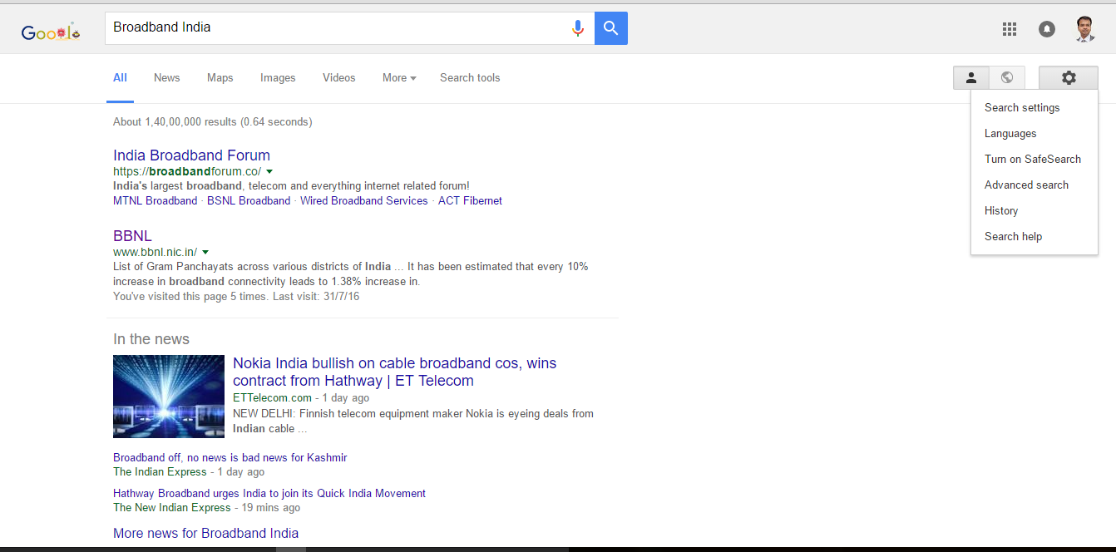
Google Web Search

Slide 7
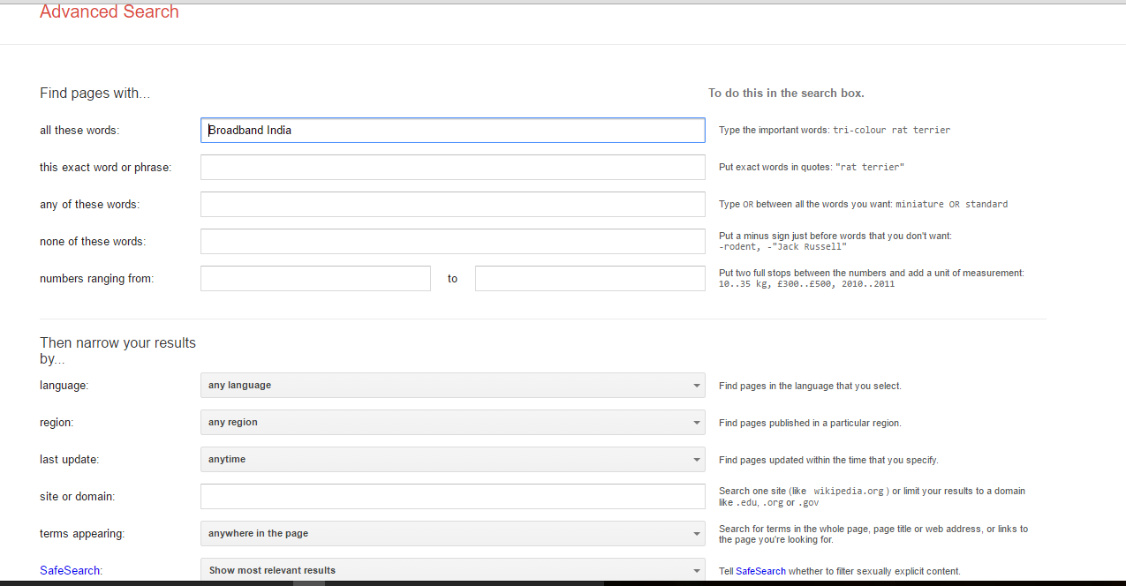
Google Advanced Search

Slide 8
Google Scholar

Slide 9
Institutional Portals
Government websites
INGOs (World Bank, ADB etc)
Regulatory agencies
Think tanks
Research institutes
Consultancy firms
Different headings (resources, reports etc)
Different access (registration, pay, free)

Slide 10
INGOs

Slide 11
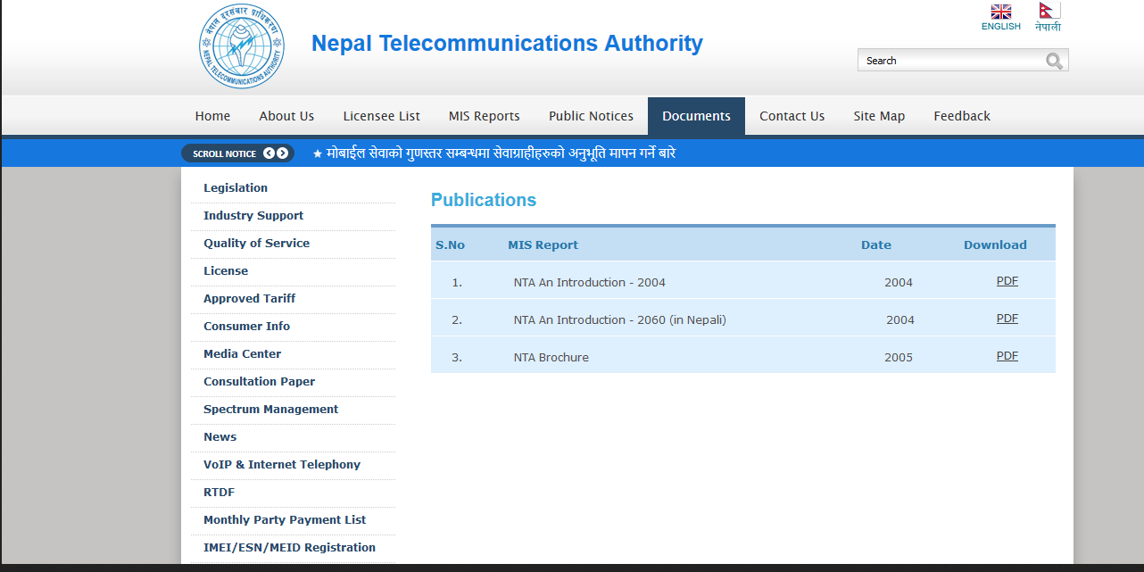
Regulators

Slide 12
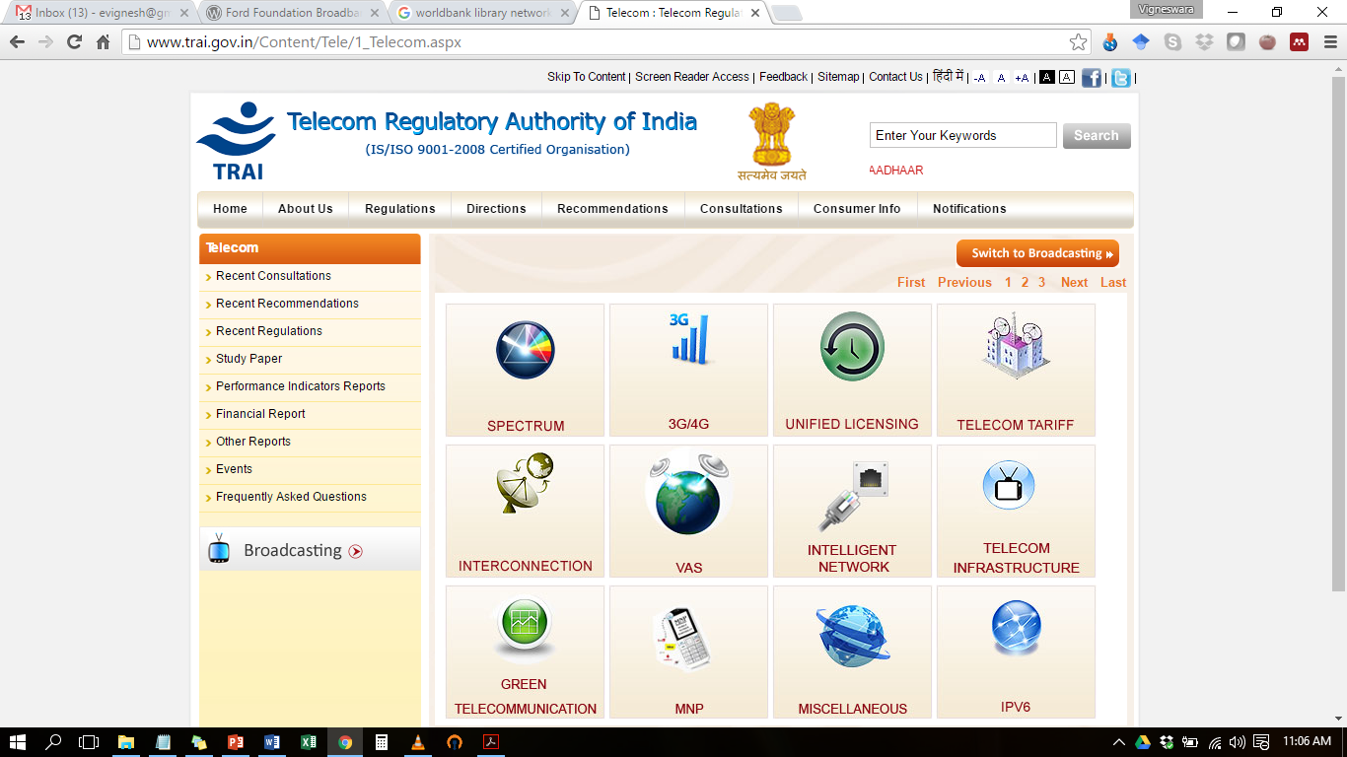
TRAI

Slide 13
Others too

Slide 14
Think Tanks

Slide 15
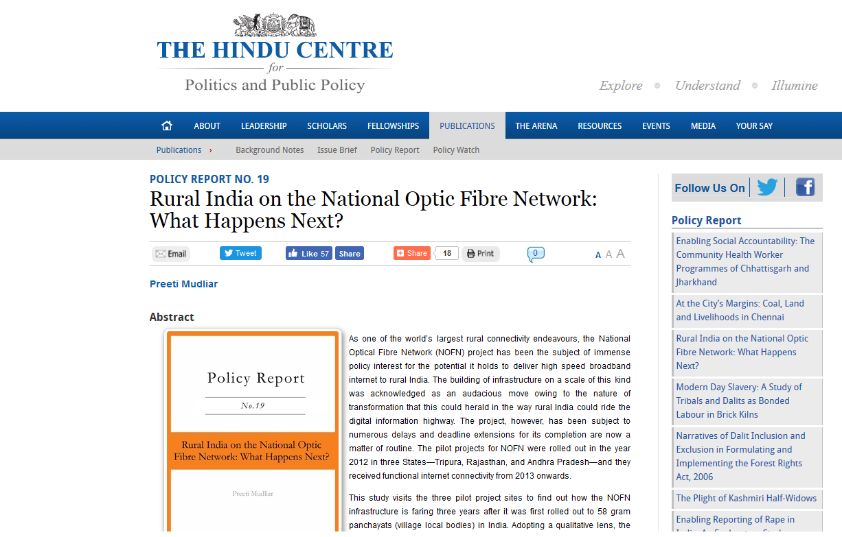
Or Policy Research Centers

Slide 16
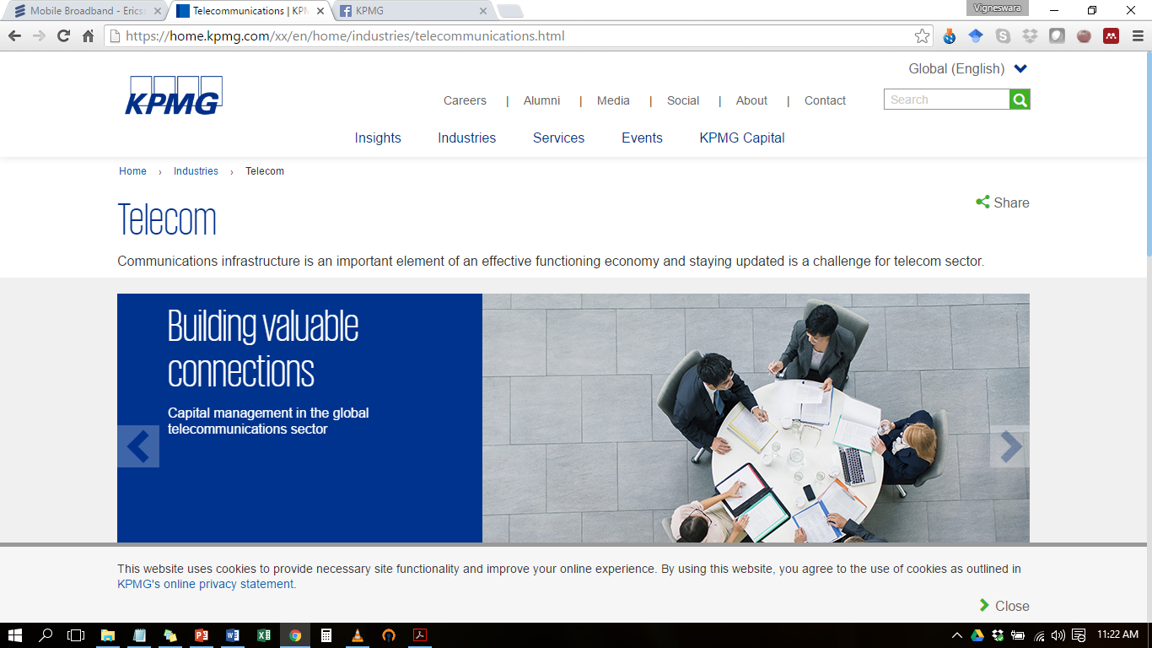
Consultancy firms

Slide 17
Working papers of Universities

Slide 18
University Repositories

Slide 19
Electronic Databases
Organized digital collection of published material – elsewhere & stand alone
Paid
Available in academic institutes
PROQUEST, EMERALD, SCIENCEDIRECT, EBSCO
Free
IDEAS, SSRN

Slide 20
IDEAS

Slide 21
SSRN

Slide 22
Peer Reviewed Journals
Both Open Access & Paid

Slide 23
Old school

Slide 24
Types
Reports
Policy papers
Case studies
News briefs
Working papers
Peer –reviewed papers
Data summaries

Slide 25
Leads
Self-search & in Inbox
Social Media platforms
Follow the potential sources
Alerts
Google scholar, E-databases, Journals
Google alerts for ‘experts’

Slide 26
Tips for searching
Keywords, synonyms
Playing with Boolean operators
Differ for portals
Narrowing
Geography
Period
Language
Area of interest
Reading Title, abstract, tables, figures & others

Slide 27
Keeping track
Referencing systems
Mendeley, Zotero
MS Word
Folders & folders
Author name & title of paper (to remember & remind)

Slide 28
Finally…
Become better with experience
RAs, PhD students and interns also help
Constant & continuous!

Slide 29
Thank you! Q?

