Slide 1
Baseline knowledge relevant to Nepal ICT policy
Rohan Samarajiva, Laleema Senanayake, Shazna Zuhyl
Dhulikhel, 14-17 July 2017
This work was carried out with the aid of a grant from the International Development Research Centre, Canada and UKaid from the Department for International Development, UK.

Slide 2
Objective of module
Provide you with
Data that you can use for your assignments
Because the data are not comprehensive, the footnotes will help you get started on your own investigations
Do your own data sheet relevant to your assignment
Most importantly, the ability to critically assess the data

Slide 3
Value of comparison

Slide 4
Is connectivity increasing?
Looks impressive

Slide 5
But PK is in middle of pack when compared

Slide 6
Appropriate comparison set
Same size?
Sri Lanka? Cambodia?
Same GDP levels?
Cambodia? Myanmar?
Regional grouping?
SAARC?
Usually, one selects peers and a few aspirational comparators
Can you do better than we have?
Is there a more appropriate comparison set for your topic?

Slide 7
Basic economic-demographic data
 | Bangladesh | Cambodia | Myanmar | Nepal | Sri Lanka
GDP per capita (current USD) (2015) | 1,211.7 | 1,158.7 | 1,161.5 | 743.3 | 3,926.2
Poverty headcount ratio at USD 1.9 a day 2011 PPP/% of population | 19 (2010) | 2.2 (2012) | N/A | 14.9 (2010) | 1.9 (2012)
Population/’000 | 142,319 (2011) | 14,674 (2013) | 51,419 (2014) | 26,494 (2011) | 20,360 (2012)
Urban population as % | 24.6 (2011) | 21.4 (2013) | 30 (2014) | 17 (2011) | 18.2 (2012)

Slide 8
Special qualities of population
 | Bangladesh | Cambodia | Myanmar | Nepal | Sri Lanka
Disabled population as % of tot population | 1.4 (2011) | 2.1 (2013) | 4.6 (2014) | 4 (2011) | 7.1 (2015)
% pop. affected by disasters (natural and technological) in 2016 | 2.1 | 17 | 1.9 | 0.07 | 4.6
Net number of migrants as prop of population (2012) | -1.56 | -1.1 | -0.9 | -1.4 | -2.3

Slide 9
Nepal’s disability numbers raise many questions
National census 2011 reported that 1.94 percent of the total population is living with some kind of disability, an extraordinarily low number that does not mesh with comparators
For example, Sri Lanka’s national census of 2012 reported that persons with disabilities (PWD) amounted to 8.7 percent of the population
According to the 2014 census, Myanmar’s PWDs amounted to 4.48 percent of the population
Different numbers are given by other sources
The National Living Standard Survey (NLSS) of Nepal 2011 reported PWDs to be 3.6 percent of population
The World Report on Disability (2011) claimed a 15 percent disability prevalence rate in Nepal
LIRNEasia’s 2017 survey will seek to shed light on the issue, though we will not be able to do what a census can do

Slide 10
Half of Nepal’s population is under 23.6 yrs of age: What does being youngest country mean for ICT policy?
 | Bangladesh | Cambodia | Myanmar | Nepal | Sri Lanka
Median age of population | 26.3 (2016 est.) | 24.9 (2016 est.) | 27.1 (2014) | 23.6 (2016 est.) | 32.5 (2016 est.)
Child mortality rate per 1,000 (2015) | 37.6 | 28.7 | 50 | 35.8 | 9.8
Maternal mortality ratio per 100,000 (2015) | 176 | 161 | 178 | 258 | 30
Adult mortality rate per 1000 (2015) | 129 | 174 | 199 | 165 | 138
Age dependency ratio | 73 (2011) | 52.4 (2013) | 52.5 (2014) | 84 (2011) | 61.3 (2013)

Slide 11
You have to put meaning into data
Age dependency is actually a combination of two things:
Child dependency
Elder dependency

Slide 12
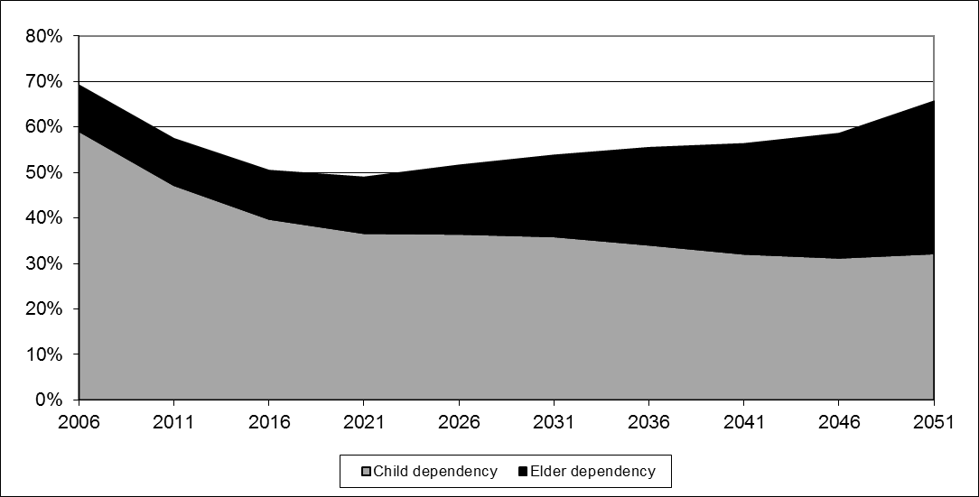
How child & elder dependency changes over time: Bangladesh, 2006-2051

Slide 13
Does ICT policy have to be designed for aggregate dependency or child/elder dependency
What is more significant for Nepal? For Sri Lanka?
ICT policy has to be made for future, not past or present
What dependency numbers are relevant?

Slide 14
Nepal population pyramid, 2017 & 2022

Slide 15
Is it true that Nepal had full employment in 2011? Now?
 | Bangladesh | Cambodia | Myanmar | Nepal | Sri Lanka
Literacy rate adult (15 and above)/% | 64.6 (2015) | 80.7 (2013) | 89.5 (2014) | 57.4 (2011) | 93.2 (2015)
Primary school enrolment/% net | 52 (2015) | 38 (2008) | 48 (2014) | 60 (2015) | 85 (2011)
Secondary school enrolment/% gross | 64 (2015) | 45 (2008) | 51 (2014) | 67 (2015) | 99.7 (2013)
Tertiary school enrolment/% | 13 (2014) | 13 (2015) | 14 (2012) | 15 (2015) | 20 (2015)
Unemployment rate/% | 2.3 (2013) | 0.3 (2013) | 4 (2014) | 2 (2011) | 4.7 (2015)

Slide 16
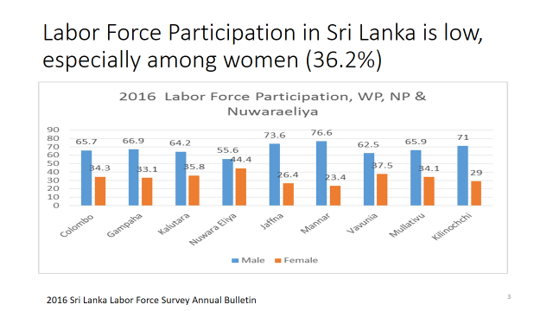
Always interrogate the numbers
Look at the definition used in each country
Unemployment rate is calculated using those working and looking for work as the base

Slide 17
Unpack the numbers
National unemployment figures are averages; they mask significant differences
By gender
By age cohorts
Among regions within country
By educational achievement

Slide 18
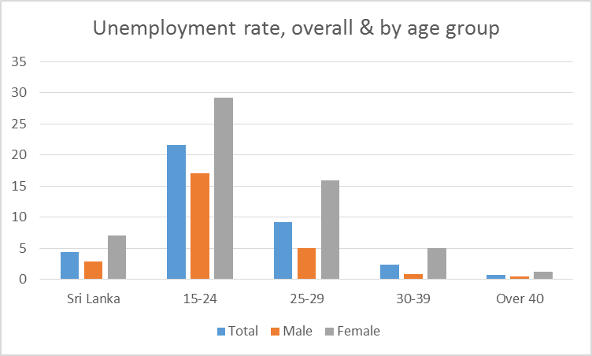
Unemployment rate for 15-24 yrs group is 4x Sri Lanka rate; for 25-29 group, it is 2x
2016 Sri Lanka Labor Force Survey Annual Bulletin

Slide 19
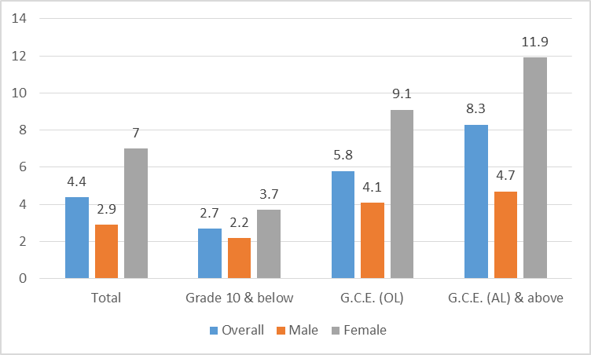
In Sri Lanka, more education ➔ higher unemployment

Slide 20
Bring it back to ICT policy
What is connection between unemployment and ICT?
Youth unemployment and ICT?

Slide 21
What does more than 100 SIMs/100 people mean? Is it something to be proud about?
 | Bangladesh | Cambodia | Myanmar | Nepal | Sri Lanka
Number of mobile network operators | 6 | 6 | 4 | 3 | 5
Largest mobile network operator | Grameen Phone | Metfone | MPT | Ncell | Dialog
Mobile SIMs per 100 (2016) | 77.9 | 124.9 | 75.7 | 96.8 | 118.5

Slide 22
Do these numbers pass smell test? Can Internet subscriptions > Facebook users > Internet users?
 | Bangladesh | Cambodia | Myanmar | Nepal | Sri Lanka
Households with Internet access at home (%) (2016) | 13.8 | 26 | 23.5 | 15 | 21.1
Internet subscriptions/’000 | 67,245 (2017) | 6,795 (2015) |  | 15,389 (2017) | 4,920 (2016)
Internet subscriptions per 100 | 47.25 | 45.7 |  | 58.1 | 24.1
Internet users per 100- ITU method (2015) | 14.4 | 19.0 | 21.8 | 17.6 | 30.0
International Internet bandwidth bit/s per Internet user (2015) | 6,184 | 17,792 | 5,196 | 2,700 | 13,886
Facebook users per 100 (2017) | 16.2 | 35.4 | 27.2 | 27.1 | 24.1

Slide 23
How reliable are the indicators?
Facebook users?
Internet users?
Internet subscriptions?
How does one ensure comparability?
Definitions
Time periods

Slide 24
How ITU estimates number of Internet users in absence of demand-side surveys
Internet Users = multiplier x Internet Subs (supply side)
Where
The multiplier = a number used to reflect that each subscription is used by more than one individual (e.g. at kiosks)
Internet subscriptions = Internet subscription of all types (speeds, technologies etc. )
Wired, wireless etc.
Above is then cross checked with other evidence (e.g. if HH access data available, Users > HH access number must be true, etc. )

Slide 25
Building on foundations of sand…
Multipliers chosen at discretion of Country administrations
Perverse incentive to use higher multiplier to show high Internet penetration in country
Difficulties in counting Internet subscriptions include…
Over-counting (counting all “Internet-capable” SIMs, irrespective of use)
Under-counting (being able to only count SIMs that have subscribed to a data package; SIMs with only voice packages may use Internet, but operators cannot count; impossible for pre-paid)
General difficulty with multiple ownership (one user with fixed and many SIM connections) leading to questionable multipliers
Notes:
But there are many problems with this method. The multipliers are chosen at the discretion of the country administration. While this may be fare considering differences in family sizes and different practices in diverse nations, the problem is that there is no consistency or guidance on how to define the multiplier. This makes comparison between countries meaningless.
Then there are also other problems with counting Internet subscriptions. Oftentimes many countries report on the number of data enabled SIMs rather than subscriptions which are actually used to access the Internet. On the other hand, there can be under counting due to countries only reporting on the number of data subscriptions, but not counting all the pre-paid connections that do not have a specific data plan but are used to access the Internet.
There are also other difficulties due to multiple SIM ownership.
So you can see there are many problems in the method of estimating the % of Internet Users.

Slide 26
Difficult to find rationale for multipliers
Country |  |  | Fixed Internet Subscriptions (000s), 2009 | Internet Users (000s), 2009, ITU method | ITU multiplier
Russia |  |  | 88,068 | 59,700 | 0.68
Mauritius |  |  | 224 | 290 | 1.3
Liberia |  |  | 15 | 20 | 1.33
Liechtenstein |  |  | 17 | 23 | 1.38
Hong Kong, China |  |  | 3,042 | 4,300 | 1.41
Huge variance in Multipliers: 0.68 (Russia) to 500 (Afghanistan) in 2009
“Similar” countries with very different multipliers
Afghanistan - 2,000 fixed subscriptions; Multiplier=500
Burundi - 5,000 fixed subscriptions; Multiplier=13
…
…
…
…
…
…
…
…
Côte d'Ivoire |  |  | 18 | 968 | 53.78
Sudan |  |  | 44 | 4,200 | 95.24
Iraq |  |  | 3 | 325 | 104.84
Uganda |  |  | 30 | 3,200 | 106.67
Afghanistan |  |  | 2 | 1,000 | 500

Slide 27
Nepal has highest priced mobile data packages, though income levels lowest among comparators
 | Bangladesh | Cambodia | Myanmar | Nepal | Sri Lanka
Fixed broadband operator and price sub-basket, USD (2016) | BTCL, 4.2 | Metfone, 12 | MPT, 16 | NTC, 6.4 | SLT, 4.2
Mob broadband operator & price sub-basket (500 MB data cap, access via handset, prepaid), USD (2016) | Grameenphone, 2.2 | Metfone, 1 | MPT, 2.1 | Ncell, 5.9 | Dialog, 1.6
Mob broadband operator & price sub-basket (1 GB data cap, access via USB dongle, postpaid), USD (2016) | Grameenphone, 5 | Metfone, 2 | MPT, 4.9 | Ncell, 5.9 | Dialog, 1.7
Mobile cellular operator and price sub-basket, USD (2016) | Grameenphone, 1.7 | Metfone, 6.85 | MPT, 1.6 | Ncell, 2.4 | Dialog, 0.9

Slide 28
Based on LIRNEasia research on proposed ITU ICT Price Basket Method
Fixed BB | Mobile BB (prepaid, handset based 500 MB) | Mobile BB (postpaid, USB dongle based 1 GB | Mobile Cellular
Operator with the largest market share Intended for residential use, regular / non-promotional offers (e.g. no F&F plans) In advertised currency, including local taxes Validity period = 30 days (or closest)
Regular residential single user monthly plan | Prepaid plan intended for use via a mobile phone | Postpaid plan intended for use via a USB dongle | Prepaid plan (postpaid if < 2% on prepaid. E.g. Japan)
Cheapest on the basis of 1 GB data cap and min 256 Kbps | Cheapest on the basis of 500 MB data cap / month min. | Cheapest on the basis of 1 GB data cap / month min | Cheapest on the basis of 30 calls + 100 SMS
If there are different commitment periods, the 12-month locked-in plans are selected | Excludes set up / recurrent fees | Excludes set up / recurrent fees | If price varies between number of minutes, average of a 3 min call
Excludes cost of fixed telephone line |  |  | Peak, off-peak; on-net, off-net prices are collected

Slide 29
Is electricity in homes relevant to ICT access?
 | Bangladesh | Cambodia | Myanmar | Nepal | Sri Lanka
Households with electricity (%) | 56.6 (2011) | 48 (2013) | 32.4 (2014) | 67 (2011) | 90.2 (2013)

Slide 30
Internet readiness best understood through composite indices
 | Bangladesh | Cambodia | Myanmar | Nepal | Sri Lanka
Global competitiveness index (2016)- out of a possible 140 | 107 | 90 | 131 | 100 | 68
Doing business index (2016)- out of a possible 190 | 176 | 131 | 170 | 107 | 110
Network Readiness Index (2016)- out of a possible 139 | 112 | 109 | 133 | 118 | 63
ICT Development Index (2016)- out of a possible 175 | 145 | 125 | 140 | 142 | 116
Global innovation index (2017)- out of a possible 127 | 114 | 101 |  | 109 | 90

