Slide 1
Demand-side Research
P. Vigneswara Ilavarasan, PhD

Slide 2
Demand Side Research
Of end-users
Evidence based policy making
Drive new or validate new
telecom service quality – call drops
Useful, even if policies are filling affordability / feasibility gaps
Inputs for mid term corrections

Slide 3
With other data…
ITU/OTHER INT’L/NTL ORGs
Raw data
Composite indices (ranking countries)
OPERATORS/SUPPLIERS
Financial data
Operational data (equipment, quality)
Complaints
Transaction Generated Data (Big Data)
REGULATOR/ POLICY MAKER
Network level data for decision making and Monitoring
Complaints
USERS
Quantitative surveys
Qualitative studies
THIRD PARTY RESEARCH
Specialized Studies based on data obtained from all stakeholders
Notes:
What are "supply side" indicators/data?
• Data about the SUPPLIERS of ICT services and those who
work with them
– Telecom operators, equipment manufacturers,…
• Collected and reported by SUPPLIERS themselves or
regulators/policy makers, researchers, consultants
• Might be produced by those who work with them or
regulate them
– Telecom operators
– Equipment manufacturers
– Regulators
• As opposed to “demand side” indicators/data
– About CONSUMERS of ICT services

Slide 4
The Process
Define the need
Need of information
Need of solution
Design the method
Sampling
Tools
Collect Data
Primary & Sec
Quali & Quanti
Analyze
Tabulations
Interpretations

Slide 5
Defining need
Narrowing down the question
Digital Divide = mobile penetration
Converting into concrete measure
Service quality = call drops
Scale of research determined by…
Time
Money
Personnel

Slide 6
Use of earlier knowledge
Performance Expectancy
Behavioral Intentions
Use Behavior
Effort Expectancy
Common Sense, Intelligence, Experience?
Social Influence
Facilitating Conditions
Gender
Age
Experience
Voluntariness of Use
Unified Theory of Acceptance and Use of Tech.
Venkatesh et al., 2003

Slide 7
Designing the Method
Sources of data
Primary & secondary
Survey & Census
Nature of approach
Quantitative & Qualitative
In percentage & Description of a mobile user
Sampling
Probability & Convenient
Every second street & my street

Slide 8
Data Collection
Primary Data
Researcher Generated
Many
Secondary Data
Using the existing data
All possible forms
Pictures, tables, paintings, interviews, blogs, etc

Slide 9
Methods

Slide 10
1. Participant observation
Direct observation
no talks & just seeing, hearing & noting
Participate & Observe
reveal | hide your identity
Write / type / organize your observations
Ethnography
You are in the field

Slide 11
2. Survey
Collecting from individual respondents
Give Que to respondents Or You fill it!
In person, email, telephone, e-chat, home, mall, road…
Repeating same questions to all
Minimum of 60 for statistical analysis
Follow sampling process for representation

Slide 12
3. Qualitative Interviewing
Direct, phone, chat, written responses
Set of questions – may be structured to ‘Inventory of keywords’
Two way process
Audio recorders? / Taking notes?
Probing the respondents for insights
45 minutes for others!

Slide 13
4. Focus group discussion
Set of questions ~ Interview Questionnaire
~10 participants & you as moderator
Provide the lead – set of questions
They speak and dominate….
You listen, observe, & direct
~ 45 minutes of others time
Audio, taking notes..

Slide 14
5. Experiments


O1

O2













Slide 15
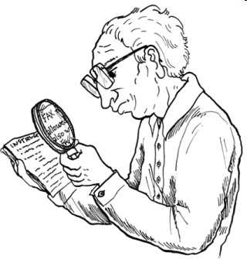
6. Secondary Data Analysis
Unobtrusive methods
One way process
Use the available data / material
Organize them for the answers
Possible sources:
Trade press (industry specific magazines & columns in the newspapers)
Household data from government

Slide 16
7. Case Study
Unit of analysis is one
Individual, region, firm, organization etc
All possible sources of data
All possible forms of data
In-depth
Multiple questions

Slide 17
Analysis
Quantitative:
Summary: Mean, SD, Frequency Distribution
Inferential: Regression, Cluster Analysis etc
Qualitative
Identifying patterns / themes

Slide 18
Examples

Slide 19
Teleuse @ BoP
Pilot surveys in 2004
Very limited traction
Large surveys in 2005, 2006, 2008, 2011, 2013, 2015
Over 20,000 face to face interviews in 7 countries since 2005: Bangladesh; Pakistan; India; Sri Lanka; Philippines; Thailand; Indonesia (Java only), Myanmar
Qualitative studies in 2007, 2009, 2011, 2013, 2014

Slide 20
Awareness
70% of the institutional users aren’t aware
Awareness of BharatNet
(% of surveyed organizations)
Awareness of BharatNet
(Base: Total private and public organizations)
Q. How familiar with BharatNet would you say you are?
Notes:
Out of the total respondents 70% didn’t know about BharatNet at all while 8% (overall) claimed that they know about it very well.
Public organizations were more aware about BharatNet than private organizations. Only 6% of the respondents from private organizations knew about BharatNet very well.
Out of the respondents, 36% of the Private salaried employees were aware of BharatNet followed by 13% of state government organizations. 70% of the Private organizations with 1 employee didn’t know anything about BharatNet followed by 72% of private organizations with 1% employees.

Slide 21
Multistage Cluster Sampling
Customer Relationship Management in Telecom & Electricity
City
Good & Weak Cities thro Data
Wards
Systematic Sampling
Mohallas
Systematic Samp. Only in BG
Blocks in SL
Systematic Sampling
Streets
MEs
Method
Proportionate to National Trends

Slide 22
Qualitative & Quantitative
Mixed methods
Impact is better
Aids each other!

Slide 23
58% in LK do not get an advance notice about power cuts
Do you get advance notice about power blackouts? - NO (%BOP MEs who use electricity for business)

Slide 24
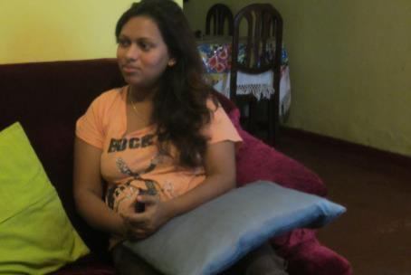
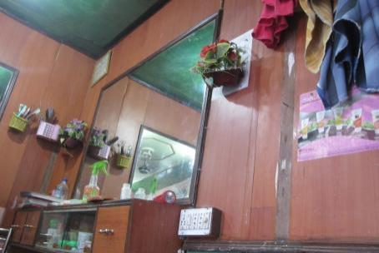
Name: Mihiri
Age: 30 years
Education: Secondary Education
Location: Colombo
Business: Services– Beauty Parlor
Employees: None
Years of Service: 3
Runs her business from rented accommodation
Has an electricity connection.
Electricity is essential for her business.
Unable to serve her clients if there is no electricity.
Lack of information on power-cuts has an adverse effect on her livelihood.
Inside the Beauty Parlour
Notes:
It is a profile of a specific type of user/ individual
Could have been developed using multiple approaches:
Mini-ethnographies
Case study
Photo novella
Useful in communicating research results to others

Slide 25
Ethics of demand side research
Obtain informed consent
Permission for sharing (transcripts, photos, video etc)
Prevention of deception
They should know about your research
Briefing & debriefing
Protection of privacy
Report should not trace the respondent
Gifts to respondents
Not primary motivator for participation

Slide 26
Which method?
Depends on research requirements:
Exploratory, descriptive & causal
Research goals/ questions
Time and funds
Researcher’s own skills, beliefs and values

Slide 27
Q?
Thank you!

