Slide 1
Emergency Response Organization (ERO), Convergence Behavior, Social Media Communications and Crisis Response: An Empirical Study of the 2015 Nepal Earthquake Police Twitter Project
Rajib Subba, PhD
dr.rsubba@gmail.com
@DrRaaSu
https://www.facebook.com/rajibsubba

Slide 2
What happens when a disaster strikes?
When a disaster strikes, spontaneous and massive movement of people, information and assets take place toward the disaster site (Fritz and Mathewson, 1957).
Personal Convergence
Disaster
Informational Convergence
Resources Convergence

Slide 3
Conventional Approach
Disaster risk management is traditionally falls under the purview of Emergency Response Organizations, and, primarily, focuses on logistics and human resources MGMT.
On the one hand most of the organizational controlled Information Systems are off limits to general public hindering their participation in HA/DRR activities!
On the other with the advent of ICTs including Social Media their participation is ever increasing!

Slide 4
Introduction
Skeptical participation of Emergency Response Organizations (ERO) in social media particularly for Police
Mono-centric, Hierarchical, Bureaucratic, Unified Command, Rank & File Vs Open, Free-style, Decentralized, Flat
Effective use of social media by Police departments for crisis response insufficiently understood
Who are the people they communicate with?
What types of crisis-related information are shared with them? How do people react to these messages?
How does the general public react to a social media run by a police organization?

Slide 5
Research Questions
Do Twitterati exhibit the same convergence behaviors when communicating with an ERO?
Between them? And with the police?
Would there be (Twitter) best communication practices to assist crisis response efforts?

Slide 6
Theoretical and Analytical Framework
Broadcast Information
Broadcast Warning
Encourage Behavior
Appeal for Information
Fighting Rumors
(Ehnis and Bunker, 2012 & 2013)
Crisis Communication Practices
Interactions
Returnees
Anxious
Helpers
Curious
Exploiters
Supporters
Mourners
Detectives
(Fritz and Mathewson, 1957; Kendra and Witchendorf 2005; and Subba and Bui 2010).
Convergence Behaviors
Institutional Elements
Institutional Elements
Scott (2008)
Expectations, Profile, Protocols, Mission, Norms, Roles, Jobs etc

Slide 7
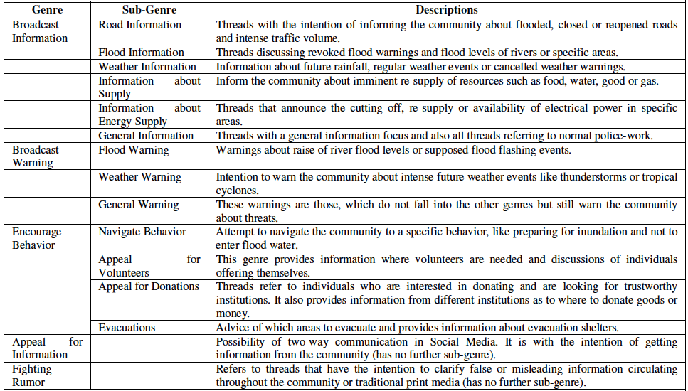
Police Crisis Communication Practices [Ehnis and Bunker (2012 & 2013)

Slide 8
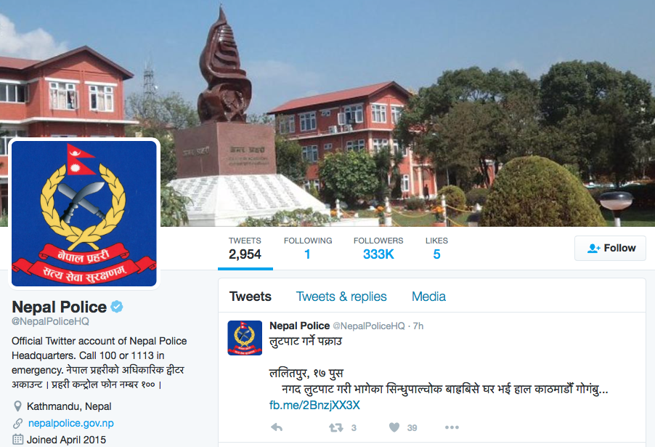
Methodology
Research Site
Data Collection
Netnography [Kozinets, 2010]
Twitter Analytics
Analysis
A content analysis of Nepal Police Tweets from the aftermath of the 2015 Nepal earthquake was conducted.
Codes, Categories, Themes
Twitter Analytics

Slide 9
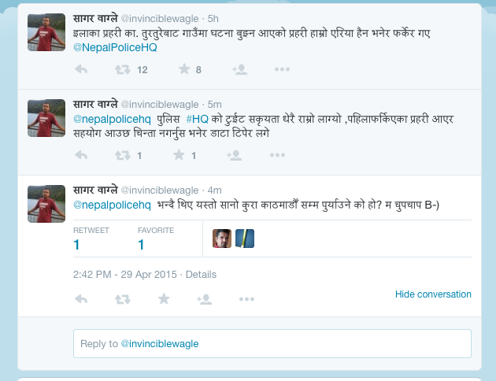
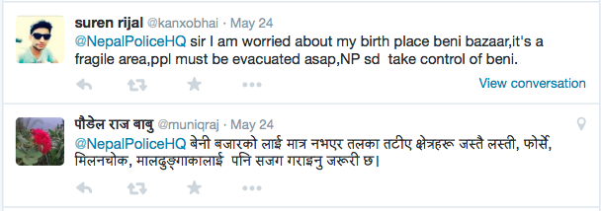
Findings: An Instantiated Typology of e-Convergence
The Returnees:
Texts in box are unofficial translation.
Fritz & Mathewson (1957) identified five convergence behaviors:
The Returnees
The Anxious
The Helpers
The Curious
The Exploiters
The Anxious:
Area police personnel came to our area to assess the damages but returned while saying that this is not their area @NepalPoliceHQ
@nepalpolicehq Activity of Police #HQ in Twitter is really good, the Police personnel who went back earlier returned, said that help will come do not worry, also collected data.
@nepalpolicehq while returning they were grumbling who is the one who informed Kathmandu about this trivial matter. I kept quite B-)
@NepalPoliceHQ Not only Beni Bazar, it is necessary to inform people living near by the river banks in Lasti, Forse, Milanchok, Maldhunga.

Slide 10
Findings: An Instantiated Typology of e-Convergence
The Helpers
Fritz, C. E., & Mathewson, J. H. (1957). Convergence Behavior in disasters: A problem in social control. Committee on Disaster Studies. Disaster Research Group.
The Curious:
@nepalpolicehq How long is the lake? Is village submerged? How long is hazardous area from the river?

Slide 11
Findings: An Instantiated Typology of e-Convergence
The Supporters:
Texts in box are unofficial translation.
Assistance of @NepalPoliceHQ through social media during crisis is a highly appreciable work. Lets thank together. Lets follow ☺
The Mourners
Kendra and Wachtendorf (2003a).

Slide 12
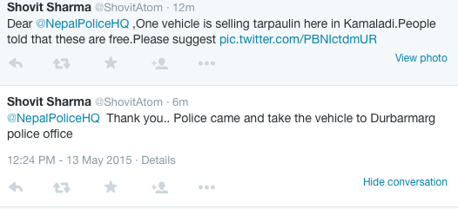
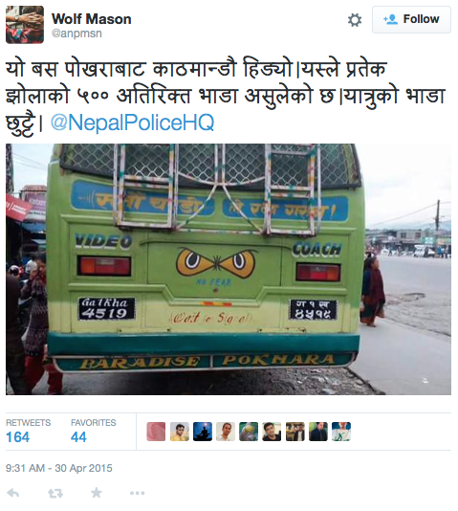
Findings: An Instantiated Typology of e-Convergence
The Exploiters
Texts in box are unofficial translation.
The Detectives
This bus has moved from Pokhara to Kathmandu. It has charged Rs 500 extra for every luggage. Travelling fee is extra. @NepalPoliceHQ
Subba, R., &Bui, T. (2010).

Slide 13
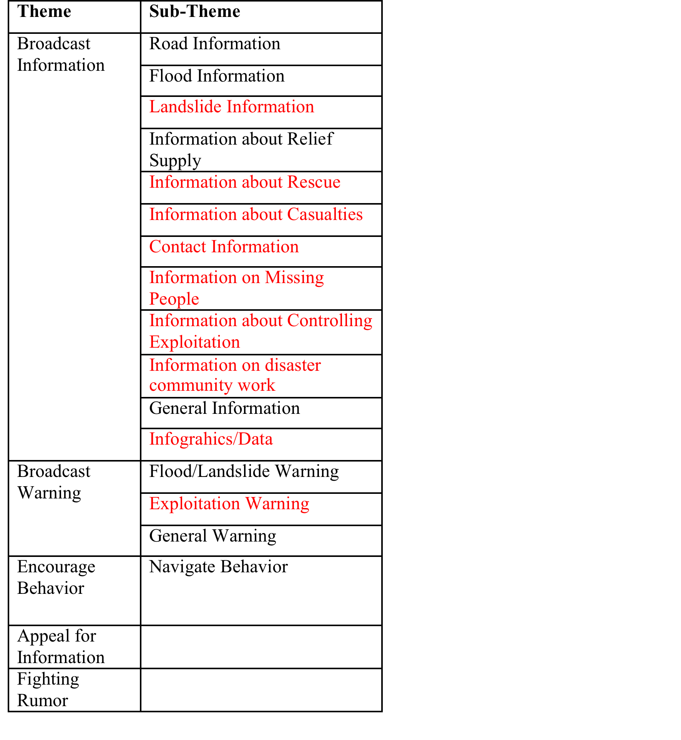
Crisis Communication Practices of Nepal Police on Twitter

Slide 14
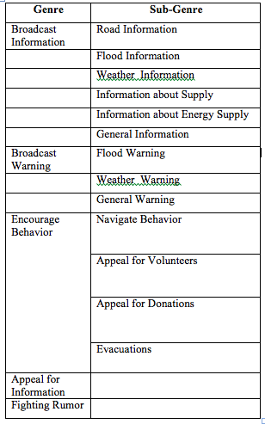
A Comparative Analysis
Queensland Police, Australia
Nepal Police
Red Text: Difference from AusPol

Slide 15
Crisis Communication Practices of Nepal Police April and May 2015

Slide 16
Interactions between Convergence Behaviors and Crisis Communication Practices
Engagement Rate, April 2015
A, C, D, H, M, R, S - represents convergence behaviors.

Slide 17
Interactions between Convergence Behaviors and Crisis Communication Practices
Engagement Rate, May 2015
A, C, D, H, M, S - represents convergence behaviors.

Slide 18
Convergence Behaviors, Crisis Communication Practices and Institutional Elements
Detective Behavior
Information on Controlling Exploitation
EXPECTATIONS
@NepalPoliceHQ
Based on your information the bus with license# 4519 has been fined Rs 1000.
Institutional elements interacting with CBs & CCP.
This bus has moved from Pokhara to Kathmandu. It charged Rs 500 extra for every luggage. Travelling fee is extra. @NepalPoliceHQ
OBDIENCE TO DUTY
Communication exists between EROs (Police and public) when public expectations are matched by ERO’s obedience to duty.

Slide 19
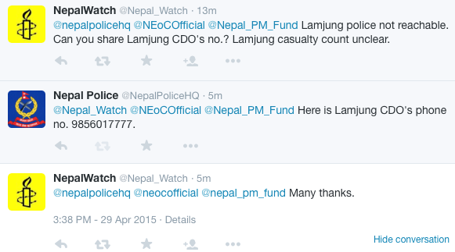
Future Research
National DMIS Governance Framework should incorporate Social Media users for crisis management.
Intra Agency Coordination and Inter Agency Coordination by using Social Media.
@nepalpolicehq and other EROs e.g. @NEoCOfficial @NepalArmy @APF-Nepal

Slide 20
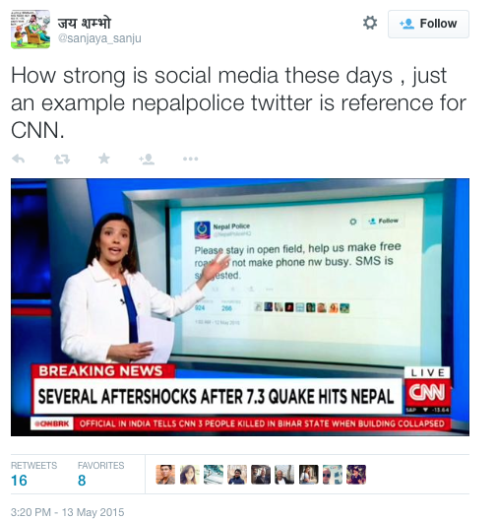
Social Media and Crowd Sourcing
This example shade lights on how government organizations in spite of resource crunches can carpe diem to work effectively when faced with a large scale disaster.

Slide 21
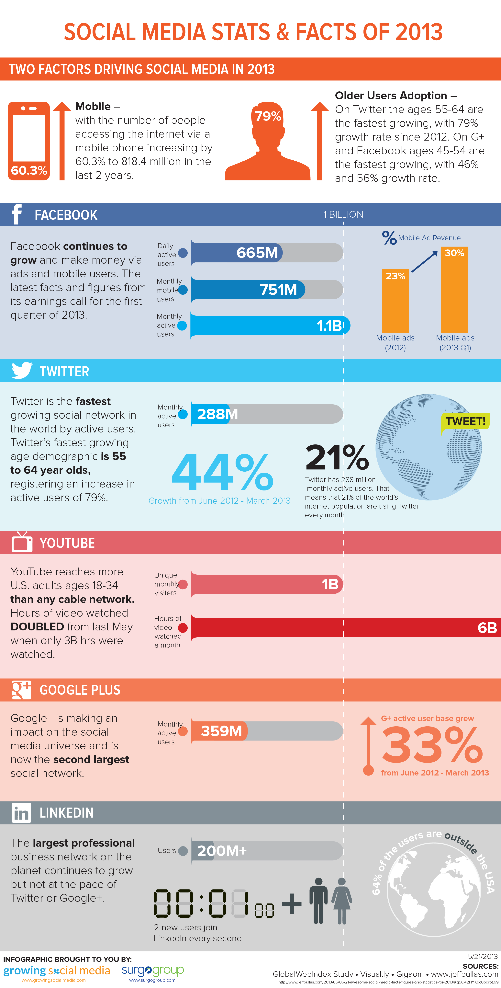

Slide 22
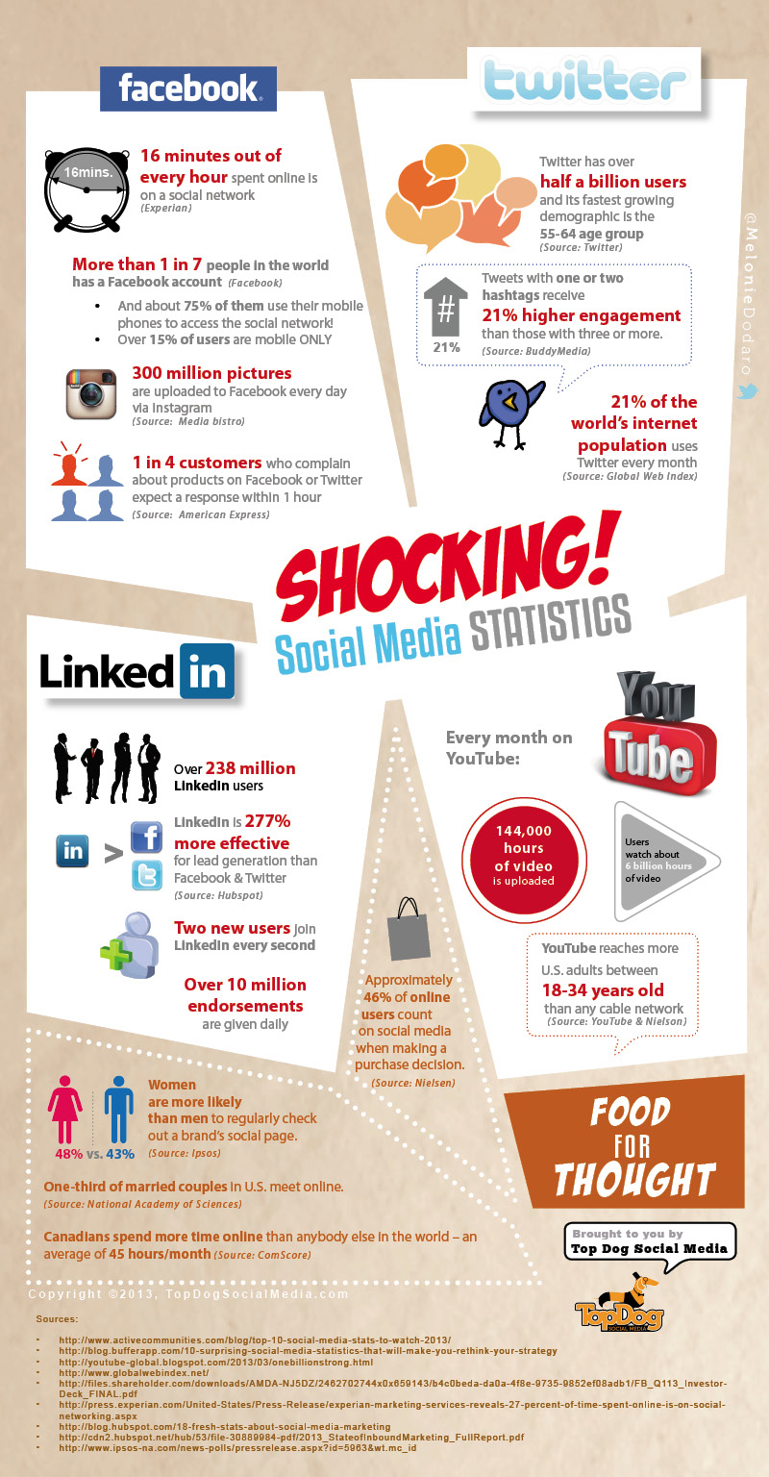

Slide 23
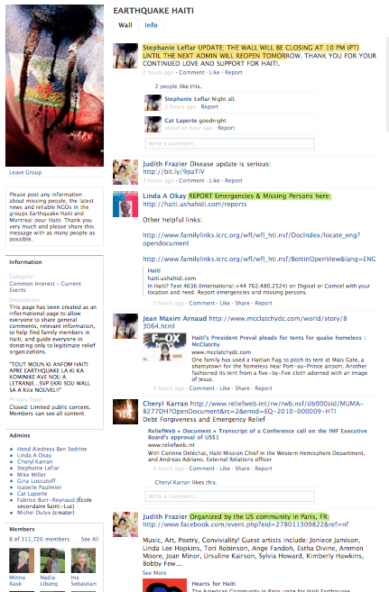
Social Media and Crisis Management
Why it’s a good thing
Educate
Inform
Share
Notes:
Over the last few years people have come to understand that social media sites and online tools can be extremely helpful during a crisis. Haiti is a good example of the emergence of Social Media as a tool to inform the world what as happening as well as inform first responders of community needs.

Slide 24
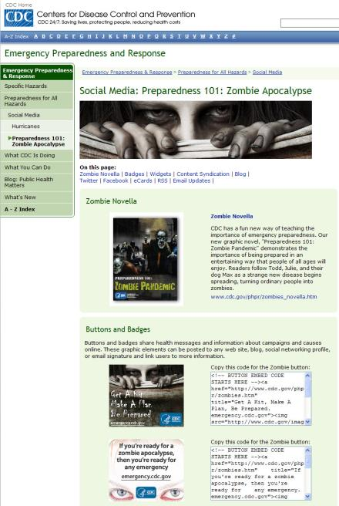
Before a Crisis
Help educate & train
general public
disaster personnel
network organizations
Recruit volunteers
Build situational Awareness
Notes:
Before a crisis strikes, social media sites & tools can be used to:
Help educate & train
general public
disaster personnel
network organizations
Recruit volunteers
Build situational Awareness
Education Example – Center for Disease Control spruced up their Hurricane preparedness messages by using the example of the Zombie Apocalypse which spread while wildfire on the internet.
Situational Awareness Example – World Health Map. What is the situation in an area that you might be traveling to. Also, this example is a a post – crisis example – Haiti & cholera.

Slide 25
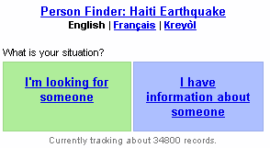
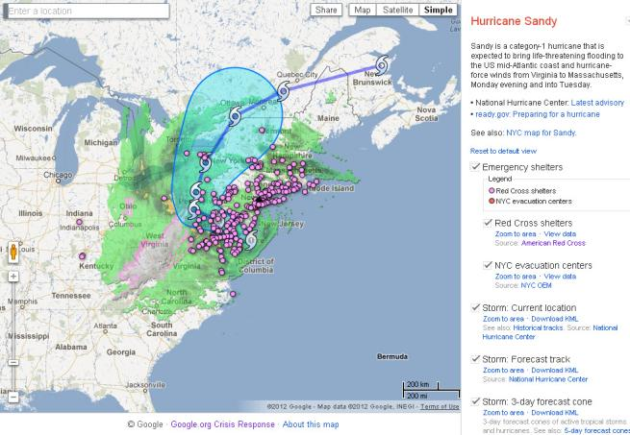
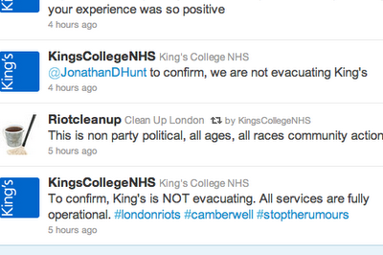
During a crisis
Provide real time information updates
Share photos and video
Help account for people
Reach out to others
Quash rumors
YouTube Video – Neda dying in Iran
Notes:
Google Map for during Hurricane Sandy – it provided information on storm location, emergency shelters, evacuation routes, etc. Other maps for power outages.
Source: Mashable.com
Anyone with a cell phone can take photos and/or video and immediately post them to YouTube, Twitter, Facebook, etc.
Governments can try to suppress the media but they can’t suppress every form of Social Network – no matter how hard they try. Example: Iranian protests. Video of a young woman injured and eventually dying after been wounded. The 40-second video was taken using a cell phone and then uploaded to Youtube and Twitter. Within hours, millions of people around the world saw this video and it became a rally point for many government opponents.

Slide 26
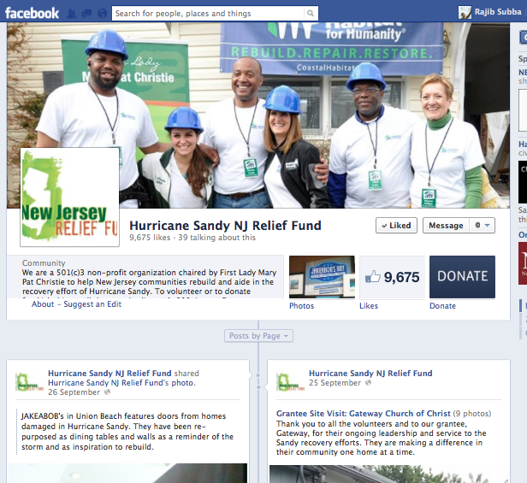
After a crisis
Information sharing on recovery efforts
Fundraise for disaster relief
Notes:
After a crisis, there is still a time of rebuilding. Information on recovery efforts can be shared on social media. As part of your communications plan it’s important for people to see that action is being taken otherwise it could undermine your efforts. It also gives people an opportunity to participate in the recovery.
Finally it’s social media has emerged as an important fundraising tool by NGOs/Non-Profits for recover efforts.

Slide 27
And Yet!
Most of the Organizational controlled information systems are off limits to general public hindering their participation in the HA/DRR activities.
Many perceive that Emergency Responder Organizations (ERO) are reluctant to coordinate and collaborate online (publicly)!

Slide 28
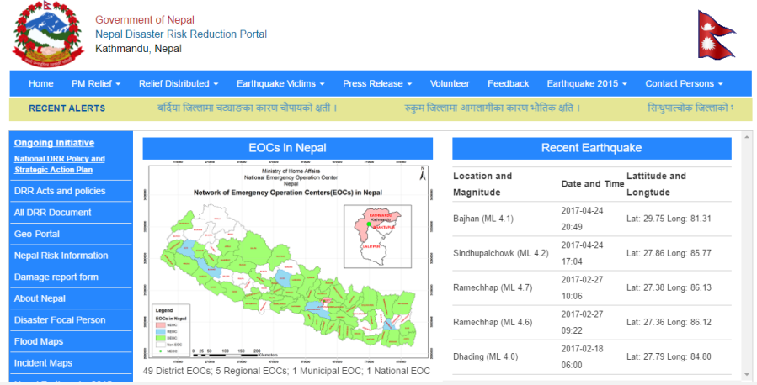
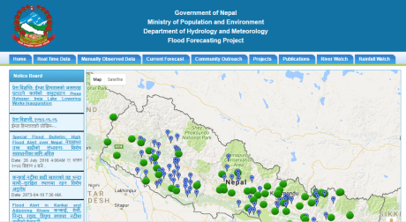
Disaster Management Information System Framework
MIS Backend
Nepal Emergency Operations Center
Documents & Photos
Person Finder
Messaging: SMS & Email
Disaster Victim Identification
Organization registry
Logistics management
Integration
Weather/Flood Info Sys
DRR Portal
One Stop Access
Multi-Disaster Management System
Coordination Among Stakeholders
Seismic Data
Geo Spatial Data
DSS
Decision Support System
Knowledge based Portal
Linkages
Other Information Systems

Slide 29
Conclusions
Social Media including Twitter could be used as an effective communication and collaboration platform between the disaster management authority and the general public, making it easier for the former to serve the community.
Aligned response with expectations for information on the status of road situations, casualties, landslides, relief and rescue operations, contacts and missing persons, helped build a collaborative relationship between the ERO and the public.
Interaction Site like Twitter Handle helped highlight the difference in response priorities between the police and the general public, thus allowing the former to reconsider its planning activities.
Resilient Communication Networks and Infrastructure is must.

Slide 30
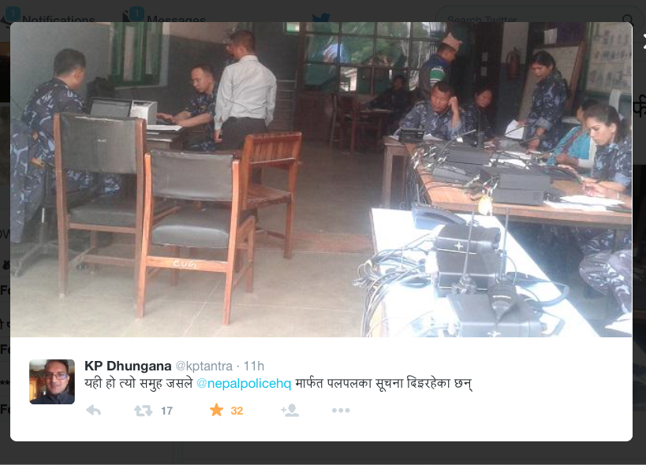
Any Question? Thank You!
This is the team that provides real-time information via @nepalpolicehq.

