Slide 1
Broadband Access in India: Insights from a Demand Side Research
P. Vigneswara Ilavarasan, PhD
IIT Delhi

Slide 2
Agenda
Context
Demand side research & NOFN
Absorptive capacity
Questions
Method
Findings
Implications

Slide 3
Broadband India
http://trai.gov.in/sites/default/files/Press_Release_No50_Eng_13072017.pdf

Slide 4
Context…
Digital India realization
egovernance
Digital divide
Roads Vs Youtube
Does IT matter?

Slide 5
Demand Side Research
Of end-users
Evidence based policy making
Drive new (telecom service quality – call drops)
Validate (Online driving license registration)
Useful, even if policies are filling affordability / feasibility gaps
Inputs for mid term corrections
Following all possible rigorous methods

Slide 6
International Backhaul
National Optical Fiber Network / BharatNet
State owned Telco and Public Fiber Networks
Domestic Backhaul
International Connectivity
Point of Interface
Block
Service Providers
BBNL PoP
Pilot- 58 GPs connected
Target – 250000 GPs
Customers
Point of Interface
At Gram Panchayat
Access Network
Implemented by BBNL – SPV (BSNL, Railtel, PowerGrid ), wholesale bandwidth provider. Costing ~6 B USD. Digital India Cost – 18 B USD.

Slide 7
Broadband Regulatory and Policy Framework
Supply Side
Infrastructure and networks
Broadband wholesale offers
Demand Side
Awareness, trust and usage capabilities
Content and services
Supply push by Indian government – BharatNet
Demand Pull ?
Survey of Institutional Users in pilot areas of BharatNet

Slide 8
http://www.livemint.com/Opinion/HEPnbjHSOEiX8SYszi0UyK/Building-another-pipe-dream.html

Slide 9
Broadband Ecosystem & impact on economy
Kelly, T. and Rossotto, C. M. (Eds). (2010). Broadband strategies handbook. Washington: The World Bank.

Slide 10
Question
To assess
whether present & potential institutional users in the gram panchayats of NOFN pilot phase,
own and possess adequate capacity
to use and access the Internet
and
to deliver services to the rural households

Slide 11
Areas of enquiry
Level of ownership and usage of Internet
Awareness of the NOFN, its potential and the projected benefits
Impact of Internet on the way consumers conduct their businesses / activities
Future intention of use of Internet in consumers conduct of businesses / activities
Potential challenges to NOFN that consumers foresee

Slide 12
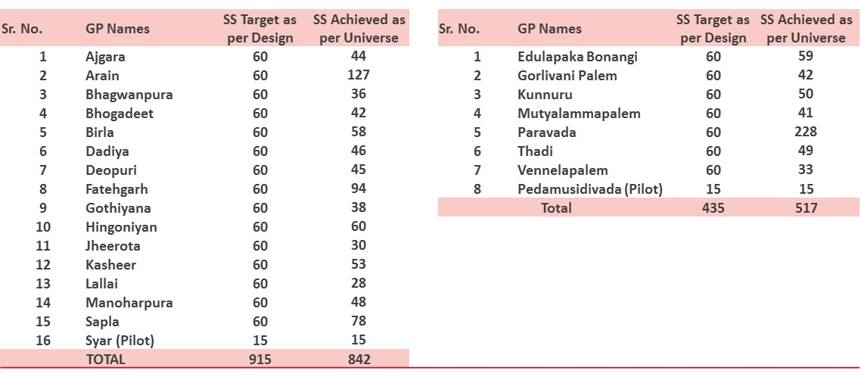
Method
Computer assisted in-person Quanti. interviews
With heads or in-charges
50% of Pilot GPs in Rajasthan (15) & AP (7)
Arain (842) & Paravada (517)
Systematic random selection

Slide 13
Quota
State Government Organization | 25%
Central Government Organization | 25%
Private Organization | 25%
Non-governmental Organisation (Public/Private) | 5%
Semi-governmental Organization | 10%
Centre | State Government Organization |  | Central Government Organization |  | Private Organization |  | Non-governmental Organisation (Public / Private owned) |  | Semi-governmental Organization |  | TOTAL
 | Target | Achieved | Target | Achieved | Target | Achieved | Target | Achieved | Target | Achieved | Target | Achieved
Ajmer TOTAL | 225 | 229 | 225 | 20 | 225 | 524 | 45 | 6 | 90 | 48 | 900 | 827
Parwada TOTAL | 105 | 63 | 105 | 5 | 105 | 392 | 21 | 2 | 42 | 40 | 420 | 502
GRAND Total | 330 | 292 | 330 | 25 | 330 | 916 | 66 | 8 | 132 | 88 | 1320 | 1329

Slide 14
Institutional Profile
Notes:
Most of the public organizations were schools and banks followed by co-operative societies and other organizations.
Out of the state government organizations, 29% of the organizations were Anganwadis’ (basic health care centers), 29% were schools and 7% were Panchayat offices.
Out of the central government organizations, 56% were post offices, 39% were banks and 12% were gas stations Out of the semi government organizations 41% were milk dairy shops and 37% were cooperate societies.
Out of these organizations, 22% of the organizations turnover was more than INR 500,000.

Slide 15
Using a service that you don’t know about

Slide 16
70% of the institutional respondents weren’t aware of BharatNet
Awareness of BharatNet
(% of surveyed organizations)
Awareness of BharatNet
(Base: Total private and public organizations)
Q. How familiar with BharatNet would you say you are?
Notes:
Out of the total respondents 70% didn’t know about BharatNet at all while 8% (overall) claimed that they know about it very well.
Public organizations were more aware about BharatNet than private organizations. Only 6% of the respondents from private organizations knew about BharatNet very well.
Out of the respondents, 36% of the Private salaried employees were aware of BharatNet followed by 13% of state government organizations. 70% of the Private organizations with 1 employee didn’t know anything about BharatNet followed by 72% of private organizations with 1% employees.

Slide 17
Those who are aware, didn’t know what exactly BharatNet is
Perception on BharatNet
(Base: Respondents who are aware of BharatNet)
Q65. Please share your agreement or disagreement with each of these statements
Notes:
Less thatb150 in a poorer state and 250 in an advanced state

Slide 18
Is there a demand?

Slide 19
Use of Internet was low: at 35%
Use of BharatNet was even lower: Only 3%
Percentage of organizations using BharatNet
(Base: % of surveyed organizations)
All base: 1359
Organizations Use Internet (35%)
Organizations Don't use Internet (65%)
Use BharatNet (3%)
Do not use BharatNet (32%)
Purchase intention to use BharatNet (21%)
Purchase intention not to use BharatNet (11%)
Purchase intention to use BharatNet (9%)
Purchase intention to not use BharatNet (6%)
Notes:
69% of the organizations that use Internet stated that the trigger to use Internet was to get instant access to information followed by 58% stating that they can do many things at once using Internet and 51% stating that everyone around uses Internet. Influenced by colleagues was among the top three triggers of use of Internet by private players.

Slide 20
75% institutional users – “can continue existing work without Internet”
Reasons for not using Internet
(Base: Organizations that Don't use Internet)
Q. 51 We would like to know the reason behind not using internet for your organisation
Notes:
Out of the 65% of the organizations that are not using Internet, 50% stated that they are not planning to use Internet in the future as well.
Seventy Five Percent of the organizations that don’t use Internet agreed that Internet is not relevant to the type of work they do and 70% of the organizations mentioned that they don’t have the required devices to access Internet. 52% of the organizations did not have prior experience in using Internet.
The main reason for not using BharatNet in the organizations that are aware of BharatNet was breakdown of equipment followed by slow connection of NOFN and the presence of Internet by other service providers. 32% of the private organizations strongly agreed that NOFN connection is very slow and 34% of private organizations stated that Internet from other service providers is already available.
The institutions as well as the individuals surveyed said that Internet is expensive during the survey. Nearly 2/3rd of the organizations said that the internet that they use is either ‘Very expensive‘ or ‘Somewhat expensive’. Furthermore, 85% of individuals say that their internet is either ‘Very expensive’ or ‘Somewhat expensive’

Slide 21
Using other service providers - for not using BharatNet
Reasons for not using BharatNet
(Base: Organizations that use Internet through other service providers)
Q64. Reasons for not using internet through BharatNet

Slide 22
If people experience / know the benefits of BharatNet, the demand for the service will increase

Slide 23
20% of the institutional users used Internet to get access to information
(Base: Respondents who use Internet)
Q36. Can you please tell me, Why did your organization / business get the Internet connection??

Slide 24
Awareness campaigns can be used to make opinion leaders / early adoptors aware of BharatNet

Slide 25
Newspapers were the main source of awareness followed by word of mouth
Sources of awareness of BharatNet
(Base: Respondents who are aware of BharatNet)
Q63. Where did you come to know about BharatNet)?

Slide 26
Policy Suggestions?
BBNL
Campaigns
Awareness – Access, Tariff
Benefits – Demos, Potential
Single window clearances
Trade Associations
Innovation Hack Meets
Viable business models, Third party content providers
CSR – Inclusive digital society
Private Entrepreneurs
Contact centers for hospitals, NSDC, Education etc
Private Telecom Service Providers
Public wifi hotspots?

Slide 27
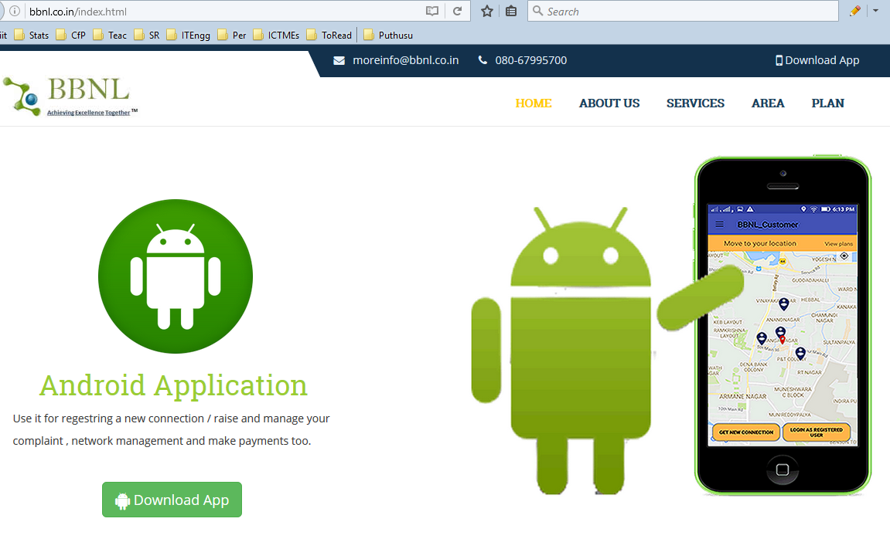
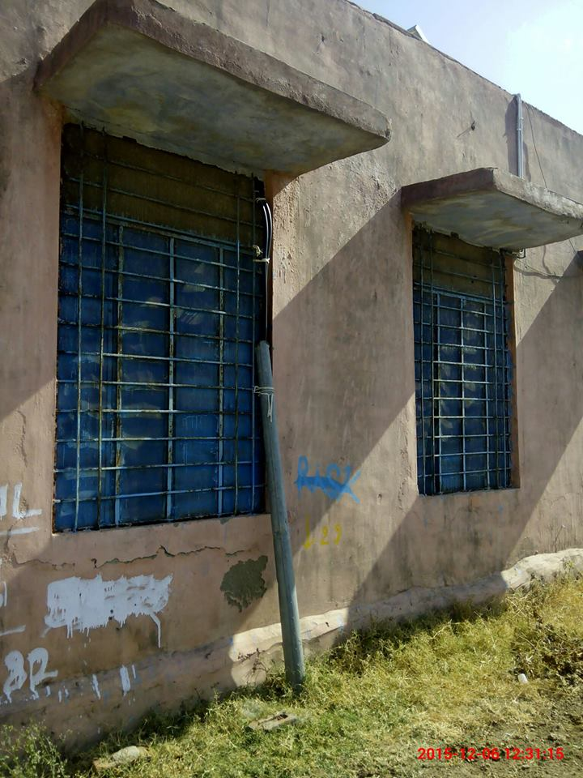
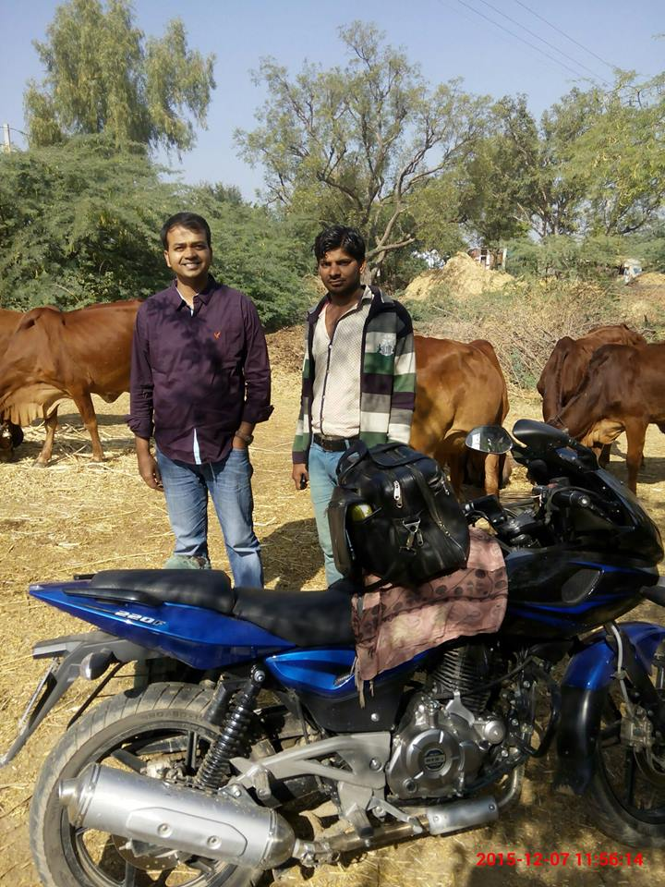
May be of interest

Slide 28
Q?
Thank you!
vignes@iitd.ac.in
99 10 23 04 07

