Slide 1
Security, blocking of websites, shutting down networks and related issues
Krishna Oolun
Course on Regulatory Design and Practice
Nay Pyi Taw, September 2017
This work was carried out with the aid of a grant from the International Development Research Centre, Canada and the Department for International Development UK..

Slide 2
Outline
The context
Role and responsibility of the regulator
Technical solutions
Case study
Lessons learnt and recommendations

Slide 3
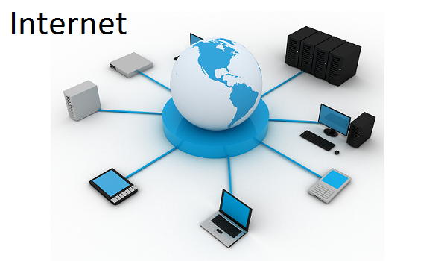
The converging platform for Telecommunications, IT, Media (broadcast) and Entertainment – TIME
Critical Information Infrastructure

Slide 4
The regulator revisited
Embark on a process of consolidating regulation across sectors that are converging and to bring regulation up-to-date
The very first step is to create the enabling instrument:-
take steps to regulate or curtail the harmful and illegal content on the Internet and other information and communication services;
ensure the safety and quality of every information and communication services including telecommunication service and, for that purpose, determine technical standards for telecommunication network, the connection of customer equipment to telecommunication networks;
entertain complaints from consumers in relation to any information and communication service and, where necessary, refer them to the appropriate authorities;

Slide 5
Steps to be taken by regulator
License conditions to be imposed on ISPs requiring them to put up the relevant filtering mechanism
regulator may also act as a trusted neutral entity in facilitating filtering of national interest
Regulator may set up a multi-stakeholder platform that provide consumer support in matters relating to inappropriate contents of the internet or any other ICT platform
Regulator may also advise the policymaker of the need to have an overarching cybersecurity strategy

Slide 6
Technical solutions - principle
Blocking and filtering can be based on relatively static blacklist or be determined more dynamically based on a real-time examination of the information being exchanged.
Blacklists may be produced manually or automatically and are often not available to non-customers of the blocking software.
Blocking or filtering can be done at a centralized national level, at a decentralized sub-national level, or at an institutional level.
Blocking and filtering may also vary within a country across different ISPs

Slide 7
Technical solutions – terminologies
Blacklisting is the action of a group or authority, that compile a blacklist of people, contents or other entities in general to be avoided or distrusted as not being acceptable
Protocol is a set of rules that any two or more devices that need to communicate to each other have to follow to enable proper communication
Internet protocol (IP) is the set of rules that connecting entities need to use when using the internet as the means of communication
IP address is a numerical label assigned to each device connected to a computer network that uses the Internet Protocol for communication. it serves two principal functions: host or network interface identification and location addressing

Slide 8
Technical solution - methodology
Internet Protocol (IP) address blocking: By denying access to a certain IP address.
If the target Web site is hosted in a shared hosting server, all websites on the same server will be blocked.
This affects IP-based protocols such as HTTP, FTP and POP.
Limitation:
Can use proxies to access the target websites
but proxies may be jammed or blocked
To get over that some large websites such as Google have allocated additional IP addresses to circumvent the block,

Slide 9
Technical solution - methodology
Domain Name System (DNS) filtering and redirection: Blocked domain names are not resolved, or an incorrect IP address is returned.
This affects all IP-based protocols such as HTTP, FTP and POP.
A typical circumvention method is to find an alternative DNS resolver that resolves domain names correctly, but domain name servers are subject to blockage as well, especially IP address blocking.
Another workaround is to bypass DNS if the IP address is obtainable from other sources and is not itself blocked.
Examples are modifying the Hosts file or typing the IP address instead of the domain name as part of a URL given to a Web browser.

Slide 10
Technical solution - methodology
Uniform Resource Locator (URL) filtering: URL strings are scanned for target keywords regardless of the domain name specified in the URL.
This affects the HTTP protocol.
Typical circumvention methods are to use escaped characters in the URL, or to use encrypted protocols such as VPN.

Slide 11
Technical solution - methodology
Packet filtering: Terminate TCP packet transmissions when a certain number of controversial keywords are detected.
This affects all TCP-based protocols such as HTTP, FTP and POP.
Search engine results pages are more likely to be AFFECTED.
Typical circumvention methods are to use encrypted connections – such as VPN OR SSL – to escape the HTML content.

Slide 12
Technical solution - methodology
Connection reset: If a previous TCP connection is blocked by the filter, future connection attempts from both sides can also be blocked for some variable amount of time.
Depending on the location of the block, other users or websites may also be blocked, if the communication is routed through the blocking location.
A circumvention method is to ignore the reset packet sent by the firewall.

Slide 13
Technical solution - methodology
Network disconnection: A technically simpler method is to completely cut off all routers, either by software or by hardware (turning off machines, pulling out cables).

Slide 14
Technical solution - methodology
Technical mechanisms are subject to both over- and under-blocking since it is often impossible to always block exactly the targeted content without blocking other permissible material or allowing some access to targeted material and so providing more or less protection than desired

Slide 15
Case study – child sexual abuse (CSA) filtering
Under section 18 (1) m of the ICT Act 2001 of Mauritius, one of the functions of the ICT Authority is to "take steps to regulate or curtail harmful and illegal content on Internet and other information and communication services".
Under the child protection act of Mauritius, it is provided that any material in any form that exhibits contents of child sexual abuse in whatever form shall be deemed to be illegal
The legal mandate ☑

Slide 16
CSA filtering – aim and object
In fulfilling its statutory mandate, the ICT Authority has launched on the 8th of February 2011, a centralised online content filtering solution to filter access to child sexual abuse (CSA) sites for Internet users in Mauritius.
The deployment of this filtering system was intended to reduce the availability and circulation of child abuse images in Mauritius - and limit the trauma experienced by victims' when their images circulate on the Internet (social regulation)
At the same time, it is intended to protect against accidental viewing, thus giving people in Mauritius, the confidence in the Internet they deserve (quality of service regulation)

Slide 17
CSA filtering – the process
Consultations with operators
Consultations with government, ministries and ombudsperson for children
Consultations with academia, civil society representatives, consumers’ association, the police department
Engagement with international potential partners (Internet watch foundation)
Engagement with technology providers
Creation of a multi-stakeholder platform
Assessment of technical solutions
Presentation of solution and obtain stakeholders’ buy-in

Slide 18
CSA filtering – the system
In order to implement this centralised online content filtering solution, the ICT Authority had chosen the Netclean Whitebox technology which has been developed specifically for this task in 2006.
This CSA filtering set up was initially hosted at the data centre of the ICT Authority and was connected to all local ISPs providing Internet access to the public in Mauritius until June 2014.
After that period the CSA filtering set up has been shifted on a cloud-based mode whereby no hardware is required at the ICTA premises.

Slide 19
CSA filtering – the operation
The system is based on a hybrid Border Gateway Protocol (BGP) and Uniform Resource Locator (URL) filtering system.
The first step is where a server containing the list of blocked sites (blacklist) checks the IP addresses of these sites and advertises the routes for these sites to go to a filtering server hosted at the ICT Authority rather than the destination web site.
The second step is where the filtering server checks the URL against the blacklist using packet inspection and if blocked then the request is not passed on to the destination web site but redirected to a blocking server and displays a block page.
If the site is not on the list, the filter passes the request as normal and the site is accessed by the ISP customer ("clean traffic").
The URL filtering list for this component will be the list provided by the Internet Watch Foundation (IWF), that is widely recognised as one of the best in the world at managing a URL list of CSA sites coupled with the Interpol blacklist.

Slide 20
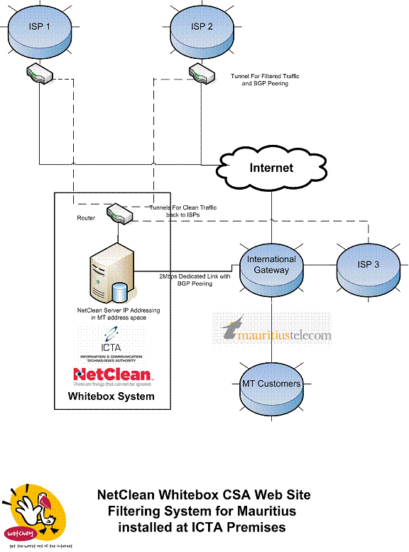
CSA filtering – technical setup

Slide 21
CSA filtering - evaluation
This system has the following advantages:
It has very little effect on the passage of most network traffic so has little effect on performance.
It has a lower cost than one-step filters that need to filter all of the ISP’s traffic.
As it does not have a proxy server it does not suffer from the potential problem of requests being changed to the proxy IP address from the customer’s original one.
As it uses external BGP it can be hosted external to the ISP and is ideal for country gateway implementations
The centralized system can be used as a cyber security infrastructure shared among ISPs and managed by the regulator

Slide 22
CSA filtering – Post implementation review
With the implementation of this CSA filtering solution, the regulator is ensuring that ISPs are supplying their customers with an Internet connection which is clean from access to CSA websites in the same way that a water company makes sure that the water provided in its pipes is uncontaminated
The regulator collects data about the number of hits on CSA website contents
This figure has been on the constant decrease

Slide 23
Lessons learnt – recommendations
Security, blocking… should not be taken in isolation or stand alone activity
It should form part of a national cybersecurity strategy that is put in place
Especially that telecom itself is moving more and more towards ip-based network, cyber security strategy becomes more important
It will provide more resilience to the critical information infrastructure
The advantage we have today is global framework exists
The ITU-GCA is a very good reference model to adopt and develop locally
The regulator is ideally placed to play the ecosystem manager role

Slide 24
Lessons learnt – recommendations
“Cybersecurity is an ecosystem where laws, organizations, skills, cooperation and technical implementation need to be in harmony to be most effective,” – Global cybersecurity index report (July 2017) released by ITU
Five pillars of the ITU Global Cybersecurity Agenda: legal, technical, organizational, capacity building and international cooperation
From experience:
Legal: Computer misuse and cybercrime act, data protection act, electronic transactions act, ict act
Technical: the required set up for filtering if required, threat monitoring centre, computer incident reporting team (CERT/CIRT)

Slide 25
Lessons learnt – recommendations
Organizational: the regulator, the CERT team, the police cybercrime unit, national cybercrime committee being a multi-stakeholder forum
Capacity building/international cooperation: GLACY, impact

Slide 26
Thank you for your attention
Krishna.oolun@intnet.mu

