Slide 1
Bhasa Buddy

Slide 2
Accessibility- Behind the Picture
???
Pick me Up, Mom

Slide 3
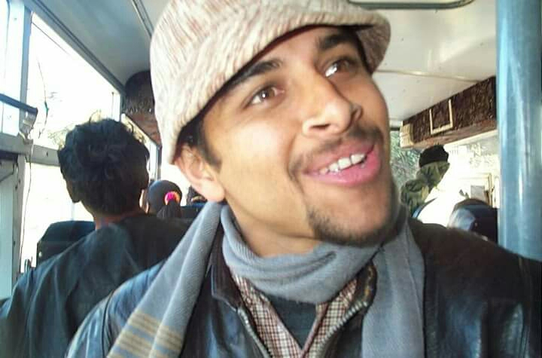
Meet Mr. Ram Prasad Adhikari

Slide 4
VALUE PROPOSITION
A bridge in the communicative stream
Accessibility to Nepali alphabets, words and phrases
The impact of language on identity

Slide 5
UNDERLYING MAGIC
Interactive Gameplay
Words Formation
TAP, DRAW and CLAP
Sign-Language Assistance
Creative Examples

Slide 6
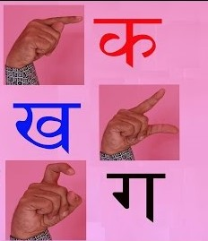
Methodology

Slide 7
Bhasa Buddy Roadmap
First 30 days
App Prototype
Beta release of Bhasa Buddy
2nd Month
Beta release of Bhasa Buddy
6th month
Complete release of Bhasa Buddy game
1 year
Workout on Word Formation and additional features

Slide 8
What’s in our favour
Nepal Constitution 2072 (2015) mentions the right to education in Sign Language

Slide 9
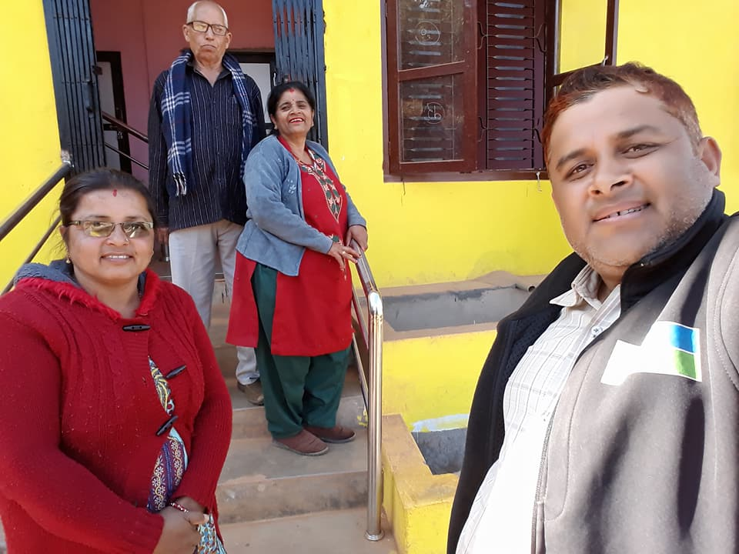
The sweet echo of success!

Slide 10
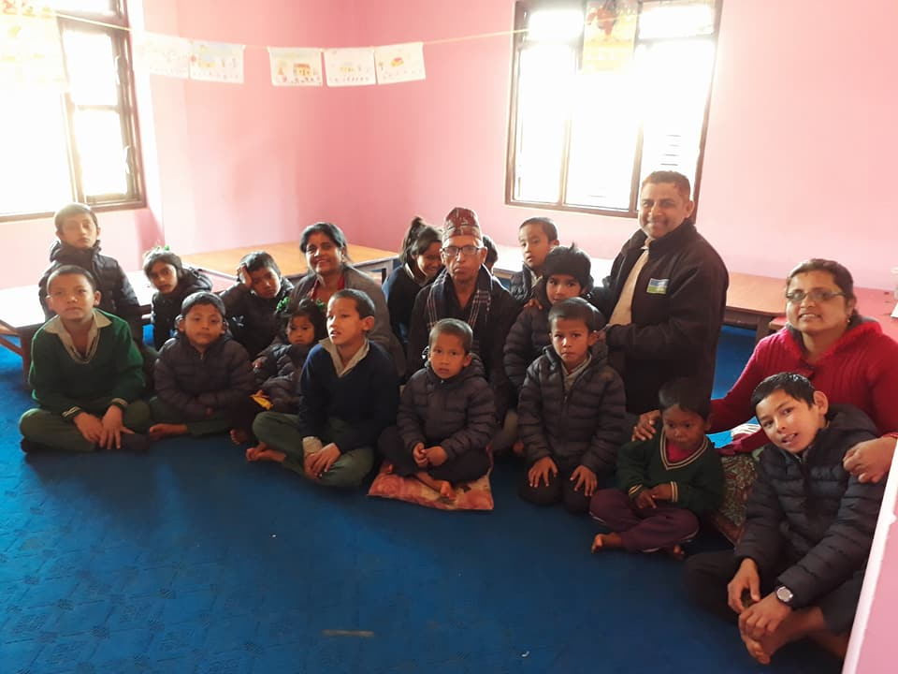
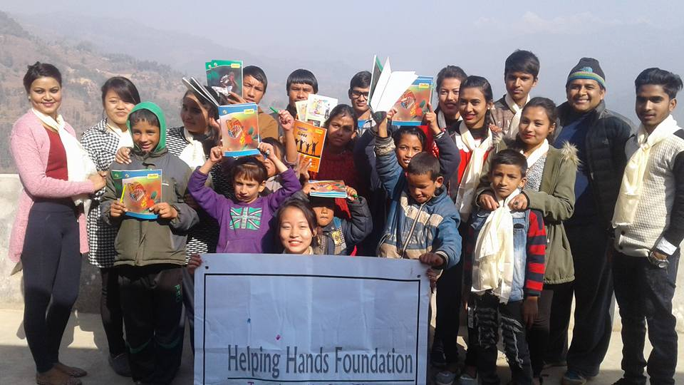
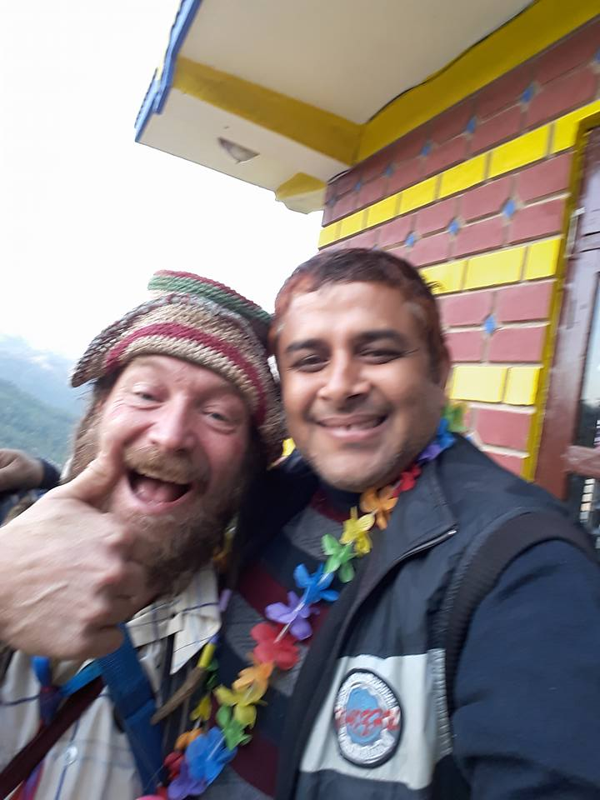
At the Helm of Dreams!

Slide 11
Thank you!

