Slide 1
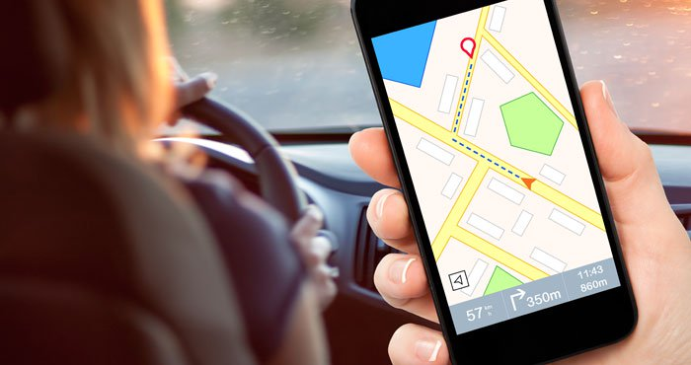
Navigator for Diffabled People
College for Professional Studies

Slide 2
Existing Applications
Google Maps
Maps.me

Slide 3
Prevailing Problems
Not diffabled-user-friendly
Inappropriate approximation
of distance while walking
Language barrier

Slide 5
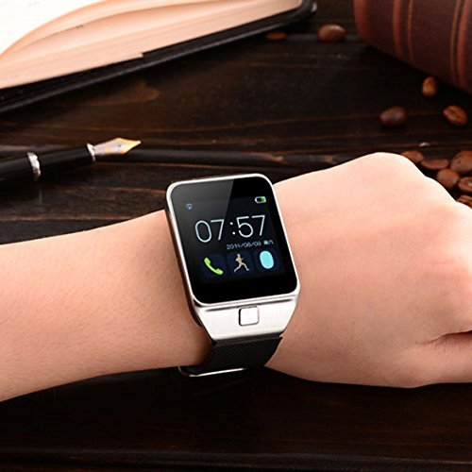
Proposed Solution
Minimal User Input for Operation
Ask for current location at any time
Notify about any turnings and diversions

Slide 6
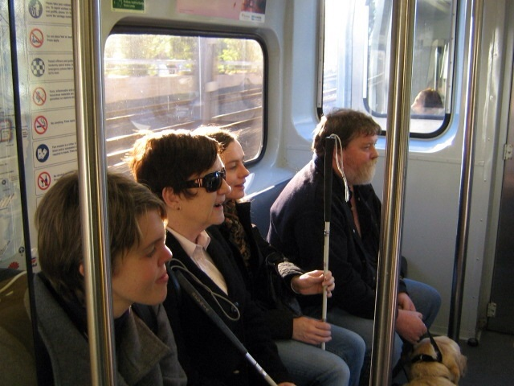
Proposed Solution
Different behavior while walking and riding vehicles
Suggestion of destined location with relative to public landmarks to identify precise location
Nepali language

Slide 7
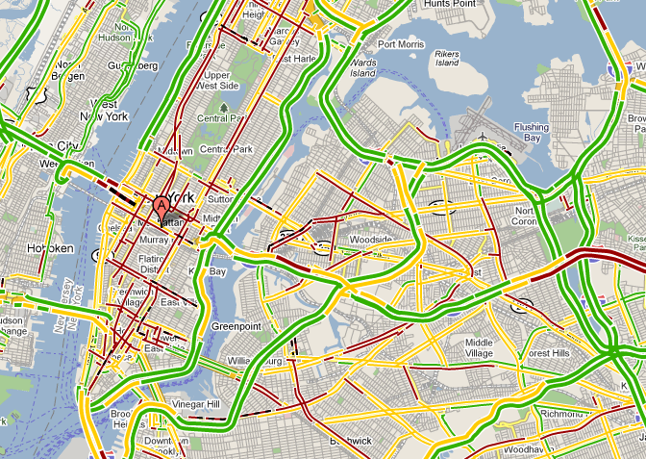
Additional Features
Allows users to escape heavy traffic
Localized language

Slide 8
Targeted Users
Primary
People with Visual Impairment
Secondary
Tourists
Normal People

Slide 9
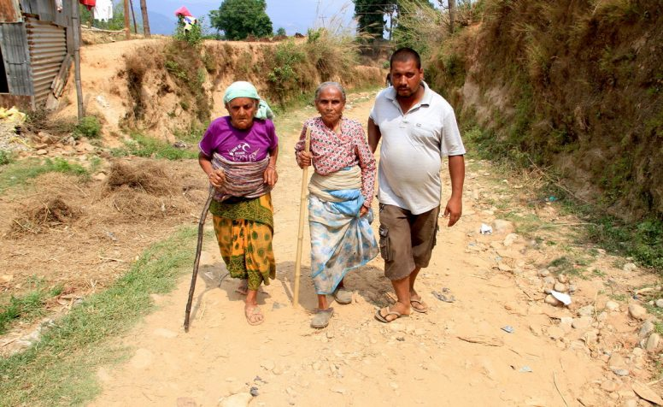
Limitations
Wont be applicable for rural areas
May be expensive due to mobile data usage

Slide 10
Any Queries?

