Slide 1
Pragmatic first steps in ensuring accessible ICTs
This work was carried out with the aid of a grant from the International Development Research Centre, Canada and the Department for International Development, UK

Slide 2
Smartphones and the disabled in Nepal
Granular details not readily available
Lots of different claims
LIRNEasia is collecting disabled data through a large-sample survey in Nepal in 2018
Smartphones are becoming cheaper
Nepal’s take up will increase over time

Slide 3
Data from the region. Smartphones are a crucial component of a good Internet experience
Q: What type of mobile is it? Multiple responses allowed [1] basic phone [2] feature phone [3] smartphone (Multiple Response)
Base | Argentina | South Africa | Guatemala | India | Nigeria | Pakistan | Bangladesh | Cambodia | Kenya
All respondents | 1,500 | 1,208 | 1,517 | 5,069 | 1,808 | 2,002 | 2,020 | 2,123 | 1,208
Notes:
Basic phone = calls and texting only
Feature phone = calls, texting, basic capabilities for multi-media (e.g., photos/music) and internet
Smartphone = uses an operating system such as Android, iOS, through which 3rd party ‘apps’ can be run on the phone; usually with a touch screen (covering 75% of its front area)
Africa single response Asia & LATAM multiple response

Slide 4
Examples of actions by operators

Slide 5
US: AT&T set up advisory panel on access and aging
“The panel composed of national leaders in assistive technology, aging and cross-disability issues. It provides advice and counsel to AT&T's subsidiaries, affiliates and leadership teams regarding issues of mutual interest. AAPAA meets semiannually to discuss a specific area of the business with guest speakers & corporate subject matter experts. Members John Anschutz-Manager, Assistive Technology Center Shepherd Center Kelly Buckland Executive Director, National Council on Independent Living (NCIL) Yanira Cruz, PhD, President & CEO National Hispanic Council on Aging Lise Hamlin, Director of Public Policy Hearing Loss Association of America Lee Huffman, AccessWorld and Technology Information Editor American Foundation for the Blind Angela Jones, SVP Business Development & Lifestyle AARP Services Inc. Ben Lippincott, Manager, Industry Relations Wireless RERC Linda Mastandrea CEO Law Offices of Linda Mastandrea Alfred Moye' Board of Directors SeniorNet Jason Resendez Executive Director, UsAgainst Alzheimer's Latino Network Latinos Against Alzheimer's Coalition Gloria Satriale, Esq. Executive Director, Preparing Adolescents and Adults for Life (PAAL) President, Mission for Educating Citizens for Autism Claude L. Stout Executive Director Telecommunications for the Deaf and Hard of Hearing, Inc. (TDI) Amy VanDeVelde National Connections Program Manager The OASIS Institute”
Source: AT&T website
Notes:
https://www.wireless.att.com/learn/articles-resources/disability-resources/advisory-panel.jsp

Slide 6
AT&T has accessibility plans for deaf/hard of hearing and for those with speech disability
“Voice calling is not their primary mode of communication. These plans are for customers who mainly use text messaging or video calling.
How to apply for AT&T Accessibility plans
Customers interested in the AT&T Text Accessibility plan (TAP) must qualify by completing the Text Accessibility Plan (TAP) Application and Certification Form (PDF, 342KB). TAP plans are available for all versions of iPhone.”
Source: AT&T website
Notes:
https://www.att.com/esupport/article.html#!/wireless/KM1207491

Slide 7
What’s in it for operators?
Different markets segments have to be addressed: disabled persons constitute different market segments
Emotional payoff from assisting disabled communities

Slide 8
Actions by regulator/government

Slide 9
Primary focus
Address the information asymmetry
Executives in telcos know intuitively about the needs of abled individuals
They need to learn about the needs of the disabled
Special attention to mechanisms that improve communication between the disabled and operators

Slide 10
Use of consultative committees are encouraged by US regulator
The Federal Communication Commission (FCC) Consumer Guide- Telecommunications Access for People with Disabilities states “Companies should engage in a number of activities to identify barriers to accessibility and usability. For example:
When conducting market research, product design, testing, pilot demonstrations and product trials, companies should include individuals with disabilities in target groups for such activities.
Companies should work cooperatively with disability-related organizations.
Companies should undertake reasonable efforts to test access solutions with people with disabilities.”
Source: Consumer Guide- Telecommunications Access for People with Disabilities. Federal Communications Commission
Notes:
https://www.fcc.gov/consumers/guides/telecommunications-access-people-disabilities

Slide 11
Hong Kong: Consultative approach and publicity also required
“Consultation and Co-operation
Obligatory Requirements
20. Fixed operators, PSPs, mobile telephone operators, paging operators and internet service providers should consult and co-operate with the CA to ensure that the needs and interests of the elderly and people with a disability are fully taken into account in the development and provision of telecommunications services and apparatus specified in the Code.
Publicity
Obligatory Requirements
21. Fixed operators, PSPs, mobile telephone operators, paging operators and internet service providers should ensure that the measures which they take in order to comply with the obligatory requirements of this Code are widely publicized, taking into consideration the need to disseminate information in appropriate formats and through appropriate channels for the elderly and people with a disability.”
Source: Guidelines given by the Office of the Communications Authority-Hong Kong
Notes:
https://www.coms-auth.hk/filemanager/statement/en/upload/186/cop201302e.pdf

Slide 12
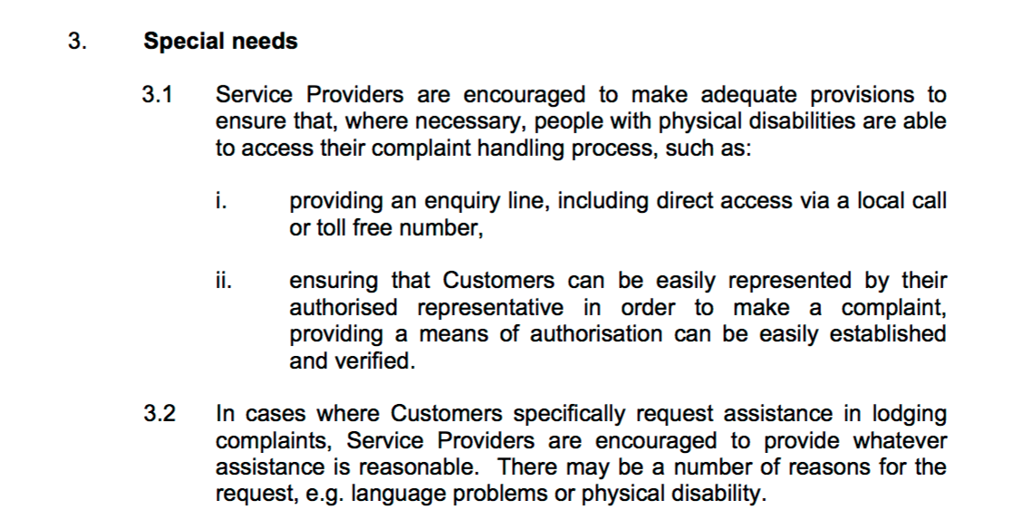
Malaysia: Local call/toll free number for ease of making complaints for those with physical disabilites recommended
Source: General Consumer Code of Practice for the Communications and Multimedia Industry Malaysia (2003) Communications and Multimedia Forum of Malaysia, MCMC
Notes:
https://www.skmm.gov.my/skmmgovmy/files/attachments/GeneralConsumerCode.pdf

Slide 13
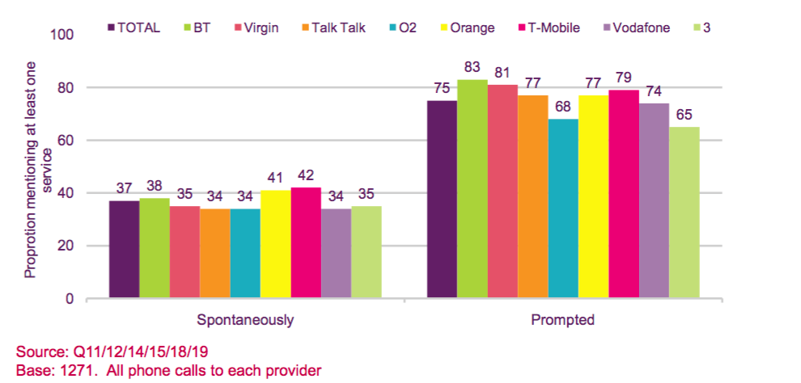
35% mentioned services spontaneously, 75% after prompted
Regulator commissoned studies to assess information provided to consumers with disabilities on products designed for them
Source: Ofcom (2010) Disabilities Mystery Report
Notes:
https://www.ofcom.org.uk/__data/assets/pdf_file/0032/68549/disabilitiesmysteryshoppin.pdf

Slide 14
Excerpt from draft universal service strategy of Myanmar
Improved access and usability of various ICT services for disabled people: the USF will work with notable representative disability groups to identify specific barriers and requirements from persons with disabilities in regards to using ICT services; initial indications are that there are already, for example, several helpful applications for both blind and deaf people but that they only exist in English and need to be converted into the Burmese language.

Slide 15
Nepal’s unimpressive performance with universal service
The government has spent only 2.6 per cent of the money accumulated in Rural Telecommunications Development Fund (RTDF) in the last 17 years. This shows that a huge amount of resources has remained idle in the fund, which was supposed to be utilised for extending telecom services to rural areas.
As of March-end, Nepal Telecommunications Authority (NTA) collected a total of Rs 10.22 billion for RTDF from income of its licensees till last fiscal. Each licensee of NTA contributes two per cent of their annual income from services in RTDF that was established as per a provision in Telecommunications Act 1997.
The Act says the fund has to be used for making telecom services available in ‘rural areas’. So far, Rs 265.69 million has been paid to Nepal Telecom (NT) and Rs 2.95 million to Subisu Cable Net from the fund for their involvement in service expansion to rural and remote areas.

Slide 16
The difference now
In the old days, we had to rely on operators and regulators for everything
Now we can do things on our own, with the help of well designed apps that can exploit the potential of the smartphone

