Slide 1
Skills needed in the “new normal”
Rohan Samarajiva
Sri Lanka Technological Campus|15 June, 2020

Slide 2
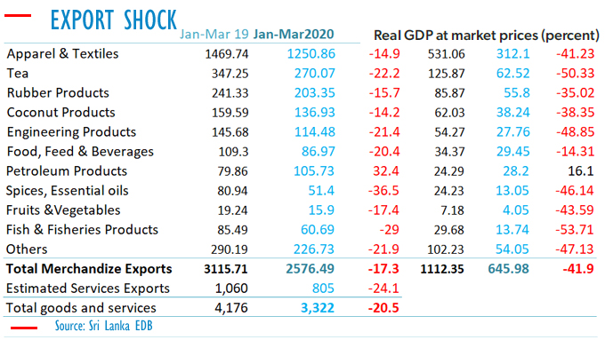
What is the new normal?
Humans will fear close contact with other humans
The state will enforce social distancing and related measures
There will be a massive decline in worldwide economic demand, caused first by government actions to “flatten the curve” and then by job/livelihood losses and uncertainty re earnings
  Demand for non-essential goods and services will take time to come back
  Reworking supply chains to make the resilient may help certain sectors and hurt others
    Long ➔ short
    Few ➔ many
http://bizenglish.adaderana.lk/merchandise-exports-fall-by-64-in-april/

Slide 3
Kinds of work in the new normal
Entirely online
Online & face-to-face
Only face-to-face

Slide 4
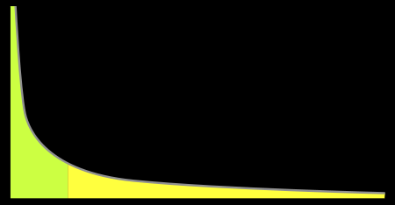
Entirely online work is better for some
Price is determined by supply and demand
  Actual labor (or professional) markets are limited by geography and law
    If you can offer services in different markets, you may have more demand ➔ price may rise
    But markets are generally not opened one way only; market opening may allow greater supply too ➔ price may remain the same or even decline
    Also, whatever monopolies that existed in your own market may be breached
      Therefore, insecure professionals oppose trade agreements and liberalization of markets for professional services
    Some professionals will prosper in virtual markets
      Weak ones protected by artificial barriers may be driven out
  Power law begins to apply

Slide 5
From 2016 Study: Earnings of Online Freelancers in Sri Lanka
Many worked part time (2-3 hours a day) to earn LKR 20,000/mo.
Few earned up to LKR 200,000/month..
Average earning from freelancing was LKR 15,000- LKR 20,000
Some exceptional workers earn 100,000- 200,000 from freelancing

Slide 6

But entirely online may be deceptive
Most effective may be mostly online, with occasional face-to-face interactions
What may be lost
  Trust
  Non-verbal communication
  Concentration of attention
  “Water-cooler conversations”, serendipitous connections
  Contextual and tacit knowledge

Slide 7
Online (even partial) is going to be more important: How can we position ourselves better?
If participating directly in new normal economy, as entrepreneur/professional
  Understand power law; be best at what you do
  Do not pass up on opportunities for face-to-face interactions such as conferences
  Do not neglect the non-instrumental and non-verbal aspects of communication, even when interacting online
    Lighting, backdrop, etc. matters
If participating as member of organization
  Pay attention to how work is evaluated
  Try to make up for loss of water-cooler conversations
  Value of professional approach to meetings
    On time
    Prior preparation
    Follow up

Slide 8
Common to “normal” & “new normal”; common to those who work on their own & those who work in organizations
“An engineer’s “half-life of knowledge,” an expression coined in 1962 by economist Fritz Machlup to describe the time it takes for half the knowledge in a particular domain to be superseded, everyone seems to agree, has been steadily dropping. For instance, a 1966 story in IEEE Spectrum titled, “Technical Obsolescence,” postulated that the half-life of an engineering degree in the late 1920’s was about 35 years; for a degree from 1960, it was thought to be about a decade.”
“In 2002, William Wulf, the president of the National Academy of Engineering, was quoted as saying that,” The half-life of engineering knowledge… is from seven to 2½ years.” More recent estimates emphasize the low end of the range, especially for those working in IT.”
https://spectrum.ieee.org/riskfactor/computing/it/an-engineering-career-only-a-young-persons-game

Slide 9
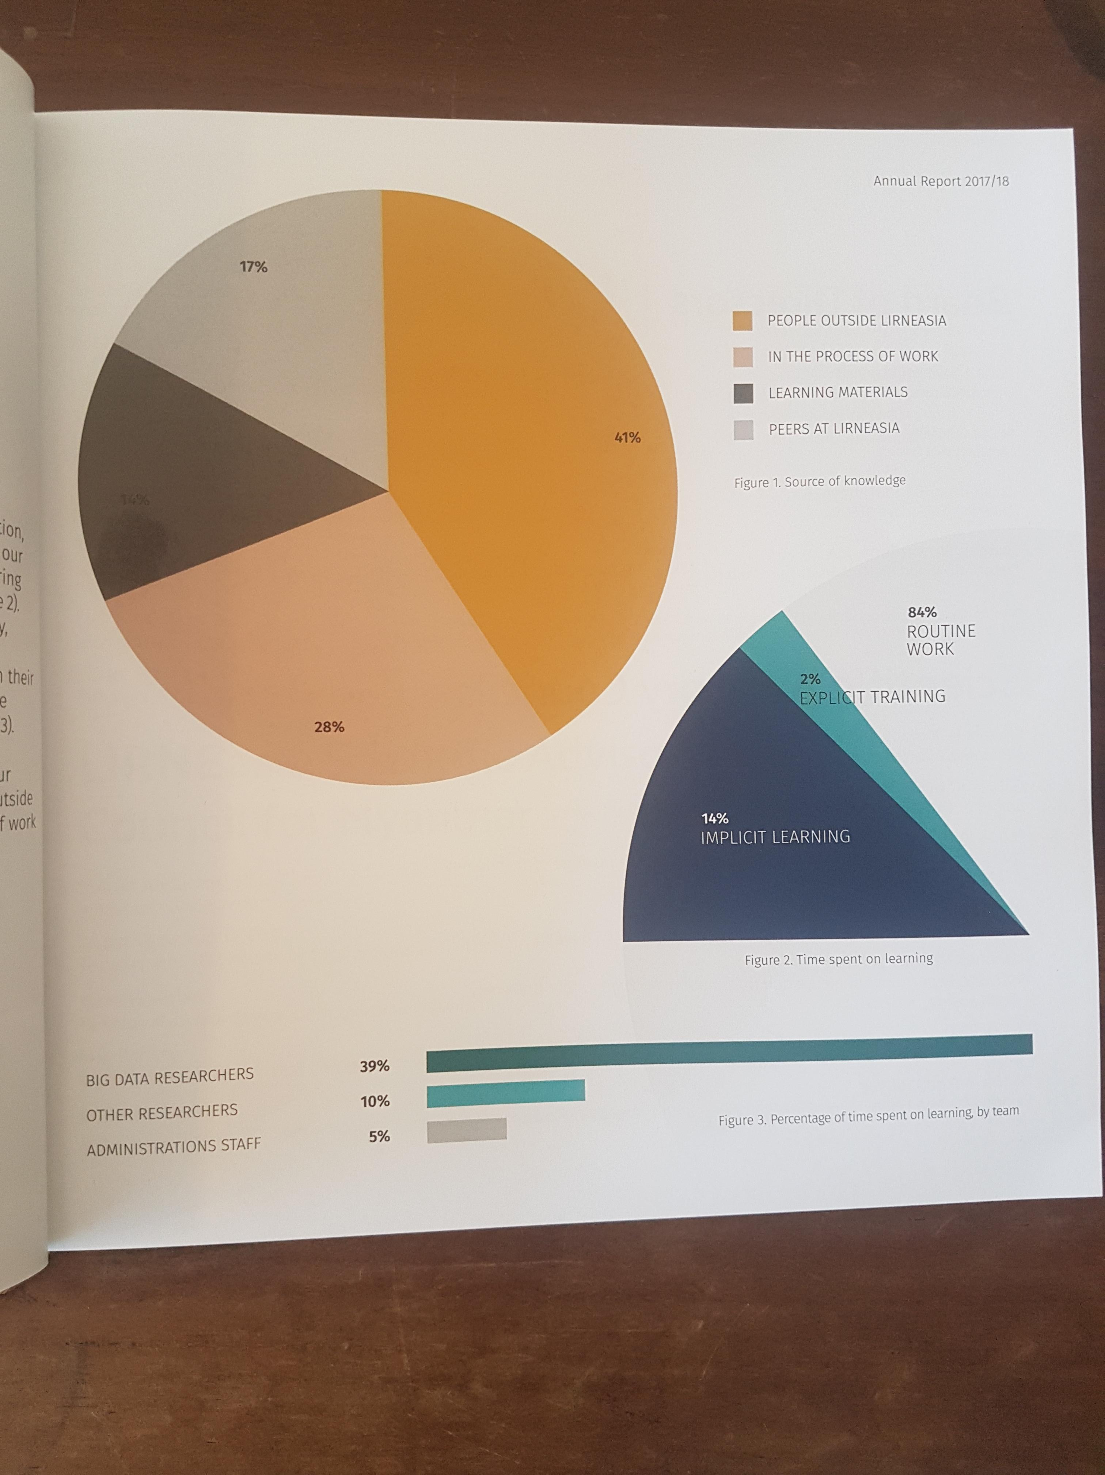
Time spent on learning while on the job at LIRNEasia
In Data Algorithms and Policy team, 39% of work time was spent on learning in 2018
10% for others engaged in research; 5% for those in administration
Some learning occurred in the course of work, as would be expected in a research organization, but some of it is explicit when we pay fees for Coursera

Slide 10
Is learning enough? How do we show others our learning (credentials)?
Conventional education is only partly about learning
The primary product is a credential, learning happens in the process of gaining a credential
What we have found at LIRNEasia is that in-employment learning is not easily converted into a credential acceptable to traditional organizations such as government
  But increasingly, organizations at cutting edge, will do their own assessments
In January 2014 we took a chance on a young man who was still completing his BIT degree
Since December 2018 he has been a Database Engineer in Tallinn, Estonia
Interviews, in our case; experience gauged through interviews and tests by others
Badging is another possibility ➔ traditional universities are bundlers of training; badging allows the student to do own bundling

Slide 11
www.lirneasia.net
rohan@lirneasia.net

