Slide 1
Data protection in an interconnected world
Rohan Samarajiva
University of Sydney Policy and Internet Conference
29 September 2022

Slide 2
Outline
Problems with an international dimension, focusing on Global South
Analysis of data protection legislation promoted as solutions (using recent legislation in Sri Lanka and Kenya)
Big picture of tension between global tech companies using the affordances of digital technology and governments/regulators in nation states
Policy innovation: discerning emulation

Slide 3
Problems

Slide 4
Do users need Tech Company services and/or protection by national regulators?
Example: A person uses Google Maps (along with a billion plus others)
While some data are downloaded to the device, the app lives in the cloud
By use of Google Maps, a person jointly creates “his/her data”
Has been used by investigators to track and identify criminal suspects ➔ includes personal identifiable information (PII) ➔ would normally be covered by data protection law, possibly with higher protection
What is there is a data breach? What if data are misused? What specifies the responsibilities of the service provider?
Where do the data reside? In which jurisdiction?
Somewhere in the Google Cloud, possibly in data centers multiple countries
Which state/Data Protection Authority (DPA) has authority over the data?
None, really. Perhaps US as a default

Slide 5
Do data protection laws allow productivity-enhancing uses of data? 1
Example: A Sri Lankan firm contracts an A/B experimentation platform headquartered in Silicon Valley to improve its service offerings
Experimentation platform designs and executes A/B tests on transaction-generated data made available by the client
Data falls within scope of Sri Lanka Personal Data Protection Act, No. 9 of 2022, because it is processed by a controller or processor who:
(i) is domiciled or ordinarily resident in Sri Lanka;
(ii) is incorporated or established under any written law of Sri Lanka;
(iii) offers goods or services to data subjects in Sri Lanka including the offering of goods or services with specific targeting of data subjects in Sri Lanka; or
(iv) specifically monitors the behaviour of data subjects in Sri Lanka including profiling with the intention of making decisions in relation to the behavior of such data subjects in so far as such behaviour takes place in Sri Lanka. (s. 2(1)(b))

Slide 6
Do data protection laws allow productivity-enhancing uses of data? 2
Assume consent has been obtained for experimentation
Yet, for the experimentation to be conducted, it must be
Transferred to the custody of the A/B Testing Firm, located outside Sri Lanka
Unlikely that a US firm will locate in a small economy (USD 84 billion and shrinking)
Is it realistic to require A/B Testing Firm to register with the Sri Lankan DPA?
Is cross-border data flow which is essential for the use of SaaS (Software as a Service) permitted for
Public authorities?
Private entities?

Slide 7
Analysis of solutions

Slide 8
Data protection legislation: Are we driving, looking at the rearview mirror?
Much of the thinking on data protection, including consent and purpose-specification principles, come from 1980 OECD Guidelines on the Protection of Privacy and Transborder Flows of Personal Data
Are principles developed in the context of people filling up credit assessment forms valid in today’s context of pervasively collected and processed transaction-generated data?
Should we be looking at data processing in the context of
Exporting Business Process Outsourcing (BPO) services? OR
Using SaaS and cloud services to make economic sectors more productive? OR
Developing AI-based innovative businesses?

Slide 9
The GDPR effect
GDPR [EU General Data Protection Regulation], which came into effect in May 2018, has had major effects worldwide because
It is the most comprehensive general law on privacy at a time sectoral privacy regulation is in retreat even in the US
Its adequacy provisions provide strong incentives to adopt similar legislation
Even before GDPR, European model was being emulated across the world
Lobbying for data protection legislation in Sri Lanka (and across the Global South) motivated by desire of those with an interest in doing business with EU (esp BPO) to obtain adequacy certification under GDPR
Yet, illuminating to see that only Andorra, Argentina, commercial organizations in Canada, Faroe Islands, Guernsey, Isle of Man, Japan, Jersey, New Zealand, South Korea, Switzerland, and UK have been certified in four years
Only Argentina in the Global South; S Korea only in 2022

Slide 10
A recent data protection law in South Asia
Digital Ministry (not law ministry) appointed committee to draft bill in January 2019 ➔ Greater openness to inputs
Framework of new bill made public in June 2019 before formal draft ready (unusual)
Comments invited
Multiple consultations held
Draft by Legal Draftsman’s Department published on website in September 2019 (usual to publish in Gazette after Cabinet approval)
Further comments received
Government changed before Cabinet approval received
New Minister of Justice published the Bill in November 2021 after obtaining Cabinet approval (not usual to make major changes after this)
Critical comments in media in December 2021
Bill with floor amendments enacted in March 2022 ( after unusual delay)

Slide 11
Registration not required: By Oct 2019, major change made in response to comments
Concerns were raised that
Compliance costs would be excessive, especially for small enterprises because of the obligations and annual registration requirement
At least have multi-year registrations as in Kenya
DPA would have to be overlarge to handle workload
Data controllers such as Google unlikely to register, and if pressed, Sri Lankans would be deprived of valuable services
No change in who was subject to the obligations set out in the law such as the requirement to appoint a Data Protection Officer (DPO), but registration requirement was removed; however, notification of DPO still required
Sidestepped problem of global data controllers not willing to register ➔ becoming scofflaws or withdrawing from market
Will DPO-notification obligation be obeyed in the breach?
Not inconsistent with GDPR but was radical break from general regulatory practice which prioritized ability to reach regulated entities
Also deprived DPA of a revenue stream and made it dependent on Treasury allocations

Slide 12
Different resolution to tension between global tech companies & domestic regulators
Kenya’s Data Protection Act and regulations that were approved more or less at the same time (2019-2022), also modeled on the GDPR, retained the registration requirement, with minor exceptions for small firms
Global tech companies such as Facebook required to register from 2022
Not clear whether the Office of the Data Protection Commission will succeed in compelling registration
Unlikely that domestic regulators are likely to prevail except in the most attractive Global South markets such as India and perhaps South Africa

Slide 13
Provisions on data localization changed by March 2022
For public authorities, processing outside Sri Lanka requires an adequacy decision by the Minister
“Public authority” means a Ministry, any Department or Provincial Council, local authority, statutory body or any institution established by any written law, or a Ministry, any Department or other authority or institution established or created by a Provincial Council; [but not state-owned company as was the case until floor amendments were made in March 2022]
For other data controllers [private sector including state-owned companies, such an airline or a utility] processing may be done in countries without adequacy if
Data subject has consented
Required by contract or pre-contractual measures
In the public interest, etc.

Slide 14
Again, drafters side-stepped confrontation with global tech companies
Above flexibilities introduced by floor amendments in Parliament avoided the impasse that would have resulted from provisions in version published in November 2021
In December, I pointed out that
It was totally unrealistic to expect global tech companies to fragment their databases and process the Sri Lankan part in country;
The result would be all entities public and private being compelled to rely solely on the two sub-standard and expensive Tier 3 data centers in the country; and
The state airline would have to withdraw from the One World Alliance because it would be impossible to process frequent-flyer data on Sri Lankan passengers

Slide 15
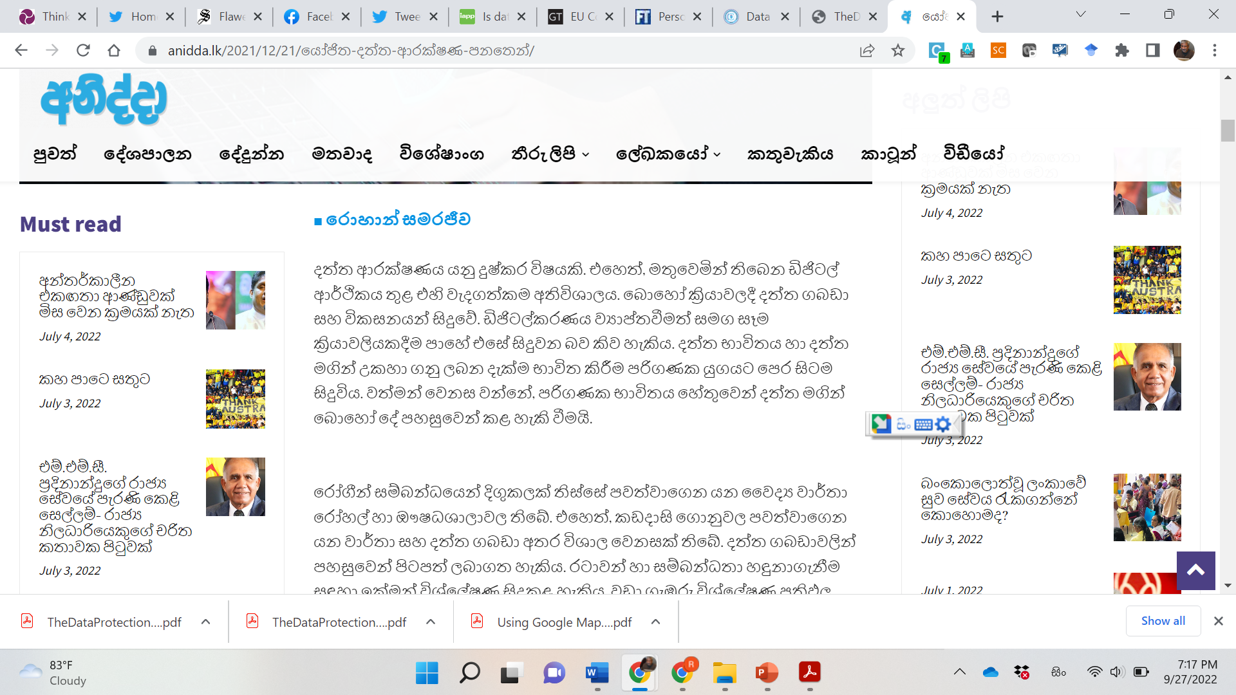

Slide 16
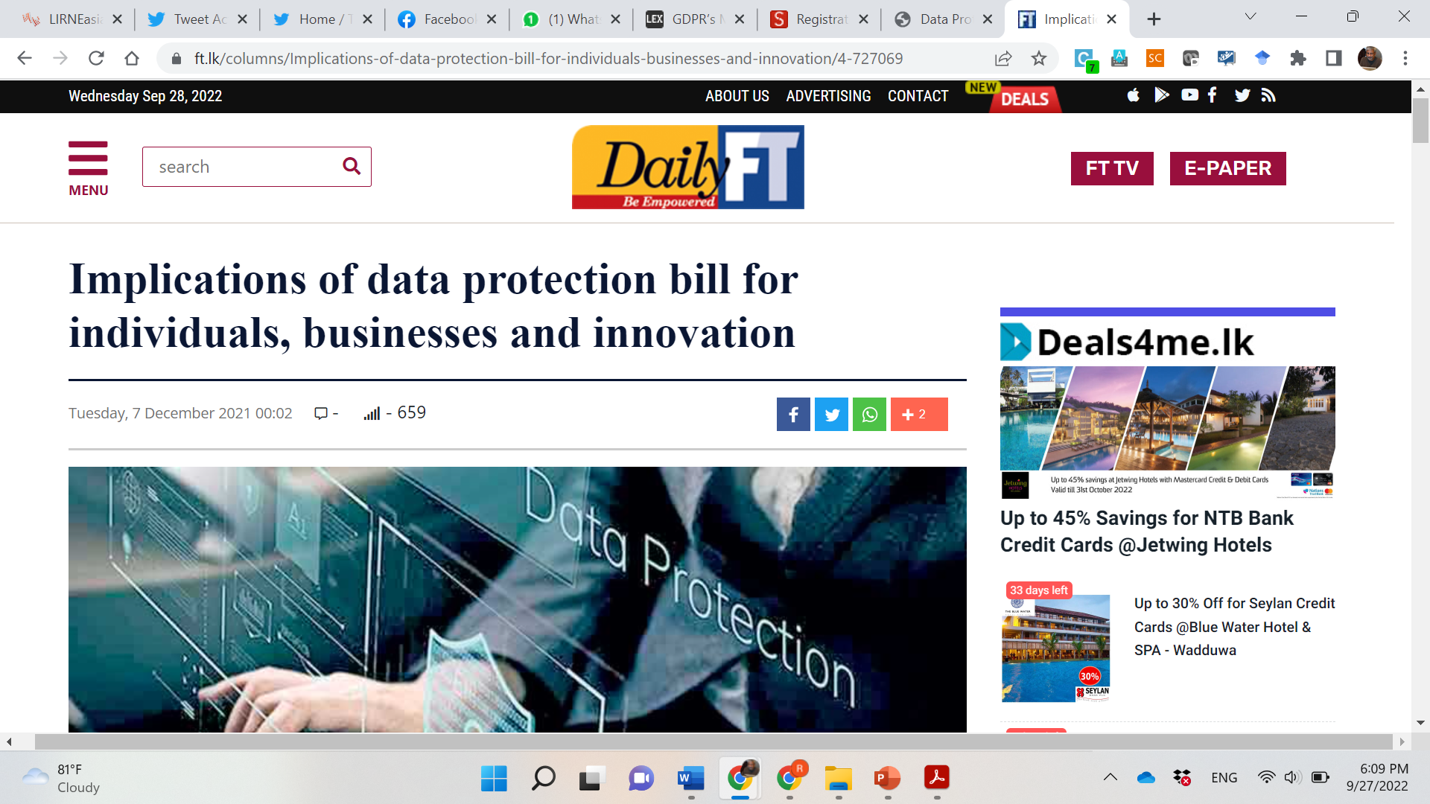

Slide 17
Muddling through, imperfectly
In contrast with the Kenyan drafters, the Sri Lankans learned from comments received through the consultation process and the media and devised workarounds for the most egregious problems
However, loose ends remain
Registration has been removed, but Data Protection Officers must still be notified, even by the smallest of data controllers (e.g., a micro-enterprise that maintains a customer database) and by global tech companies
Most likely that s. 20(4) requirement that DPO contact information will be published and notified to DPA and Schedule V requirement that data subjects be provided contact information of DPOs will be ignored
Removal of registration fees and fines as source of revenue for DPA means it will be dependent on Treasury for funding, which has serious implications for ensuring DPA is competently staffed

Slide 18
Capacity is a problem even in Europe; serious constraint in Global South
European data protection authorities are under resourced, do not have enough staff with the necessary technical skills, and take inordinately long to respond to complaints
All but three DPAs (Germany, Italy, & UK) had annual budgets of less than 25 million Euros
The California Privacy Protection Agency that is being set up, an entity with a narrower remit than the GDPR, will have an annual budget of $ 10 million (9 million Euros) in its first year
Above benchmarks may be interpreted to mean that a sum in the range of $ 10 million a year is required to run an efficient data protection authority in Global South. Likelihood of a data protection authority being given even a fraction of that is small
Result ➔ typical underfunded state agency incapable of fulfilling its over-ambitious remit
Implication: Unlikely to meet conditions for adequacy certification under GDPR
“We have a lack of enforcement,” said Ulrich Kelber, the chairman of Germany’s data protection authority, which has the highest budget in the European Union, at roughly €85 million when including regional agencies. “Most of the European governments don’t give enough resources to the data protection authorities.”

Slide 19
Harms minimized, but unlikely to gain adequacy certification from EU
Responsive drafters in Sri Lanka minimized harms arising from ill-considered transplantation of European model of data protection that does not seem to work well even in Europe
But this may not happen everywhere, as seen in Kenya case
Wishes of the GDPR cloning proponents are unlikely to be realized because
EU seems to be selective/political in granting adequacy certification, and has certified only Argentina among non-OECD countries in the four years GDPR was in effect
With a complex law that is impossible to properly implement, unlikely that countries in the Global South will get certified anyway

Slide 20
Can Sri Lankans & Kenyans use Google maps after the law comes into effect?
Sri Lanka, yes. Also, Google Transliterate; Live Transcribe, Facebook, TikTok etc.
Kenya, depends.
If Google and other Global Tech Companies register with DPA and develop workaround for processing of data on Kenyan data subjects outside Kenya, perhaps
If no accommodations made by DPA, Google may withdraw from Kenya. No service in that case
If tech companies ignore the law and the DPA lets them, yes

Slide 21
Can Sri Lankan businesses use SaaS and cheap/high quality cloud services?
Yes, for private entities which are not public authorities as defined in Act
Subject to Ministerial discretion for public authorities
But better remove clumsy workarounds and abandon data localization [Applicable to all small economies]
As cyber security becomes increasingly important, it is foolish to not diversify risks by using domestic as well as foreign cloud services, better equipped to engage in an “arms race” with persistent and resourceful attackers
Address lawful-access-to-data concerns through a different mechanism such as a version of the US CLOUD Act

Slide 22
The big picture
Fifty years ago, before the emergence of the Internet, scholars such as Ithiel de Sola Pool were postulating that nation states would prove incapable of regulating new communication technologies such as satellites
China has proved that state cannot be counted out, but small economies that cannot do without engagement with the outside world, have a much harder task

Slide 23
Beyond technology
China’s Great Firewall (a combination of laws, technology, and thousands of Internet police (could be as high as 50,000)) has shown that the nation state is capable of exerting control
But a price has to be paid that cannot easily be afforded by small economies that are integrated with the global economy and are not fully autocratic
Can the economy/society do without the conveniences (free and for-fee) that are offered by Global Tech Companies?
China is an enormous economy that was able to support indigenous Tech Companies such as WeChat and Sina Weibo
Will its people tolerate pervasive surveillance and censorship like they do in China?
The downfall of the Rajapaksa family regime was triggered by their unsuccessful attempt to shut down all social media on 3 April 2022

Slide 24
The asymmetry of power
Small and poor nation states cannot disengage from the world economy (and the Global Tech Companies) easily
Even post-coup Myanmar has not shut down Facebook nationwide and permanently
They cannot do what North Korea and Cuba do
Nor can they afford the Great Firewall, though some in China’s orbit are trying and Myanmar may

Slide 25
Discerning emulation

Slide 26
How to keep connected & yet protect what needs protection
Attempts to clone GDPR compliant laws in the Global South will fail for several reasons, including
Lack of capacity to implement overly complex legislation, and
Inability to fully impose conventional data protection provisions on Global Tech Companies
Does this mean that they should
Engage in “data protection theater” (as is being done in some countries of the Global South)? OR
Do nothing (as was the case for many years and is still the case in many countries of the Global South)?

Slide 27
Good policy (and legislation) is based on emulation; no point in reinventing the wheel 1
The most important thing is to decide on what the primary objective is:
Is it getting more BPO work from Europe?
Is it developing cutting-edge software and service firms, based on AI?
Is it improving the productivity of firms across the economy?
Is it safeguarding privacy of citizens and protecting them and local firms against cyber attacks?
Is it promoting local data center operations, by giving them captive customers?
If multiple objectives exist, their relative weights must be decided

Slide 28
Good policy (and legislation) is based on emulation; no point in reinventing the wheel 2
But one must first look to see if the model being emulated works well in its place of origin and also whether it can serve the objectives decided for your country
Objectives of EU’s GDPR quite different from those of countries that are emulating it
Europe’s relative weakness in firms that are AI focused, compared to US and China needs consideration
Most importantly, the model must be appropriate for the local conditions
Most countries in the Global South cannot afford to spend massive amounts on DPAs ➔ without adequate funds, they will be able to attract high-quality personnel (even if administrative rules permit above-the-norm compensation

Slide 29
Be discerning
Look beyond GDPR
Singapore has had a data protection law and enforcement for years; they do not seem to be placing GDPR adequacy as their principal objective
Allows a lot of discretion to regulator which is not that problematic given Singapore’s administrative culture and compensation practices
China’s data protection law of 2021 is also worth looking at though it’s unlikely to serve as a model

Slide 30
For more information www.lirneasia.net
rohan@lirneasia.net

