Slide 1
Stories from the field: studying urban, poor micro-entrepreneurs
Helani Galpaya
Dhaka, 30 April 2014
This work was carried out with the aid of a grant from the International Development Research Centre, Ottawa, Canada and the Department for International Development , UK.

Slide 2
Definitions
Micro-entrepreneurs (MEs) = those employing
0 -9 employees
paid part or full time workers
inclusive of family members
Low income = MEs in socio-economic classification (SEC) C, D and E and B1,B2, (for those employing 1-9 employees)
SEC based on education and job
Close correlation to income
Urban = definition used by the National Statistics Office in each country
Notes:
Urban poor MEs

Slide 3
A ‘weak city’ and ‘strong city’ in each country identified
Strong/weak determined by proxy indicators
Bangladesh: poverty + literacy + electrified households
Sri Lanka: various poverty measures by province
India: City Competitiveness Ranking by state
Bangladesh:
Strong: Dhaka
Weak: Gaibanda+Kurigram [Rajshahi division]
In Sri Lanka: Colombo (Western Province) and Kurunegala/Kuliyapitiya/Puttalam/ Chilaw (NW Province)
India: Delhi and Patna (in Bihar)
Notes:
Urban poor MEs

Slide 4
No country had registry of MEs. Closest possible data used to determine quotas
Bangladesh: Economic Census (BD Bureau of Statistics)
Number of small establishments (of <10 employees) in manufacturing, trade, services
Number of small establishments based on employment (0, 1-3 and 4-9 employees)
Sri Lanka: Census of Industry (2003/2004) by Department of Census and Statistics
India : Non-agricultural Enterprises in the Informal Sector, 2000. (Survey)
Notes:
Urban poor MEs

Slide 5
More on sampling method
In each country, two locations were selected. The capital city and another city which is weaker in terms of governance.
In Bangladesh, cities were divided into wards, then mahallas and then streets. Within each mahalla, all the streets were listed alphabetically. Every third street was selected and respondents were found for the study.
As some of the enumeration areas (streets/mahallas) were inaccessible due to incessant hartals (public protests) and governmental restrictions, additional enumeration areas were selected using the similar process.
A Snowballing sample was also used to achieve some difficult quotas (e.g. females or MEs having 4-9 employees)

Slide 6
Quantitative study: 3180 MEs surveyed. 915 in Bangladesh
1279
915
Patna
986
Kurunegala, Kuliyapitiya, Puttalam & Chilaw
Gaibandha & Kurigram
Delhi
Colombo

Slide 7
Qualitative research after the survey to understand why and to re-design
The survey: answers the WHAT questions
Qualitative research:
answers WHY questions
for envisioning (better) solutions
88 protocols
Day ethnographies at sites of service provision
In-depth interviews with service providers
In-depth interviews with MEs
Community group design activities

Slide 8
Notes:
Sri Lanka

Slide 9
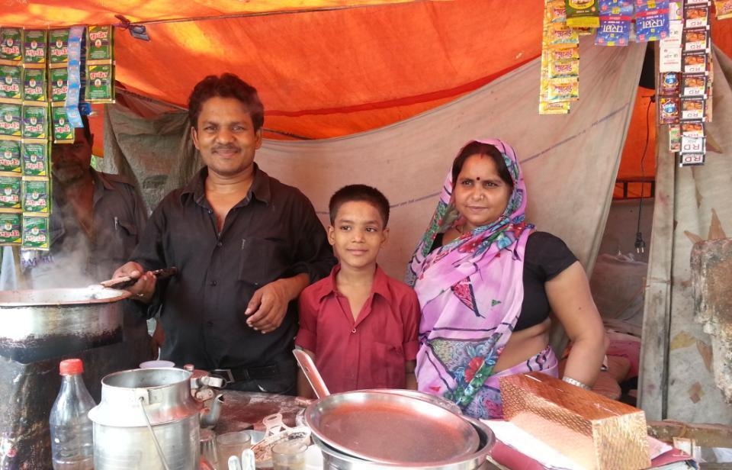
Notes:
India

Slide 10
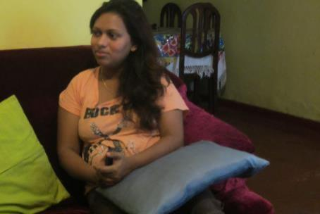
Notes:
Sri Lanka

Slide 11
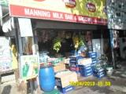
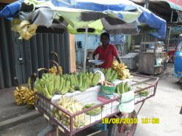
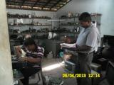
Bangladesh (BD) sample similar to Sri Lanka (LK) in education. Similar to India (IN) in age and female participation
 | Bangladeshi cities | Indian cities | Sri Lankan cities
Average age | 36 | 36 | 42
Female micro-entrepreneurs | 9% | 12% | 26%
Illiterate or primary schooling only | 39% | 87% | 29%

Slide 12
BD sample ore numerate than IN. Over 77% of MEs in BD can do calculations
Please tell me about your numerical abilities (as % low-income MEs)

Slide 13
68% of MEs in BD are in trade
Type of business (as % of low-income MEs)
Notes:
My business makes some goods or wares by manual labour or by machinery-Manufacturing
My business provide maintenance and repair of certain goods or activity-Services
My business buys and sells goods and wares-Trade

Slide 14
Majority operate from a rented location
Could you tell us where your business is located? (as % low-income MEs)

Slide 15
More MEs operate from a rented location in strong city
Could you tell us where your business is located? (as % low-income MEs)

Slide 16
Most businesses started using savings.
How did you get the money to start your business? Tell the main source (as % of low-income MEs)

Slide 17
Over half of MEs use own savings in strong city. In weak, NGOs/money lenders are important
How did you get the money to start your business? Tell the main source (as % of low-income MEs)

Slide 18
More MEs in BD have a separate bank account for business
Does your business have a separate bank account to use just for business purposes?
(as % of low-income MEs)
Do you have any bank account in your name? (as % of low-income MEs)

Slide 19
But normally deal with cash
How do you normally do make or receive payments in your business? [MC] (as % low-income MEs)
Notes:
Business transaction are around cash

Slide 20
Extra income will be used for both personal and business use
If you have extra income / profit from business, will you utilize it for business or home use?
(as %low-income MEs)

Slide 21
In–person preferred to mobile phones when interacting with customers
Do you think: interacting with customers in-person is preferred than mobile phone in your business? (as % low-income MEs)

Slide 22
In–person also preferred to mobile when interacting with suppliers
Do you think: interacting with suppliers in-person is preferred than mobile phone in your business? (as % low-income MEs)

Slide 23
TELECOM use by Micro-entrepreneurs

Slide 24
BD the highest users of mobiles for business
Do you use _________for your business related activities? (% low income MEs)

Slide 25
Lower use of mobiles for business in the weaker cities
Do you use mobile phones for your business related activities? (% low income MEs)

Slide 26
Most MEs in BD who don’t use mobiles find it too expensive
What is the main reason you don’t use a mobile phone for business?
(% low income MEs who don’t use a mobile for business)

Slide 27
Main telecom service provider for MEs in BD
Who is your main mobile telecom service provider?
(% low income MEs who use mobiles for business)

Slide 28
More MEs in BD have multiple SIMs
Multiple SIM ownership
 | Bangladesh | India | Sri Lanka
Low income MEs who use mobiles for business (2013) | 35% | 16% | 11%
BOP mobile owners (Teleuse@BOP 2011) | 18% | 11% | 17%
Please tell me how many active mobile SIM cards/connections you have in total that you regularly use?(% low income MEs who use mobiles for business)

Slide 29
Coverage & friends factor in choosing the service provider
What is the most important reason for selecting the service provider?
(% low income MEs who use mobiles for business

Slide 30
Majority of MEs use pre-paid mobiles
Is your mobile phone connection pre-paid? (% low income MEs who use mobiles for business)

Slide 31
Reloads from agents/shops most popular in BD
How do you normally recharge your mobile? Give the most used option
(% low income MEs who use pre-paid)

Slide 32
Low income MEs recharge more than other BOP
Average recharge per month (USD)
 | Bangladeshi cities | Indian cities | Sri Lankan cities
BOP pre-paid mobile owners (2011) | 1.61 | 1.99 | 3.18
Low-income MEs who use pre-paid for business (2013) | 8.91 [696 Taka] | 6.21 | 10.67
 | Bangladeshi cities
 | Strong city | Weak cities
Average recharge per month in Taka (Low-income MEs who use pre-paid for business) | 840 | 527
Notes:
Dialog ARPU (average revenue per user is LKR 352

Slide 33
Mobiles most used in emergency. Contacting & coordinating with suppliers/customers next. But lower in BD
Please tell us the most important reason to use a mobile phone for business
(% low income MEs who use mobiles for business)

Slide 34
Higher use of SMS, cameras and games in BD
 | Bangladeshi cities | Indian cities | Sri Lankan cities
SMS | 43% | 28% | 49%
Video recorder/ camera | 42% | 30% | 21%
Games | 38% | 37% | 22%
Dual SIM | 22% | 19% | 9%
Touch Screen | 11% | 12% | 9%
Mobile Internet | 7% | 3% | 7%
Apps for social networking | 5% | 1% | 7%
MMS, picture messaging facility | 6% | 2% | 5%
Email | 3% | 1% | 4%
Google Maps | 3% | 1% | 3%
Features normally used (% low income MEs who use mobiles for business)

Slide 35
Biggest problems in BD are call drops & coverage
Please tell me the mobile phone related problems you have faced
(% low income MEs who use a mobile for business) [MC]
Notes:
Same chart but with more problems in second chart

Slide 36
Problems worse in the strong city in BD
Please tell me the mobile phone related problems you have faced
(% low income MEs who use a mobile for business) [MC]

Slide 37
35% of BD MEs say network dis-connections & call drops affect business
Does network dis-connectivity / call drops affect your business?
(% low income MEs who use a mobile for business

Slide 38
Network dis-connectivity / call drops affect their business more in the weaker cities
Does network dis-connectivity / call drops affect your business?
(% low income MEs who use a mobile for business

Slide 39
Most MEs do not interact with telecom service provider
When was the last interaction with the service provider?
(% low income MEs who use mobiles for business)
Notes:
Two charts are same only legends are different. Categorized differently

Slide 40
When they do interact, more than half do so through call center
How do you normally contact your telecom service provider?
(% low income MEs who have interacted with service provider)

Slide 41
Service provider interaction overall better in LK
Experience with service provider – YES (% low income MEs who have interacted with service provider)

Slide 42
A closer look at BD performance
Experience with service provider – YES (% low income MEs who have interacted with service provider)

Slide 43
Experience with provider better in weaker cities
Experience with service provider – YES (% low income MEs who have interacted with service provider)

Slide 44
Only 28% of BD MEs complained about any problem
Have you complained about these problems to the telecom service provider?
(% low income MEs who have mobile related problems)

Slide 45
71% in BD did not think it was any use complain
Why did you not complain to the service provider?
(% low income MEs who faced problems but didn’t complain)

Slide 46
Most complaints have been attended to
Have any of your major complaints not been attended by the service provider?
(% low income MEs who complained)

Slide 47
Only 3% of MEs changed their provider in the last year
Did you change your primary telecom service provider in the last year?
(% low income MEs who use a mobile for business)
Notes:
Extra talk time
Wave of some charges

Slide 48
Electricity use by Micro-entrepreneurs

Slide 49
Many have an electricity connection which they use for business
Do you have an electricity connection which you use for business purpose? Where electricity can be from the grid, solar, generator and other sources ( % low income MEs)

Slide 50
Those who don’t have electricity don’t see a need for it
What is the main reason for not having electricity connection for business? (% low income MEs who not have electricity for business)

Slide 51
Those without a need for electricity operate from a variable location
Location of the business (%BOP who don’t need electricity for business )

Slide 52
51% of those who have electricity have a separate connection in BD
Do you have a separate electricity connection separate for your business?
(% low income MEs who use electricity for business)

Slide 53
55% in BD have a separate connection for business because it is a requirement
Please tell us the most important reason for having a separate electricity supply for your business? (% low income MEs who have separate connection for business)
Notes:
personal

Slide 54
Many IN BD have a shared electricity connection because they have no choice
Please tell us the most important reason for having a shared connection [as a part of home or somebody’s home/business] for your business? (% low income MEs who have a shared connection for business)

Slide 55
Most MEs BD, LK on the grid. Battery/ generators mainly used in IN
Who is the main supplier of electricity to you? (% low income MEs who use electricity for business)

Slide 56
29% of BD MEs have the connection in their name
Is the electricity connection in your/or your business’s name?
(% low income MEs who use electricity for business with supply from electricity co.)

Slide 57
More people in BD weak cities have the connection in their name
Is the electricity connection in your/or your business’s name?
(% low income MEs who use electricity for business with supply from electricity co.)

Slide 58
Most can’t change the name because connection is in landlord’s name
Please tell us the most important reason for not having connection in your name
(% low income MEs who don’t have the connection in their name)

Slide 59
Connection been in landlord’s name is bigger barrier in BD strong city
Please tell us the most important reason for not having connection in your name
(% low income MEs who don’t have the connection in their name)

Slide 60
BD and IN grid electricity customers pay half the amount as in LK
Taka 734
USD
 | Strong city | Weak cities
Average monthly bill in BD (Taka) | 902 | 562
How much is your average monthly electricity bill?
(% low income MEs who use electricity for business with supply from electricity co.)

Slide 61
Most BD MEs pay to the landlord, 9% pay via mobile
What is the most frequent used method of payment for your electricity consumption?
(% low income MEs who use electricity for business with supply from electricity co.)

Slide 62
More MEs in weak BD city use mobile to pay
What is the most frequent used method of payment for your electricity consumption?
(% low income MEs who use electricity for business with supply from electricity co.)
Notes:
This may not be the ME himself paying via mobile but them getting a small shop owner who can pay via his mobile. The ME gives money to shop owner who pays via mobile…

Slide 63
59% of MEs in BD get a bill
Do you get an electricity bill?
(% low income MEs who use electricity for business with supply from electricity co.)

Slide 64
More MEs in BD weak cities gets a bill
Do you get an electricity bill?
(% low income MEs who use electricity for business with supply from electricity co.)

Slide 65
62% in BD satisfied with information in bill.
Are you satisfied with the information in your bill? (% low income MEs who receive a bill)

Slide 66
Energy efficient lighting: most popular money saving method
Please tell us about your most important step in conserving energy [reducing electricity bill] you have been following?(% low income MEs who use electricity for business with supply from electricity co.)

Slide 67
Blackouts, voltage fluctuations, inaccurate bills are common problems
Did you face this problem? (% low income MEs who use electricity for business from electricity co.)

Slide 68
Blackouts and voltage fluctuations most common problems faced
However few complained about it
Please tell us whether you faced these problems in the last 2 years. (% low income MEs who use electricity for business from electricity co.)
Did you complain about this problem? (% low income MEs who faced those problems)

Slide 69
MEs say blackout affect their business severely
Do blackouts affect your business severely? (%BOP MEs who faced blackouts)

Slide 70
38% of BD MEs have a generator to manage blackouts
How power black outs are managed for business purposes? (% low income MEs who use electricity for business

Slide 71
49% in BD do not get an advance notice about power cuts
Do you get advance notice about power blackouts? - NO (% low income MEs who use electricity for business)
Notes:
58% don’t get advance notice

Slide 72
Public announcements the method of getting through to most about power cuts
How do you get advance notice about power blackouts? [Multiple Answers] (% low income MEs who get advance notice)

Slide 73
77% in BD have not interacted with the service provider
Have you ever interacted/talked with the electricity service provider?- NO
(% low income MEs who use electricity for business)

Slide 74
Most see no use of complaining
Why did you not complain to the service provider? (% low income MEs who use electricity for business)

Slide 75
71% of MEs in BD mainly complained to the provider
For the main problem with electricity you complained about, whom did you complain to? (% low income MEs who complained)

Slide 76
Walk-ins to the provider the most common way to complain in LK
For the main problem with electricity you complained about, how did you complain? (% low income MEs who complained)

Slide 77
50% in BD unsatisfied with the action taken for problem complained about
For the main problem with electricity you complained about, were you satisfied with the action taken? -NO
(% low income MEs who use electricity for business who complained about a problem)

Slide 78
Unpacking consumer unhappiness: polite but slow
 | Bangladeshi cities
I was treated politely by their office / call center personnel | 75%
It is easy to find the locations where payment can be made | 66%
Information on how to contact the service provider is /was readily available | 51%
The waiting time to reach a concerned officer was appropriate | 50%
Information on procedures and documents to get new connection was readily available | 49%
The amount of time I need to wait to get a new connection is satisfactory | 39%
Information on procedures to reconnect was readily available | 39%
The amount of time taken to reconnect was satisfactory | 33%
Information about the procedure for changing ownership of a connection was readily available | 29%
The amount of time I need to spend to change the ownership of the connection satisfactory | 19%
Experience with the service provider- YES (% low income MEs who have interacted with the provider)

