Slide 1
WAY FORWARD
Improving
CRM Practices in Electricity Sector

Slide 2
Challenges
Multiple challenges were identified from both supply and demand side studies. We have already discussed the supply side perspective in earlier session. Following slides briefly highlight the demand side challenges.

Slide 3
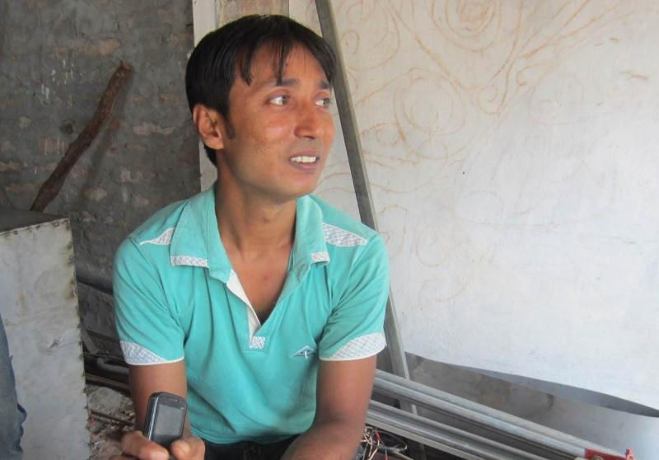
Challenge A: Obtaining a New Electricity Connection
Name: Harunur Rashid
Age: 31 years
Location: Dhaka
Education: Grade 8
Occupation: Welding
Number of Employees: One
I have been running my business for the past 17 years and I require electricity at all times to conduct my business
“I obtained my electricity connection after a period of six months. I had to bribe the intermediary and give him Tk. 22,000. I had to run around a lot before I finally obtained my connection.”

Slide 4
Challenge B: Grievance redressal
About 80% MEs think it is not worth complaining. A small percentage said they don’t know how to contact the electricity utility.
Some said they don’t know the process. A few even said they are scared to complain.

Slide 5
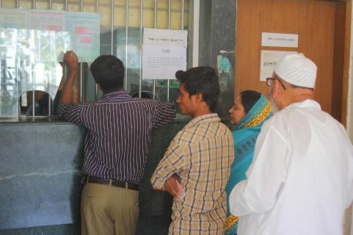
Challenge B: Grievance redressal (contd.)
When a problem arises, majority (74%) lodge complaints with the office of the electricity company. However, most of them need to visit the provider’s office or customer care center to lodge complaints. This results in a long queue and high average waiting time.

Slide 6
Challenge B: Grievance redressal (contd.)
Majority (53%) of the respondents are not satisfied with the action taken upon their complaints.
70% MEs said they have not received any reference ID verbally or in written form for their complaints.

Slide 7
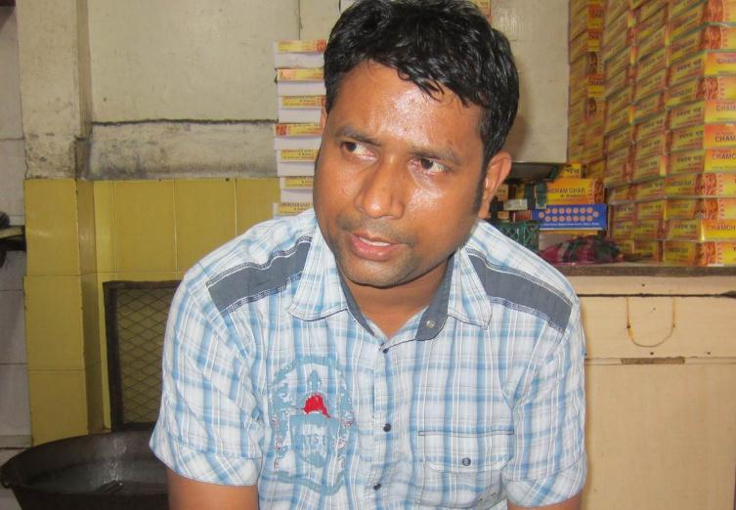
Challenge C: Bribing the Lineman
Name: Ashutosh Ghosh
Age: 35 years
Location: Dhaka
Education: Grade 9
Occupation: Sweet Shop Owner
Number of Employees: Two
I need electricity in my shop so that the sweets in my shop do not go bad
“due to heavy rains, there are a lot of power cuts. Every time we call the lineman, he takes an hour to come and then asks for tk. 200 to fix the line. My work has suffered many times because of these power cuts and the delays in fixing it.”

Slide 8
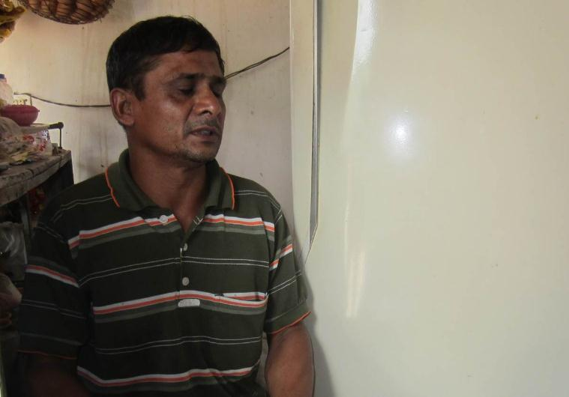
Challenge D: Difficulty in understanding the electricity bill
“I do not understand what is written in English. I only look at the amount and check it with the reading on my meter.”
Name: Lutfor Hossain
Age: 48 years
Location: Dhaka
Education: Grade 4
Occupation: Grocery store
Number of Employees: None
I started my business in the year 2009. I obtained the electricity connection in my shop on my own. I understood the documents required from a lineman and got everything done.

Slide 9
Potential Solutions
Following slides highlight a number of potential solutions addressing major challenges discussed so far.

Slide 10
Solution - 1: Separate Service Center for new connection
Service provisioning for a new connection could be separated from rest of the services. A separate service center (i.e. Fast-track center) focused only on providing new connections could be helpful in this regard.
Consumers who will be applying for a new connection be it residential or commercial, will be served from Fast-track centers. Applications will be processed as a separate, high-priority work stream so that the entire process could be completed by a given period of time (e.g. within 30 days).

Slide 11
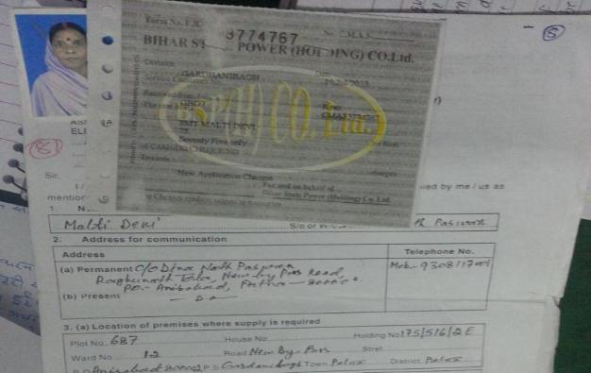
Solution - 2: Know Your Connection
The electricity board conducts a pre-evaluation of available infrastructure in order to help understand backend requirements for processing new connections. An approximate time range is established within which a new connection has to be processed.
Approximate time for new connection
SMS
SMS updates of the status of the new connection

Slide 12
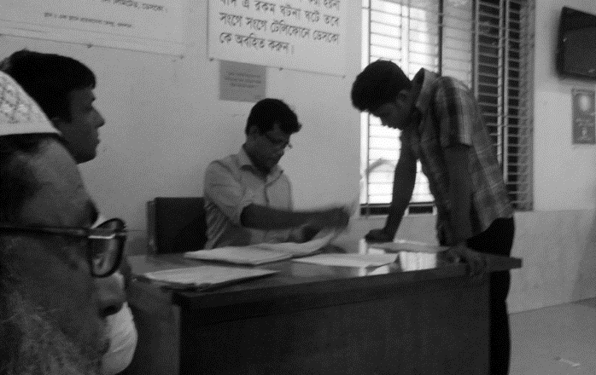
Solution - 3: Electricity Agent
Deploy authorized intermediaries who act as agents (more like Mobile Banking Agents) on behalf of the distributors for providing information and resolving consumer complaints quickly since consumers are unable to get adequate information about their electricity connections.
MEs wanting a new connection can submit their documents with the intermediary.
The intermediary can be called or visited upon, when the ME desires a status update.
In case of disruptions in service the ME meets the authorized intermediary to access information about the time to be taken to resolve the same.
MEs walk to the nearest authorized intermediary for accessing information
Notes:
This solution was contested at the workshop, as there was concern over the possibilities of the intermediaries taking bribes, and difficulty of managing it.

Slide 13
Solution - 4: 24/7 Call Center
Each of the distributors should have 24/7, dedicated Call Centers so that consumers don’t need to visit the Customer Care Center in-person for minor issues.
The communication tool and method adopted by call centers need to be tailored to the extent possible. More human interaction instead of IVR and preferably with greetings through respective local dialects could make a big difference in the customer experience.

Slide 14
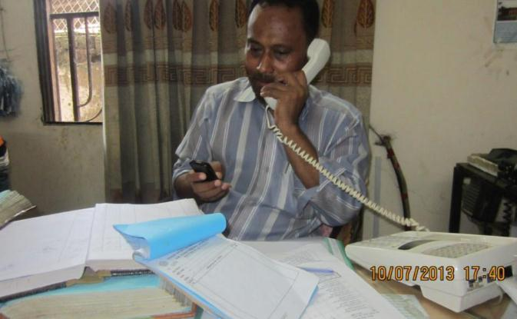
Solution - 5: Service Rating
Consumer calls made to the electricity office by the MEs should be recorded so that the Supervisors can keep track of SP interactions. After the query of the ME has been resolved, the ME can rate the SPs response via SMS.
ME can rate the Service Providers response to the query via SMS

Slide 15
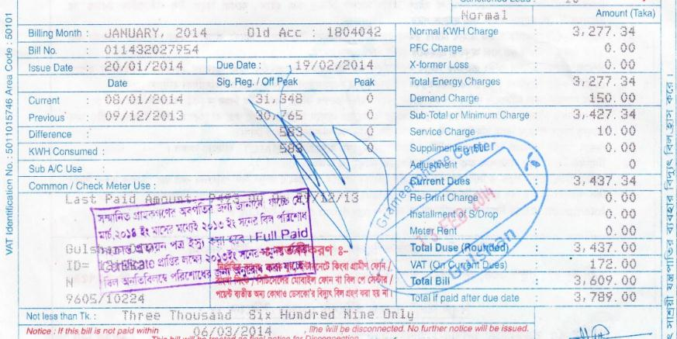
Solution - 6: Bill in Local Language
Provision of the electricity bill in the local language in addition to English. The amount on the bill should be highlighted.
3,609

Slide 16
Solution - 7: Bill with useful information
MEs are given an approximate consumption for various appliances because MEs are completely dependent upon the bill to understand their usage.
1 fan for 10 hours = 10 units

Slide 17
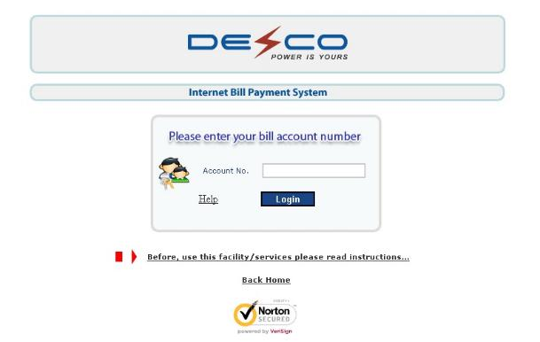
Solution – 8: Data Security
A number of distributors are providing online bill payment service. However, most of them are not sufficiently equipped with security measures. For instance, an urban-centric distributor does not have any password protection against its consumers’ data.
Each account should be provided with a password for online log-in into the distributor’ websites so that a two factor authentication is ensured.

Slide 18
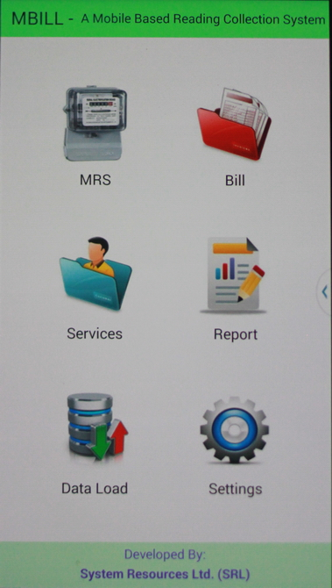
Solution – 9: Smart Billing
BPDB is currently testing a new solution for their billing system. The new mechanism (developed by SRL) is designed to reduce cost, reduce delay and enhance transparency in the billing process.
In this new system, a meter reader remotely connects with a workflow management system through a mobile app.
He downloads his target households on daily basis, takes pictures of the meters, and enters the information in the mobile app.
At the end of the day, he uploads a batch file to the server with the picture, meter reading, timestamp and GPS location of all households he visited that day.
This solution is expected to be piloted for 100,000 connections across the country.

Slide 19
Solution – 10: Renewable Energy
Only 55% of the households in Bangladesh are connected to the electricity grid. Renewable energy may offer viable opportunities for the remaining 45% off-grid households.
Up to 2013, the total number of SHSs (Solar Home Systems) installed across the country is around 2.7 million (5 times the number of DESCO’s connections).
To meet the limited energy needs of rural customers and many MEs, renewable energy could be a good alternative.

Slide 20
Solution – 11: Prepaid Metering
To date, two distributors (DESCO and BPDB) deployed around 57,000 pre-paid meters across the country. We have talked to a few consumers who talked about some issues they still face.
Notes:
A picture here might be useful. Maybe the text could be summarized, and a picture could be included.

Slide 21
Solution – 11: Prepaid Metering (contd.)
Despite the early uptake, there are still a number of areas where further improvement is possible.
Given the slab-tariff rate in Bangladesh, all pre-paid meters should work in CTS (Currency Transfer System); not UTS (Unit Transfer System).
UTS
CTS
Vending Station
Pre-paid meter
BDT to KWh Conversion
Distributors don’t have any mechanism to get information from pre-meters and install tariff rate updates in real time. For instance, DESCO can have this done only when the customer comes to the vending station to recharge his account.
If someone recharges his account for a longer period of time (say six months) and does not come to the vending station for a prolonged period of time, DESCO won’t have any information about that specific meter for that long period. Further, the meter won’t be updated if there is any change in tariff rate in the meantime.
Notes:
A picture here might be useful. Maybe the text could be summarized, and a picture could be included.

Slide 22
Summary Mapping
Solutions discussed so far can directly address multiple challenges as following:
SOLUTIONS
CHALLENGES
SOLUTIONS
Solution - 1
DEMAND
SIDE
Solution - 7
Fast Track Center
Bill with Useful Info.
Solution - 2
Challenge - A
Solution - 8
Know Your Connection
New Connection
Data Security
Solution - 3
Challenge - B
Grievance Redressal
Solution - 9
Electricity Agent
Smart Billing
Challenge - C
Solution - 4
Bribing the Lineman
Solution - 10
24/7 Call Center
Renewable Energy
Challenge - D
Solution -5
Electricity Bill
Solution - 11
Service Rating
Pre Paid Metering
SUPPLY SIDE
Solution - 6
Bill in Local Language

