Slide 1
Composite Indices
Gayani Hurulle Laleema Senanayake
This work was carried out with the aid of a grant from the International Development Research Centre, Canada.

Slide 2
Doing Business Index How Business is Done in the Developing World: Deals vs Rules- Hallward Driemier & Prichett
ICT Development Index
Network Readiness Index
Knowledge Economy Index
A4AI Affordability Index
Country comparisons

Slide 3
What are composite indices?
Composite indices are those measurement efforts that require synthesis of numerous factors into one given factor Sainz (1989)
4 steps of preparing composite indices
Selection
Scaling
Weighting and aggregation
Validation Mc Granahan et al (1978)

Slide 4
Doing Business Index- World Bank
Doing Business index analyses laws, regulations and administrative requirements affecting various aspects of private enterprise in 189 countries.
It focuses primarily on regulations that affect SMEs operating in the largest business city of an economy. The 2015 report however, also covers the 2nd largest business city in countries with a population of over 100 million.

Slide 5
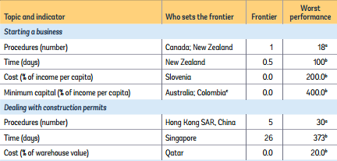
10 topics, 31 indicators
Starting a business
Dealing with construction permits
Getting electricity
Registering property
Getting credit
Protecting minority investors
Paying taxes
Trading across borders
Enforcing contracts
Resolving insolvency
Equal weights across all indicators and sub indices
This year’s report used Distance to Frontier (DTF) scores to benchmark economies with respect to a measure of regulatory best practice- showing the gap between each economy’s performance and the best performance on each indicator
Source: World Bank (2015) Doing Business Report

Slide 6
Sources of information
Relevant laws and regulations
DB respondents (experts)
Governments of economies
WB group regional staff
How many experts does Doing Business consult?
Questionnaires are administered to experts: lawyers, business consultants, accountants, freight forwarders

Slide 7
How Business is Done in the Developing World: Deals vs Rules Hallward Driemeir & Prichett
Highlights that DB is based largely on de jure institutions
Many developing countries create complex and burdensome legal procedures
Chong, La Porta, Lopez-de-Silanes, and Shliefer (2014) document that even in relatively straightforward services like handling misaddressed international mail, developing country governments show little to no compliance with their own policies
How is business actually done?

Slide 8
Doing Business vs Enterprise surveys
Doing Business | Enterprise Surveys
189 countries | 135 countries
Annually | Occasionally
13,752 experts | Random sample of 130,000 firms in main urban centres
Questionnaires, conference calls, written correspondence, visits by the team | Questionnaires and interviews- standardized since 2005 using same questionnaire and methodology
De jure processes- experts are asked to answer questions assuming that all firms fully comply with the rules & no third party intervention | De facto practice Provides reported experiences of firms
Estimates a single number | No precise records, tend to cluster answers around focal times (e.g.: 7 or 15 days)- creates noise, unsure if upward/downward biased
Sources: Doing Business Report 2015, Hallward- Driemeier & Prichett (2015)

Slide 9
3 common topics are analysed in the paper
Days to get a construction permit
Days to start a business/get an operating license
Days to clear imports/customs

Slide 10
Questions asked e.g.: re construction permits
Doing business: The question has to be about a specified type of building, which is a warehouse to be used “for general storage activities, such as storage of books or stationery” and “not be used for any goods requiring special conditions, such as food, chemicals or pharmaceuticals.” It will have two above-ground stories and 14,000 square feet, and each floor will be three meters high. It will be on the fringe of the city, with road access, on a plot of land that is 10,000 square feet. The warehouse will be “valued at 50 times income per capita.”
Enterprise survey: Over the last two years, did this establishment submit an application to obtain a construction-related permit?” And if the answer is yes, then: “In reference to that application for a construction-related permit, approximately how many days did it take to obtain it from the day of the application to the day the permit was granted?”

Slide 11
The median DB reported time was 177 days while the median ES reported time was 30 days
Larger the DB value, larger the gap between the DB value and the ES median
R² of quartic regression of 0.11

Slide 12
At low values of DB, some DB<ES median At high values of DB, all DB>ES median
Extremely low R² of quartic regression: 0.023

Slide 13
Nearly all observations are below the 45º line, some near it
R² of quartic regression: 0.125

Slide 14
DB carried out annually, ES only occasionally. Fewer data points as only countries with repeated ES between 2006 and 2014 were used.
Little change in ES, while DB values have fallen

Slide 15
24 countries Chosen if: 1. if there was a change in the DB value in getting construction permits at least 20 days
2. If there was a repeated ES survey
No change in ES in many- maybe due to a short gap between ES DB has only increased in 3 Both have only increased in 1

Slide 16
Fast and slow firms within countries
Enterprise Surveys also reveal differences across firms within each country
ES data show that there is more variation across firms within a country than across countries
In obtaining construction permits
10th percentile: Burundi- 99 days 90th percentile: Albania- 320 days
The difference in the same between fast firms in the ‘fastest’ and ‘slowest’ countries is only 13 days. The variation among the slow firms is even higher at 305 days (10 months).

Slide 17
Large variation between the performance of fast and slow firms
Fast firms largely unaffected by regulations considered by the DB index
Slow firms not affected uniformly. Some ES report delays greater than times estimated by the DB index

Slide 18
Networked Readiness Index- WEF
NRI measures the capacity of countries to leverage ICTs for increased competitiveness and wellbeing (Source:WEF Global IT Report 2015)
Methodology
Covers 143 economies
Data sources
½ of the individual indicators used in the NRI are sourced from international organizations ( ITU, UNESCO, Other UN agencies, and the World Bank, national sources)
½ World Economic Forum’s Executive Opinion Survey (13,000 business executives).

Slide 19
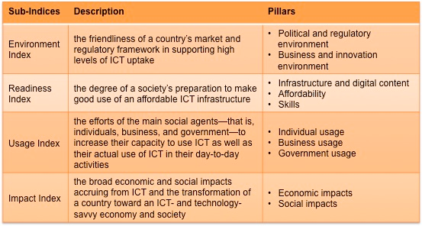

Slide 20
Framework of the NRI

Slide 21
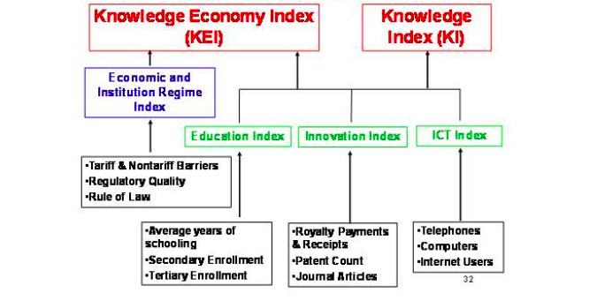
Knowledge Economy Index
The World Bank’s Knowledge Assessment Methodology is an online interactive tool that produces the Knowledge Economy Index (KEI)–an aggregate index representing a country’s or region’s overall preparedness to compete in the Knowledge Economy (KE).

Slide 22
Sub Index | Indicator | Source
The Economic Incentive and Institutional Regime | Tariff & Nontariff Barriers | Heritage Foundation's Trade Policy index
 | Regulatory Quality | Governance Indicators, World Bank
 | Rule of Law | Governance Indicators, World Bank
Education and Human Resources | Average years of schooling | Barro and Lee
 | Secondary Enrollment | UNESCO
 | Tertiary Enrollment | UNESCO
The Innovation System | Royalty and License Fees Payments and Receipts | USPTO
 | Patent Applications Granted by the US Patent and Trademark Office | USPTO
 | Scientific and Technical Journal Articles | USPTO
Information and Communication Technology (ICT) | Telephones per 1,000 people | ITU
 | Computers per 1,000 people | ITU
 | Internet Users per 10,000 people | ITU

Slide 23
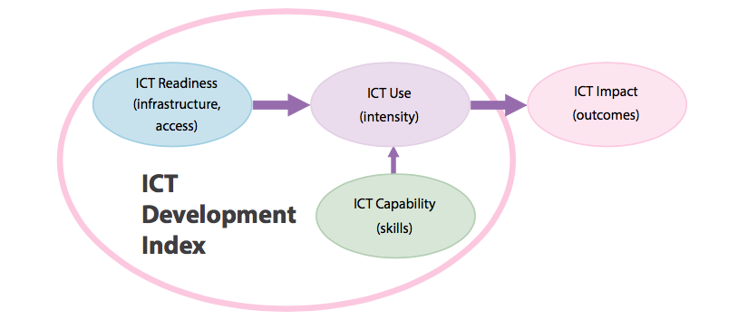
ICT Development Index- ITU
Source: ITU, Measuring Information Society 2014

Slide 24
ICT Development Index: indicators
Sub Index | Indicator
ICT Access | 1. Fixed-telephone subscriptions per 100 inhabitants
 | 2. Mobile-cellular telephone subscriptions per 100 inhabitants
 | 3. International Internet bandwidth (bit/s) per Internet user
 | 4. Percentage of households with a computer
 | 5. Percentage of households with Internet access
ICT use | 6. Percentage of individuals using the Internet
 | 7. Fixed (wired)-broadband subscriptions per 100 inhabitants
 | 8. Wireless-broadband subscriptions per 100 inhabitants
ICT Skills | 9. Adult literacy rate
 | 10. Secondary gross enrolment ratio
 | 11. Tertiary gross enrolment ratio
Source: ITU , Measuring Information Society 2014

Slide 25
ICT Development Index: indicators
The Index deliberately does not measure prices and affordability in each country. Instead, the Affordability Index measures progress toward increased broadband adoption, and the policy and regulatory environments that lead to affordability” A4AI Affordability Report 2014
The 2013 AI included ITU indicators measuring broadband prices as a % of GNI (cost of fixed band per capita, cost of mobile band per capita, cost of bandwidth per MB) This is not included in the 2014 report
Affordability Index
Infrastructure sub-index
Access sub-index
Equal weights across all indicators and sub indices

Slide 26
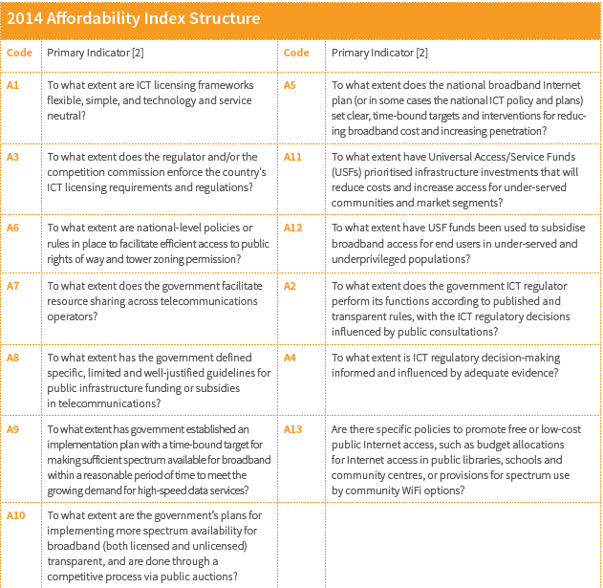
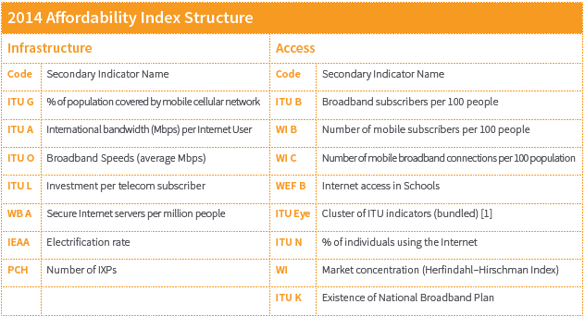
Uses primary and secondary data Primary data based on framework by World Wide Web Foundation’s Web Index Survey questions were judged based on predetermined criteria by 3 country experts

Slide 27
Rankings allow cross country comparisons
 | Ghana | Indonesia | Myanmar | Sri Lanka | Thailand | Vietnam
Doing Business Index (2015) Out of a possible 189 | 70 | 114 | 177 | 99 | 26 | 78
Network Readiness Index (2015) Out of a possible 143 | 101 | 79 | 139 | 65 | 67 | 85
ICT Development Index (2013) Out of a possible 166 | 113 | 106 | 150 | 116 | 81 | 101
Knowledge Economy Index (2012) Out of a possible 145 | 113 | 108 | 145 | 101 | 66 | 104
A4AI Affordability Index (2014) Out of a possible 51 | 26 | 27 | 36 | - | 13 | 22

Slide 28
Rankings allow cross country comparisons
 | Doing Business | NRI | IDI | KEI | A4AI
Ghana | 0.63 | 0.30 | 0.32 | 0.22 | 0.5
Indonesia | 0.40 | 0.45 | 0.36 | 0.26 | 0.48
Myanmar | 0.06 | 0.03 | 0.10 | 0.00 | 0.3
Sri Lanka | 0.48 | 0.55 | 0.30 | 0.31
Thailand | 0.87 | 0.54 | 0.52 | 0.55 | 0.76
Vietnam | 0.59 | 0.41 | 0.39 | 0.28 | 0.58

