Slide 1
Independent regulation: Why it’s needed for sector growth
Rohan Samarajiva
Yangon, 21 June 2016
This work was carried out with the aid of a grant from the International Development Research Centre, Canada and the Department for International Development UK..

Slide 2
What is special about infrastructure?
Affects entire society (or most influential members), therefore politically sensitive
Large, lumpy investments that take time to make returns on, therefore, risky for investors
Will the promises that were made at time investment made be kept?
Will the people who made the promises be in place throughout?
Will the political pressures arising from nature of infrastructure services override promises?

Slide 3
Private investment in infrastructure
If credible solution for problem of “will promises be kept?” not provided, risk will be built into business plan, leading to:
Higher costs to consumers
Investments that are skewed to short term and quick returns

Slide 4
1st best solution: Ideal public administration
Insulation from day-to-day interference by politicians is a basic element of good public administration practice
Administrative/legal accountability for implementation
Were the administrative actions within the law (were they “ultra vires?)
Were they taken following the principles of natural justice?

Slide 5
Different forms of accountability
Legislators make laws; are politically accountable to people at elections
Executive makes policy, plans, strategy; is politically accountable either to people directly or through legislature
Administrative service implements laws, policies; accountable for staying within parameters of law/policy/strategy and for following principles of natural justice
But insulated from day-to-day political interference

Slide 6
We are far from the ideal (or seen as being far)
In most developing countries, despite all good intentions (e.g., Art. 121 of Myanmar Constitution prohibiting civil service personnel from becoming MPs), public administration is not immune from political interference
In any case, perception is what matters in attracting investment
It is perceived that our Ministries/departments do not meet high standards of public administration

Slide 7
2nd best solution
Independent, effective regulation
Carve out an “island” of higher-quality public administration for the sector to which we wish to attract private investment
Make sure its qualities are well communicated (need to change perception)
Appoint the right people so that the perception is continually reinforced

Slide 8
Minimal definition
The regulatory body is separate from, and not accountable to, any supplier [. . . ]. The decisions of and the procedures used by regulators shall be impartial with respect to all market participants.
Adapted from Fourth Protocol of the GATS, Regulatory Reference Paper, 1997, article 5 (only international treaty level instrument on infrastructure regulation)

Slide 9
Regulator-government relations
Insulation from day-to-day interference by politicians is basic element of good public administration practice
Political accountability for policy setting
Administrative/legal accountability for implementation
Additional insulation for some agencies
E.g., Attorney-general; Anti-corruption bodies
In order to change perceptions that affect investment, necessary to give additional insulation to infrastructure regulatory agencies such as the Myanmar Telecommunications Commission, promised to be established by 8 October 2015

Slide 10
Why is present arrangement problematic?
Ministry of Transport & Communication is policy maker
It has two ICT-related units under it
PTD (current regulator)
MPT, operator (joint venture with KDDI & Sumitomo)
If you are another operator, in competition with MPT, would you think
Ministry policy making will be fair or biased to MPT?
PTD regulation will be fair or biased to MPT?

Slide 11
Independence for regulators?
Does not exist in all cases
E.g., Chile, Israel, Nordic countries
But is needed, when overall governance is poor
Basic (not sole) rationale of regulation in developing countries (=countries with poor governance) is protection of investors from administrative expropriation
Analogy: dike to protect island of good governance from ocean of bad governance
But it is not enough to build a dike; it must be maintained

Slide 12
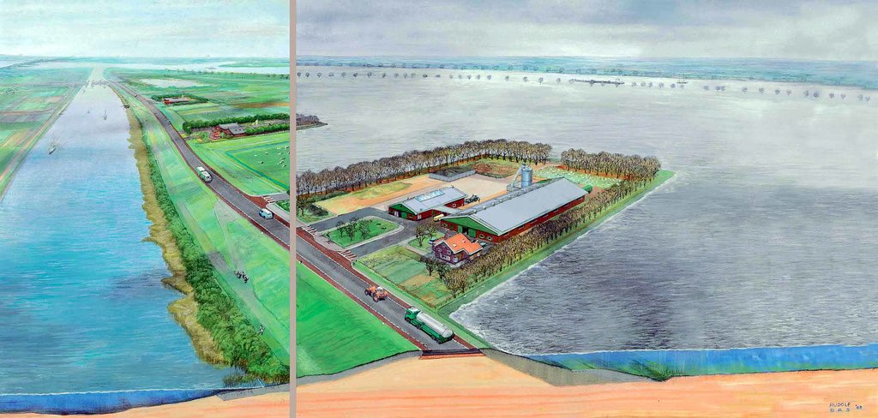
How dikes work

Slide 13
Necessary conditions
Specified appointment procedures of decision makers
Based on merit/expertise, not solely political loyalty
Removal procedures of decision makers
Hard to remove; relatively easy to appoint
Accountability through transparency
Reporting relationship
“Line” Ministry?
Chief executive?
Legislature?
Financial autonomy
Certainty; ability to plan; invest in/obtain expertise
Prevent use as instrument of pressure

Slide 14
Sufficient condition
Legitimacy: The way to win independence
Expertise
Procedural legitimacy
Communication
Engagement with consumers
Legitimacy building=dike maintenance

Slide 15
What is legitimacy?
Acceptance of existence and authority of an entity by those who can affect it or are affected by it
Distinguished from powers and duties set out in formal legal documents
A subjective category that resides in the eyes of others

Slide 16
Legitimacy in whose eyes?
Government
“Line” Ministry
President’s/PM’s office
Finance/Industry
Legislature/Judiciary
“Private”
Incumbent/new entrants
Public/”opinion leaders”

Slide 17
Actors who can affect/are affected by a regulatory agency
Appellate Authorities, incl courts
Chief Executive’s Office
Legislature
Auditor General
Investors/Advisors
DFIs
Ministry of Finance
Subject Ministry
Attorney General
Regulatory Agency
Incumbent/PSUs
Private Operators
Key Civil Society Players
Media

Slide 18
Expertise
Important, but inadequate by itself
Because application of expertise under conditions of imperfect knowledge always involves judgment
No justification for sector regulation without expertise

Slide 19
Procedural legitimacy
Legal requirement, in many cases
Essential ingredient of legitimacy
Reinforces expertise-based claims
Generates new information; improves information quality
Creates conditions for “buy-in” by stakeholders, reducing appeals
“Appeal-proofs” regulatory decisions, increasing likelihood of winning if appealed

Slide 20
Procedural legitimacy
Legal requirement in many countries
India: requirement for consultation papers and open houses in TRAI legislation
USA: Administrative Procedures Act
Sri Lanka:
Telecom Regulatory Commission may hold public hearings and conduct public-notice proceedings
Public Utilities Commission Act has both public hearing (formal) and consultation (less formal) provisions
In most countries judiciary will ask whether natural justice/due process principles have been followed in considering pleas for review/appeal/writ remedies

Slide 21
Natural-justice principles
Hear both sides
Judge must be unbiased
Make decision based on the record

Slide 22
Communication
“How do they know you’re expert/ procedurally legitimate/ doing good if they do not know/you don’t tell them?”
Source of informal power
“Sweet talking,” “jawboning” and “framing”
Affect the symbolic environment of government--the media
Key to public support
But many regulators are uncomfortable with public communication
Because they see themselves in a quasi-judicial role and/or
Because they do not know how, having come from administrative backgrounds

