Slide 1
ICTs, Economic Development, Gender
Helani Galpaya
Yangon, Nov 2016
This research presented here was carried out with the aid of a grant from the International Development Research Centre, Canada and the Department for International Development UK, as well as funding from the GSMA

Slide 2
About LIRNEasia and MIDO
LIRNEasia’s mission:
“Catalyzing policy change through research to improve people’s lives in the emerging Asia Pacific by facilitating their use of hard and soft infrastructures through the use of knowledge, information and technology.“
MIDO’s vision
“To narrow the digital divide between rural and urban Myanmar, with the application of ICT in socioeconomic sectors with the aim of reducing poverty and promoting inclusiveness.”

Slide 3
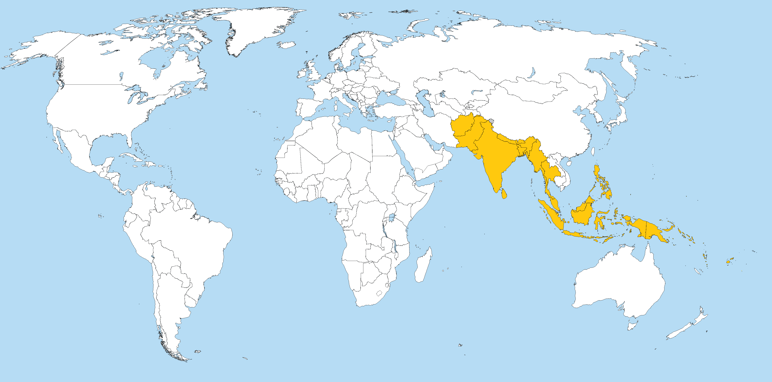
Countries that we engage with

Slide 4
Access to ICT → economic development ?
Searching for Evidence of Impacts

Slide 5
We already saw early impacts on small businesses in Myanmar through our qualitative research
Research on urban, poor, micro entrepreneurs (MEs)
An ME = someone that is self employed or runs a business that employs up to 9 full time equivalent staff
Poor = SEC (Socio Economic Classification) D and E
We used focus groups, mini-ethnographies, site visits.
Talked to 124 MEs (men + women)
In 5 cities: Yangon, Mandalay, Bago, Nay Pyi Taw, Mawlamyine, Mandalay
Aged 15-45
See http://lirneasia.net/projects/sr/ for this systematic review and others cited in this slide set

Slide 6
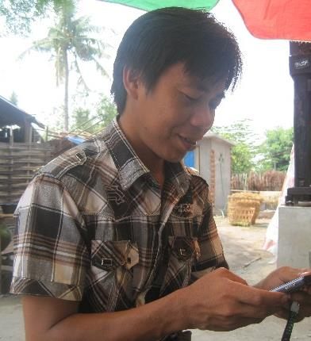
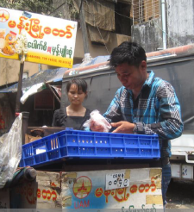
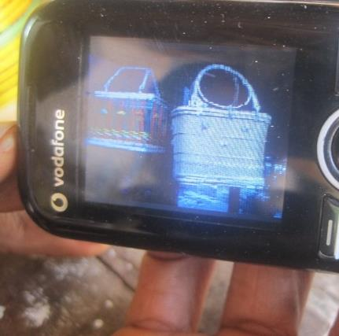
Though phones mostly used for social purposes by MEs, there was some business use. Difference between now (when they owned a phone) vs. before
Coordinating with customers
Coordinating with suppliers
“ A lot of my customers call me before they come to the shop to inquire if I’m there. I can also inform them to collect their product when it is repaired. About 60% i Taw
Aung, dumpling seller, Yangon:
Uses phone to inform supplier when in need of more supply
Marketing: digital catalo
Htwe (44, Souvenir maker, Nay Pyi Taw) shows customers photos on his phone of basket designs which he can make

Slide 7
But positive impacts of ICTs likely were moderated by other factors: e.g. access to financial services
Almost no one had a bank account
2 had accessed formal micro-finance loans
All other relied on informal financial services
Loans at very high interest (2 – 20% per month)
Loans used to finance operating costs, not as investment
To buy daily supply of goods to sell the next day
Manual money transfers (phones only to coordinate)
Low financial literacy
“Analog complements” to digital dividends

Slide 8
But our sector is full of case studies. Do we have systematic evidence, generalizable results
To show that ICTs have put hope in the hearts and money in the pockets of people?
One methodology: A Systematic Review
a method of analyzing and synthesizing a very large number of research studies
A formal methodology, auditable by anyone
Registered with a certifying authority (3 in the world)
See http://lirneasia.net/projects/sr/ for this systematic review and others cited in this slide set

Slide 9
Impacts of networked devices on urban micro, medium, small enterprises is positive
A systematic review
“impact of business relevant information through networked devices on mobile internal efficiency and business growth of urban medium, small and micro enterprises”
All published and grey literature in English language; Since the year 2000
24,204 results from electronic search→ 650 studies initial title abstract screening → 30 full screen → 10 critical appraisal
Result: Networked devices have a only a small positive effect on the growth of the MSMEs
Effect size 0.047 with a confidence interval (-0.513, 0.606)
Result: Networked devices positive effect on internal efficiency of the MSMEs, but results are not stat. significant
Effect size of 0.321 with a confidence interval (-2.740, 3.382)
See http://lirneasia.net/projects/sr/ for this systematic review and others cited in this slide set

Slide 10
What about impacts in rural areas? Micro-level results are positive
A SYSTEMATIC REVIEW of the impact of mobile phones in RURAL livelihoods
All published and grey literature in English language; Since the year 2000
14,128 results from electronic search → 8,981 studies initial title abstract screening → 1,460 subject to full text screening
28 electronic + 20 grey literature: subject to critical appraisal
Included/allowed methods: Experimental, quasi-experimental, observational studies, natural experiments:
Various types of interventions allowed:
Infrastructure interventions (mobile coverage reaching people);
Device Interventions (mobile handsets/SIMs bought/given);
Content and App Application Interventions (providing apps for a particular task or community)
See http://lirneasia.net/projects/sr/ for this systematic review and others cited in this slide set

Slide 11
…..Intervention = Rollout of mobile phone networks in rural areas. Result= positive micro level impact. Generalizable results
Markets are better off
reduced price variation; reduced waste/increase in proportion of produce sold; increased prices; increased market participation
Households are better off
Wage income increase; profits of home business increase; assets increase; expenditure increase
Individuals are better off
Increase in employment
All above from people self-coordinating themselves/their activities after getting mobile signal.
Not being pushed by governments/NGOs/INGOs
See http://lirneasia.net/projects/sr/ for this systematic review and others cited in this slide set

Slide 12
No experimental or quasi-experimental studies in Myanmar.
Maybe LIRNEasia’s ongoing research will shed some light on impacts
Two nationally representative sample surveys of ICT use in Myanmar
2015 (data available online; presented in Myanmar multiple times).
2016 just finished field work, data analysis ongoing
We will be able to see differences between 2015 and 2015
And do econometric modeling of impacts
Results by December this year

Slide 13
But for any impact, owning your own phone is important: owners more likely to have made livelihood related calls than non-owners
Q: Can you tell us the purpose of your [last] call?
Base: Respondents who had ever used a phone before
Source: LIRNEasia 2015 survey of ICT use in Myanmar representative of the population 15-65 years. See report at http://lirneasia.net/wp-content/uploads/2015/07/LIRNEasia_MyanmarBaselineSurvey_DescriptiveStats_V1.pdf
Notes:
l502c For what purpose was this call?

Slide 14
Men and women both increase livelihood calls when they own a phone. But women overall make less livelihood calls
Purpose of the last call made or received (% of 15-65 year olds who have used a phone before)
Female
Males
Q: Can you tell us the purpose of your call?
Base: Respondents who had ever used a phone before
Source: LIRNEasia 2015 survey of ICT use in Myanmar representative of the population 15-65 years. See report at http://lirneasia.net/wp-content/uploads/2015/07/LIRNEasia_MyanmarBaselineSurvey_DescriptiveStats_V1.pdf

Slide 15
Those that have become mobile owners do claim the benefits…
Source: LIRNEasia 2015 survey of ICT use in Myanmar representative of the population 15-65 years. See report at http://lirneasia.net/wp-content/uploads/2015/07/LIRNEasia_MyanmarBaselineSurvey_DescriptiveStats_V1.pdf
Base: All respondents
Notes:
Break into two/labels

Slide 16
(continued)
“Before I just listened to what others said. Now I read the news on my phone so I can tell my parents and even talk back to others. I am more up to date.
-Female owner, 25, SEC C, Yangon
Base: All respondents
Source: LIRNEasia Baseline Survey (2015)

Slide 17
Do women use and own phones?
Women, phones, ICTs

Slide 18
Based on two sets of data collected in 2015
Quantitative (survey) data by LIRNEasia
Qualitative data by GSMA & LIRNEasia
Household , individual, ward level survey
Representative of 97% of households, 96.3% of population 15-65 years at 2.5% margin of error
12,000+ respondents
8,138 households
554 ward / village leaders
In-depth interviews and FGDs in Yangon and Pantanaw
91 females and males interviewed

Slide 19
Access/use: Gender difference is small, though males are slightly more frequent teleusers
Q: When did you last use a phone to take or receive a call? It could be through your own phone, a neighbors' phone, a friend's phone, communication kiosk/shop or any other. It also need not be paid for?
Base: All respondents
Source: LIRNEasia Baseline Survey (2015)
Notes:
l501 When did you last use a phone to take or receive a call? It could be through your own phone, a neighbor's phone, a friend's phone, communication kiosk/shop or any other. It also need not be paid for?

Slide 20
Rural women have less frequent use than urban women. Similar pattern for men
When was the last time you used a phone?
(% of 15-65 year olds)
Base: All respondents
Source: LIRNEasia Baseline Survey (2015)

Slide 21
Income effects dominate – use by poor women similar to that by poor men
Base: All respondents
Q: When did you last use a phone to take or receive a call? It could be through your own phone, a neighbor's phone, a friend's phone, communication kiosk/shop or any other. It also need not be paid for?
Base: All respondents

Slide 22
Women use phones owned by others. But shared use is not always easy
Reluctance from owners to share due to privacy concerns
High cost
Fear of ‘breaking’ the phone
“My siblings wouldn’t share their phone. They have boy and girlfriends.”
-Female, owner, 25, SEC C, Yangon
“I have to top-up her [phone] even though I only received the phone call but we look together on the Internet. I can only afford to top-up with 1000 kyats. Although I only received the phone call, I need to top-up her phone.”
-Female non-owner, 29, SEC D/E, Yangon
"If something goes wrong while I am using it, I’m afraid I will have to pay for it. I don’t want to bother other people. I’m afraid they might yell at me if I ask.”
-Female, non-owner, 29, Pantanaw
Notes:
She is referring to a friend whose phone she sometimes borrows when she needs, with whom she also looks at posts on Facebook and the Internet regularly.
She is referring to her cousins who live in the same house and have mobiles – this is the single mother (profile 2), she never uses a phone, because she is scared she will have to pay If it breaks, and she can’t afford to repay due to her financial situation. She faces inconveniences due to not using a mobile for her communication, yet she would prefer to avoid it due to the reason above.
Another difficulty here mentioned by a couple of respondents is that public payphones are harder to find these days. Can’t find a quote, but just FYI

Slide 23
But 29% gender gap in mobile ownership
Base: Myanmar population 15-65 living in accessible areas
Source: LIRNEasia Baseline Survey (2015)
Male phone owners
(% of male population)
-
Female phone owners
(% of male population)
Gender gap in ownership (%)
=
Male phone owners
(% of male population)

Slide 24
Even higher in the lower income groups
INCREASING HOUSEHOLD INCOME
BOP/Below MMK300,000: 34%
Base: Myanmar households in accessible areas
Source: LIRNEasia Baseline Survey (2015)

Slide 25
Binary logistic regression to identify factors effecting phone ownership
 | Coefficient (B) | Odds Ratio | Change in Odds Ratio due to 1 unit increase in explanatory variable | P.Value
Gender (0=male; 1=female) | -0.536 | 0.585 | -42 | 0.00
Secondary education being the highest obtained (0=no, 1=yes) | 0.438 | 1.55 | 55 | 0.00
Tertiary education being the highest obtained (0=no, 1=yes) | 1.564 | 4.777 | 378 | 0.00
Having television at home (0=no, 1=yes) | 0.61 | 1.84 | 84 | 0.00
Having electricity at home (0=no, 1=yes) | 0.342 | 1.407 | 41 | 0.00
Employment status (0=not employed; 1=employed) | 0.608 | 1.836 | 84 | 0.00
Perceived economic impact of mobile (scalar variable: 1-5) | 0.067 | 1.07 | 7 | 0.25
Perceived knowledge impact of mobile (scalar variable: 1-5) | 0.122 | 1.13 | 13 | 0.04
Perceived emotional impact of mobile (scalar variable: 1-5) | 0.235 | 1.265 | 27 | 0.00
Proportion of family members having mobile (scalar variable: 1-10) | 0.304 | 1.355 | 36 | 0.00
Proportion of friends having mobile (scalar variable: 1-10) | 0.047 | 1.048 | 5 | 0.00
Monthly household expenditure (MMK) | 0.115 | 1.122 | 12 | 0.01
Age of respondent (no. of years) | -0.005 | 0.995 | -0.5 | 0.09
Constant | -3.439 | 0.032 | -97 | 0.00
Binary logistic regression output
significant at 0.01 level
significant at 0.05 level
not significant
Source: LIRNEasia Baseline Survey (2015)
Notes:
The odds ratio is a way of presenting the probability of an event. The odds of an event happening indicate the probability that the event will happen, divided by the probability that the event will not happen. The odds ratio implies that, for each unit increment of the independent variable, the odds of the concerned dependent variable (in this case, mobile adoption) changes by a percentage of (odds ratio – 1)
A binary logistic regression is a way of modeling the probability of an event when the event is a binary outcome, so adoption = 1 (yes) or 0 (no).
Coefficient (column 2) ) in logistic regression cannot be directly interpreted. The Odds Ratio (col. 3) is calculated from it.
The ‘Odds’ is directly related to (but not the same as) the probability of something happening.
Odds = probability of adoption / probability of not adopting
So, from the odds ratio, you can calculate by how much your odds of adopting changes by a 1 unit increase in the explanatory variable (col.4/pink column). So where you have a binary explanatory variable (e.g., gender), your change in probability is in relation to the gender variable going from 0 (male) to 1 (female).
In this case we have given the change in odds as a %, which is what you see in the pink column, also plotted on the graph on the next slide.

Slide 26
Being a woman in Myanmar reduces odds of owning a mobile by 42% (even after taking into account gender differences in education and employment status)…
% Change in odds of mobile adoption (i.e. ownership) due to 1 unit increase in explanatory variable
Being a woman in Myanmar reduces the odds of mobile adoption of 42%, after the differences in other factors are taken into account
Notes:
Being employed increased the odds of adoption by 84%, completing tertiary education increases odds by 378% (but note, the number with tertiary education is relatively low)

Slide 27
Where Myanmar stands compared to other countries
Country | Gender gap (%) | Year | Years since 1st mobile license issued | GDP/capita(current USD)
Niger | 45 | 2014 | 14 | 378
India | 36 | 2014 | 15-19 | 1,582
DRC | 33 | 2014 | 13(?) | 442
Myanmar | 29 | 2015 | 1 | 1,204
Jordan | 21 | 2014 | 13 | 5,423
Indonesia | 10 | 2014 | 15 | 3,492
Kenya | 7 | 2014 | 15 | 1,358
Mexico | 6 | 2014 | 17* | 10,326
Colombia | 3 | 2014 | 23* | 7,904
Egypt | 2 | 2014 | 11 | 3,199
Turkey | 2 | 2014 | 10 | 10,515
China | 1 | 2014 | (?) | 7,590
Sources: GSMA (Gender gap data), World bank (income data), Various (liberalization data)
Notes:
*Exact date of issue of 1st mobile license can not be ascertained; in stead, date when telecom industry was liberalized or independent regulator was established
Additional notes:
India – duopoly broken in 1995, NTP implemented in 1999
DRC- by 2001, 16 mobile licenses had been issued
Egypt - entrance of a 3rd player in 2003
China – mobile operators are all state-owned

Slide 28
Why don’t more women own mobiles? They cannot afford it; they don’t ‘need’ it.
Main reason for not owning a mobile phone
% of non-owners∫
Base: Non-owners
Source: LIRNEasia Baseline Survey (2015)

Slide 29
What a lack of affordability means
Household incomes are low overall (74% at BOP)
50% of women are not employed according to baseline survey
Women who ARE employed still earn significantly less than men
Base: Myanmar households in accessible areas
Source: LIRNEasia Baseline Survey (2015)

Slide 30
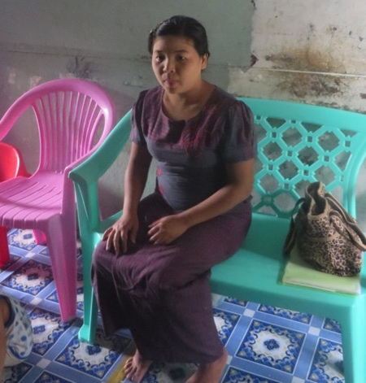
‘Affordability’ is measured against the cost of a smartphone. Men & women prefer them
Some can afford (or have the option) of a keypad phone, but would rather hold out for the opportunity to get a smartphone/ ‘touch phone’
Prestige factor
To access data services (Facebook, Viber, etc.)
For games
“At times [my husband] gives me money to buy a mobile phone. But I have to use it for school fees for my children. And what I want to get is a smart phone, which I can’t afford to buy yet…[The lowest price for a handset is] more than 60,000-70,000 kyats. But those are not good enough, only handsets that cost more than 1 lakh kyats are good enough to be used...[i.e.,] more durable than the [cheaper] ones.”
-Housewife, 28, Yangon

Slide 31
Female owners as likely to own a ‘touch phone’ as male
“A touch phone is high class, and you can play games with it. Keypads are outdated”
-Female FGD respondent, 18-28, SEC C/D, Pantanaw
Base: Day wage earners
Source: LIRNEasia Baseline Survey (2015)

Slide 32
Women are usually family/household financial managers or ‘CFOs’ (Chief Financial Officers)
Family income is (usually) handed over to the primary female in the house who budgets for the month and ensures money is available for necessities
They play key role in household decisions, incl. mobile phone adoption
Limited product knowledge limits their participation in purchase decision
‘He gives me the salary when he is paid, all of it. But when he needs some he requests from me. When he goes to work he needs to have meal but there was no one he knows so I have to make sure that he has money.’
Female non-owner, 36, SEC D, Yangon
“Others hold a touchphone so I wanted one, too. My wife agreed and came along when I bought it.”
Male owner, Yangon
“My wife complains if I top up too much.”
Male owner, 30-45, SEC B/C, Yangon

Slide 33
Different from other Asian countries (2008): women had much less of a say, esp. South Asia
Q: Who was the main decision maker in purchasing [your] mobile phone?
Base: BOP mobile owners
Source: LIRNEasia Teleuse@BOP3 survey (2008)

Slide 34
But as CFO, they are responsible for whole family. And put others’ needs before their own.
They feel the need to to conserve the limited family budget (even at the expense of their needs)
‘Women also have to take care of the family. Instead of spending their money on phone charges, they have to use it for food.’
- Female non-owner, 36, SEC D, Yangon
“At times [my husband] gives me money to buy a mobile phone. But I have to use it for school fees for my children. And what I want to get is a smart phone, which I can’t afford to buy yet.”
-Female non-owner, Housewife, 28, Yangon
“I plan to buy a mobile but we don’t have enough income. My wife says that I shouldn’t buy one. She is about to give birth so we need to save the money.”
Male non-owner, 18-29, SEC D/E Pantanaw

Slide 35
Even when the household already has a mobile, women often tend to get lowest priority…
Women’s role as the home-maker (rather than the bread-winner) has a strong impact on their becoming mobile owners
Whoever goes outside of the house gets priority
‘Males are the head of the household. You have to favor and respect them. He has to lead the family. Whatever we do, we have to discuss with him.’
Female mobile owner, 18-28, SEC C/D, Pantanaw
‘If we could buy another phone, it would be for my husband. The next one will be my brother’s. This is because they are working. Only after that will I get my own phone’
-Female, non-owner, 47, Pantanaw
‘Males work and have business so they carry the phone. But if the wife has a business she also has one. Today even youngsters and children have a mobile.’
-Female mobile owner, 19, SEC C, Yangon

Slide 36
They ‘do not need’ their own mobiles

Slide 37
‘I have no use for it/don’t need one’ ≈ There is already one in my household which I can use
Base: Non-owners
Source: LIRNEasia Baseline Survey (2015)
Notes:
Lack of a need is a higher concern among those who don’t yet have a mobile in the household, especially for female non-owners

Slide 38
Many women don’t see the value of having their own phone
The main uses of mobiles are social and entertainment (their perception)
They neither have the time nor money to spend on a mobile connection
“Females don’t have the time to learn and fiddle with phones since they are busy at home. They are not as skillful as us.”
-Male, owner, 30-45, SEC C/D, Pantanaw
“I had a look at Clash of Clans but I am not interested so I just stopped. I have to pay attention to the finance of the family.
Female non-owner, 36, SEC D/E, Yangon
“Usually women my age hardly own a mobile in this village because they don’t have an income.”
-Female owner, 52, SECC/D, Pantanaw
“I told my husband you are just playing the game (COC) all the time but do nothing. When we tell him to babysit he is playing games.”
-Female non-owner, 36, SEC D/E, Yangon
“Females need income to top it up.”
-Female non-owner, 30-45, SEC B/C, Yangon
“These days we are wasting so much time with gaming or chatting.”
-Female owner, 18-29, SEC B/C, Yangon

Slide 39
Similar pattern seen among low-income non-owners in 2011 in other countries: More females didn’t see a need for their own mobile
Base: Non-owners
Source: LIRNEasia Teleuse@BOP4 survey (2011)

Slide 40
Women often don’t have the skills to use data services fully
Many women need help to even place a call
Women are unable to participate in handset/SIM purchase, so what is purchased may not meet their needs
Women miss out on the ‘introduction’ to the mobile at the point of purchase
Rely on others (males) for knowledge
Fear of ‘breaking’ the phone prevents greater use by women
Those who knew English faced less difficulties
“We don’t fiddle with it a lot because we are concerned that we would damage it. We don’t want to waste money. I can’t afford a new one.”
FGD Yangon, female owners, 18–29, working, SEC B/C
“Males know better how to operate and to repair phones … there are hardly females working in phone shops.”
HV Yangon, female owner, 19, SEC C

Slide 41
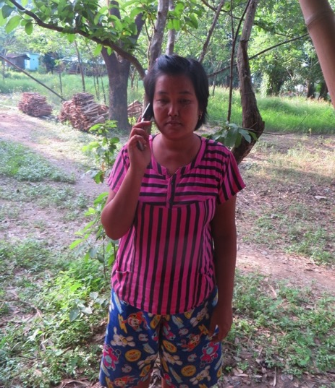
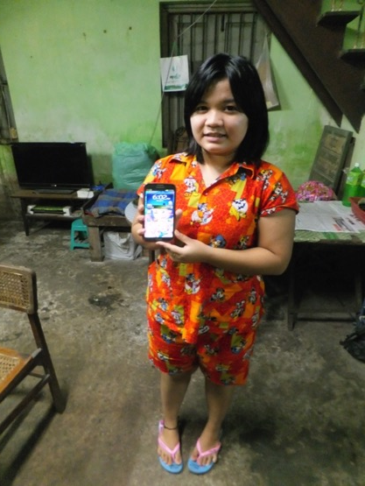
…but all this is changing as gender roles change, and more women go out to work or study
‘Living here without any relatives is really hard for me. I’ve got no-one to talk to, no shoulder to cry on if I face a problem… so I have to discuss it with my mother over the phone.’
-Undergraduate student, 19, from a village, boarding in Yangon for her studies
‘I no longer need to wait till the wholesalers come and buy mats nor do I need to go to Pantanaw to sell them, as I did before. I just have to contact them through my mobile phone. It obviously saves time and money.’
-Mat weaver and chief wage earner in her household, 39, Pantanaw
Notes:
Gamer chic – context

Slide 42
There is hope…...
Latest data (2016 national survey)

Slide 43
2016 (June-Aug) Nationally representative sample of 7,500
The survey represents 298 townships (97% and 96.3% of total households and total population aged 15-65 respectively)
Excludes unsafe and non-accessible areas (32 townships)
95% Confidence interval, +/-3% margin of error
Stratified four stage PPS cluster sampling design used; stratification by:
Population size (big cities; other major cities; smaller townships)
Geographic region (Delta, Eastern hills, Long coast, etc.)
Urban/rural
Fieldwork conducted June-August 2016
Face-to-face interviews using data entry tablets

Slide 44
Males still more frequent users
Base: 2016, All respondents
Q: When did you last use a phone to take or receive a call? It could be through your own phone, a neighbour's phone, a friend's phone, communication kiosk/shop or any other. It also need not be paid for

Slide 45
Overall level of teleuse has increased; female access is almost on par with male
Base: 2015 v 2016, All respondents
Q: When did you last use a phone to take or receive a call? It could be through your own phone, a neighbour's phone, a friend's phone, communication kiosk/shop or any other. It also need not be paid for

Slide 46
2016 Gender gap in mobile ownership = 25% I.e., males 25% more likely to be mobile owners than females
Male phone owners
(% of male population)
-
Female phone owners
(% of male population)
Gender gap in ownership (%)
=
Male phone owners
(% of male population)
Base: 2106, All respondents
Q: Which of the following describes your status of mobile phone ownership?

Slide 47
Gender gap reduced from 29% in 2015 to 29% in 2016
Gender gap | 29% | 25%
 | 2015 | 2016
Base: 2015 v 2016, All respondents
Q. Which of the following describes your status of mobile phone ownership?

Slide 48
Female subscribers just as likely as males to own a smartphone
Base: 2016, All mobile handset owners
Q. How many functioning smartphones (‘touch phones’)/ keypad handsets do you own?

Slide 49
But women less likely to have the skills to use it independently
Base: 2016, All mobile handset owners
L528a1 Can you please tell me, which of the following activities you have ever done on your mobile or on the Internet/online, and for each one, whether you have done it by your self, or with someone else’s help.

