Slide 1
Introduction to demand-side research
with examples from Nepal research
Isuru Samaratunga
17th of Feb 2019

Slide 2
Understanding the demand side

Slide 3
Governments/
International Telecommunication Union
Service Providers
User
Mobile Phone Manufacturers
Value Added Service Providers
APP Developers

Slide 4
Who is supplying and who is demanding?
Value Proposition
User
Fit
To figure out the ‘fit’ we need observations

Slide 5
What to Observe?
Functional jobs
Social jobs
Personal jobs
Supporting jobs
User Job(s)
Source: https://strategyzer.com/

Slide 6
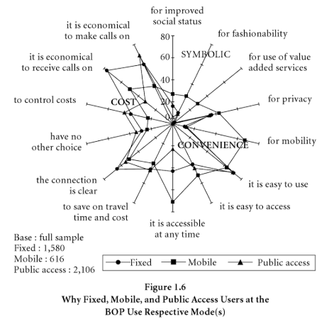
What to Observe?
Functional jobs
Social jobs
Personal jobs
Supporting jobs
Source: ICT Infrastructure in Emerging Asia: Policy and Regulatory Roadblocks , 2008;(Edited by Rohan Smarajiva and Ayesha Zainudeen)

Slide 7
Observe User Jobs
What functional jobs is the user trying get done?
(e.g. perform or complete a specific task, solve a specific problem, ...)
What social jobs is the user trying to get done?
(e.g. trying to look good, gain power or status, ...)
What emotional jobs is the user trying get done?
(e.g. esthetics, feel good, security, ...)
What basic needs is the user trying to satisfy?
(e.g. communication, sex, ...)
Source: https://strategyzer.com/

Slide 8
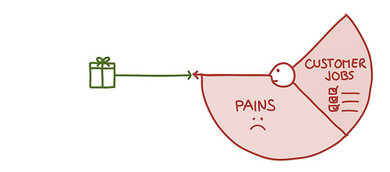
Observe the User Pains
What does the user find too costly?
(e.g. takes a lot of time, costs too much money, requires substantial efforts, ...)
What makes the user feel bad?
(e.g. frustrations, annoyances, things that give them a headache, ...)
How are current solutions underperforming for the user?
(e.g. lack of features, performance, malfunctioning, ...)
What are the main difficulties and challenges the user encounters?
(e.g. understanding how things work, difficulties getting things done, resistance, ...)
Source: https://strategyzer.com/

Slide 9
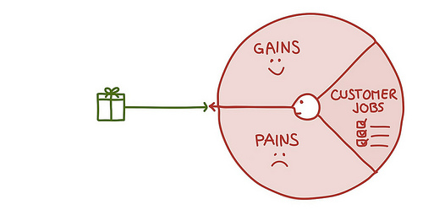
Observe the User Gains
Which savings would make the user happy?
(e.g. in terms of time, money and effort, ...)
What outcomes does the user expect and what would go beyond his/her expectations?
(e.g. quality level, more of something, less of something, ...)
How do current solutions delight the user?
(e.g. specific features, performance, quality, ...)
What would make the user’s job or life easier?
(e.g. flatter learning curve, more services, lower cost of ownership, ...)
Source: https://strategyzer.com/

Slide 10
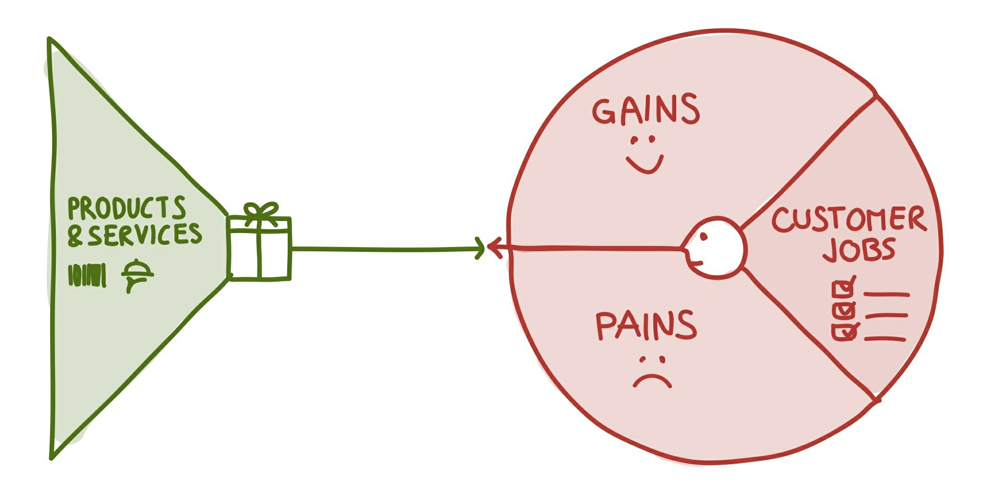
Observe Products and Services
Products and services can be tangible (e.g. manufactured goods, face-to-face customer service), digital/virtual (e.g. downloads, online recommendations), intangible (e.g. copyrights, quality assurance), or financial (e.g. investment funds, financing services).
What are the products and services that help the user to fulfill functional, social, or emotional jobs? Also what are the products and services which help him/her satisfy basic needs?
Are the products and services crucial or trivial to the user?
Source: https://strategyzer.com/

Slide 11
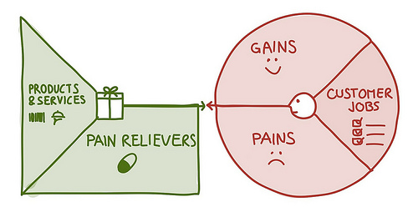
Observe Pain Relievers
... produce savings? (e.g. in terms of time, money, or efforts, ...)
... make the users feel better? (e.g. kills frustrations, annoyances, things that give them a headache, ...)
... fix underperforming solutions? (e.g. new features, better performance, better quality, ...)
... put an end to difficulties and challenges the users encounter? (e.g. make things easier, helping them get done, eliminate resistance, ...)
... wipe out negative social consequences the user encounter or fear? (e.g. loss of face, power, trust, or status, ...)
Source: https://strategyzer.com/

Slide 12
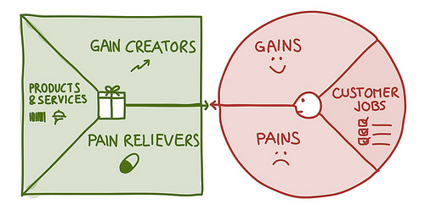
Observe Gain Creators
...create savings that make the user happy?
(e.g. in terms of time, money and effort, ...)
... produce outcomes the user expects or that go beyond their expectations?
(e.g. better quality level, more of something, less of something, ...)
... copy or outperform current solutions that delight the user?
(e.g. regarding specific features, performance, quality, ...)
... make the user’s job or life easier?
(e.g. flatter learning curve, usability, accessibility, more services, lower cost of ownership, ...)
Source: https://strategyzer.com/

Slide 13
Value Proposition Policies etc..
User Profile
Source: https://strategyzer.com/

Slide 14
Supply side and demand side
Understanding demand-side
Need research
Source: https://strategyzer.com/

Slide 15
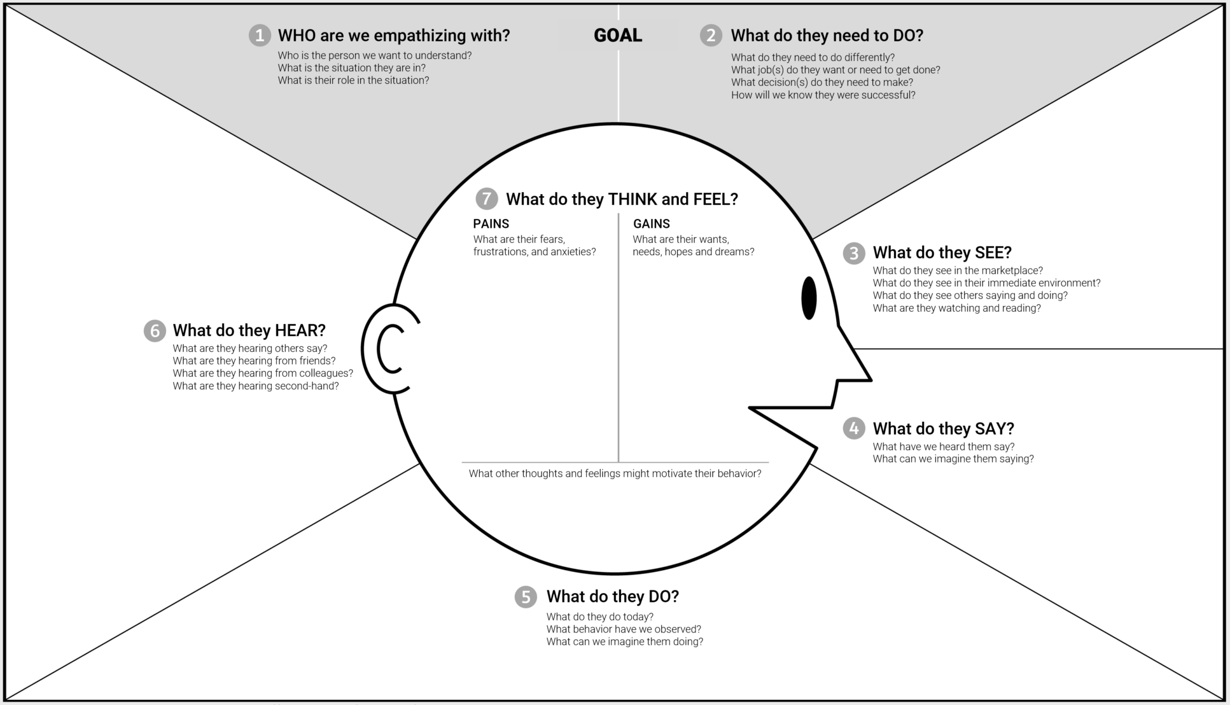
Empathy Map (demand side)
Source: https://strategyzer.com/

Slide 16
Basic steps of
quantitative & qualitative research

Slide 17
Basic steps (quants and qualits)
Research design
Data Collection
Data Analysis
Sampling
Tools
What is the objective?
Who gives data?
The best instrument
Input of the research
How to analyse data?
Hypothesis formulation
Conceptual Framework
Census or surveys
Random or non- random sampling
Non-random sampling
Questionnaires
Discussion Guide
Interviewing/
Auditing
Discussions
Descriptive/Inferential .
Coding/Interpretative

Slide 18
Basic steps of Nepal studies
Research design
Data Collection
Data Analysis
Sampling
Tools
What is the objective?
Who gives data?
The best instrument
Input of the research
How to analyse data?
Understanding the ICT usage of Nepalis and Persons with disabilities
(PWDs); quants & qualits
Random selection of Primary Sampling Unit and listing
Random selection of households and individuals
Snowballing
Asked questions from HHH/Random HH representative
Conducted discussions with selected persons
Interviewed using tablet(CAPI) based quesionnaires
Discussed based on Discussion Guide
Descriptive analysis and pattern identification
Data labelling/coding/themes and theme network identification

Slide 19
Research Design
Designed according to the research objectives; and
The cost
Response rate
Researcher bias
Potential misinterpretation
Privacy
Burden on the respondents
Ethical concerns
quantitative or qualitative
Q: Is this the appropriate design to research the question?

Slide 20
Quantitative
Qualitative
Pros | Can be generalized Repeatable Anonymous Answer questions such as how much, how many and how long | Flexible Less expensive Explore depth and details Answer questions such as how and why
Cons | Limited ability to probe Costly | Difficult to generalize Cannot quantify

Slide 21
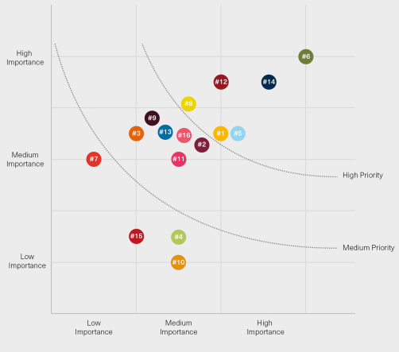
Sampling
Sample can increase with desired precision level; findings can be saturated at one point
Sample size determination
Materiality Matrix - Stakeholders
Size of the target population
Precision level
Level of representation
Heterogeneity of the sampling units
Research question
Cost
Time
Relevance to the Stakeholder
Impact to the Stakeholder
Q: Is the sample representative?

Slide 22
The survey in Nepal uses the recent re-classification of urban-rural by the CBS. Makes triangulation/comparison with past data difficult, even at national level level
2011
2017
460 Gaunpalikas classified as Rural
3,901 VCDs classified as Rural
Nepal was divided in to 3,973 VDCs/Municipalities.
VDCs were converted to Gaunpalikas. There are 753 local units (Gaunpalikas and Municipalities) in Nepal
293 Municipalities (Including metropolitan and sub- metropolitan cities) classified as Urban
72 Municipalities classified as Urban
AfterAccess sample was designed based on the 2017 new urban-rural classification of wards
Source
http://cbs.gov.np/image/data/Population/Population%20Monograph%20of%20Nepal%202014/Population%20Monograph%20of%20Nepal%202014%20Volume%20I%20FinalPrintReady1.pdf
http://cbs.gov.np/image/data/2017/Population_Ward_Level_753_Local_Unit.pdf

Slide 23
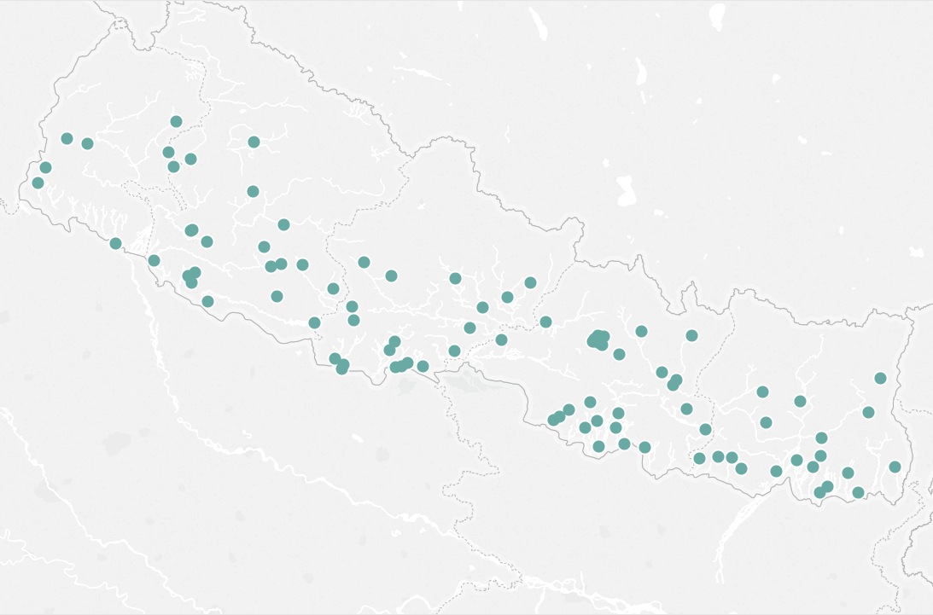
Nationally representative survey among age 15-65 population and age 15-65 PWD population
Nepal main survey sample designed to be representative of 15-65 population at:
National level
Urban-rural level
Men vs Women
With 95% Confidence Interval; +/-3.3 margin of error at national level
Sample GPS locations recorded by CAPI device at time of survey
Nepal PWD survey sample designed to be representative of age15-65 PWD population at national level
With 95% Confidence Interval; +/-9.8 margin of error at national level
2,000 individuals from 2,000 households for the main survey
400 PWDs from 400 households for the PWD survey
in 100 wards

Slide 24
Sample designed to represent Nepal as a whole; random selection at every stage of sampling
Stage 1:
Stratified random sampling of the primary sample units (PSUs) with probability proportionate to size (PPS) sampling
100 wards covering all Provinces
48 Districts
Information collected during the listing stage
Split the ward level sample frame into urban and rural PSUs
Random selection of required number of wards 60 urban wards and 40 rural wards using PPS
GPS coordinates also captured on CAPI device (mobile/tab) for every structure listed during listing
households with disabled people were identified during the listing
PSUs with > 250 households segmented, and 1 segment randomly selected for listing

Slide 25
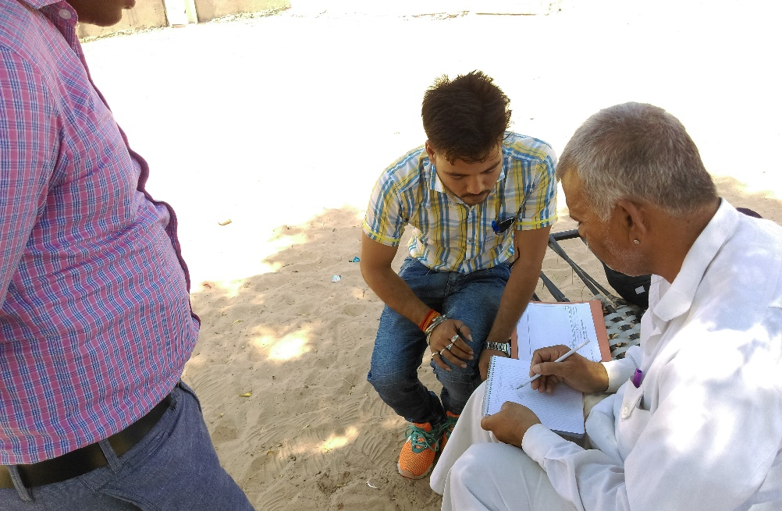
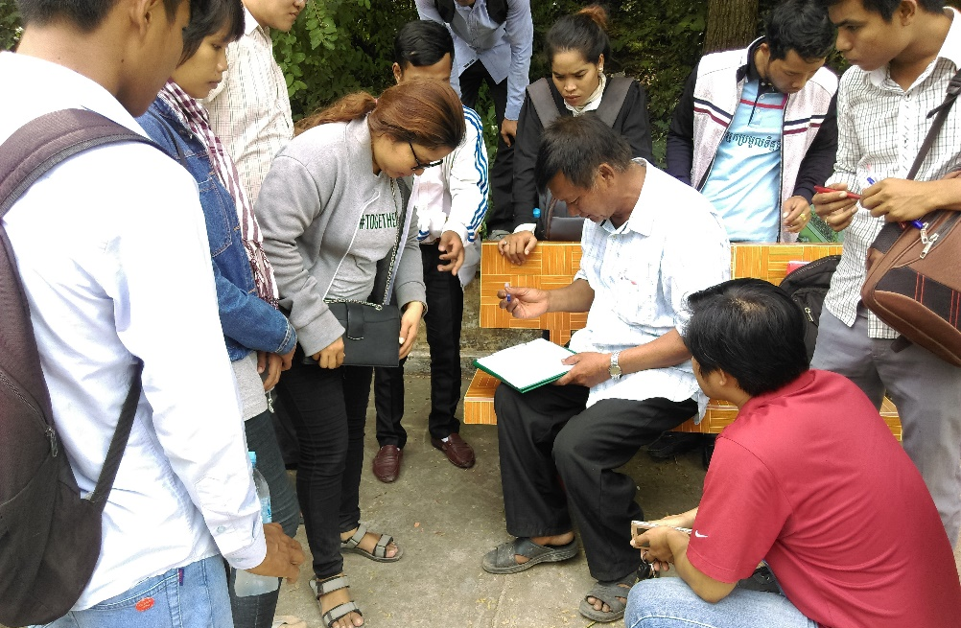
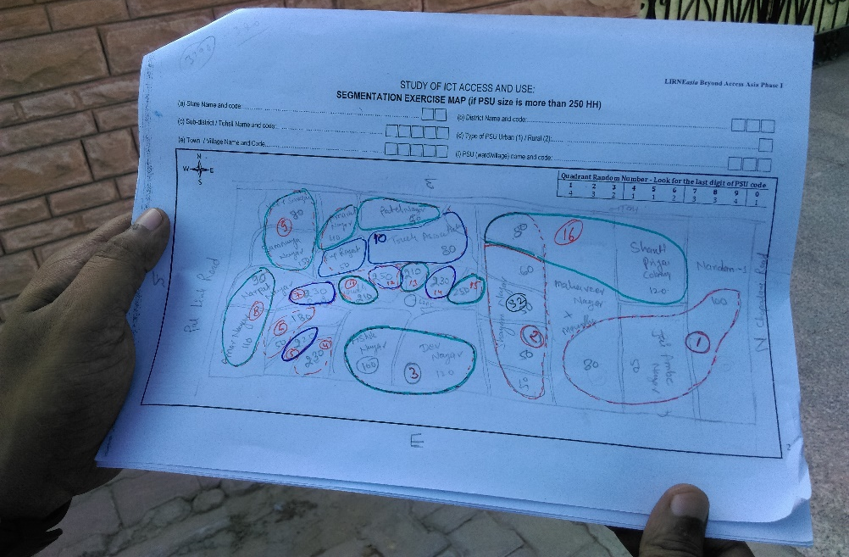
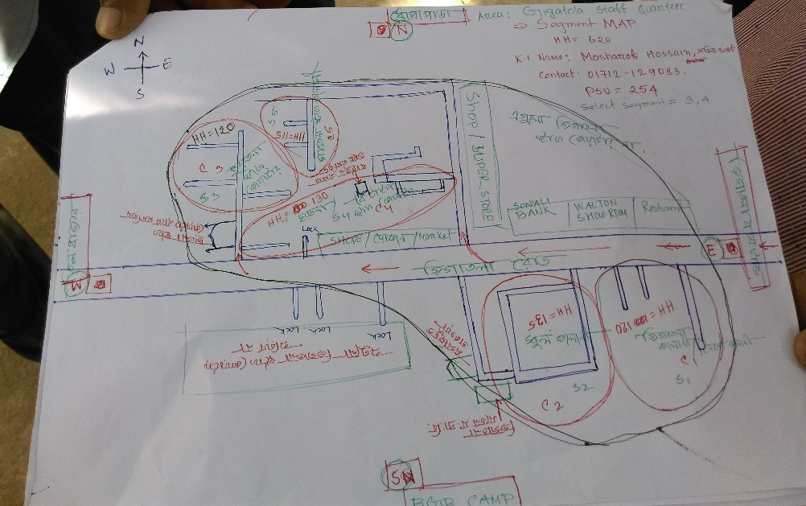
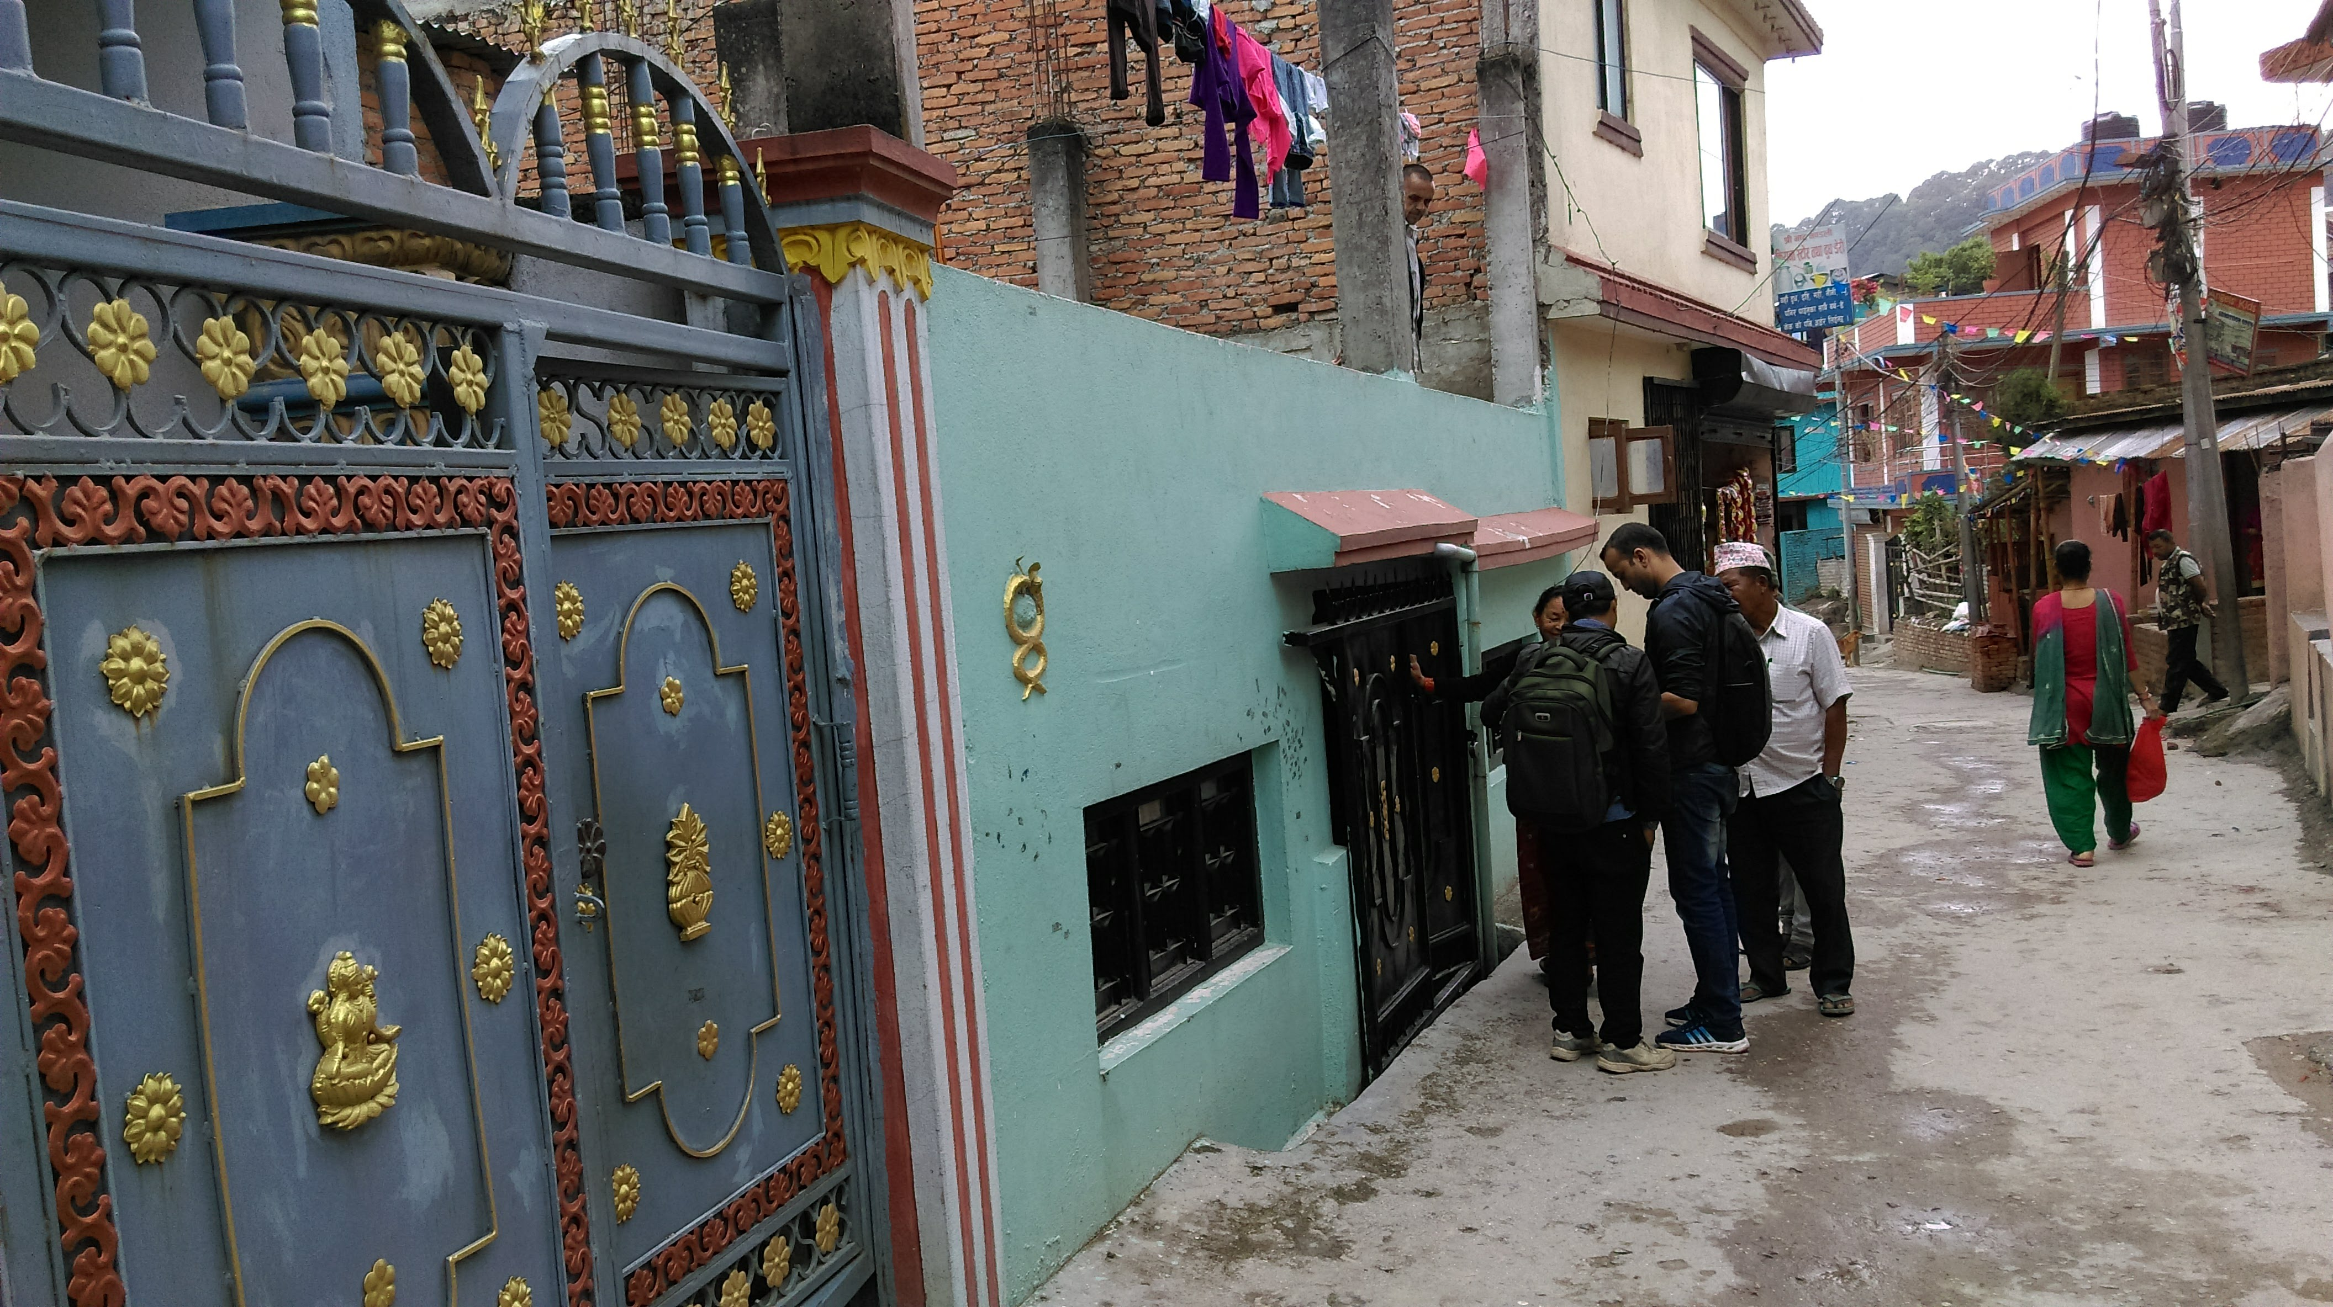
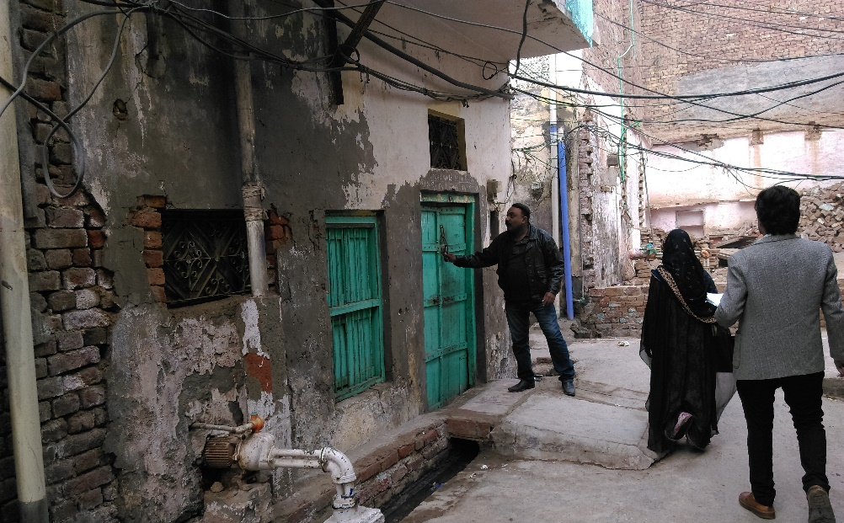
Stage 2:
Mapping and listing of selected PSUs
Obtaining PSU information (boundaries, households, etc.) from key informants
Mapping of randomly selected village or ward with the help of the key informants
Segmentation of wards and villages where the number of households exceeding 250
KI Interview in India
KI Interview in Cambodia
Mapping & segmentation
List of structures of the entire segment identifying the eligible households
In Nepal; all households with disabled people were identified during the listing
Segmentation Map - India
Segmentation Map - Bangladesh
Listing of households
Listing - Nepal
Listing - Pakistan

Slide 26
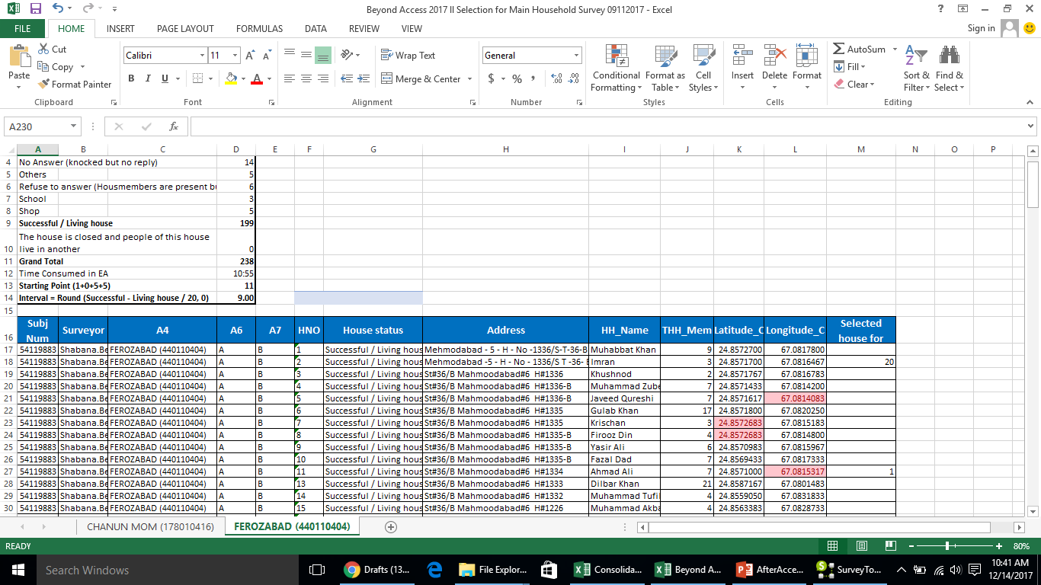
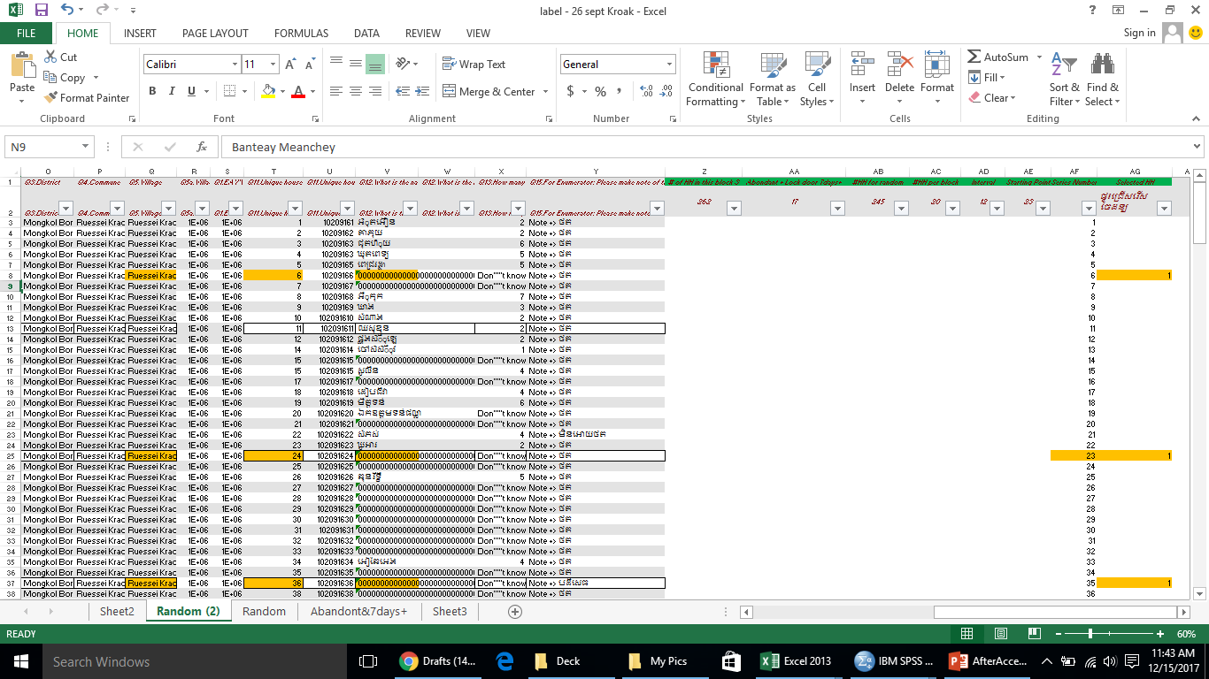
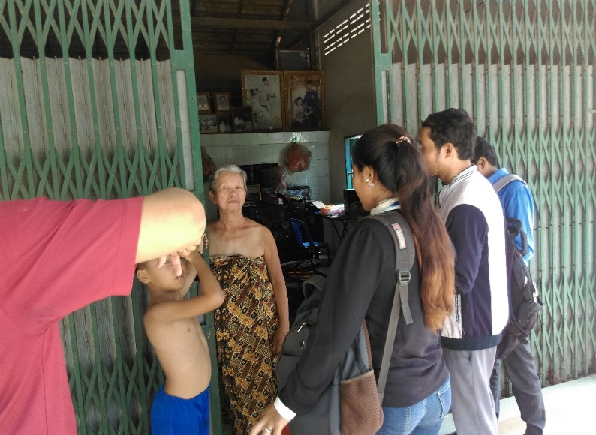
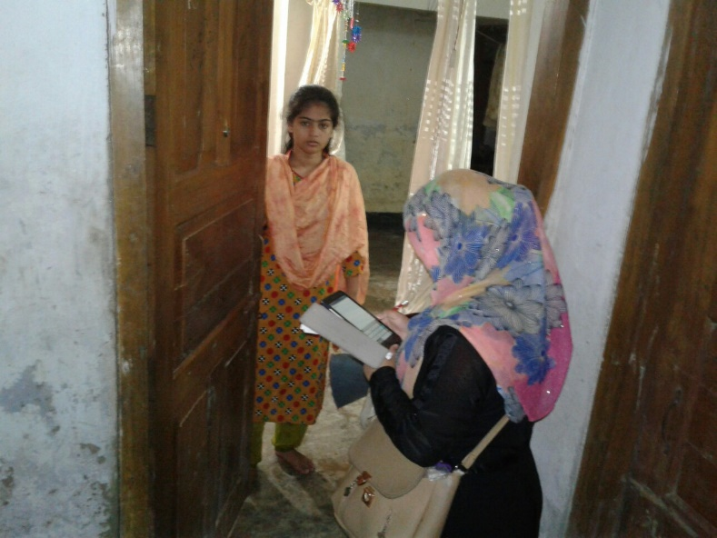
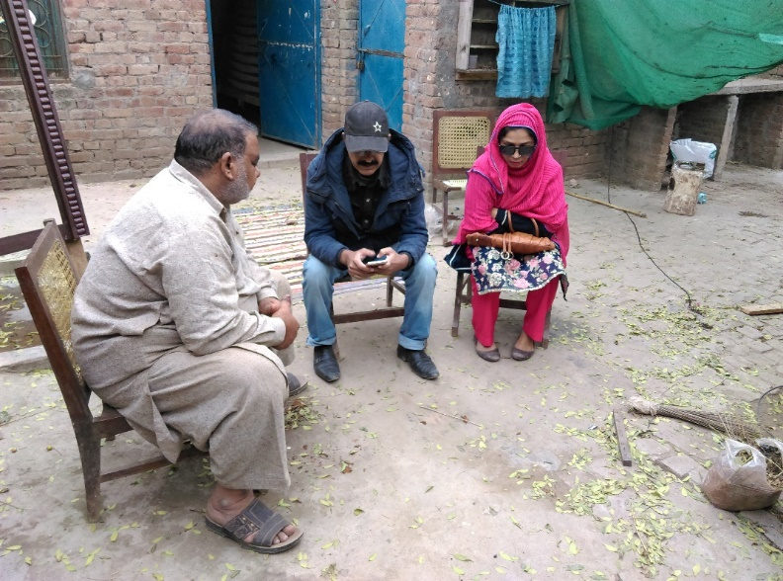
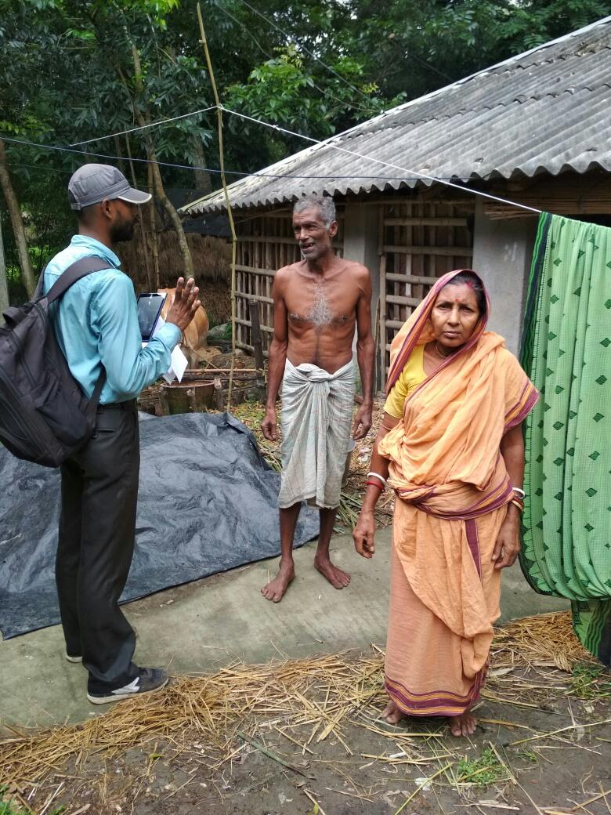
Stage 3:
Random selection of listed households
Random selection of households conducted systematic random sampling using the household lists collected during the listing
Random selection of 20-25 households for the main survey
Random selection of 4 households for the PWD survey
Random HH selection in PK
Random HH selection in KH
Stage 4:
Household interview (with household representative) and individual interview (with randomly selected individual after listing eligible members in household roster)
Interviews conducted on mobile devices
Listing all the household members in the household roster
Randomly selecting one member from age 15-65 from the list for the main survey (from 20 households)
Randomly selecting one member from age 15-65 from the list for the PWD survey (from 4 households)

Slide 27
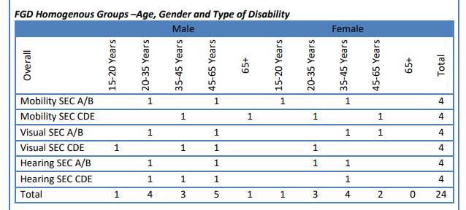
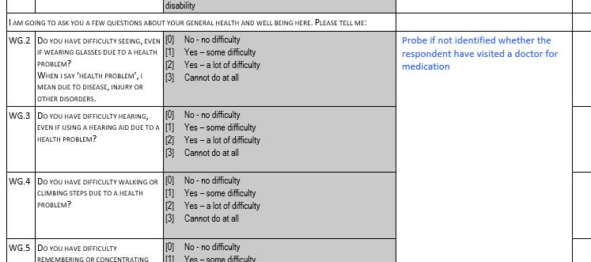
Due to lack of any database on the types of disability or age groups a screening and recruitment questionnaire is used and snowball sampling used in the qualitative research in Nepal
Screening and recruitment questionnaire
In addition 03 ICT user and non-user mix groups
Participant Quota
The respondent quota specified 89 minimum respondents who are users of ICT out of which minimum 54 were smartphone owners
Minimum 55 non ICT users
Minimum 60 should be employed, 48 should not be employed

Slide 28
Quantitative Tools & Data Collection
Types of survey questions in questionnaires
Close ended questions
Dichotomous questions
Rank order questions
Open ended questions
Q: Have they used the right type of questions?

Slide 29
Close ended questions
Dichotomous questions

Slide 30
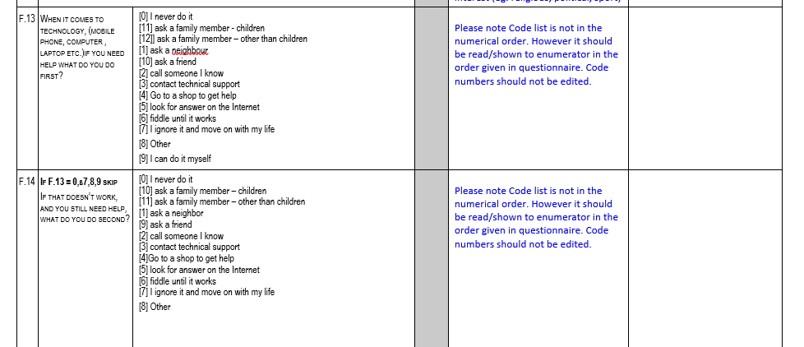
Rank order questions
Open ended questions
WHAT ARE YOUR SUGGESTIONS TO IMPROVE THE SERVICES?

Slide 31
Qualitative Tools (FGD) & Data Collection
03
04
Guidelines
Opening question
No right or wrong answers, only different points of view, you don’t need to agree with others; but listen respectfully, we are recording
Let’s find out some more about each other..
06
Ending Questions
Suppose that you had one minute to talk, Of all things we discussed, Have we missed anything?
01
Welcome
Introduce Moderator and Assistant
02
Our topic is..
05
The results will be used for, You were selected because
Core - Discussion
Can you walk me through...
Q: Have they probed / explored well?

Slide 32
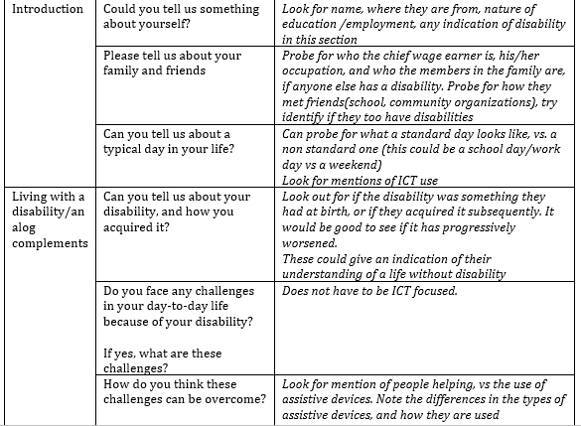
Focus Group Discussion Guide

Slide 33
Quantitative Analysis
Descriptive
Measures of central tendency Measures of dispersion Percentage calculation Charts
Inferential
Statistical tests to see a pattern we observe is due to chance or not due to program or intervention effects.

Slide 34
A descriptive analysis from the quantitative study
Q1: Do you own a mobile phone?
Q2: How many active SIM cards do you have, (SIM cards that you used in last 30 days)?
Q3: Do you own a personal Desktop computer or Laptop?
Base | Argentina | Colombia | South Africa | Peru | Paraguay | Guatemala | India | Nigeria | Pakistan | Ghana | Myanmar | Bangladesh | Cambodia | Kenya | Tanzania | Nepal | Rwanda | Mozambique
All respondents | 1,240 | 1,425 | 1,610 | 1,478 | 1,357 | 1,407 | 5,069 | 1,706 | 2,002 | 1,145 | 7,204 | 2,020 | 2,123 | 1,179 | 1,102 | 2,008 | 1,118 | 1,091

Slide 35
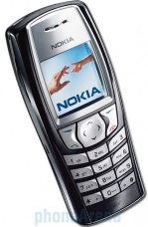
A descriptive analysis from the quantitative study
Q: Do you own a mobile phone?
Q: Why do not you have a mobile phone?
Q What type of mobile phone do you have?
All respondents | 400
Non-owners of mobile phone | 271
Mobile phone owners | 129

Slide 36
Qualitative Analysis
Based on Coding
Grounded Theory Framework analysis Content analysis Theme analysis Metaphor analysis Qualitative Comparative analysis
Based on Interpretation
Phenomenology Hermeneutics Narrative analysis Discourse analysis Ethnography Conversation analysis

Slide 37
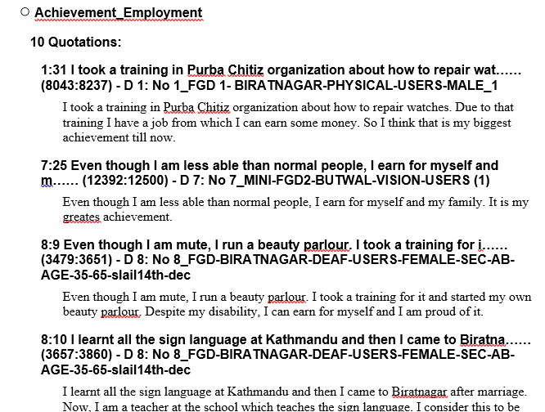
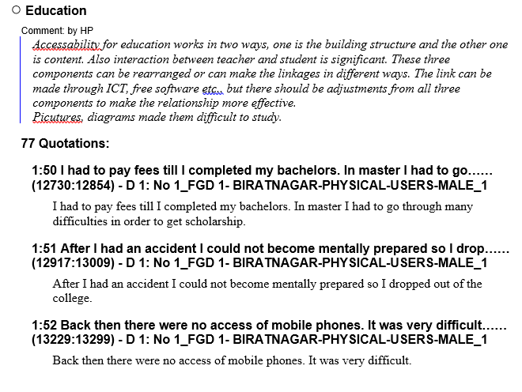
Coding and Theme identification - qualitative study

Slide 38
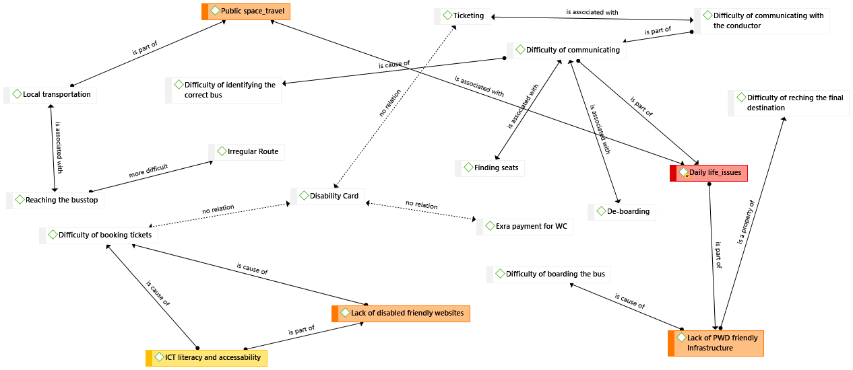
Network view of ‘public travel theme’

Slide 39
Reference
Business Model Generation: A Handbook for Visionaries, Game Changers, and Challengers; by Alexander Osterwalder and Yves Pigneur
Doing Social Science Research; by Simeon J Yates
ICT infrastructure in emerging Asia: Policy and Regulatory Roadblocks; edited by Rohan Samarajiva and Ayesha Zainudeen
https://strategyzer.com/

